Slide 1
Tutorial 9 Getting Started with JavaScript

Slide 2
Objectives
Insert a script element
Write JavaScript comments
Display an alert dialog box
Use browser debugging tools
Reference browser and page objects
Use JavaScript properties and methods

Slide 3
Objectives (continued)
Write HTML code and text content into a page
Work with a Date object
Use JavaScript operators
Create a JavaScript function
Create timed commands

Slide 4
Server-Side and Client-Side Programming
Server-side programming: Program code runs from the server hosting the website
Advantage
Connects a server to an online database containing information not directly accessible to end users
Disadvantages
Use server resources and requires Internet access
Long delays in cases of system over-load

Slide 5
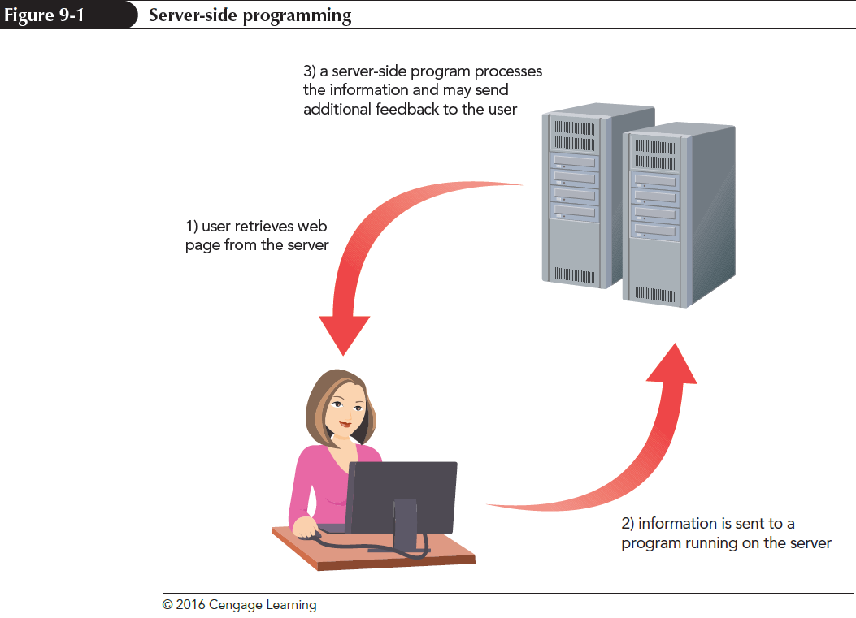
Server-Side and Client-Side Programming

Slide 6
Server-Side and Client-Side Programming
Client-side programming: Programs run on the user’s computer using downloaded scripts with HTML and CSS files
Distributes load to avoid overloading of program-related requests
Client-side programs can never replace server-side programming

Slide 7
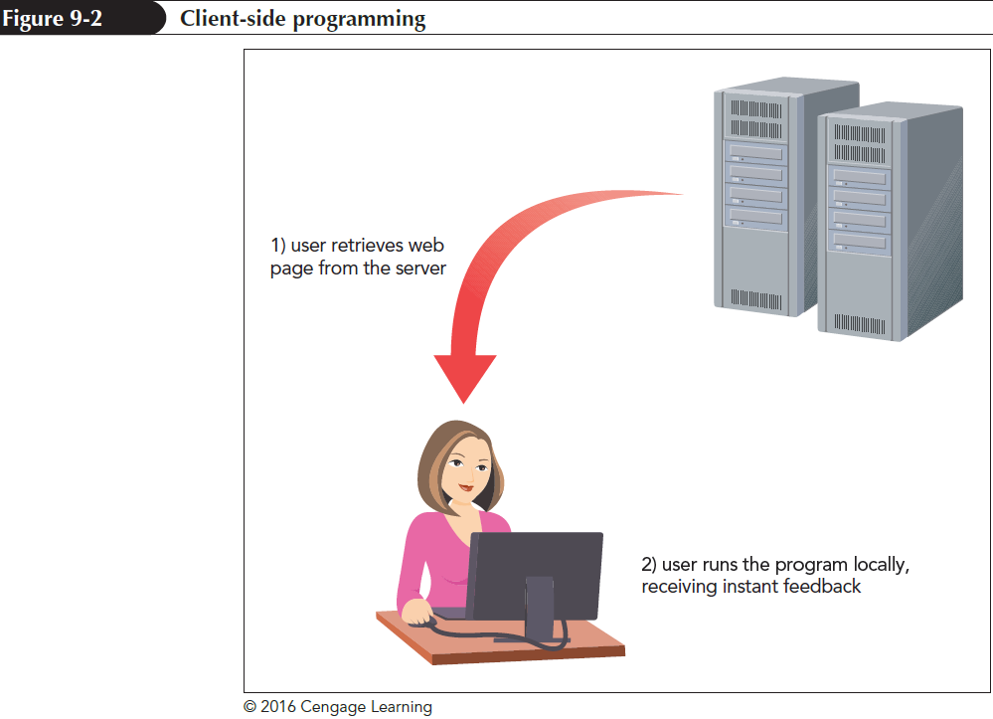
Server-Side and Client-Side Programming

Slide 8
The Development of JavaScript
JavaScript is a programming language for client-side programs
It is an interpreted language that executes a program code without using a compiler
Compiler is an application that translates a program code into machine language
JavaScript code can be directly inserted into or linked to an HTML file

Slide 9
Working with the script Element
JavaScript code is attached to an HTML file using the script element
<script src=”url”></script>
where url is the URL of the external file containing the JavaScript code
An embedded script can be used instead of an external file by omitting the src attribute
<script>
code
</script>

Slide 10
Loading the script Element
script element can be placed anywhere within an HTML document
When a browser encounters a script, it immediately stops loading the page and begins loading and then processing the script commands
async and defer attributes can be added to script element to modify its sequence of processing

Slide 11
Loading the script Element
async attribute tells a browser to parse the HTML and JavaScript code together
defer attribute defers script processing until after the page has been completely parsed and loaded
async and defer attributes are ignored for embedded scripts

Slide 12
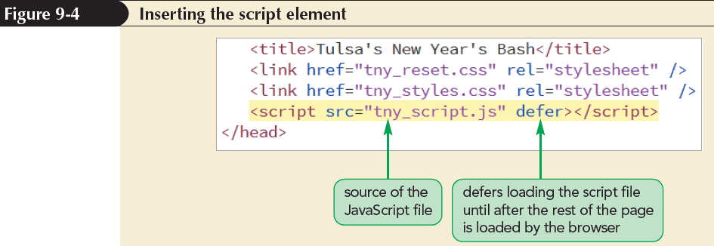
Inserting the script Element

Slide 13
Creating a JavaScript Program
JavaScript programs are created using a standard text editor
Adding Comments to your JavaScript Code
Comments help understand the design and purpose of programs
JavaScript comments can be entered on single or multiple lines

Slide 14
Creating a JavaScript Program
Syntax of a single-line comment is as follows:
// comment text
Syntax of multiple-line comments is as follows:
/*
comment text spanning
several lines
*/

Slide 15
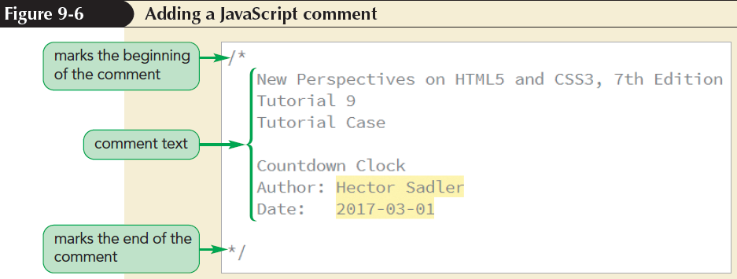
Creating a JavaScript Program

Slide 16
Creating a JavaScript Program
Writing a JavaScript Command
A command indicates an action for a browser to take
A command should end in a semicolon
JavaScript command;

Slide 17
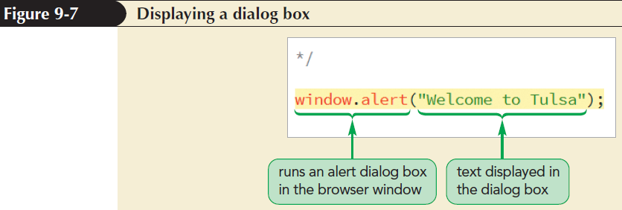
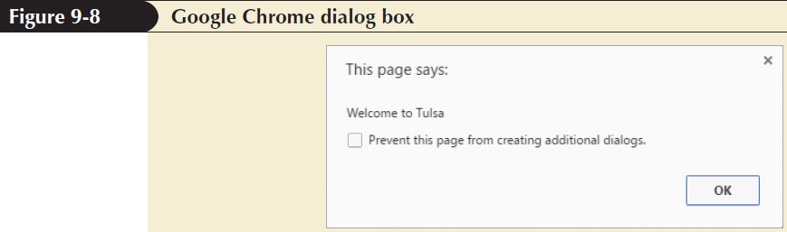
Creating a JavaScript Program

Slide 18
Creating a JavaScript Program
Understanding JavaScript Syntax
JavaScript is case sensitive
Extra white space between commands is ignored
Line breaks placed within the name of a JavaScript command or a quoted text string cause an error

Slide 19
Debugging your Code
Debugging: Process of locating and fixing a programming error
Types of errors
Load-time errors – occur when a script is first loaded by a browser
Run-time errors – occur during execution of a script without syntax errors
Logical errors – are free from syntax and executable mistakes but result in an incorrect output

Slide 20
Opening a Debugger
Debugging tools locate and fix errors in JavaScript codes
Shortcut to open a debugging tool is F12 key
The tools can also be opened by selecting Developer Tools from the browser menu

Slide 21
Inserting a Breakpoint
A useful technique to locate the source of an error is to set up breakpoints
Breakpoints are locations where a browser pauses a program to determine whether an error has occurred at that point during execution

Slide 22
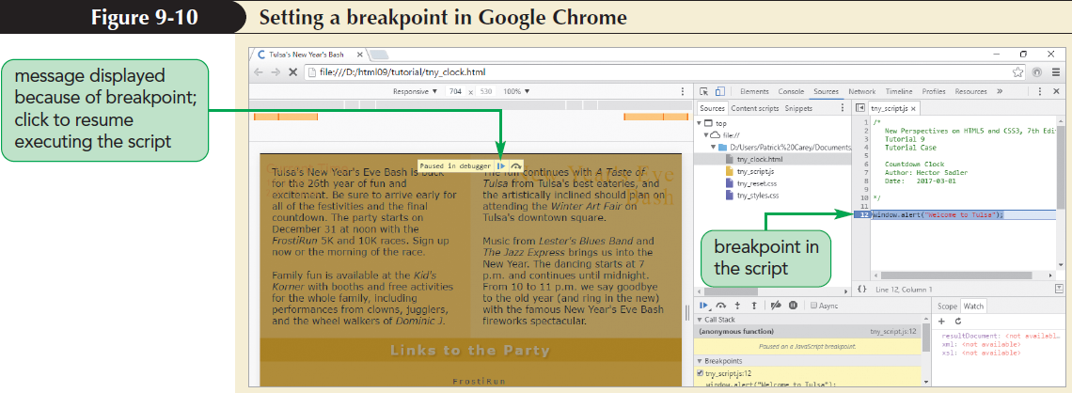
Inserting a Breakpoint

Slide 23
Applying Strict Usage of JavaScript
Strict mode enables all lapses in syntax to result in load-time or run-time errors
To run a script in strict mode, add the following statement to the first line of the file:
“use strict”;

Slide 24
Introducing Objects
Object: Entity within a browser or web page that has properties and methods
Properties: Define objects
Methods: Act upon objects
JavaScript is an object-based language that manipulates an object by changing one or more of its properties or by applying a method that affects the object’s behavior

Slide 25
Introducing Objects
Types of JavaScript objects
Built-in objects – intrinsic to JavaScript language
Browser objects – part of browser
Document objects – part of web document
Customized objects – created by a programmer to use in an application
Browser object model (BOM) and document object model (DOM) organize browser and document objects in hierarchical structures, respectively

Slide 26
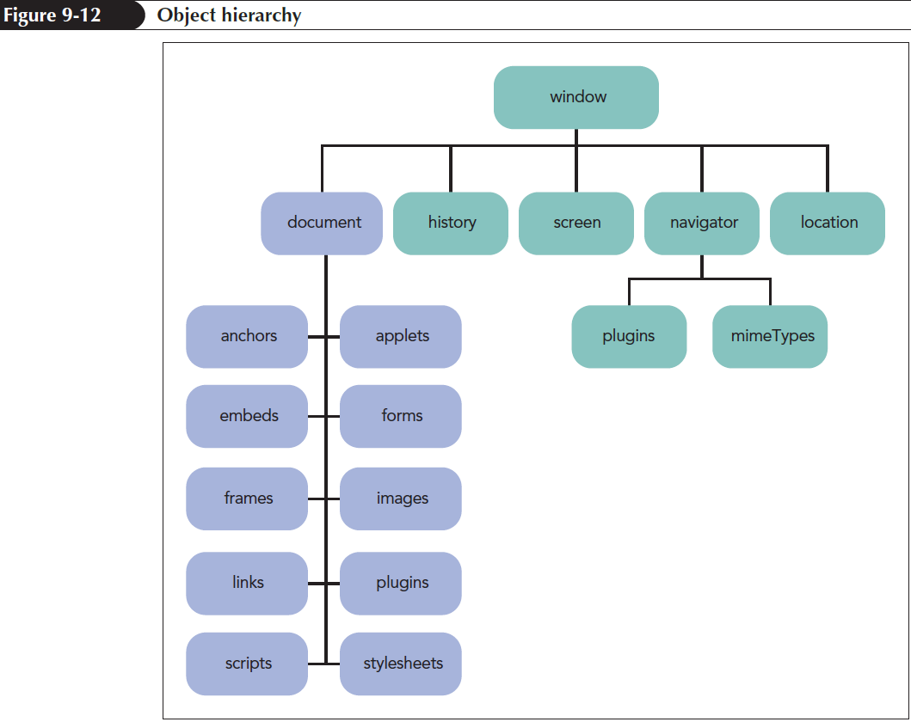
Introducing Objects

Slide 27
Object References
Objects within the object hierarchy are referenced by their object names such as window, document, or navigator
Objects can be referenced using the notation
object1.object2.object3 ...
where object1 is at the top of the hierarchy, object2 is a child of object1, and so on

Slide 28
Referencing Object Collections
Object collections: Objects organized into groups
window.document.images
To reference a specific member of an object collection, use
collection[idref]
or collection.idref
where collection is a reference to the object collection and idref is either an index number or the value of id attribute

Slide 29
Referencing an Object by ID and Name
For example
<img src=“tny_logo.jog” id=“logo” />
You can reference that image using
document.images[0]
document.images[“logo”]
document.images.logo

Slide 30
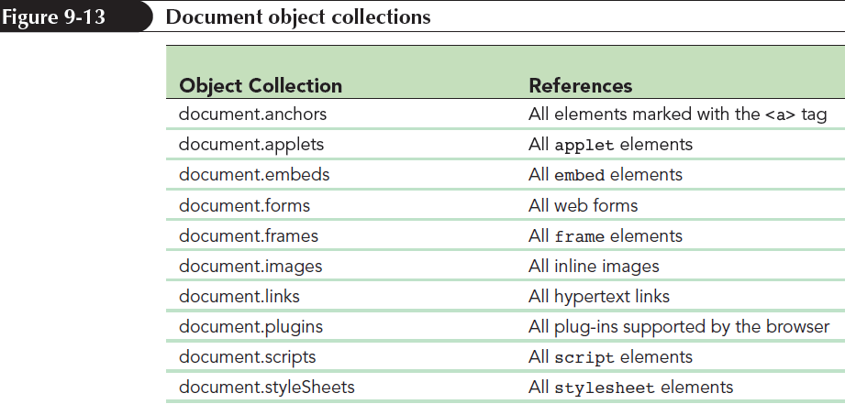
Referencing Object Collections

Slide 31
Referencing an Object by ID and Name
Object collections can also be referenced based on tag names using
document.getElementsByTagName(tag)
where tag is the name of an HTML element
For example:
document.getElemenstByTagName(“h1”)
document.getElementsByTagName(“h1”)[0]

Slide 32
Referencing an Object by ID and Name
Object collections can also be referenced based on class using
document.getElementsByClassName(class)
where class is the value of the class attribute from an HTML document
For example: document.getElementsByClassName(“newGroup”)

Slide 33
Referencing an Object by ID and Name
Object collections can also be referenced based by the value of their name attribute using
document.getElementsByName(name)
where name is the value of the name attribute associated with the element.
For example:
document.getElementsByName(“newGroup”)

Slide 34
Referencing an Object by ID and Name
An efficient approach to reference an element is to use its id attribute using the expression
document.getElementById(id)
where id is the value of id attribute
<img src=“tny_logo.jog” id=“logo” />
You can reference that image using
document.getElementById(“logo”)

Slide 35
Changing Properties and Applying Methods
An object can be modified in two ways
Properties
Object property is accessed using
object.property
where object is a reference to an object and property is a property associated with that object
object.property = value;
Read-only properties cannot be modified

Slide 36
Changing Properties and Applying Methods
Applying a Method
Objects can be modified using methods
Methods are applied using the expression
object.method(values)
where object is a reference to an object, method is the name of the method applied to the object, and values is a comma-separated list of values associated with the method
e.g. window.alert(“Welcome to Javascript”)

Slide 37
Writing HTML Code
HTML code stored within a page element is referenced using
element.innerHTML
where element is an object reference to an element within a web document
For example,
<div id=“daysleft”>58<br/><span>Days</span></div>
document.getElementById(“daysleft”).innerHTML
would return “58<br/><span>Days</span>”
document.getElementById(“daysleft”).innerHTML =
“45<br/><span>Days</span>”

Slide 38
Writing HTML Code
textContent property
If a page element contains only text and no HTML markup, its contents can be modified using textContent property
For example
<div><span id=“days”>58</span><br/>Days</div>
To Change
document.getElementById(“days”).textContent = “dd”

Slide 39
Working with Variables
Variable: Named item in a program that stores a data value
Declaring a Variable
Introduced into a script by declaring the variable using the var keyword
var variable = value;
where variable is the name assigned to the variable and value is the variable’s initial value
Var currentMonth = “March”, currentYear = 2019;

Slide 40
Working with Variables
Conditions to assign variable names in JavaScript
First character must be either a letter or an underscore character ( _ )
The characters after the first character can be letters, numbers, or underscore characters
No spaces
No using names that are part of JavaScript language
Variable names are case sensitive

Slide 41
Variables and Data Types
Data type: Type of information stored in a variable
Supported data types
Numeric value
Text string
Boolean value
Object
null value

Slide 42
Variables and Data Types
Numeric value: Any number such as 13 or 22.5 or 3.1459 or 5.1E2
var currentYear = 2019;
Text string: Group of characters enclosed within either double or single quotation marks
var currentMonth = “March”;
Boolean value: Indicates the truth or falsity of a statement
var isMay = true;

Slide 43
Variables and Data Types
Object – Simplifies code by removing the need to rewrite complicated object references
var dateDiv = document.getElementById(“datenow”);
null value – Indicates that no value has yet been assigned to a variable
var currentDate = null;

Slide 44
Working with Date Objects
Date object: Built-in JavaScript object used to store information about dates and times. To create a date object
new Date(“month day, year hrs:mins:secs”);
Object containing current date and time
var thisDate = new Date();
To create a date object using numeric values
new Date(year, month, day, hrs, mins, secs);

Slide 45
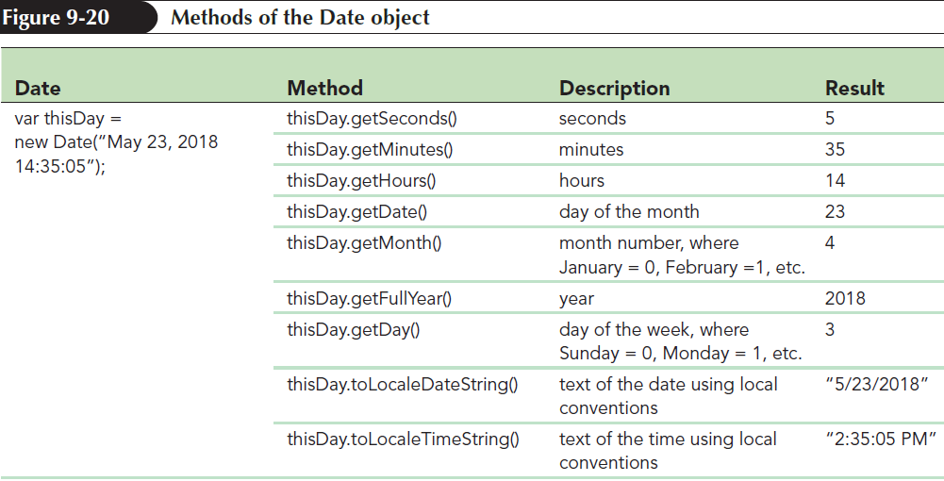
Working with Date Objects

Slide 46
Working with Operators and Operands
Operator: Symbol used to act upon an item or a variable within an expression. For example +, -, *, /, %, ++, --, -
Operands: Variables or expressions that operators act upon

Slide 47
Working with Operators and Operands
Types of operators
Binary operators – require two operands in an expression. For example + , -
Unary operators – require only one operand
Increment operator (++) – increases the value of an operand by 1
Decrement operator (--) – decreases the value of an operand by 1

Slide 48
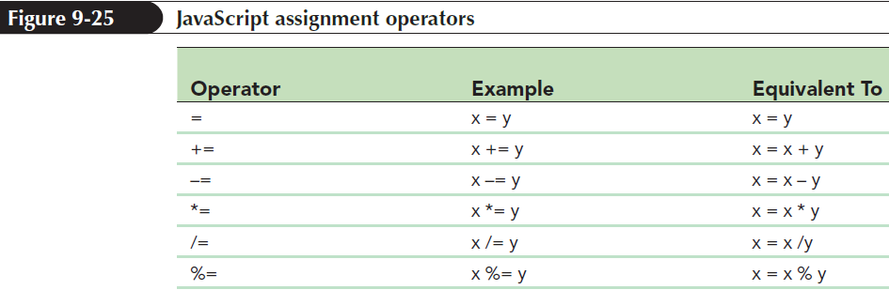
Using Assignment Operators
Assignment operator: Assigns a value to an item

Slide 49
Working with the Math Object
Math object: Built-in object used to perform mathematical tasks and store mathematical values
Syntax to apply a Math method is
Math.method(expression)
where method is the method applied to a mathematical expression

Slide 50
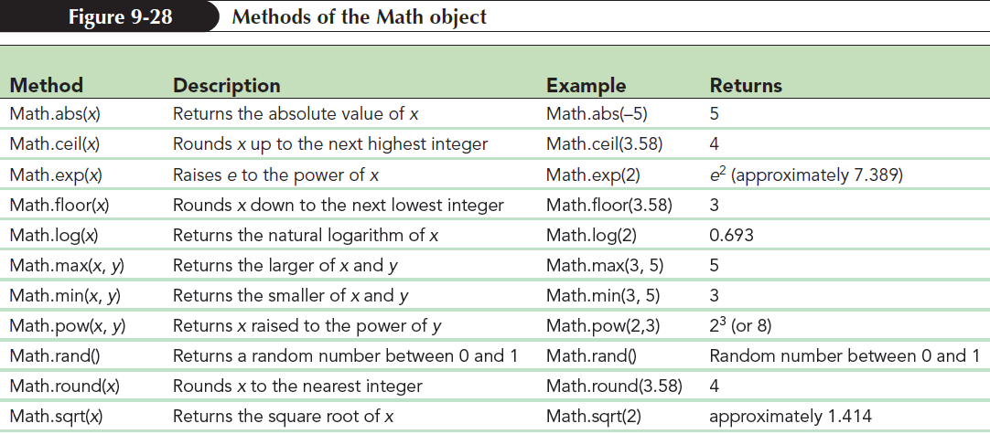
Working with the Math Object

Slide 51
Using Math Constants
Math functions refer to built-in constants stored in JavaScript Math object
Syntax to access mathematical constants is
Math.CONSTANT
where CONSTANT is the name of one of the mathematical constants supported by Math object

Slide 52
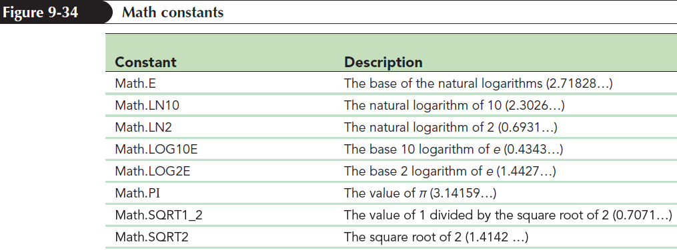
Using Math Constants

Slide 53
Working with JavaScript Functions
Function: Collection of commands that performs an action or returns a value
A function name identifies a function and a set of commands that are run when the function is called
Parameters: Variables associated with the function

Slide 54
Working with JavaScript Functions
General syntax of a JavaScript function is
function function_name(parameters){
commands
}
where,
function_name is the name of the function
parameters is a comma-separated list of variables used in the function
commands is the set of statements run by the function

Slide 55
Working with JavaScript Functions
function runClock(){
var currentDay = new Date();
var dateStr = currentDay.toLocalDateString();
var timeStr = currentDay.toLocaleTimeString();
document.getElementById("dateNow").innerHTML = dateStr + "<br/>" + timeStr;
}

Slide 56
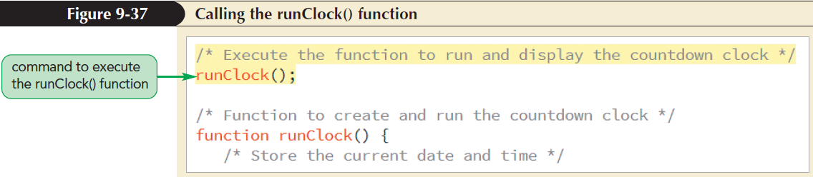
Calling a Function
General syntax to call a function
function_name(parameters values);
function_name();

Slide 57
Creating a Function to Return a Value
Functions return values using return statement
function function_name(parameters){
commands
return value;
}
where value is the calculated value that is returned by the function

Slide 58
Controlling How JavaScript Works with Numeric Values
Handling Illegal Operations
Mathematical operations can return results that are not numeric values
JavaScript returns NaN if an operation does not involve only numeric values
isNaN(value)

Slide 59
Controlling How JavaScript Works with Numeric Values
isNaN() function returns a Boolean value of true if the value is not numeric and false if otherwise
Infinity value is generated for an operation whose result is less than the smallest numeric value and greater than the largest numeric value supported by JavaScript.
isFinite(value) to check if the value is a finite number and returns a Boolean value

Slide 60
Hands-on (isNaN() function)
HTML
<div id="numeric">
</div>
Output
a is not a number
JavaScript
var text = "a";
var output = "";
if(isNaN(text)){
output = text + " is not a number "
}
else
output = text + " is a number";
document.getElementById("numeric").innerHTML =
"<p>"+output+"</p>";

Slide 61
Defining a Number Format
JavaScript stores a numeric value to 16 decimal places of accuracy
The number of digits displayed by browsers is controlled using toFixed() method
value.toFixed(n)
where value is the value or variable and n is the number of decimal places displayed in the output

Slide 62
Defining a Number Format
toFixed() limits the number of decimals displayed by a value and converts the value into a text string
var testValue = 2.835;
testValue.toFixed(1) //returns “2.8”
testValue.toFixed(2) //returns “2.84”
toFixed() rounds the last digit in an expression rather than truncating it

Slide 63
Hands-on (toFixed() function)
HTML
<div id="before">
</div>
<div id="after">
</div>
Output
Without rounding 3.141592653589793
after rounding using toFixed() 3.14
JavaScript
var text = Math.PI;
document.getElementById("before").innerHTML =
"<p>Without rounding "+text+"</p>";
text = text.toFixed(2);
document.getElementById("after").innerHTML =
"<p>after rounding using toFixed() "+text+"</p>";

Slide 64
Converting Between Numbers and Text
To convert a number to a text string us + operator
For example,
testNumber = 123; // numeric value
testString = testNumber + “”; // text string
where + operator concatenates a numeric value with an empty text string resulting in a text string

Slide 65
Converting Between Numbers and Text
To convert a text string to a number, apply an arithmetic operator to the text string
parseInt(text) function extracts the leading integer value from a text string
It returns the integer value from the text string by discarding any non-integer characters
Example,
parseInt(“120.88 lbs”); // returns 120
parseInt(“weight equals 120 lbs”); // returns NaN

Slide 66
Hands-on (parseInt() function)
HTML
<div id="before">
</div>
<div id="after">
</div>
Output
original text is 120.88 lbs
after parsing 120
JavaScript
var text = "120.88 lbs";
document.getElementById("before").innerHTML =
"<p>original text is "+text+"</p>";
text = parseInt(text);
document.getElementById("after").innerHTML =
"<p>after parsing "+text+"</p>";

