Slide 1
Tutorial 10 Exploring Arrays, Loops, and Conditional Statements

Slide 2
Objectives
Create an array
Work with array properties and methods
Create a program loop
Work with the for loop
Write comparison and logical operators
Create a conditional statement
Use the if statement

Slide 3
Introducing Arrays
Array: Collection of values organized under a single variable name
Index: The number that each individual value is associated with and that distinguishes it from other values in the array and that is used to access an individual array member
Array values are referenced using the expression array[i]
where array is the name of the array and i is the index of a specific value in the array

Slide 4
Introducing Arrays
Index values start with 0 so that the initial item in an array has an index value of 0
Second item in the array will have an index value of 1, and so on
Example
The expression monthName[4] references the fifth (not the fourth) item in the monthName array

Slide 5
Creating and Populating an Array
To create an array, apply the object constructor
var array = new Array(length);
where array is the name of the array and length is the number of items in the array
The length value is optional; if the length parameter is omitted then the array expands automatically as more items are added to it

Slide 6
Creating and Populating an Array
An array can be populated with values by specifying both the array name and the index number of the array item
Command to set the value of a specific item in an array
array[i] = value;
where value is the value assigned to the array item with the index value i

Slide 7
Hands-on Array
HTML
<div id="array">
</div>
Output
First element of the array is Jan Second element of the array is Feb
JavaScript Code
//create an array named monthName, size of the array is 12
var monthName = new Array(12);
monthName[0] = "Jan"; //assigning value to first element
monthName[1] = "Feb"; //assigning value to 2nd element
document.getElementById("array").innerHTML =
"<p><strong>First element of the array is "+ monthName[0]+" Second element of the array is " + monthName[1] + "</strong></p>";

Slide 8
Creating and Populating an Array
Populate the entire array in a single statement using the following command:
var array = new Array(values);
where values is a comma-separated list of the values in the array
Example
let monthName = new Array("Jan","Feb","Mar","Apr","May","June","Jul","Aug","Sept",
"Oct","Nov","Dec");

Slide 9
Hands-on populate an array
HTML
<div id="array">
</div>
Output
First element of the array is January Second element of the array is February
JavaScript Code
//populate entire array in a single statement
var monthName = new Array("January","February","March","April");
document.getElementById("array").innerHTML =
"<p><strong>First element of the array is "+ monthName[0]+" Second element of the array is " + monthName[1]
+ "</strong></p>";

Slide 10
Creating and Populating an Array
Array literal: Creates an array in which the array values are a comma-separated list within a set of square brackets
var array = [values];
where values are the values of the array
Example
var monthName = [“January”, February”, “March”, “April”, “May”, “June”, “July”, “August”, “September”, “October”, “November”, “December”];

Slide 11
Hands-on array literal
HTML
<div id="array">
</div>
Output
First element of the array is Mon Second element of the array is Tues
JavaScript Code
//creating an array literal
var dayNames = ["Mon","Tues","Wed","Thur","Fri","Sat","Sun"];
//printing only two elements
document.getElementById("array").innerHTML =
"<p><strong>First element of the array is "+ dayNames[0]+
" Second element of the array is " + dayNames[1]
+ "</strong></p>";

Slide 12
Creating and Populating an Array
Array values need not be of the same data type
Mix of numeric values, text strings, and other data types within a single array is allowed
Example
var x = [“April”, 3.14, true, null];

Slide 13
Working with Array Length
JavaScript array automatically expands in length as more items are added
Apply the following length property to determine the array’s current size:
array.length
where array is the name of the array
Value returned by the length property is equal to one more than the highest index number in the array

Slide 14
Reversing an Array
Items are placed in an array either in the order in which they are defined or explicitly by index number, by default
JavaScript supports two methods for changing the order of the array items
reverse()
sort()
reverse(): Reverses the order of items in an array, making the last items first and the first items last

Slide 15
Sorting an Array
sort(): Rearranges array items in alphabetical order
The sort() method when applied to numeric values will sort the values in order by their leading digits, rather than by their numerical values

Slide 16
Sorting an Array
Compare function: Compares values of two adjacent array items
The general form of a compare function is
function fname(a, b) {
return a negative, positive, or 0 value
}
where fname is the name of the compare function and a and b are parameters that represent a pair of array values

Slide 17
Sorting an Array
Based on the comparison of two adjacent array item values, the function returns a negative, positive, or zero value
If a negative value is returned, then a is placed before b in the array
If a positive value is returned, then b is placed before a
If a zero value is returned, a and b retain their original positions

Slide 18
Sorting an Array
Function to sort numeric values in ascending order
function ascending(a, b) {
return a - b;
}
Function to sort numbers in descending order
function descending(a, b) {
return b - a;
}

Slide 19
Sorting an Array (continued 4)
The compare function is applied to the sort() method as follows
array.sort(fname)
where fname is the name of the compare function
Example
x.sort(ascending)

Slide 20
Hands-on sort()
HTML
<div id="array">
</div>
Output
3,23,45,345
JavaScript Code
function func(a,b){
return a - b;}
let anotherArray = [23,3,345,45];
document.getElementById("array").textContent = anotherArray.sort(func);

Slide 21
Extracting and Inserting Array Items
Subarray: Section of an array
To create a subarray use slice() method
array.slice(start, stop)
where start is the index value of the array item at which the slicing starts and stop is the index value at which the slicing ends
The stop value is optional; if it is omitted, the array is sliced to its end

Slide 22
Hands-on slice()
HTML
<div id="arrayDiv">
</div>
Output
June,July,Aug
JavaScript Code
let monthName = ["Jan","Feb","Mar","Apr","May","June","July","Aug","Sept","Oct","Nov","Dec"];
document.getElementById("arrayDiv").
textContent = monthName.slice(5,8);

Slide 23
Extracting and Inserting Array Items
splice(): Removes and inserts array items
array.splice(start, size, values)
start is the starting index in the array, size is the number of array items to remove after the start index, and values is an optional comma-separated list of values to insert into the array
If no values are specified, the splice method simply removes items from the array
Always alters the original array

Slide 24
Hands-on splice()
HTML
<div id="arrayDiv">
</div>
Output
Jan,Feb,Mar,Apr,May,JUN,JULY,
AUG,Sept,Oct,Nov,Dec
JavaScript Code
let monthName = ["Jan","Feb","Mar","Apr","May","June","July","Aug","Sept","Oct","Nov","Dec"];
let summerMonths = monthName.splice(5,3);
document.getElementById("arrayDiv").
textContent = summerMonths;
Another way to use the splice method
let summerMonths = monthName.splice(5,3,"JUN","JULY","AUG");
document.getElementById("arrayDiv").
textContent = monthName;

Slide 25
Using Arrays as Data Stacks
Stack: Arrays can be used to store information in a data structure
New items are added to the top of the stack or to the end of the array
A stack data structure employs the last-in first-out (LIFO) principle
In the LIFO principle the last items added to the stack are the first ones removed

Slide 26
Using Arrays as Data Stacks
push() method: Appends new items to the end of an array
array.push(values)
where values is a comma-separated list of values to be appended to the end of the array
pop() method: Removes or unstacks the last item
array.pop()

Slide 27
Hands-on Stack, push() and pop()
HTML
<div id="array">
</div>
<div id=“stack">
</div>
Output
a,b,5,DC,d,m
a,b,5,DC,d
JavaScript Code
let stack = ['a','b',5,'DC’];
stack.push('d'); // ['a','b',5,'DC','d'];
stack.push('m'); // ['a','b',5,'DC','d','m’];
document.getElementById("array").innerHTML = stack;
stack.pop(); //['a','b',5,'DC','d’];
document.getElementById("stack").innerHTML = stack;

Slide 28
Working with Program Loops
Program loop: Set of commands executed repeatedly until a stopping condition is met
Two commonly used program loops in JavaScript are
for loops
while loops

Slide 29
Exploring the for Loop
In a for loop, a variable known as a counter variable is used to track the number of times a block of commands is run
When the counter variable reaches or exceeds a specified value, the for loop stops
General structure of a for loop
for (start; continue; update) {
commands
}

Slide 30
Exploring the for Loop (continued 1)
where start is an expression that sets the initial value of a counter variable
continue is a Boolean expression that must be true for the loop to continue
update is an expression that indicates how the value of the counter variable should change each time through the loop
commands are the JavaScript statements that are run for each loop

Slide 31
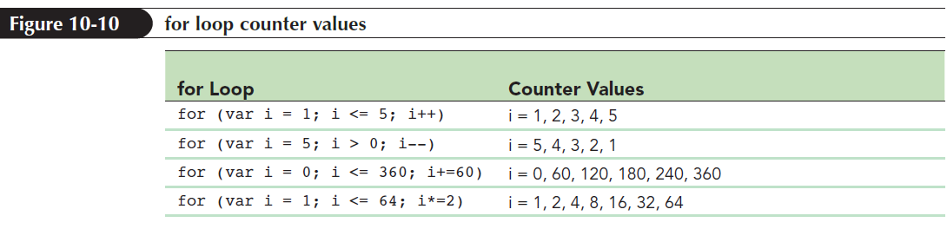
Exploring the for Loop (continued 2)
Command block: Collection of commands that is run each time through a loop
Indicated by its opening and closing curly braces { }
One for loop can be nested within another

Slide 32
Hands-on for loop
HTML
<div id=“loop">
</div>
Output
0
1
2
3
4
JavaScript Code
let htmlCode="<table>";
for(let i=0;i<=4; i++){
htmlCode += "<tr><td>" + i + "</td></tr>";
}
htmlCode += "</table>";
document.getElementById("loop").innerHTML = htmlCode;

Slide 33
Exploring the while Loop
while loop: Command block that is run as long as a specific condition is met
Condition in a while loop does not depend on the value of a counter variable
General syntax for the while loop
while (continue) {
commands
}
where continue is a Boolean expression

Slide 34
Hands-on while loop
HTML
<div id=“loop">
</div>
Output
0
1
2
3
4
JavaScript Code
let htmlCode="<table>";
let i=0;
while(i<=4){
htmlCode += "<tr><td>" + i + "</td></tr>";
i++;
}
htmlCode += "</table>";
document.getElementById("loop").innerHTML = htmlCode;

Slide 35
Exploring the do/while Loop
do/while loop: Generally used when the program loop should run at least once before testing stopping condition
Tests the condition to continue the loop right after the latest command block is run
Structure of the do/while loop
do {
commands
}
while (continue);

Slide 36
Hands-on do/while loop
HTML
<div id=“loop">
</div>
Output
0
1
2
3
4
JavaScript Code
let htmlCode="<table>";
let i=0;
do{
htmlCode += "<tr><td>" + i + "</td></tr>";
i++;
}
while(i<=4);
htmlCode += "</table>";
document.getElementById("loop").innerHTML = htmlCode;

Slide 37
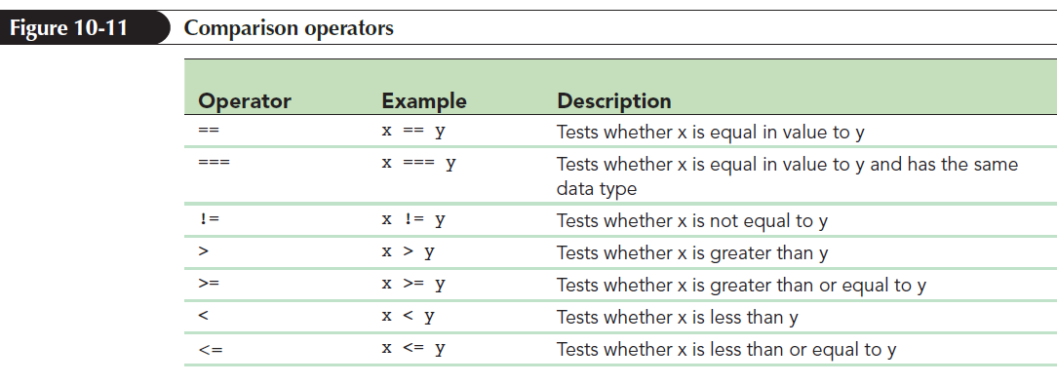
Comparison and Logical Operators
Comparison operator: Compares the value of one expression to another returning a Boolean value indicating whether the comparison is true or false

Slide 38
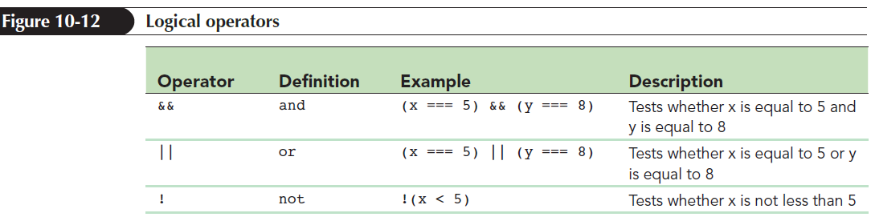
Comparison and Logical Operators
Logical operators allow several expressions to be connected
Example: The logical operator && returns a value of true only if both of the expressions are true

Slide 39
Program Loops and Arrays
Program loops: Cycle through different values contained within an array
General structure to access each value from an array using a for loop
for (var i = 0; i < array.length; i++) {commands involving array[i]
}
where array contains the values to be looped through and i is the counter variable used in the loop

Slide 40
Array Methods to Loop Through Arrays
JavaScript supports several methods to loop through the contents of an array without having to create a program loop structure
Each of these methods is based on calling a function that will be applied to each item in the array

Slide 41
Array Methods to Loop Through Arrays
The general syntax
array.method(callback [, thisArg])
where array is the array, method is the array method, and callback is the name of the function that will be applied to each array item
thisArg: A callback optional argument that can be included to pass a value to the function

Slide 42
Array Methods to Loop Through Arrays
General syntax of the callback function
function callback(value [, index, array]) {
commands }
where value is the value of the array item during each pass through the array, index is the numeric index of the current array item, and array is the name of the array
Only the value parameter is required; the other are optional

Slide 43
Running a Function for Each Array Item
forEach() method: Runs a function for each item in the array
General syntax
array.forEach(callback [, thisArg])
where callback is the function that is applied to each item in the array

Slide 44
Hands-on foreach()
HTML
<div id="array">
</div>
Output
The sum is 24
JavaScript Code
//forEach() example
var sum=0;
function sumArray(value){ //function to find sum of all the values in the array
sum += value;
}
var arr = [12,3,4,5]; //array to find the sum
arr.forEach(sumArray); //forEach function is calling sumArray()
document.getElementById("array").innerHTML = "<p>The sum is "+sum+"</p>";

Slide 45
Hands-on foreach()
HTML
<div id="array">
</div>
Output
13, 4, 5, 6,
JavaScript Code
//another forEach() example
var values = "";
function stepUp(value,i,arr){ //function to increase value of each element by 1
arr[i] = value+1;
}
var array = [12,3,4,5]; //array
array.forEach(stepUp); //forEach function is calling stepUp()
//display updated values
for(var i=0;i<array.length;i++){
values = values + array[i] + ", ";
}
document.getElementById("array").innerHTML = "<p>"+values+"</p>";

Slide 46
Introducing Conditional Statements
Parallel array: Each entry in the array matches or is parallel to an entry in the other array
Conditional statement: Runs a command or command block only when certain circumstances are met

Slide 47
Exploring the if Statement
The most common conditional statement is the if statement
General structure of the if statement
if (condition) {
commands
}
where condition is a Boolean expression that is either true or false and commands is the command block that is run if condition is true

Slide 48
Exploring the if Statement (continued)
Conditional statement uses the same comparison and logical operators that are used with program loops
Modulus operator: Returns the integer remainder after dividing one integer by another

Slide 49
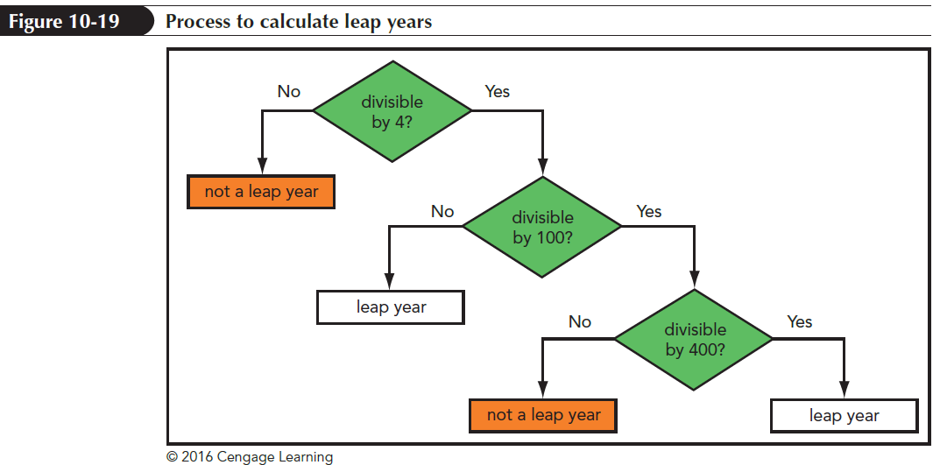
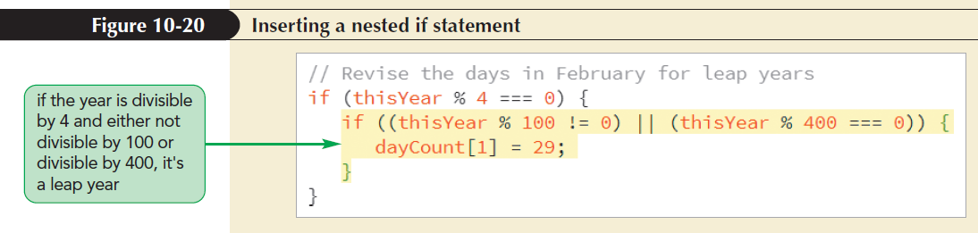
Nesting if Statements
One if statement is nested inside another

Slide 50
Exploring the if else Statement
if else statement: Chooses between alternate command blocks
It runs one command block if the conditional expression is true and a different command block if the expression is false
General structure
if (condition) {
commands if condition is true }
else {
commands if condition is false }

Slide 51
Using Multiple else if Statements
Structure of an if else statement is:
if (condition1) {
commands1
} else if (condition2) {
commands2
}...
else {
default commands}
where condition 1, condition 2,… are the different conditions to be tested

Slide 52
Hands-on if-else statements
JavaScript Code
var city = "abc";
var province = "";
if(city === "Vancouver")
province = "BC";
else if(city === "Calgary")
province = "Alberta";
else if(city === "Toronto")
province = "Ontario";
else
alert("Unknown city");
document.getElementById("array").innerHTML = "<p>The province is "+province+"</p>";

Slide 53
Exploring the break Command
break statement: Terminates any program loop or conditional statement
Used anywhere within the program code
When a break statement is encountered, control is passed to the statement immediately following it
It is most often used to exit a program loop before the stopping condition is met

Slide 54
Hands-on break statement
JavaScript Code
var array = [12,3,4,5]; //array
for(var i=0;i<array.length;i++){
if(array[i] === 4){
alert("4 is in the array");
break;
}
}

Slide 55
Exploring the continue Command
continue statement: Stops processing the commands in the current iteration of the loop and continues on to the next iteration
It is used to jump out of the current iteration if a missing or null value is encountered

Slide 56
Hands-on continue statement
JavaScript Code
var array = [12,3,null,4,5]; //array
var sum = 0;
for(var i=0;i<array.length;i++){
if(array[i] === null) //null is found jump out of current iteration
continue;
sum += array[i]; //otherwise add the value to sum
}
document.getElementById("array").innerHTML = "<p>The sum is = "+sum+"</p>";

Slide 57
Exploring Statement Labels
Statement labels: Identifies statements in JavaScript code
Can be referenced elsewhere in a program
Syntax of the statement label
label: statements
where label is the text of the label and statements are the statements identified by the label

Slide 58
Using switch Statements
switch statement
Compares the value of an expression to a value contained within the statement called a case label
case label
Represents a specific value
Executes the statement(s) if the value of the case label matches the value of the switch statement’s expression
default label
Contains statements that execute when the value returned by the switch statement expression does not match a case label

Slide 59
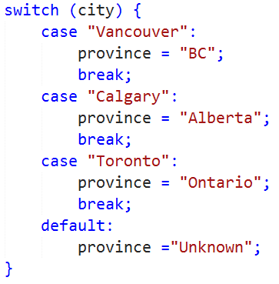
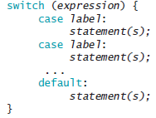
Using switch Statements
Execution of a switch statement does not automatically stop after particular case label statements execute
Include a break statement within each case label
Syntax:

Slide 60
Hands-on if-else statements
JavaScript Code
var city = "Vancouver";
var province = "";
switch(city){
case("Vancouver"): //cases are case sensitive
province = "BC";
break;
case("Calgary"):
province = "Alberta";
break;
case("Toronto"):
province = "Ontario";
break;
default:
alert("Unknown city");
}
document.getElementById("array").innerHTML = "<p>The province is "+province+"</p>";

