Slide 1
Project 2
Tic-Tac-Toe

Slide 2
Question
In this project, you will design and implement a classic two-player Tic-Tac-Toe game using HTML,
CSS, and JavaScript. Tic-Tac-Toe is a simple yet engaging game that will allow you to practice your front-end web development skills.
Create a user-friendly interface for the Tic-Tac-Toe game using HTML and CSS.
Implement the game logic in JavaScript, allowing two players to take turns and determine the winner.
Ensure that the game is responsive and works on both desktop and mobile devices.

Slide 3
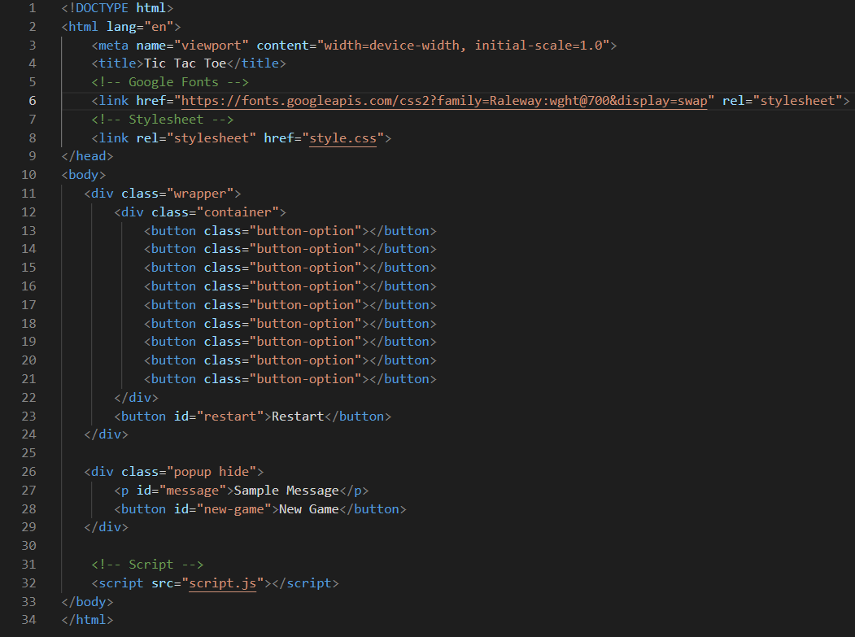
HTML Code

Slide 4
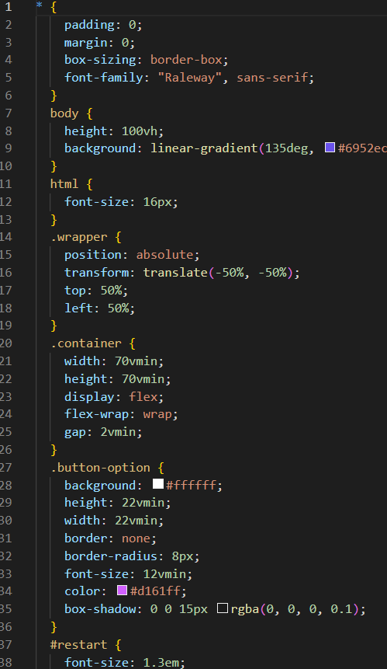
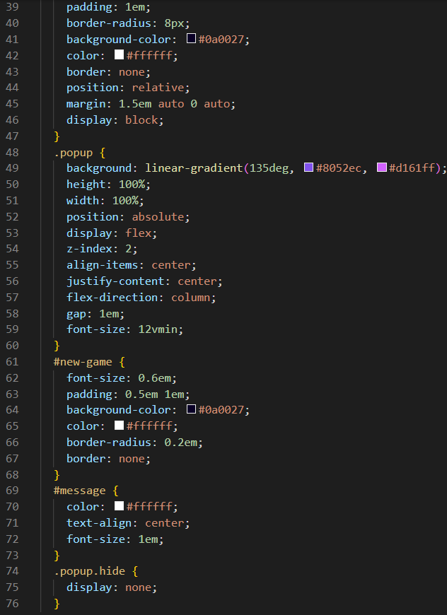
CSS Code

Slide 5
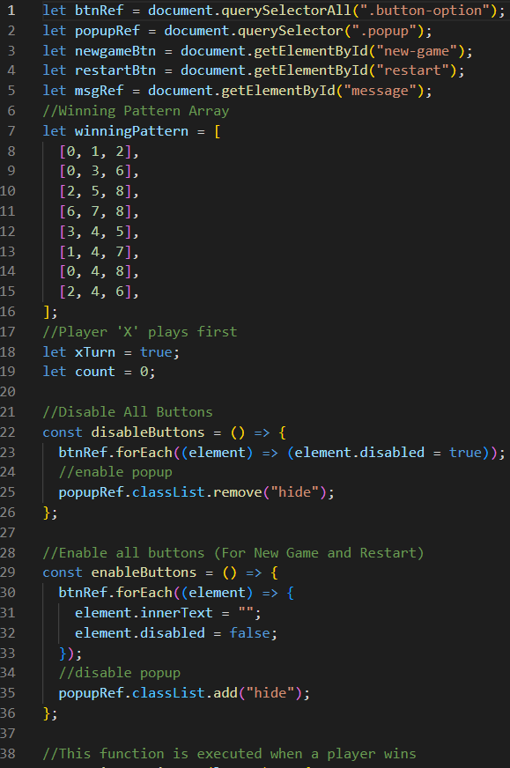
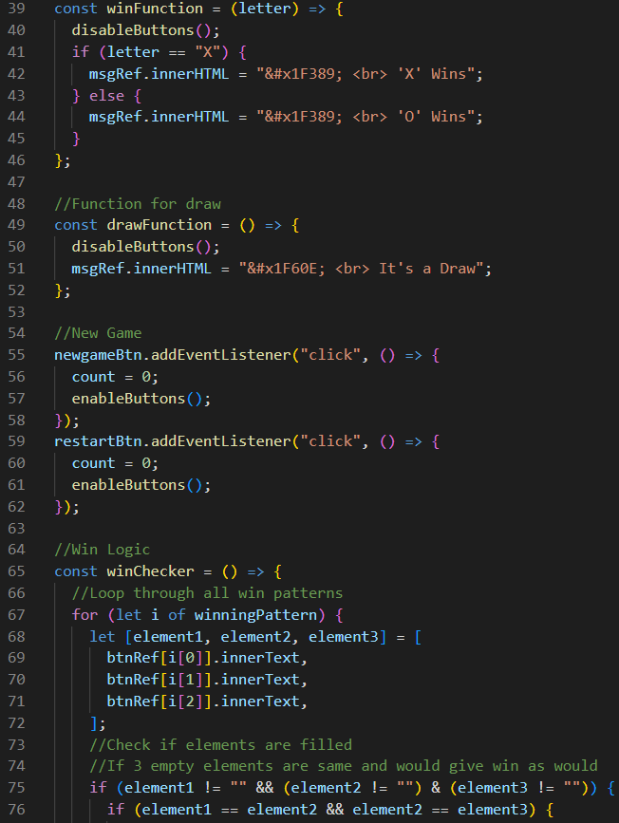
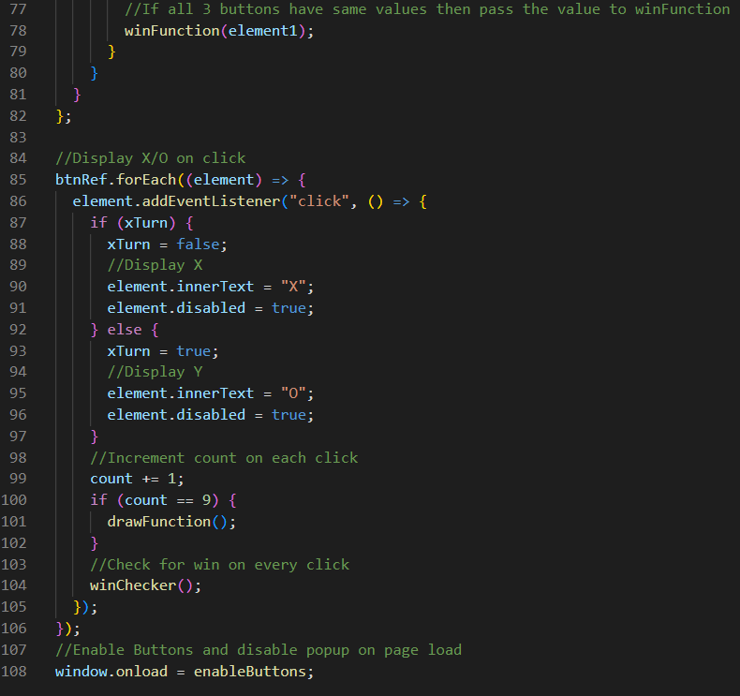
JSS Code

Slide 6

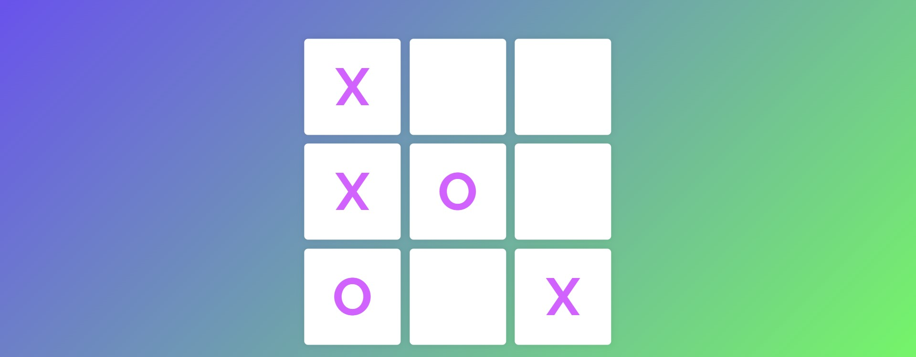

Outputs

