Slide 1

SENTRY
AI-Powered Financial
Fraud Detection System
A machine-learning pipeline that scores financial transactions in real time — from synthetic data generation to a trained model, a live API, and an interactive monitoring dashboard.
Machine Learning
Flask REST API
Real-Time Dashboard
Python
PROJECT PRESENTATION

Slide 2



THE PROBLEM
Fraud moves at machine speed.
Review teams can't keep up manually.
Card-not-present and account-takeover fraud have grown faster than rule-based fraud systems can adapt. Static rules (“flag anything over $500”) miss adaptive fraud patterns and generate too many false alarms.
$10B+
Seconds
<1%
projected annual card-fraud losses worldwide
the window to catch fraud before a transaction clears
of transactions are fraudulent — a needle-in-a-haystack problem
SENTRY — FRAUD DETECTION
02

Slide 3




PROJECT OBJECTIVE
Build a working fraud-scoring
pipeline, end to end.
Model realistic transaction data
Train an accurate classifier
Generate transaction records with the same statistical fingerprints real fraud data has.
Use supervised learning to separate fraudulent transactions from legitimate ones.
Serve predictions live
Make it usable
Expose the trained model over a REST API so any client can score a transaction instantly.
Give reviewers a dashboard to monitor risk, not just a model file sitting on disk.
SENTRY — FRAUD DETECTION
03

Slide 4
SYSTEM ARCHITECTURE
Four stages, one pipeline.
1
2
3
4
Data
→
Model
→
API
→
Dashboard
Synthetic transactions
Random Forest
Flask backend
Web interface
20,000 records, 9 features, ~3% fraud rate
scikit-learn classifier, trained & evaluated
/predict, /transactions, /metrics endpoints
Live feed, risk gauge, model insights
Each stage is a standalone, runnable component — the data generator, the training script, the API, and the frontend can all be run and tested independently.
SENTRY — FRAUD DETECTION
04

Slide 5





DATASET & FEATURES
What the model looks at.
Each transaction is described by 9 features — the same kind of signals real card networks use to spot anomalies.
amount
distance_from_home
distance_from_last_
transaction
Transaction value
km from cardholder's home
km from previous purchase
ratio_to_median_purchase
repeat_retailer
used_chip
vs. typical spend
Seen this merchant before?
Chip verification used
used_pin
online_order
hour_of_day
PIN verification used
Card-not-present order
Time the purchase occurred
SENTRY — FRAUD DETECTION
05

Slide 6

THE MODEL
Random Forest Classifier
An ensemble of decision trees, chosen for accuracy, robustness to imbalanced data, and built-in explainability.
MODEL SPECIFICATION
Handles non-linear patterns
Algorithm
Random Forest
Fraud isn't a straight line — trees split on combinations of features rules-based systems miss.
Library
scikit-learn
Trees (n_estimators)
300
Built-in feature importance
Shows reviewers exactly which signals are driving each decision.
Max depth
10
Min samples/leaf
3
Robust to class imbalance
Class weighting
Balanced
class_weight=‘balanced’ keeps the rare fraud cases from being ignored.
Train / test split
75% / 25%
Feature scaling
StandardScaler
SENTRY — FRAUD DETECTION
06

Slide 7
MODEL PERFORMANCE
Evaluated on 5,000 held-out transactions.
99.98%
100%
99.3%
99.7%
1.00
ACCURACY
PRECISION
RECALL
F1 SCORE
ROC AUC
CONFUSION MATRIX
Predicted: Legit
Predicted: Fraud
Actual:
Legit
READING THE RESULT
4,850
0
Only 1 fraud case slipped through out of 150 in the test set, and zero legitimate transactions were wrongly blocked. These scores are high because the synthetic training data has cleanly separable patterns — real-world data is noisier, and recall in particular should be expected to drop.
True Negative
False Positive
Actual:
Fraud
1
149
False Negative
True Positive
SENTRY — FRAUD DETECTION
07

Slide 8
MODEL INSIGHTS
Which signals matter most?
Feature importance from the trained Random Forest — location signals dominate the decision.
SENTRY — FRAUD DETECTION
08

Slide 9
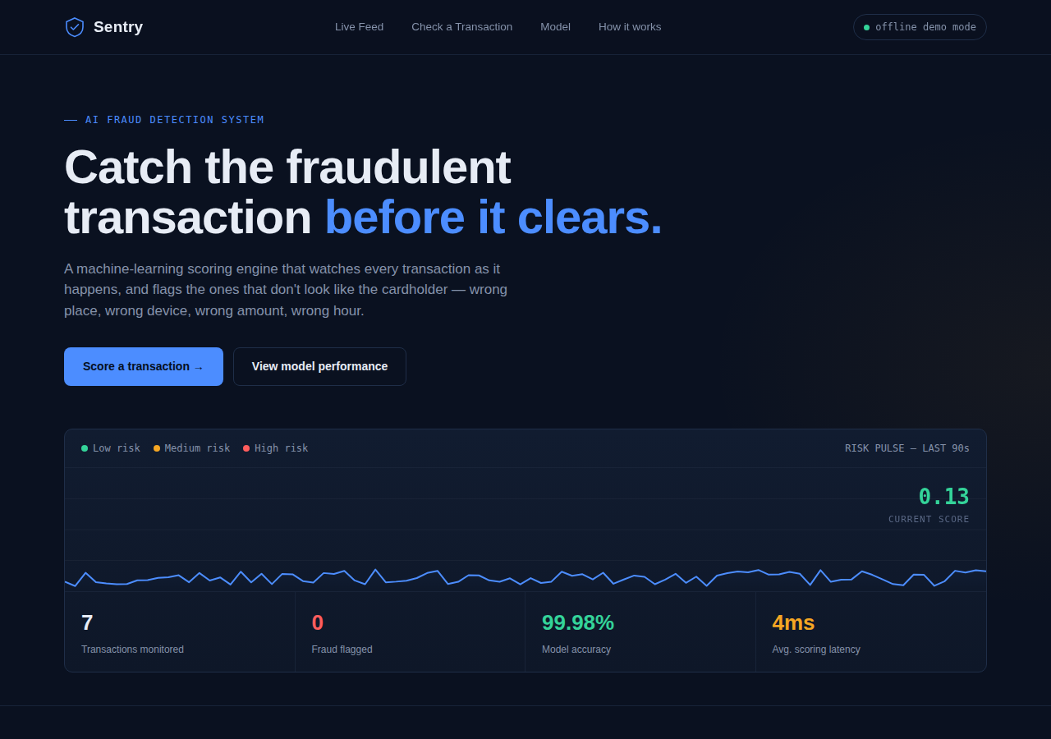
THE WEBSITE
A live dashboard, not just a model file.
The frontend calls the Flask API for live scoring — and automatically falls back to an in-browser model if the API isn't running, so the demo always works.
SENTRY — FRAUD DETECTION
09

Slide 10
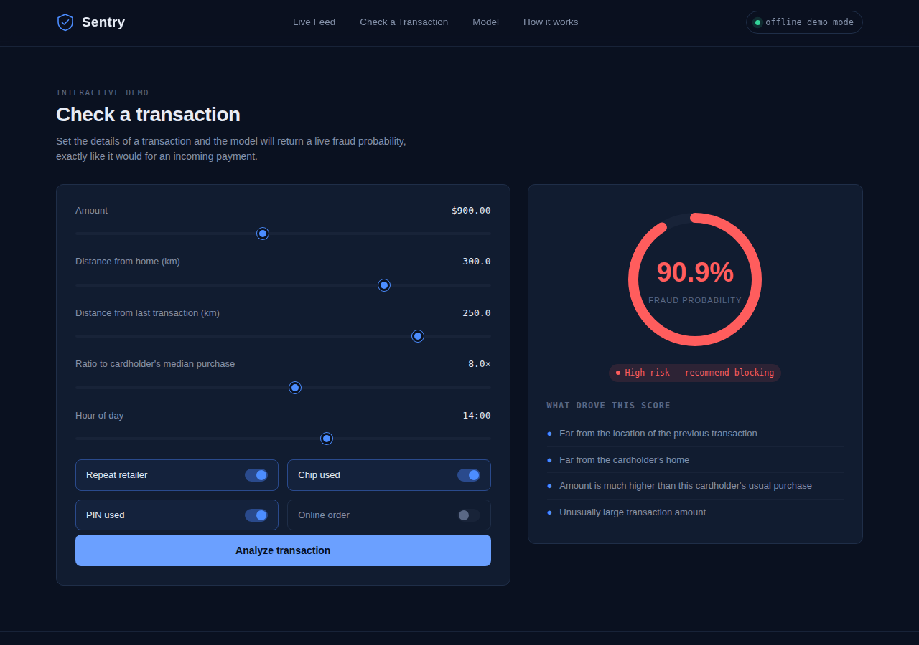
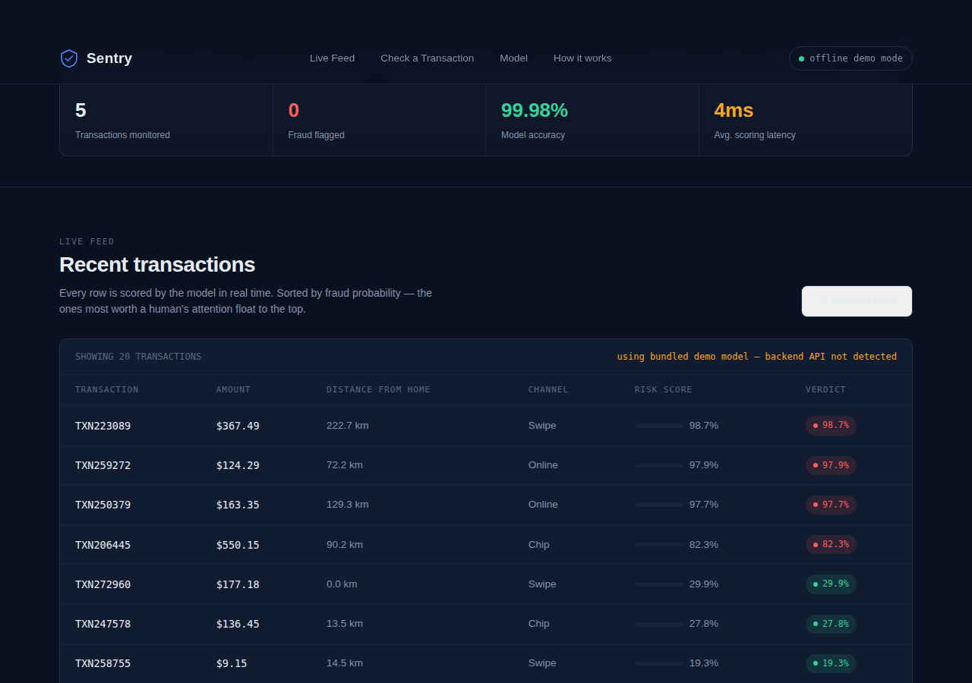
THE WEBSITE
Score a transaction. See why.
Interactive risk check — adjust transaction details and get a live probability with a plain-English explanation.
Live transaction feed — every row scored automatically and sorted by risk, so the riskiest float to the top.
SENTRY — FRAUD DETECTION
10

Slide 11

UNDER THE HOOD
Built with a standard, extensible stack.
Data & Model
Backend API
Frontend
Tooling
• Python 3
• Flask
• HTML5 / CSS3
• Git-friendly structure
• pandas / NumPy
• REST endpoints
• Vanilla JavaScript
• requirements.txt
• scikit-learn
• JSON over HTTP
• Canvas (live chart)
• Modular scripts
• joblib
SENTRY — FRAUD DETECTION
11

Slide 12
FUTURE SCOPE
Where this could go next.
1
Real-world data
Swap the synthetic dataset for an anonymized real one (e.g. Kaggle's Credit Card Fraud dataset) for realistic performance.
2
Unsupervised anomaly detection
Add an Isolation Forest or autoencoder to catch fraud patterns that have never been labeled before.
3
Explainability (SHAP)
Move from rule-based reasons to per-transaction SHAP values for precise, auditable explanations.
4
Production deployment
Add authentication, a real database, and deploy the API so the dashboard works from anywhere.
SENTRY — FRAUD DETECTION
12

Slide 13
Thank You
Sentry — AI-Powered Financial Fraud Detection System
Questions & Discussion

