Slide 1

Statistics
“Unlocking Insights from Data”

Slide 2





What is Statistics?
It is a science which helps us to collect, analyze and present data systematically.
It is the process of collecting, processing, summarizing, presenting, analyzing and interpreting of data to study and describe a given problem.
Statistics is the art of learning from data.
Statistics may be regarded as (i) the study of populations, (ii) the study of variation, and (iii) the study of methods of the reduction of data.

Slide 3


Scope of Statistics
Data Collection:
Data Analysis:
Statistics involves the systematic collection of data from different sources.
This can include surveys, experiments, observations, and more.
The scope extends to understanding how to design effective data collection methods and ensuring the reliability and validity of the collected data.
Statistical analysis is a core aspect of the field.
It includes techniques for summarizing and describing data, identifying patterns, and making inferences.
The scope of data analysis covers both descriptive statistics (such as measures of central tendency and dispersion) and inferential statistics (including hypothesis testing and regression analysis).

Slide 4



Scope of Statistics
Probability:
Inferential Statistics:
Statistical Modeling:
Probability theory is an integral part of statistics.
The scope includes understanding the likelihood of events and the mathematical principles governing randomness.
Probability is fundamental to many statistical methods, such as inferential statistics and modeling.
The scope extends to making predictions and inferences about populations based on sample data.
This includes confidence intervals, hypothesis testing, and understanding the limitations and uncertainties associated with such predictions.
Statistics is used to create models that represent relationships within data.
This can involve simple linear regression models to complex machine learning algorithms.
The scope covers understanding how to develop, evaluate, and interpret statistical models.

Slide 5
Scope of Statistics
Quality Control and Assurance:
Business and Economics:
Biostatistics and Healthcare:
In manufacturing and industry, statistics play a crucial role in quality control.
The scope involves using statistical methods to monitor and improve processes, ensuring consistency and minimizing defects.
Statistics is widely applied in business and economics for market research, financial analysis, and decision-making.
The scope includes understanding consumer behavior, forecasting trends, and evaluating business strategies.
In healthcare, statistics is employed for clinical trials, epidemiological studies, and analyzing health-related data.
The scope includes ensuring the validity of medical research and drawing meaningful conclusions from health-related data.

Slide 6



Scope of Statistics
Social Sciences:
Environmental Statistics:
Educational Research:
Statistics is used in sociology, psychology, and other social sciences to analyze and interpret social phenomena.
The scope extends to studying patterns, relationships, and trends within human behavior and society.
In environmental science, statistics is applied to analyze data related to climate, ecology, and environmental impact assessments.
The scope includes using statistical methods to understand environmental patterns and trends.
Statistics is employed in educational research to analyze student performance, evaluate teaching methods, and assess the effectiveness of educational interventions.

Slide 7
Importance of Statistics
Statistics in Planning:
Data-Driven Decision-Making:
Statistics provides planners with the tools to analyze historical data, trends, and patterns.
This information aids in making informed decisions about resource allocation, infrastructure development, and long-term strategic planning.
Risk Assessment:
Planning involves anticipating potential challenges and uncertainties.
Statistics enables planners to assess risks by analyzing probabilities, helping them develop contingency plans and make decisions that consider various potential outcomes.
Performance Evaluation:
Statistics allows planners to evaluate the performance of past plans and projects.
By analyzing key performance indicators and outcomes, they can identify areas for improvement and refine future plans.

Slide 8
Statistics in State:
Data-Driven Decision-Making:
Statistics provides planners with the tools to analyze historical data, trends, and patterns.
This information aids in making informed decisions about resource allocation, infrastructure development, and long-term strategic planning.
Risk Assessment:
Planning involves anticipating potential challenges and uncertainties.
Statistics enables planners to assess risks by analyzing probabilities, helping them develop contingency plans and make decisions that consider various potential outcomes.
Performance Evaluation:
Statistics allows planners to evaluate the performance of past plans and projects.
By analyzing key performance indicators and outcomes, they can identify areas for improvement and refine future plans.

Slide 9



Statistics in Economics:
Market Analysis:
Macroeconomic Indicators:
Forecasting and Planning:
Economists use statistical methods to analyze market trends, consumer behavior, and economic indicators.
This information is vital for understanding market dynamics, forecasting demand, and making informed economic policy recommendations.
Statistics plays a key role in measuring and analyzing macroeconomic indicators such as GDP, inflation, and unemployment rates.
These indicators provide a comprehensive view of an economy's health and guide economic policy decisions.
Economists use statistical models for economic forecasting and planning.
Whether predicting future economic conditions or assessing the impact of policy changes, statistics provides a quantitative basis for decision-making in the field of economics.

Slide 10

Statistics in Business & Management:
Performance Metrics:
Businesses use statistics to measure and analyze various performance metrics.
Key performance indicators (KPIs) such as sales figures, customer satisfaction scores, and production efficiency are assessed statistically to guide strategic decisions.
Market Research:
Statistical methods are essential in market research for understanding consumer preferences, analyzing market trends, and identifying potential opportunities and threats.
This information is crucial for developing effective marketing strategies.
Quality Control:
In business and management, statistics is applied to quality control processes.
Whether manufacturing products or delivering services, statistical tools help ensure consistency, minimize defects, and maintain high-quality standards.

Slide 11
Statistics in Accountancy and Auditing:
Descriptive Statistics:
Accountants use descriptive statistics to summarize data related to revenue, expenses, and profit for companies.
This helps in understanding the financial state of the company and comparing these metrics to previous quarters to understand how the metrics are trending over time.
Data Visualization:
Accountants use various charts like line charts, scatter plots, and box plots to visualize trends related to revenue and expenses for companies.
These visualizations help in understanding how different metrics are trending in a company over time.
Time Series Forecasting:
Accountants use time series forecasting models to predict future revenue, expenses, and profits for companies.
This allows the company to plan and understand the best-case and worst-case scenarios for revenue and expenses.

Slide 12



Statistics in Industry:
Quality Control:
Process Optimization:
Reliability Engineering:
Statistics is used in industry for quality control processes.
Statistical methods help monitor and control manufacturing processes, ensuring consistency and minimizing defects in the production of goods.
Statistical techniques are applied to optimize industrial processes.
By analyzing data, identifying key factors, and conducting experiments, industries can improve efficiency, reduce costs, and enhance overall productivity.
In industries such as manufacturing and engineering, statistics is employed in reliability engineering.
It helps analyze and predict the reliability of products and systems, guiding decisions related to maintenance and design improvements.

Slide 13

Statistics in Physical Sciences:
Experimental Design:
Statistics plays a fundamental role in the design and analysis of experiments in the physical sciences.
It helps scientists plan experiments, choose appropriate sample sizes, and analyze data to draw meaningful conclusions.
Data Modeling:
Statistical methods are used to model and analyze data in physics, chemistry, and other physical sciences.
This includes fitting mathematical models to experimental data, determining parameters, and assessing the reliability of models.
Quantifying Uncertainty:
Physical sciences often deal with measurements and observations that involve uncertainty.
Statistics provides tools for quantifying and expressing uncertainty, allowing scientists to communicate the reliability of their findings.

Slide 14

Statistics in Social Sciences:
Survey Research:
Correlation and Causation:
Predictive Modeling:
Statistics is crucial in survey research within the social sciences.
It helps design surveys, analyze responses, and draw conclusions about populations based on sample data, contributing to the understanding of social phenomena.
Social scientists use statistical methods to examine correlations between variables.
While statistics can identify relationships, it is essential in social sciences to be cautious about inferring causation, and statistical methods provide tools for assessing these relationships.
Statistical techniques are applied for predictive modeling in social sciences.
This includes predicting trends, behaviors, and outcomes based on historical data, allowing researchers to make informed projections.

Slide 15

Statistics in Biology and Medical Sciences:
Clinical Trials:
Statistics is crucial in the design and analysis of clinical trials.
It helps determine sample sizes, randomize participants, and assess the efficacy of treatments, ensuring robust and reliable results in medical research.
Epidemiological Studies:
Statistics plays a key role in epidemiology, where it is used to analyze patterns of disease, identify risk factors, and make predictions about the spread of diseases within populations.
Genomic Data Analysis:
In biology, particularly in genomics, statistics is employed to analyze large datasets.
This includes identifying genetic markers, assessing gene expression patterns, and understanding the variability within populations.

Slide 16



Statistics in Psychology and Education:
Experimental Design in Psychology:
Educational Research:
Psychological Testing and Assessment:
Statistics is integral to the experimental design in psychological research.
It helps psychologists plan experiments, control variables, and analyze data to draw conclusions about human behavior.
Statistics is extensively used in educational research.
It assists in analyzing student performance, evaluating the effectiveness of teaching methods, and making data-driven decisions to improve educational outcomes.
In psychology and education, statistical methods are applied to develop and validate psychological tests and assessments.
This includes assessing reliability, validity, and the overall effectiveness of measurement instruments.

Slide 17
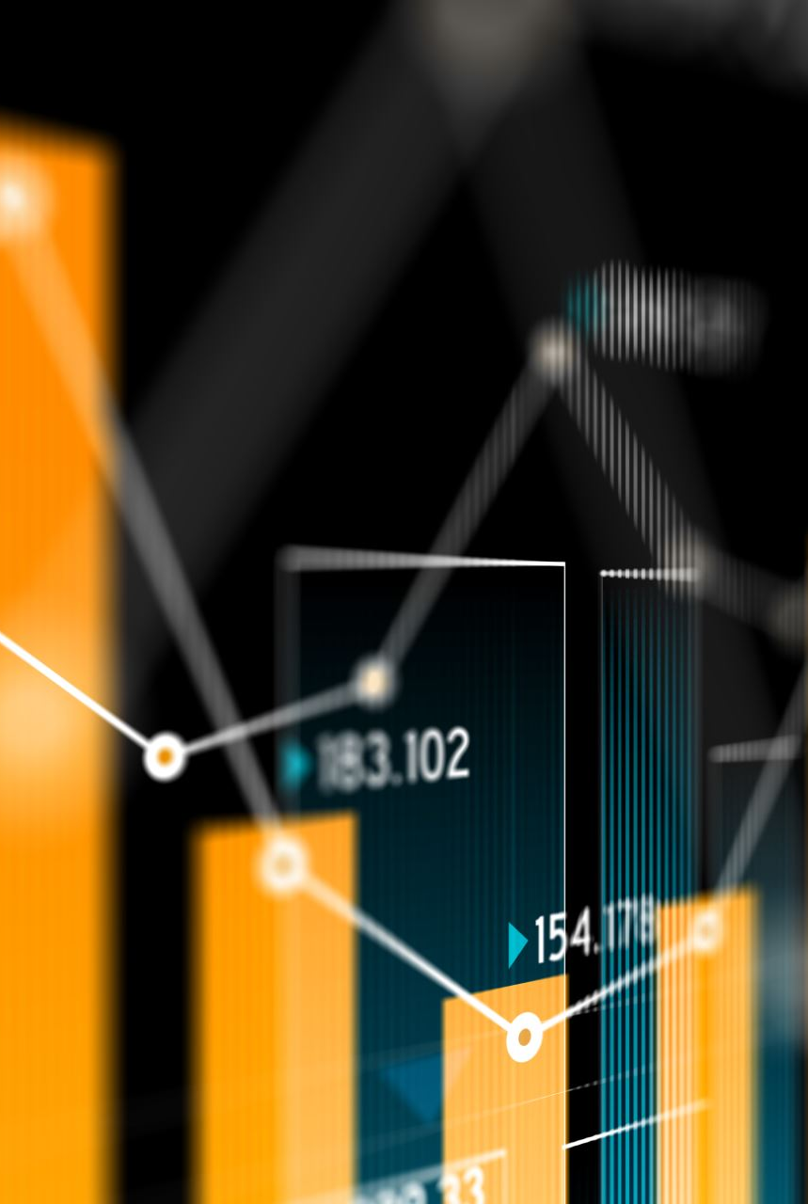
Limitations of Statistics
Statistics does not study qualitative phenomenon:
Quantitative Focus:
Statistics primarily deals with quantitative data, focusing on measurable and numerical variables.
It is not well-suited for capturing the rich nuances and complexities associated with qualitative phenomena, such as emotions, attitudes, or subjective experiences.
Loss of Context:
When applied to qualitative data, statistics may lead to a loss of context and depth.
The reduction of qualitative information to quantitative measures might oversimplify the intricate nature of qualitative phenomena, diminishing the accuracy and richness of the findings.
Limited Insight into Human Behavior:
Qualitative aspects of human behavior, cultural dynamics, and social interactions are challenging to capture through statistical methods alone.
Statistics may provide numerical trends but may not fully encapsulate the depth and meaning of human experiences.

Slide 18
Statistics does not study individuals.
Aggregated Analysis:
Statistics typically involves analyzing aggregate data, drawing conclusions about groups or populations.
Individual variations and unique characteristics may get masked in the process, limiting insights into the specific needs, behaviors, or experiences of individuals.
Generalization Challenges:
Statistical generalizations are made at the group level, and applying these findings to individuals may not always be accurate.
People within a group can vary significantly, and statistical results may not fully represent the diversity within the population.
Case-Specific Understanding:
Statistics may not provide a detailed understanding of individual cases.
It excels in revealing patterns and trends across large datasets but may lack the depth required for comprehending the unique circumstances or complexities of individual cases.

Slide 19
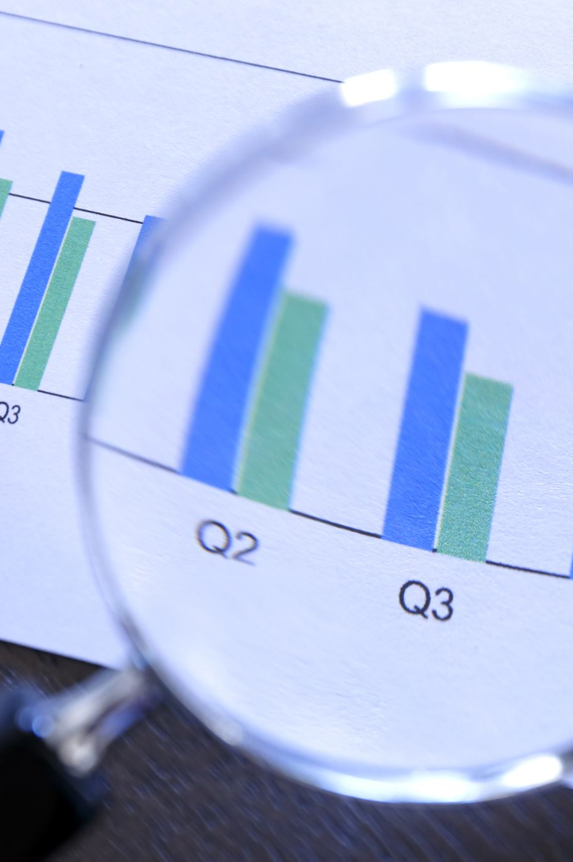
Statistical laws are not exact.
Probabilistic Nature:
Statistical laws are probabilistic rather than deterministic. They deal with likelihoods and probabilities, making predictions based on the probability of events occurring.
The inherent uncertainty challenges the notion of exactness associated with traditional laws in other scientific disciplines.
Margin of Error:
Statistical results often come with a margin of error or confidence interval.
This acknowledgment of uncertainty reflects the probabilistic nature of statistical laws. The precision associated with these laws is constrained by the limitations of sample sizes and variations within data.
Subject to Change with New Data:
Statistical laws are subject to modification as new data becomes available.
Unlike fixed laws in some scientific fields, statistical relationships can evolve with additional observations, leading to revised conclusions and insights.

Slide 20



Statistics is liable to be misused.
Misinterpretation and Manipulation:
Cherry-Picking Data:
Inappropriate Inferences:
Statistics can be misinterpreted or manipulated to support agendas or perspectives.
Whether intentionally or due to lack of statistical literacy, the misuse of statistics can lead to misleading conclusions, reinforcing misconceptions or biases.
Selectively presenting or emphasizing certain statistics while ignoring others (cherry-picking) can distort the overall picture.
This misuse undermines the integrity of statistical analyses, contributing to misinformation and miscommunication of findings.
Statistics may be inappropriately applied or misused when individuals lack a clear understanding of statistical principles.
Inaccurate inferences or conclusions drawn from statistical analyses can have significant consequences, particularly when used as a basis for decision-making.

