Slide 1


WORDPRESS
Web Content Management System

Slide 2
What Is WordPress ?
WordPress is a content management system (CMS) that allows you to host and build websites. WordPress contains plugin architecture and a template system, so you can customize any website to fit your business, blog, portfolio, or online store.
WordPress is the simplest, most popular way to create your own website or blog. In fact, WordPress powers over 43.3% of all the websites on the Internet. More than one in four websites that you visit are likely powered by WordPress.

Slide 3
Who Made WordPress ?
WordPress was created as a standalone project all the way back in 2003, originating as an offshoot of a previous project called b2/cafe log.
WordPress is open-source software, so nowadays it’s made by a huge community of contributors. But if we were to trace WordPress’ origins back to its roots, its original creation was a collaboration between Matt Mullenweg and Mike Little.
Since then, Matt Mullenweg has largely become the face of WordPress. And he’s also the founder of Automattic, which is the company behind the for-profit WordPress.com service. WordPress has pushed forward and, thanks to its contributors and huge community, developed into the most popular solution to create any type of website.

Slide 4
WordPress allows users to create and edit websites through a central administrative dashboard, which includes a text editor for modifying content, menus and various design elements.
WordPress provides plugins which provide additional functionality through WordPress Plugin Directory. There are over 54,000+ Plugins available in WordPress repository, and they can be installed through either upload or by one-click installation through the WordPress Plugin Library.
WordPress can be downloaded and installed on any server with PHP installed. However, WordPress has a service for users to host blogs, called wordpress.com. It has a limit of 3 GB of free space, with an option to upgrade for more. Users cannot add their own domain to the blog when using free option. But when user will buy one of the packages of WordPress.com, then user can use custom domain name.

Slide 5
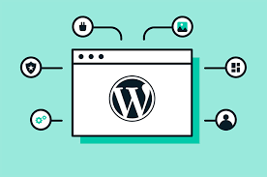
Features of Wordpress :
Flexibility
User-friendliness
Media management
Quick installation and upgrade
User management
Easy theme system
SEO friendliness
Easy social media integration

Slide 6
What Kinds Of Websites Can WordPress Make?
With the help of WordPress’ massive ecosystem of plugins and themes, you can create any type of website with WordPress.
For example, not only does WordPress power a huge number of business sites and blogs, it’s also the most popular way to create an eCommerce store as well! With WordPress, you can create:
Business websites
eCommerce stores
Blogs
Portfolios
Resumes
Forums
Social networks
Membership sites
…pretty much anything else you can dream up

Slide 7
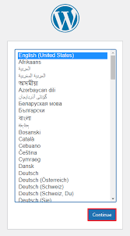
Installation and account establishment :
After visiting official site
” https://wordpress.org/download/”
Create the account for starting the
experience on wordpress.
Click on continue

Slide 8
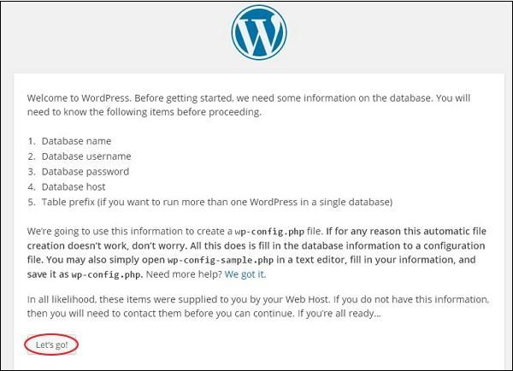

Slide 9
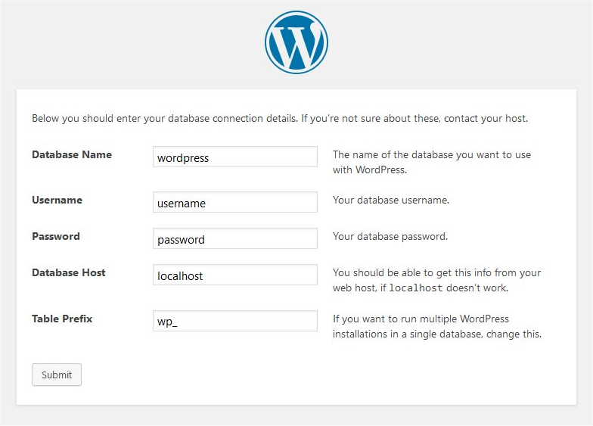
Click on Submit

Slide 10
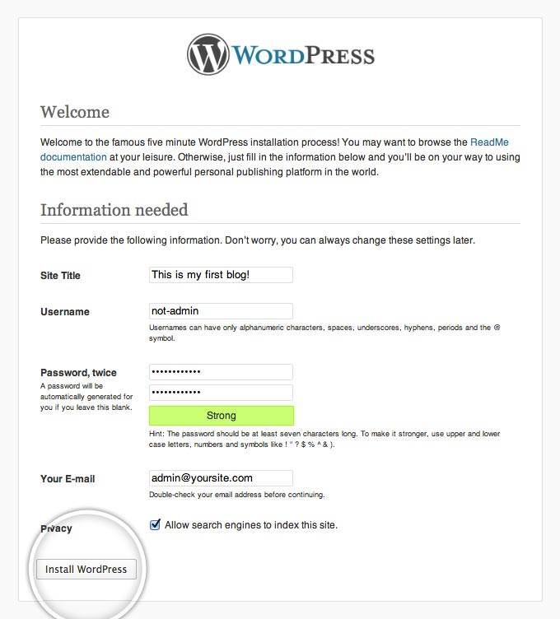
Click on “Install” for
further steps

Slide 11
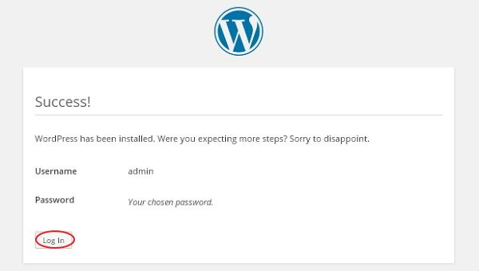
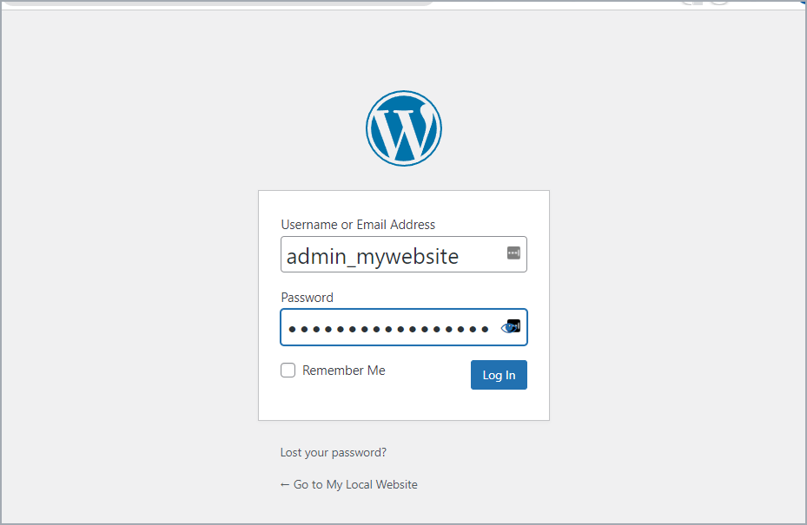
Log in to the official site
and experience the features.

Slide 12
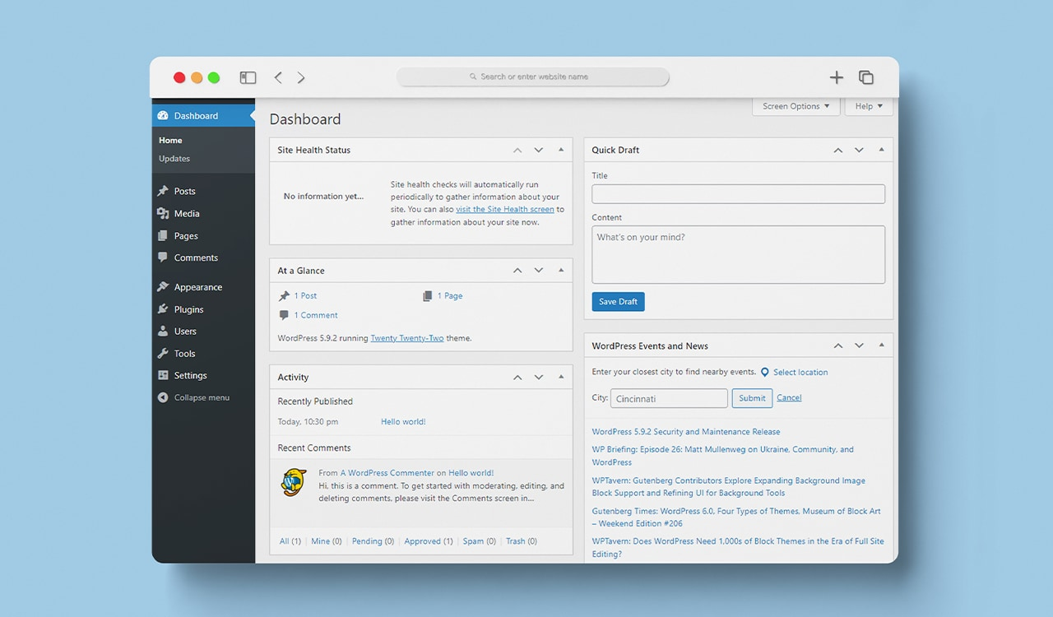

Slide 13

Submitted by :- armaan Wadhwa
Crn :- 2221145
URN :- 2303079

