Slide 1
PRESENTATION ON BIOREMEDIATION
SUBMITTED BY : ARMAAN WADHWA, GAURAV
CRN : 2221145, 22211448
URN : 2303079, 2303082

Slide 2
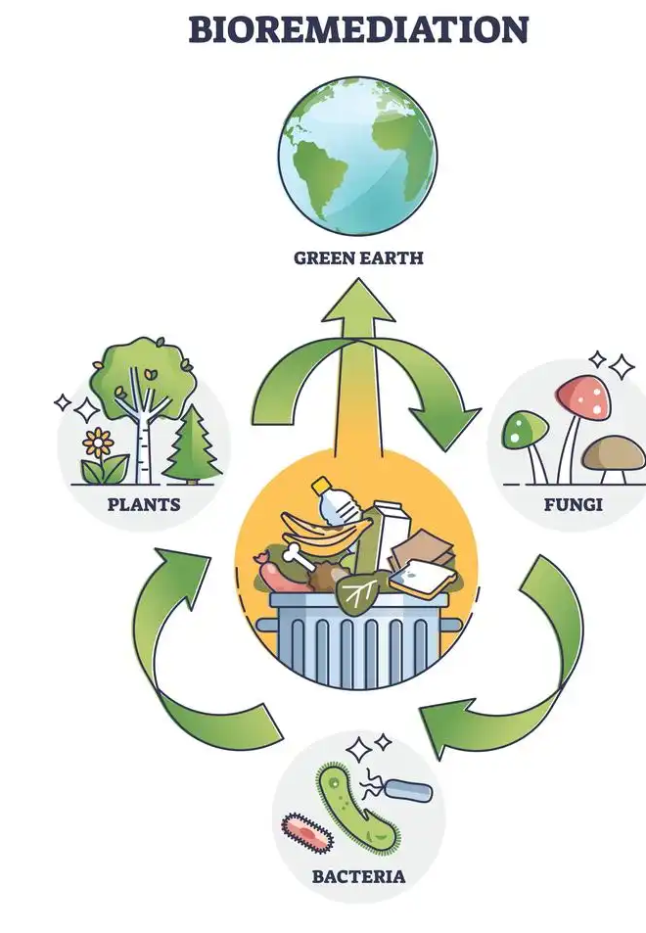
What Is Bioremediation?
Bioremediation is a branch of biotechnology that employs the use of living organisms, like microbes and bacteria, in the removal of contaminants, pollutants, and toxins from soil, water, and other environments.
Bioremediation may be used to clean up contaminated groundwater or environmental problems, such as oil spills.

Slide 3
How Bioremediation works ?
Bioremediation relies on stimulating the growth of certain microbes that utilize contaminants like oil, solvents, and pesticides for sources of food and energy. These microbes convert contaminants into small amounts of water, as well as harmless gases like carbon dioxide.
Bioremediation requires a combination of the right temperature, nutrients, and foods. The absence of these elements may prolong the cleanup of contaminants. Conditions that are unfavorable for bioremediation may be improved by adding “amendments” to the environment, such as molasses, vegetable oil, or simple air. These amendments optimize conditions for microbes to flourish, thereby accelerating the completion of the bioremediation process.

Slide 4
Bioremediation can either be done "in situ", which is at the site of the contamination itself, or "ex situ," which is a location away from the site. Ex situ bioremediation may be necessary if the climate is too cold to sustain microbe activity, or if the soil is too dense for nutrients to distribute evenly. Ex situ bioremediation may require excavating and cleaning the soil above ground, which may add significant costs to the process.
The bioremediation process may take anywhere from several months to several years to complete, depending on variables such as the size of the contaminated area, the concentration of contaminants, temperature, soil density, and whether bioremediation will occur in situ or ex situ.

Slide 5
What is In Situ Bioremediation?
In situ bioremediation refers to the bioremediation process which is performed at the original site of the contamination. In situ bioremediation concept is mainly used to treat contaminations in soil and ground water. However, the remediation rate and the effectiveness of the process depend on different factors. They are as follows:
The type of the contaminant concern
Site-specific characteristics
Contaminant distribution and concentration
Concentration of other contaminants
Microbial community of the site
Temperature
pH of the medium
Moisture content
Nutrient supply

Slide 6
What is Ex Situ Bioremediation?
Ex situ bioremediation is a technique which treats the contaminants away from the location where they were found. Contaminants are excavated or pumped out from the original site and treated inside the controlled environments. A wide range of hydrocarbons is purified by ex situ bioremediation. Contaminated soils are excavated and placed on the surface of the ground and treated using indigenous microorganisms. Ex situ bioremediation can be controlled and managed by providing required conditions.
Examples of ex situ bioremediation processes including composting, soil biopiles, landfarming, slurry reactors.

Slide 7
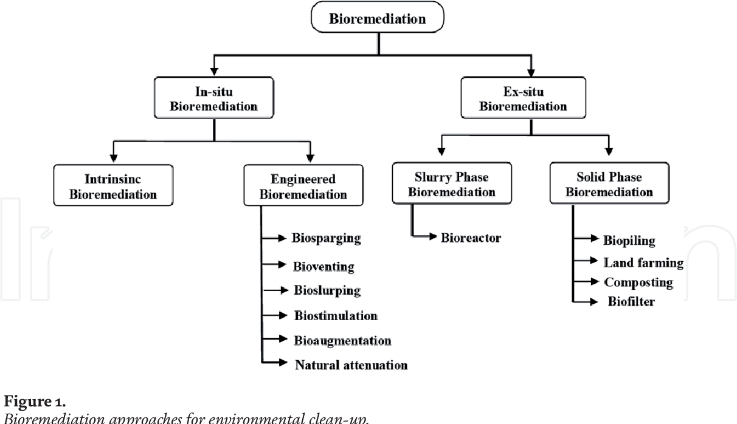

Slide 8
EXAMPLE
In 1989, the EXXON VALDEZ oil tanker ran aground off the coast of Alaska; the tanker ended up spilling approximately 11 million gallons of oil. Around this same time, bioremediation was gaining traction as a viable option for oil cleanups. The EPA and Exxon Mobil Corporation (XOM) both began testing different compounds. Initial tests regarding the effectiveness of bioremediation looked promising.
Between 1989 and 1990, more than 100,000 pounds of fertilizer was applied over more than 2000 applications to the affected areas. By mid-1992, the cleanup was considered complete, and the fertilizer had degraded nearly all the oil compounds.

Slide 9
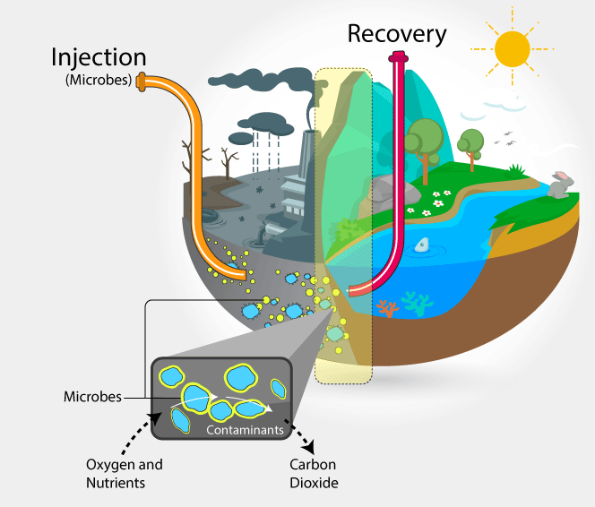

Slide 10
Pros and cons of bioremediation
Pros
cons
Complete remediation of harmful contaminants presents in the environment instead to transferring contaminants from one site to another.
Cost effective method with minimal requirements of complex tools and equipment
Environment friendly approach with use of microorganism instead of harmful chemicals
In majority cases, can be carried out on site reducing transportation cost
Minimum site destruction and disruption
Lower liability level
Low energy consumption
Only limited to biodegradable waste and contaminants
Requires extensive monitoring
Being a biological process, specificity is a major drawback in terms factors like type of environmental growth conditions, types of microorganisms, type of nutrient requirements and type of contaminants.
Possibility of production unknown and potentially toxic byproducts
Comparatively a time consuming process

Slide 11
Types of bioremediation
Biostimulation
Microbes are stimulated to begin the remediation process via chemicals or nutrients that activate them.
Bioaugmentation
Used mainly in cleaning up soil contamination, this process adds bacteria to the surface of the affected area, where they are then allowed to grow.
Intrinsic Bioremediation
Vonverts toxic materials into inert ones using the native microbiome to the affected area

Slide 12
Thank You!

