Slide 1

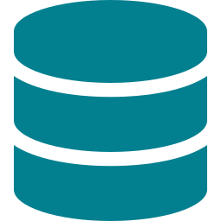
ERP System: Architecture Analysis
February 14, 2026
Codebase Exploration
Reviewed frontend and backend code structure comprehensively
Analyzed component architecture and state management patterns
Studied API endpoint design and request/response flow
Database Schema Analysis
Examined PostgreSQL database tables and their relationships
Analyzed field structures, data types, and attribute definitions
Understood overall system design and data flow architecture

Slide 2


ERP System: Environment Setup
February 16, 2026
Repository Configuration
Cloned ERP project repository to local development environment
Installed and configured pgAdmin for PostgreSQL database management
Set up all required dependencies and development tools
Code Quality & Configuration
Configured backend API endpoint in frontend.env file
Removed unnecessary console logs to enhance code maintainability
Gained comprehensive understanding of frontend and backend architecture

Slide 3

ERP System: Code Refactoring
February 17, 2026
Architecture Improvement
Refactored existing controller files by separating business logic into distinct Service and Controller layers to improve code structure, maintainability, and adherence to software design principles.
Refactoring Impact
Lines of Code
1200-1500
Benefits Achieved
• Improved code organization
• Enhanced maintainability
• Better separation of concerns

