Slide 1
Artificial Intelligence
An Overview of AI

Slide 2
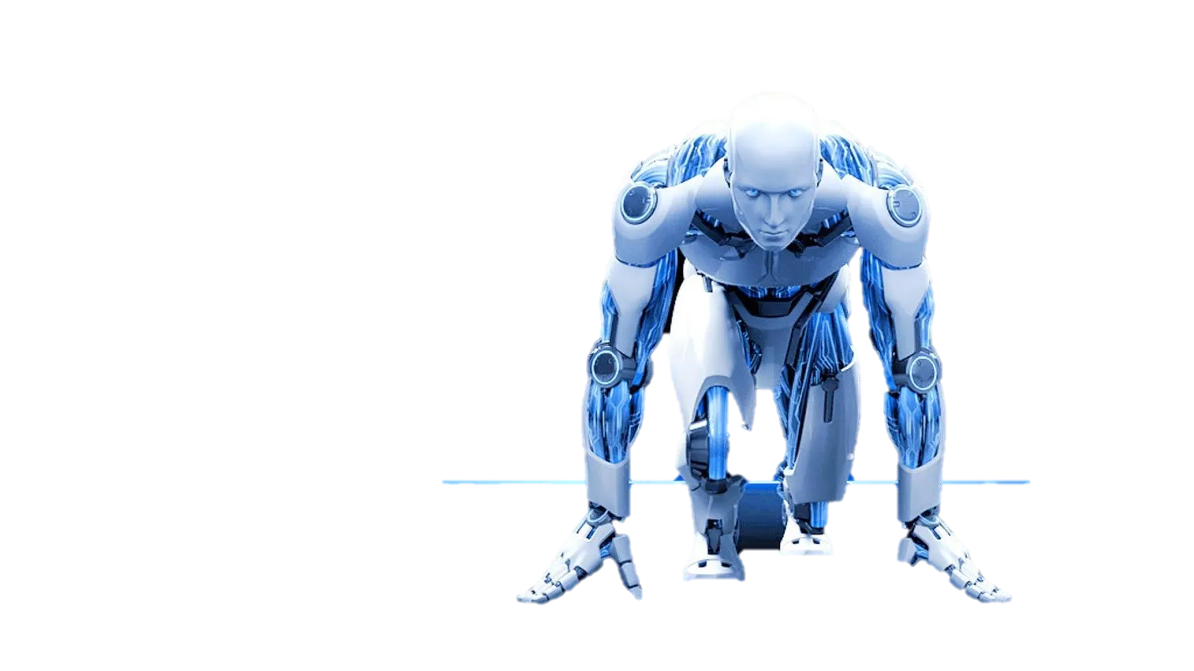
What is AI?
Artificial Intelligence refers to the simulation of human-like intelligence by machines.

Slide 3
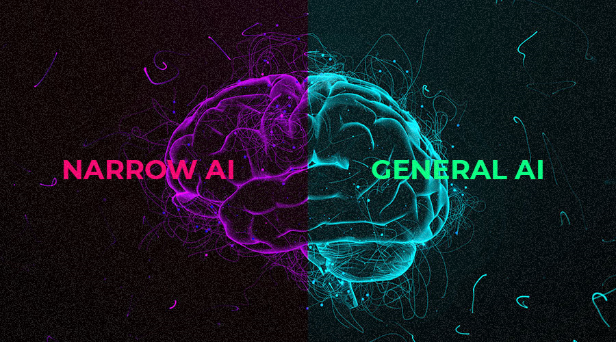
Types of ai

Slide 4
Abilities of AI
AI can analyze data, recognize patterns, solve complex problems, and make predictions.

Slide 5
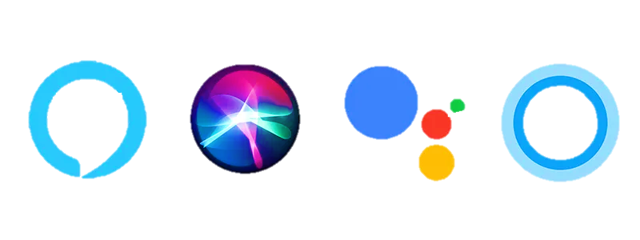
AI in Everyday Life
AI powers virtual assistants, recommendation systems, and personalized content delivery.

Slide 6
AI in Industry
AI optimizes manufacturing, financial processes, and predictive maintenance in industries.

Slide 7
Future of AI
AI's future includes advanced robotics, personalized AI etc.

Slide 8
Conclusion
In conclusion, AI is transforming industries and our daily lives, shaping the future.

Slide 9
Thank you
Utkarsh Kumar
IT (B2)
2221118

