Slide 1





Deep Insight Crew
“ENHANCING REAL-TIME LEARNING INTERACTIVITY IN WORK INTEGRATED LEARNING PROGRAMS: A MULTI-MODEL APPROACH"
Presented by: Debarati Banerjee(2022C104015)
Mrutyunjay Shukla(2022C104060)

Slide 2

Overview
  Topic Rationale and Solution Overview
  Model Demonstration
  Architecture
  Performance Metrics Overview
  Future Scope
  Q&A

Slide 3






Topic Rationale and Solution Overview
Chatbot Overview for Latecomers
Real-time Query Assistance
Note-taking Integration
Personalized Learning Support
Our solution includes a chatbot feature that provides a quick recap of the lecture content covered thus far. Latecomers can catch up efficiently without interrupting the ongoing class.
The chatbot interface allows students to ask questions as they arise during the lecture. This ensures a smooth and uninterrupted learning experience for all participants. The chatbot promptly responds with relevant information or directs students to resources for further understanding.
Our system facilitates easy note-taking by students. Not only can they receive real-time solutions to their queries, but they can also capture these solutions for future reference. The seamless integration of chatbot interactions with note-taking enhances the overall learning experience.
Our system offers personalized learning support by allowing students to revisit specific parts of the lecture through the synchronized transcript. This enables students to review material at their own pace, ensuring better comprehension and retention.

Slide 4


Model Demonstration

Slide 5
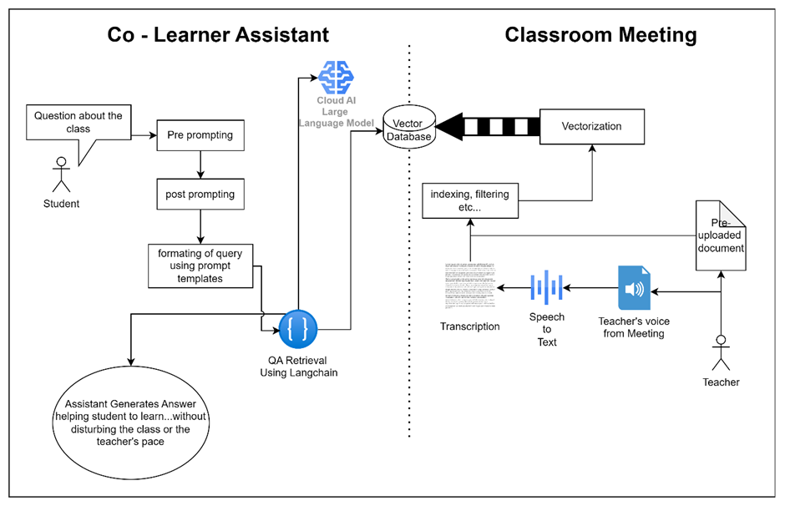
Model Demonstration

Slide 6




Future Scope
Enhanced Feedback Mechanism
To enhance our Live Lecture Support System, we're introducing a flow chart within the chatbot interface. It will display the professor's name, current student count, and questions asked during lectures. Analyzing these questions will help us understand student engagement and comprehension levels. We'll integrate a feedback mechanism into the chatbot, eliminating traditional form-filling. This data-driven approach ensures continuous improvement tailored to student needs.
Intelligent Question Suggestions
We're crafting algorithms to detect common student questions during lectures, offering instant suggestions via the chatbot interface. This accelerates response time, providing swift assistance and improving the overall learning process.
Comprehensive Content Navigation
We're integrating a table of contents feature into the chatbot interface, aligned with the BITS lecture handbook. This enables seamless navigation through lecture materials, assisting students in exam preparation and revision.

Slide 7

Future Scope
Expanded Information Resources
We're adding an option in the chatbot to access answers from ChatGPT or external sources. This offers students extra information beyond lectures, enriching their understanding and knowledge base.
Scalable Data Management
We're shifting from local storage to a scalable pipeline in a vector database for transcript and data management. This ensures efficient storage, retrieval, and management of large data volumes, facilitating scalability and performance optimization. Moreover, this transition enables students to access and ask questions from older sessions seamlessly.
Financial Benifit
ABHI LIKHNA BAKI HAI

Slide 8

Q&A

Slide 9
Deep Insight Crew
THANK YOU
For watching this presentation

