Slide 1
Types of Git Reset
Anuranjan Srivastava(codersaty)

Slide 2
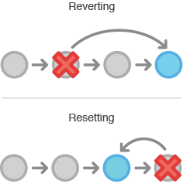
Recap
In the last video, we looked at using two Git commands; revert, and reset.
However, there are many different types of flags you can use with reset that change its functionality completely.

Slide 3
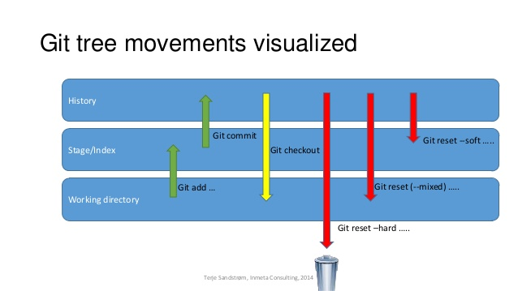
Soft
Using the ‘—soft’ flag will change your commit, but will not remove any of the changes you have made.
For example, if you reset back one commit, your environment would be the same, but the commit you are on would be changed.
This is useful if you are trying to get rid of a problem with the commit (eg. Spelling error)

Slide 4
Mixed
‘—mixed’ is the default setting for the reset command, so you do not need to specify it.
Instead of keeping everything staged and ready to commit, it instead changes the ‘stage’ to match the commit you’re reverting to.
This doesn’t remove the files; they are still in the working directory. However, you have to commit them again if you want to re-include them.
This is primarily useful for when you want to remove a file you accidentally committed.

Slide 5
Hard
‘—hard’ is the strongest out of the three, and the most commonly used.
Using this flag will reset the repository as if you were still working on that commit; leaving no data from any commits after it.
This is mostly used when some irreversible error has been made, and cannot be removed manually without completely resetting the program.

