Slide 1
Course Introduction
Anuranjan Srivastava (Codersaty)

Slide 2

Section 1: Introduction to Git
In this section, I focus on introduction the theory behind Git.
We learn some of the functions and uses of Git.
We also learn how to install Git and all of the additional features it comes with.

Slide 3
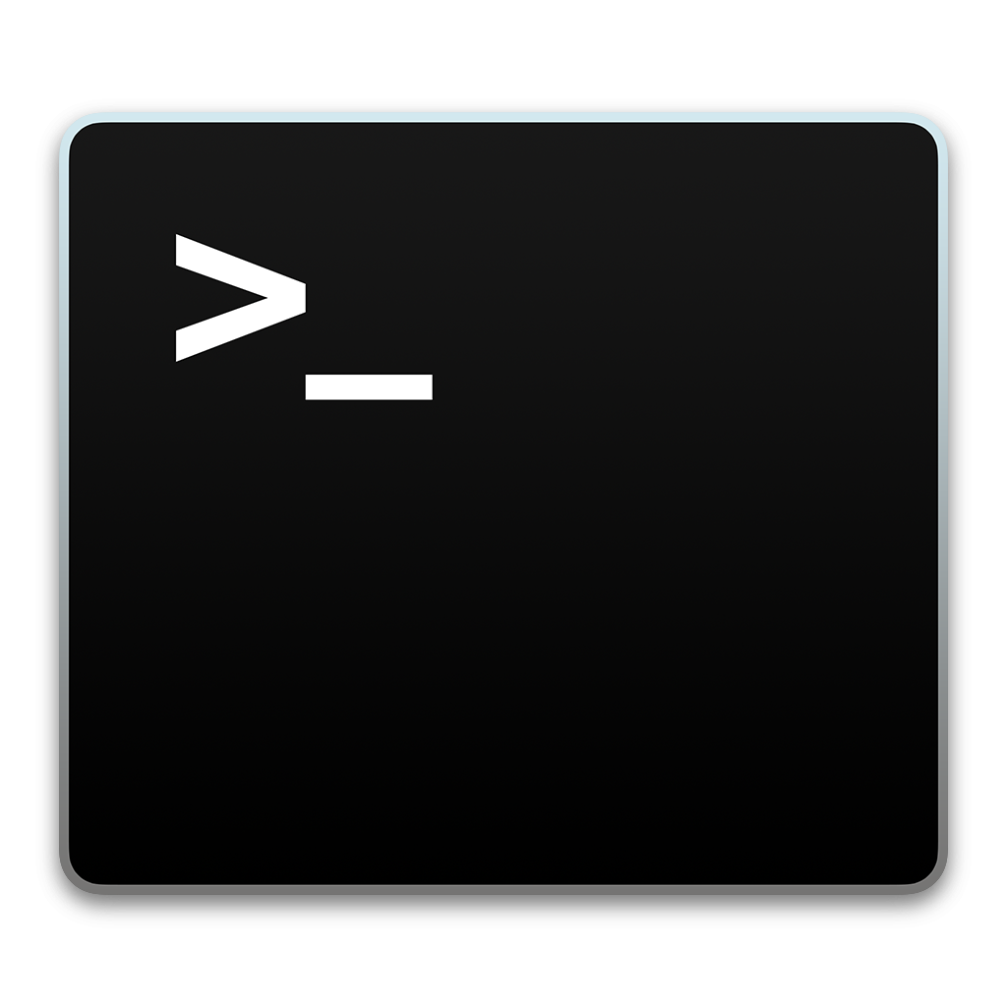
Section 2: The Terminal
In this section, We focus on getting used to the terminal environment.
I teach you the different parts of a terminal, and how it functions.
We also learn basic commands you can use with the terminal.
Because we will be using it for most of the course, it is important to get comfortable with it.

Slide 4
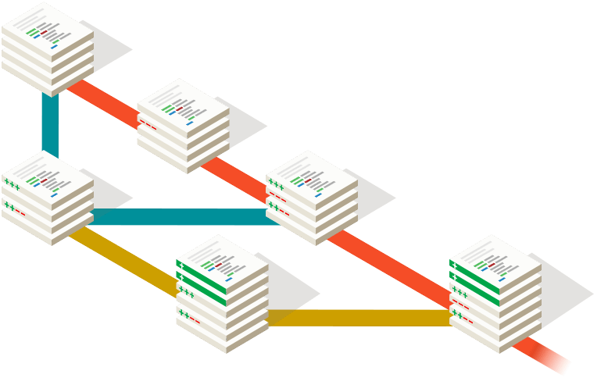
Section 3: Git Basics
This section focuses on the basics of using Git, as well as an in-depth look at Git workflow.
We learn about how Git works at its core, as well as some of its main components.
We also learn the most commonly used commands in Git, and how to use them.

Slide 5

Section 4: Git Branches
This section focuses on the inner workings and methods of Git branches.
We learn everything about branches, including theory, and common commands.
Branches are one of the integral features in Git.

Slide 6

Section 5: GitHub
Now that we know all of the local features of Git, we move on to GitHub.
We cover the theory behind GitHub in more detail, as well as creating our own GitHub account.
We take a look at all the different features that can be used in GitHub.

Slide 7
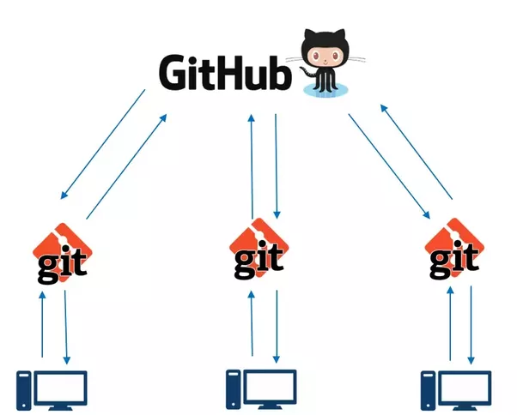
Section 6: Using Git Remotely
Now that we know both Git & GitHub, it is time to combine them together.
We learn all of the remote theory and features of remote Git commands, such as the push/pull cycle.
We learn how to push our files to a repository on GitHub.

Slide 8
Section 7: Git GUI w/ SourceTree
After mastering Git & GitHub, we can learn some supplemental software that uses Git.
We cover a program that allows you to interact with Git without using a terminal or commands called SourceTree.
We go over all of the features in SourceTree, and some of the differences between it and the terminal.

Slide 9
Lets Get Started!
Anuranjan Srivastava (codersaty)

