Slide 1
What is Git?
Anuranjan Srivastava(Codersaty)

Slide 2
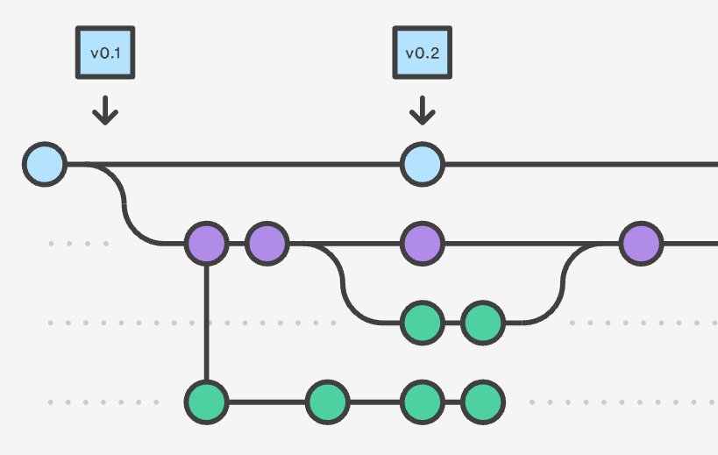
Source Control
Source control, or version control, is a way of tracking your files progress over time.
It is usually saved in a series of snapshots and branches, which you can move back and forth between.

Slide 3
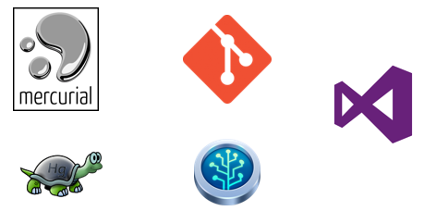
What you can do
Source control allows you to:
Distribute your file changes over time
Prevent against data loss/damage by creating backup snapshots
Manage complex project structures

Slide 4

About Git
Git is a source control software, similar to many others out there.
It follows all the same rules and concepts that any source control follows.

Slide 5
Why use Git?
The most popular source control software in the world
Lots of documentation and support
Lots of integration with other applications (SourceTree, Heroku, GitHub)

Slide 6

Summary
Git is a source/version control software.
It is the most popular source control software in the world.
It has lots of integration with other programs, giving it lots of value and demand.

