Slide 1
Section Introduction
Anuranjan Srivastava (codersaty)

Slide 2
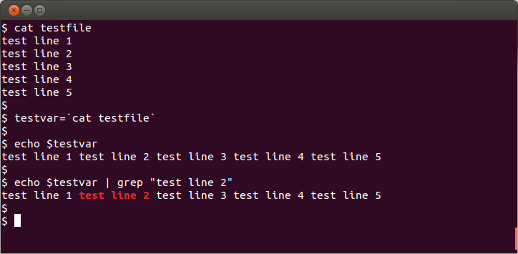
The Terminal
This section will completely focus on learning the terminal.
We will learn how to use the terminal from scratch, starting from opening the program.
The terminal is a required skill when using the raw version of Git.
All developers need to learn how to use the terminal at some point in their lives.

Slide 3
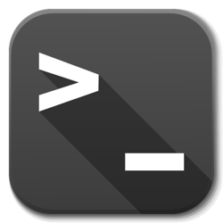
The Introduction
We will first look at the different parts of the terminal, and what it can do
We will look at some of the differences between a Windows & Unix terminal
We will learn what a ‘shell’ is and the most used shells

Slide 4
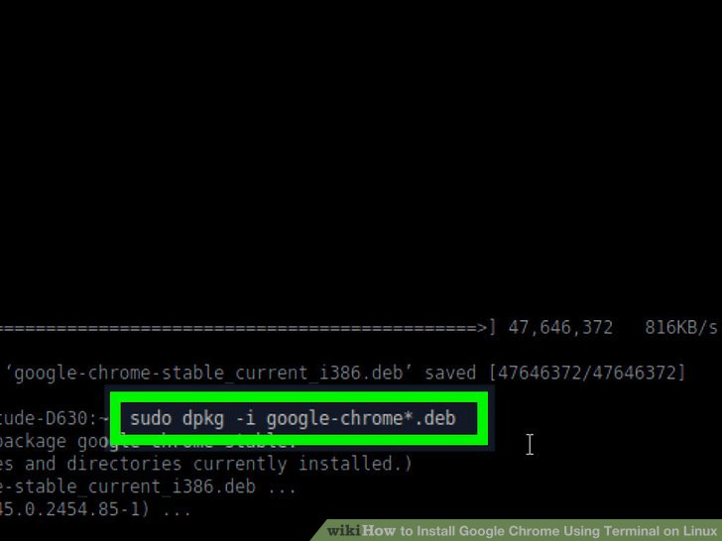
Console Commands
We then move on to talk about some of the basic commands you can use in the terminal.
This includes moving between directories, adding files, and creating directories.
We also talk about some of the different modifications you can make to a command (eg. Help, flags)

Slide 5
Lets get Started!
Anuranjan Srivastava (codersaty)

