Slide 1
SourceTree Introduction
Anuranjan Srivastava(Codersaty)

Slide 2
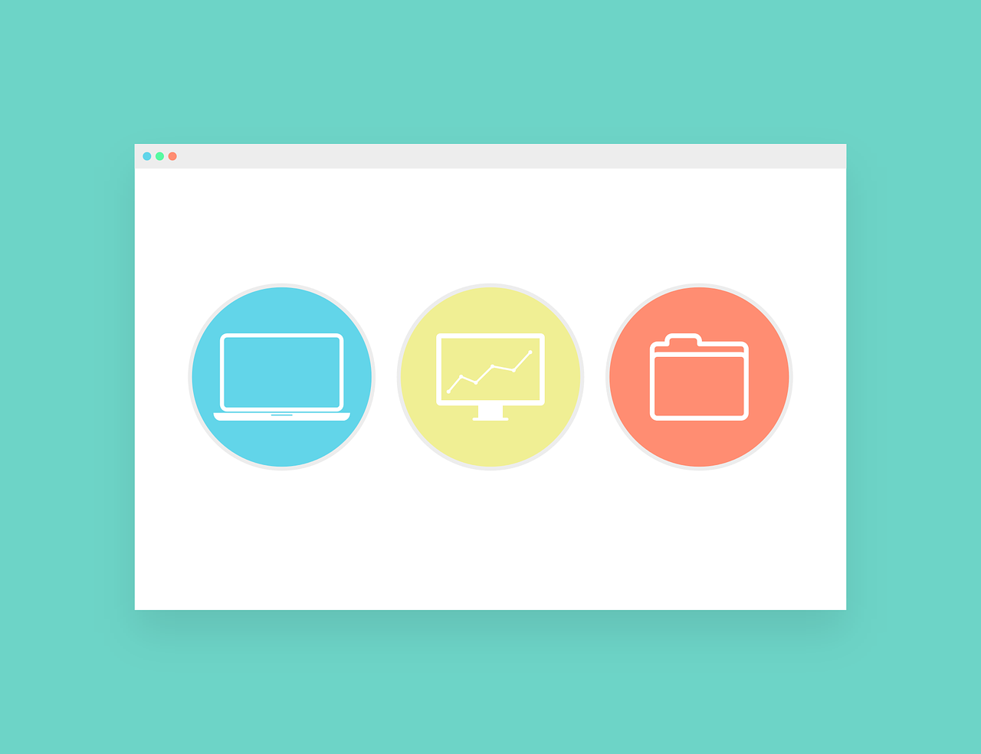
What is a GUI?
A GUI, or Graphical User Interface is any software that can allow the user to perform tasks through a graphical interface.
Most GUI’s are built off of some system or library that can only be used through the terminal or through programming, making it more user-friendly

Slide 3
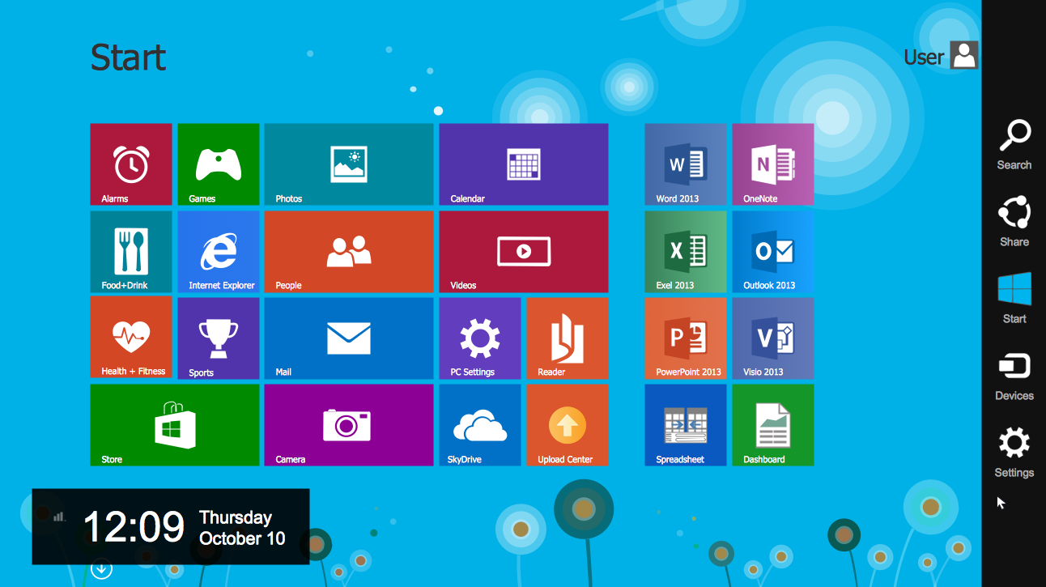
Some Examples of GUIs
Some examples of GUIs are:
Microsoft Windows Desktop
Google Chrome
Most Linux Distributions (Ubuntu, Debian)
Almost all software and applications for any device has some sort of GUI.

Slide 4

About SourceTree
SourceTree is a Git GUI allowing you to interact with your repositories through a graphical interface.
It builds off of the core Git commands and systems, however, it is executed through icons and buttons instead of terminal commands.
SourceTree is used as an alternative to the terminal when using Git.

