Slide 1
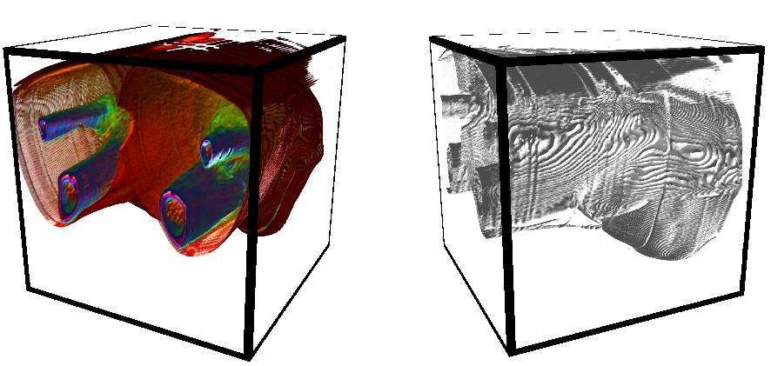
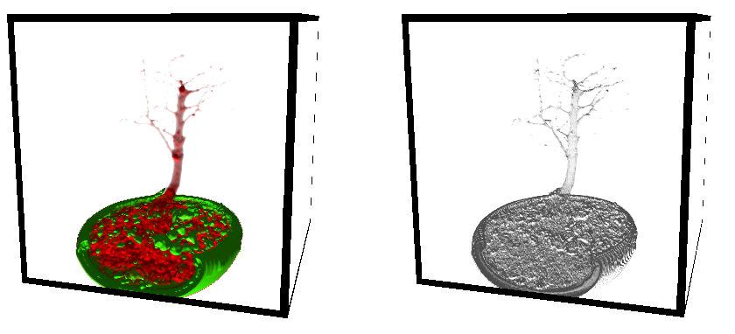
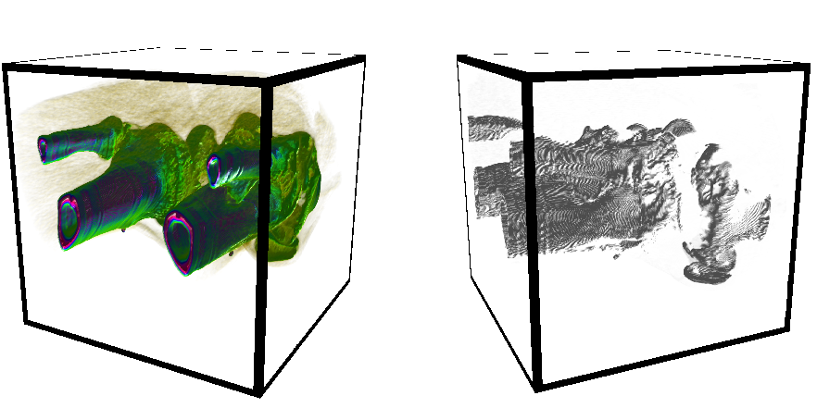
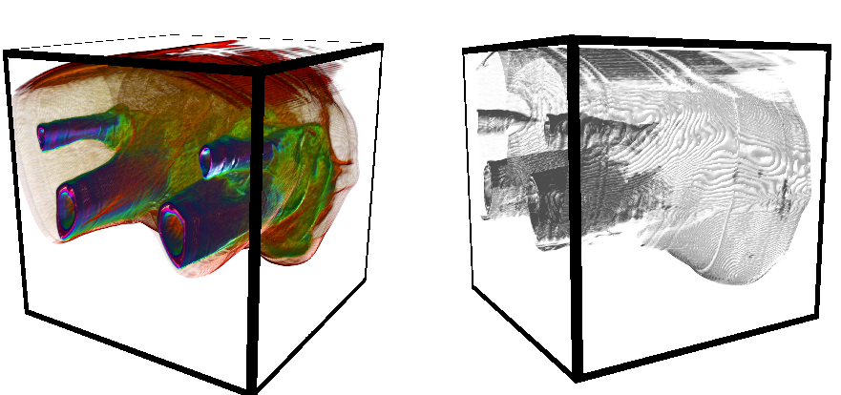
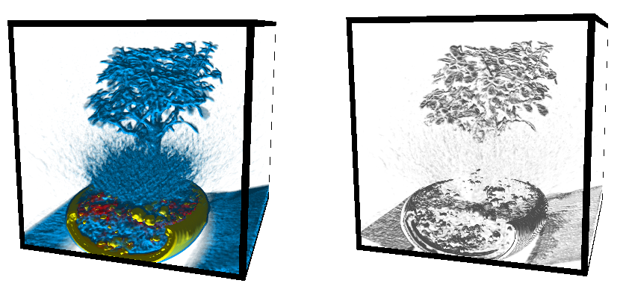
Quantifying Visibility in Volumetric Rendering with Compute Shaders
Student: Michael Stroughair Supervisor: Dr John Dingliana
Introduction
Volumetric Rendering
In Volumetric Rendering applications, understanding what aspects of the data are visible to the user is an important step in optimizing the expressiveness of the image, leading to a better final render.
The aim of this thesis is to design an algorithmic process by which visibility aspects of a Volumetrically Rendered object can be computed in real time. The two taken into consideration within this thesis are the saliency of the data set, and the relative visibility of the individual data points within the final rendered image.
In opposed to rendering a triangle mesh with a constant texture, volumetric rendering samples a 3D point cloud to create a surface representation for texturing. This allows for semi-transparent volumes to be rendered in real time.
Compute Shaders
Running separately to the rendering pipeline, Compute Shaders are a General Purpose shader solution native to OpenGL, allowing for computation work on the GPU through GLSL.
Implementation
Saliency
Main Loop
Each volume is rendered to a framebuffer with separate cameras, and each framebuffer is converted to a texture and mapped to a quad, allowing for independent movement.
GLSL
The Relative Visibility of a point is calculated by casting a ray from the point to the camera position, and sampling along it at the same interval as during the Volumetric Rendering, subtracting the alpha value of the sample from the current value for the point being computed.
The Saliency of a point is calculated by applying a Laplacian filter to the data, revealing gradients of colour intensity.
Saliency refers to how noticeable or important an object is in its surroundings. In the field of Volume Rendering, a material can be given a higher saliency through the opacity and colour values assigned to it.
Evaluation
Each image set depicts the same transfer function but with lower opacity values tied to each material, along with the visibility field associated with the view shown. A darker colour indicates a higher visibility.
M.Sc. in Computer Science
(Interactive Entertainment Technology)
The image sets show the change in the Saliency Field for the same data set but with different transfer functions. A darker colour indicates a more salient area.
Notes:
1

