Slide 1

TATYASAHEB KORE INSTITUTE OF ENGINEERING AND TECHNOLOGY WARANANAGAR- 416 113 Department of Computer Science & Engineering Academic Year (2021-22)

Slide 2
Project Topic :- Digital Shop With Business Analysis Project Guide :- Prof. S .A. Urabinahatti.
Project Members :-
Name | Roll No | Contact No
Ashutosh Sanjay Patil | 139 | 7387977373
Harshwardhan Devdatta Patil | 143 | 8291284209
Sahil Balasaheb Patil | 150 | 7066709051
Saurabh Sanjay Patil | 154 | 9359140472

Slide 3
Project Review - III
Contents –
Introduction
Motivation and Objectives
Literature Review
Problem Scope
Key Points from SRS
System Analysis & Design
Development Environment
Reference

Slide 4
Introduction
Small scale business owners face many problems in terms of business.
We provide facilities like monthly ,quarterly ,yearly sales analysis.
Create Web application that keep records of whole business.
Grow more with low expense with well managed inventory.

Slide 5
Motivation and Objective
Help admin to tackle the problem that they incur in terms of finance and organizing the business.
The business and clients will have a medium in the form of the system so that they can place the order through website.
The overview of the business is also an important aspect that will be covered by the application.

Slide 6
Literature Review
Existing System study-
The system of businesses use traditional techniques and few applications that are separate from each other.
1) The owner use registers to keep the track of information of clients.
2) To manage the finances they usually use registers or store the information in the form of excel sheets
3) To track inventory they use separate registers or different excel sheets
4)Existing system was not feasible to handle. Existing system used traditional techniques to mange and thus made the work tedious.

Slide 7
Literature Review
Proposed System –
We develop a Web application for Small scale business Owner(SP Electricals).
As per the Requirement Customer can Get product information from Website and as per the requirement Customer can Request Order to Business Owner.
As per the Customer Requirement Business owner will provide Products as well as Services and Maintenance
With the help of Software Business Owner can Track their Business Overview.

Slide 8
Problem Statement
Medium-scale enterprises use traditional techniques to organize their data.
Medium Enterprises usually don’t get an insight of the fiscal things using the traditional techniques, using web applications one can get a brief insight of the business.
Some enterprises have multiple outlets so it becomes tedious to manage information in a single place, the application will provide a central system for the entire business

Slide 9
Project Scope
Functional deliverables :
Login & registration for users.
Provides New Platform for small scale business owners.
Establish Connection with customers.
Provide Statistical Report.
Functional Boundaries :
Admin have to add products and product stock Manually.
No Delivery system provided by us.

Slide 10
Key Points of SRS
All necessary technology exists to develop the system.
This system is too flexible and it can be expanded further.
This system can give guarantees of accuracy, ease of use, reliability and security of In data.
This system can give instant responses to inquire. Our project is technically feasible because all the technology needed for our project is readily available.

Slide 11
System Analysis & Design
Block Diagram –

Slide 12
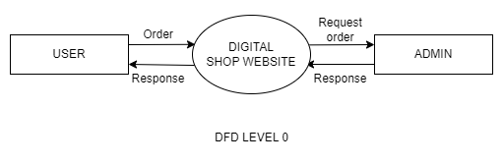
DFD Level 0:-

Slide 13
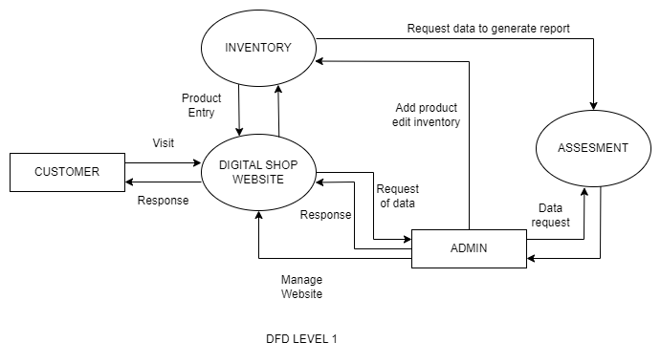
DFD Level 1:-

Slide 14
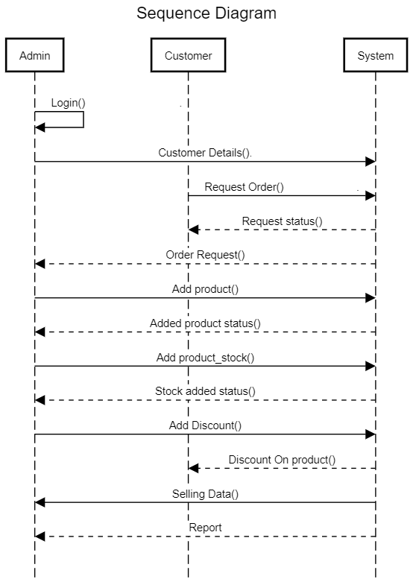
Sequence Diagram –

Slide 15
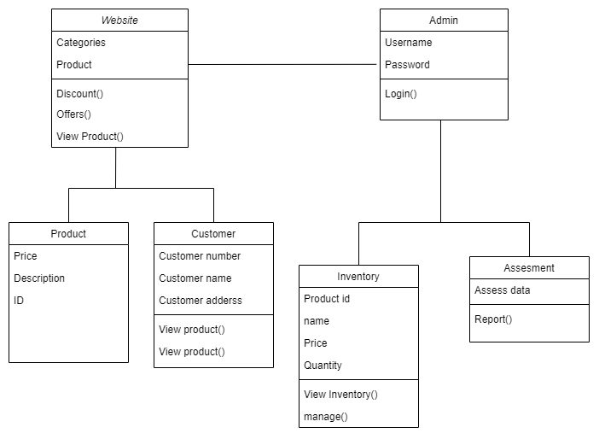
Class Diagram -

Slide 16
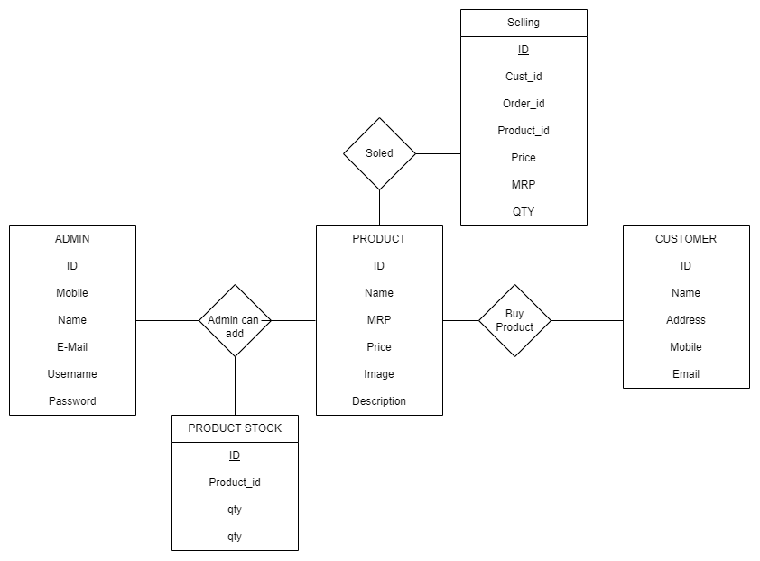
E-R Diagram-

Slide 17
Development Environment
Software:
Scripting Language:
HTML 5
CSS 3
PHP
Java Script(For Validation Only)
Code Editor:
VS Code
Hardware:
Operating System: Windows 7/8/8.1/10
Memory (RAM): 1 GB of RAM
Hard Disk Space: 250 MB of free space required for full installation.
Processor: 1.6 GHz or faster processor

Slide 18
References
• Websites:
• URL: https://www.php.net/manual/en/
• Description: PHP Documentation.
• URL: https://www.w3schools.com/mySQl/default.asp
• Description: Reference for MySql.
• URL: https://getbootstrap.com/docs/5.2/getting-started/introduction/
• Description: Bootstrap Framework documentation.
• URL: https://www.javatpoint.com/css-tutorial
• Description: Reference for CSS.

Slide 19
Thank you !

