Slide 1

Team-Ground 0

Slide 2
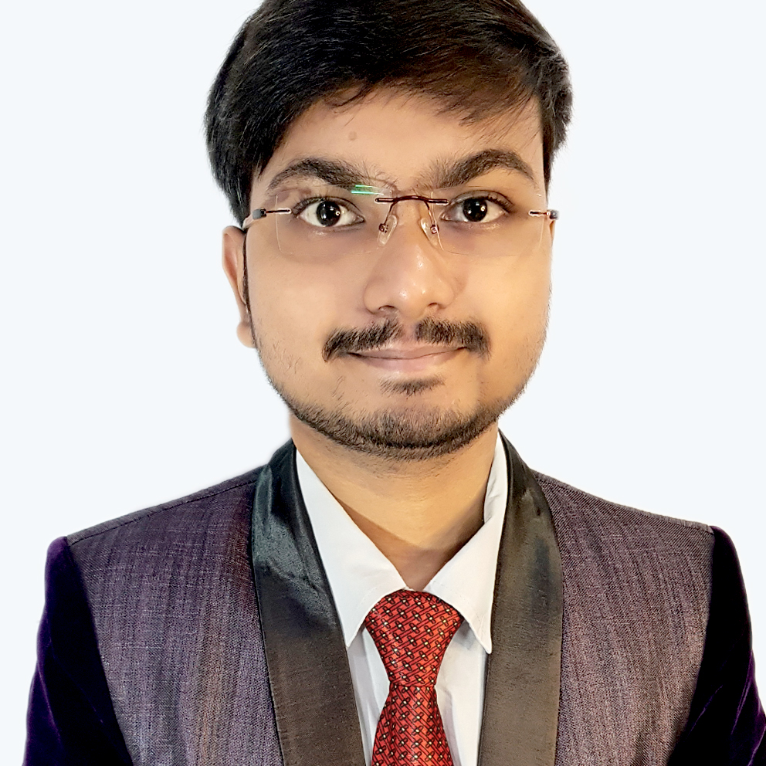
MD INZAMAMUL HAQUE
It's the little things that matters!

Slide 3

Darshil Kantariya
I stand for social causes and believe in making small efforts that matters

Slide 4

Yuvraj Devnani
Let's make life easy for people around us!

Slide 5
Our project in Open innovations

Slide 6
P
R
O
J
E
C
T
I
D
E
A
To help the Local business to grow and thrive as they used to be before the days of Amazon and flipkart.
We want to support VOCAL FOR LOCAL campaign of Made In India and therefore we want to help our local businessmen to scale up online. We want to provide them website which is user friendly and easy to use. Just create your profile, upload your goods and wait for your orders. Ah! Website link is tough to remember , no issues print the QR and share it.
We strongly believe that they still hold the same value.
For online retailers, promotion for the event is only half of the story. Without a solid technical foundation allowing the website to handle peak traffic spikes, promotion efforts go to waste.

Slide 7
Today the ecommerce has scaled to great heights thanks to websites like Amazon and flipkart.
But this has affected the local business a lot. I am a son of a shopkeeper and during this covid times when the sales were at its lowest I saw the worries of it reflected on my father's face. I knew we sold FMCG's which can never be an undesirable item but still our sales were affected. We could deliver it at much less time than online businesses. Then I had this idea that since people want to buy things at the comfort of their home why not build a website for this? But same is the case with so many others, so the question is how we can solve it?
So we came up with this idea of a website where the customers can go and look for the closest shop near them or may be their favourite shops and buy their stuff from there.
The other way is also possible that if they are looking for a product they can simply get the list of all the shops that have the same product and they can buy the cheapest ones.
Now we see that foods are easily delivered which also requires preparation time then why not these goods which does not need any processing time?
BACKSTORY

Slide 8
-We will be using HTML, CSS and JavaScript to build our website.
-We will also integrate payment gateways preferably Razorpay as we progress

Slide 9
GOALS
01
Website Up and running
Backend data base made ready to use to upload user profiles
02
03
Solve the security concerns
Provide the solution for audit the failed payments or customer grievances
04
05
Scale the business by approaching shopowners
Hurray! We did well
06

Slide 10








Team Zero
Not exactly, Same business exists but we have e-commerce business like amazon and flipkart. The problem with them is the large delivery times and low support to local shop owners. While our idea is about a tailored business to our own local needs.
HURDLES
CREATIVE VENUS
To solve

Slide 11
SOCIAL
IMPACT
UNIQUENESS
- We aim at Promoting VOCAL FOR LOCAL
- This idea is self- scalable as the shopkeeper themselves creates their profile and uploads their goods to be sold. We are providing him a medium
- The above makes our profile user friendly
- The promotion of our website will be done just by printing our QR and displaying it for scans
- For the delivery the shopkeeper has the option to either deliver it themselves or to use services like Zomato Genie etc
- The best part is we are assuring the customers of available product and shopkeeper are able to display what they sell because in business world- JO DIKHTA HAI WO BIQTA HAI
- Time saving because the products are coming from nearby
- Competitive pricing
- Availability at fingertips and assurance of faster delivery.
We are just the medium for them to thrive

Slide 12
CHALLANGES
- Database performance bottlenecks in the inventory system.
If the database isn’t functioning properly and these calls are not delivered at the speed of the requests, orders could get mixed up. Your web application could sell the same item of inventory multiple times.
Controlling the website traffic and throughput based on the locking mechanism’s operating speed is the only way to safeguard against the massive influx of customers attempting to reserve inventory of limited or deep-discount items.
- Payment gateways overheat from the sharp increase in transactions

