Slide 1
Manipal Shop Management System

Slide 2
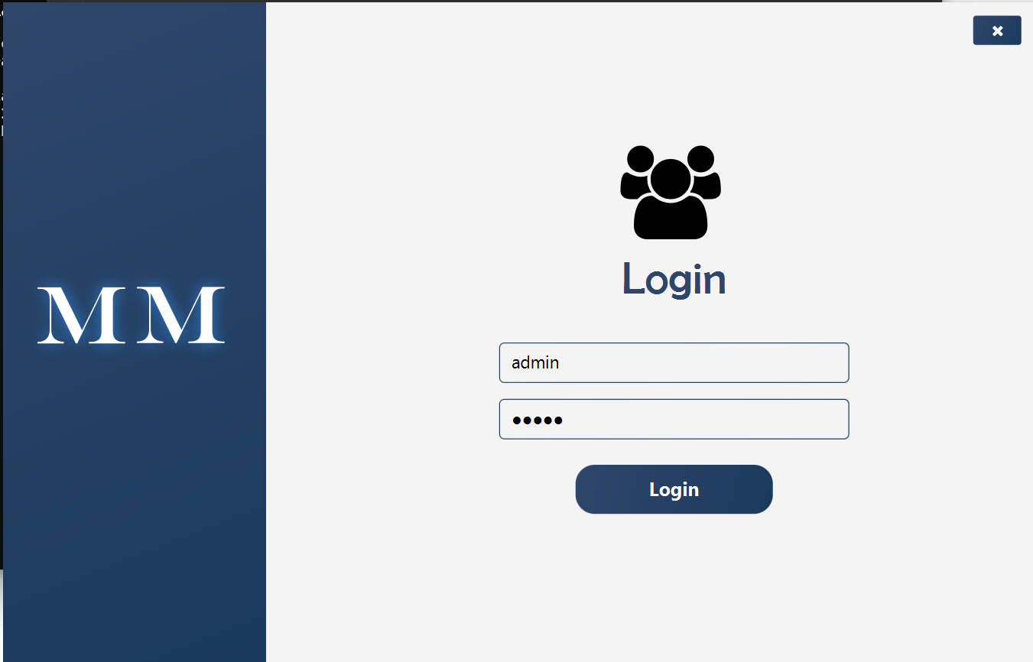
1. User Login Page

Slide 3
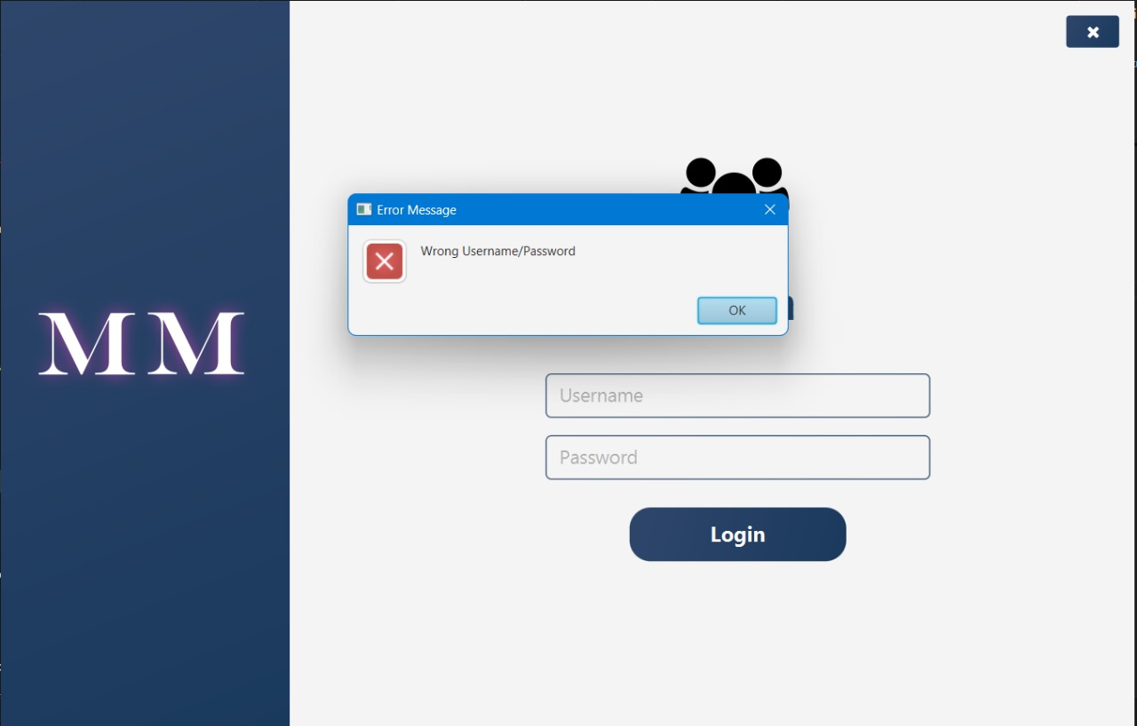
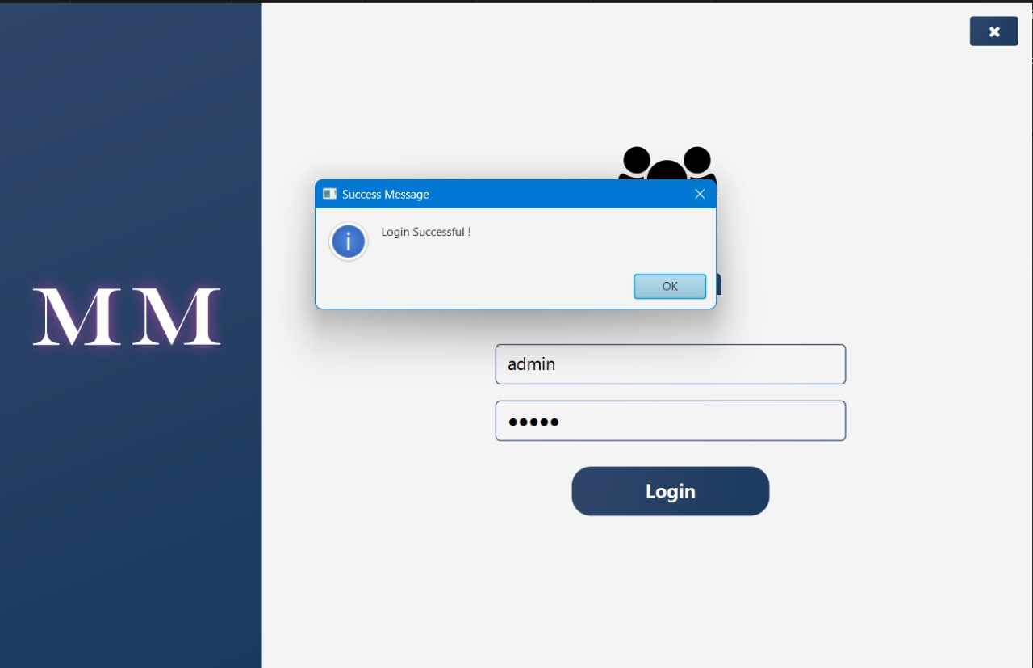
The two possibilities generated on logging in the application

Slide 4
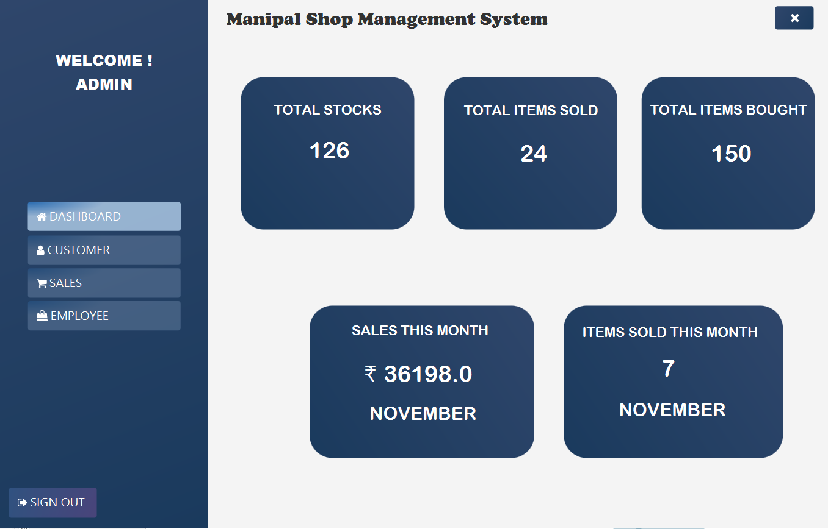
Dashboard gives us the idea of the inventory available and the sales data

Slide 5
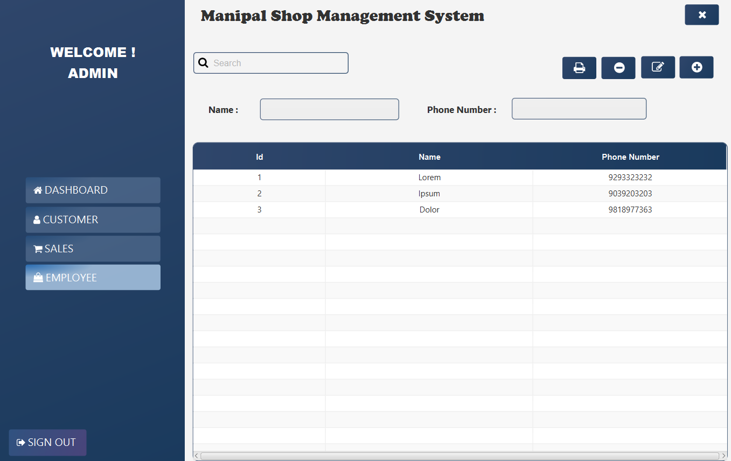
Employee Data

Slide 6
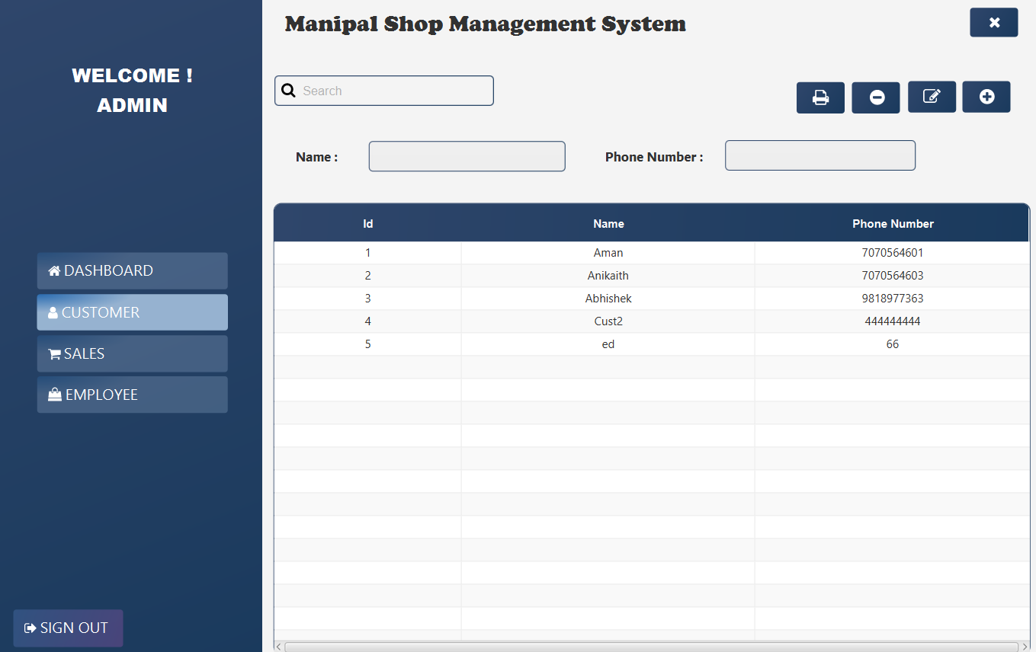
Customer Data

Slide 7
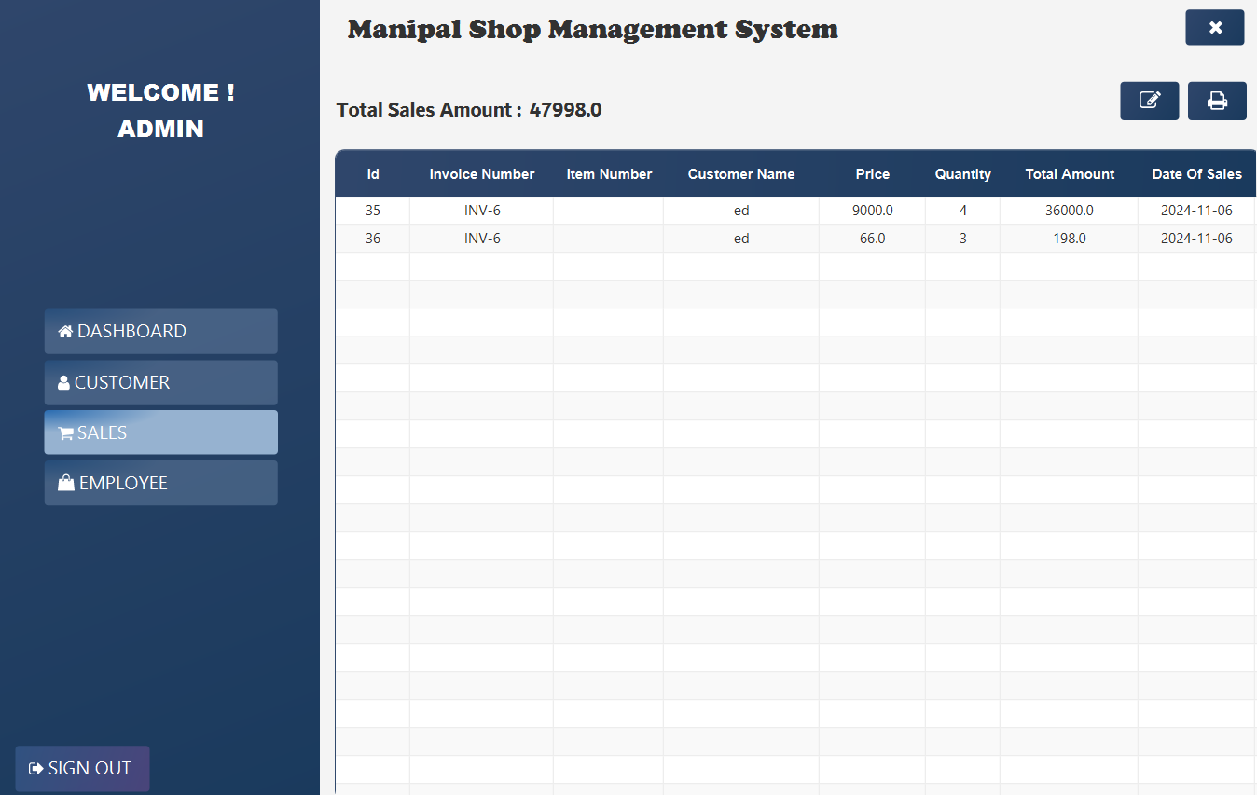
Sales Data

Slide 8
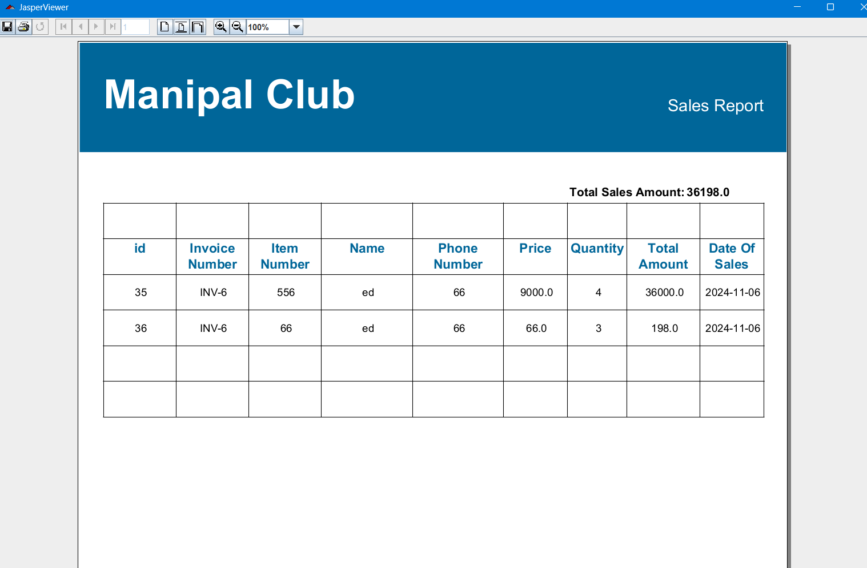
Sales Information

Slide 9
Concepts Used:
Generics to store Customer and Employee information before putting in database.
Threading to control database use.
Exception Handling – If no login details then alert Other basic Java concepts.
Plugins used:
Maven Shade Plugin
Jdbc controller to connect with Sqlite Database.
Jasper Reports to generate pdf
Maven javafx control plugin

Slide 10

Thank You

