Slide 1
EMBEDDED_RR
CSS 427 UWB Robert Griswold & Ryu Muthui 12/09/2016

Slide 2
Project Overview: Wireless Rover Navigation
2 Motorized Rovers: Master: With sensors.
Uses the sensors to navigate a line path.
Saves the navigation info and sends to Slave. Slave: No sensors.
Executes navigation info from master.
Sends statistical information when done.

Slide 3
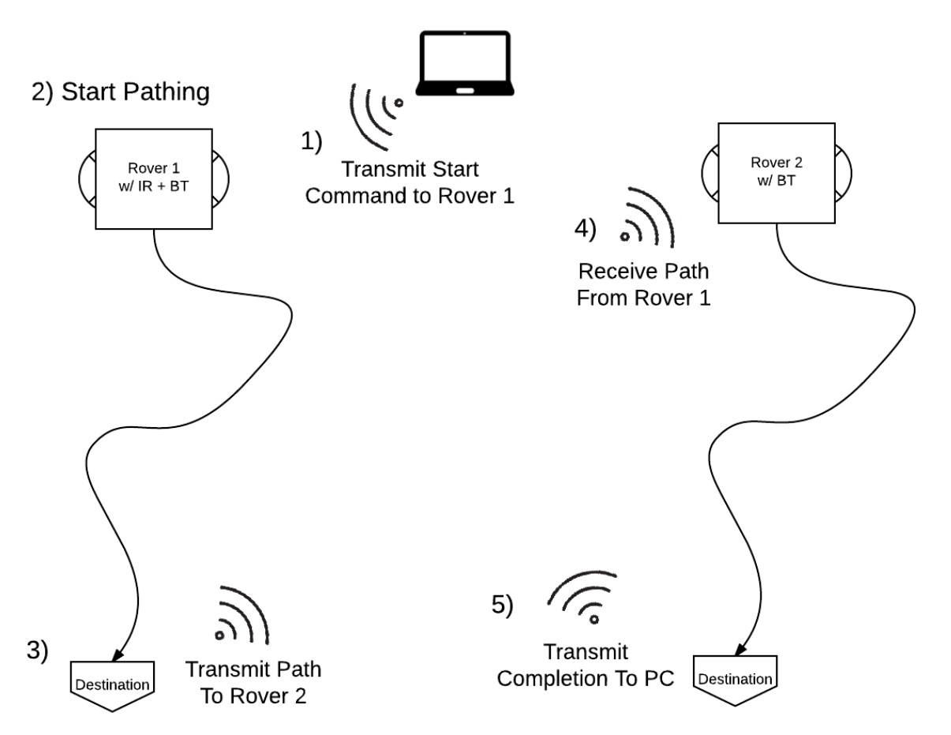
Overview: Cont.

Slide 4
Division of Work
Robert Griswold
State Machine (12.5%)
Communication Library (37.5%)
Libxbee Integration (12.5%)
Ryu Muthui
Sensor Library (12.5%)
Motor Library (12.5%)
Lights Library (12.5%)

Slide 5
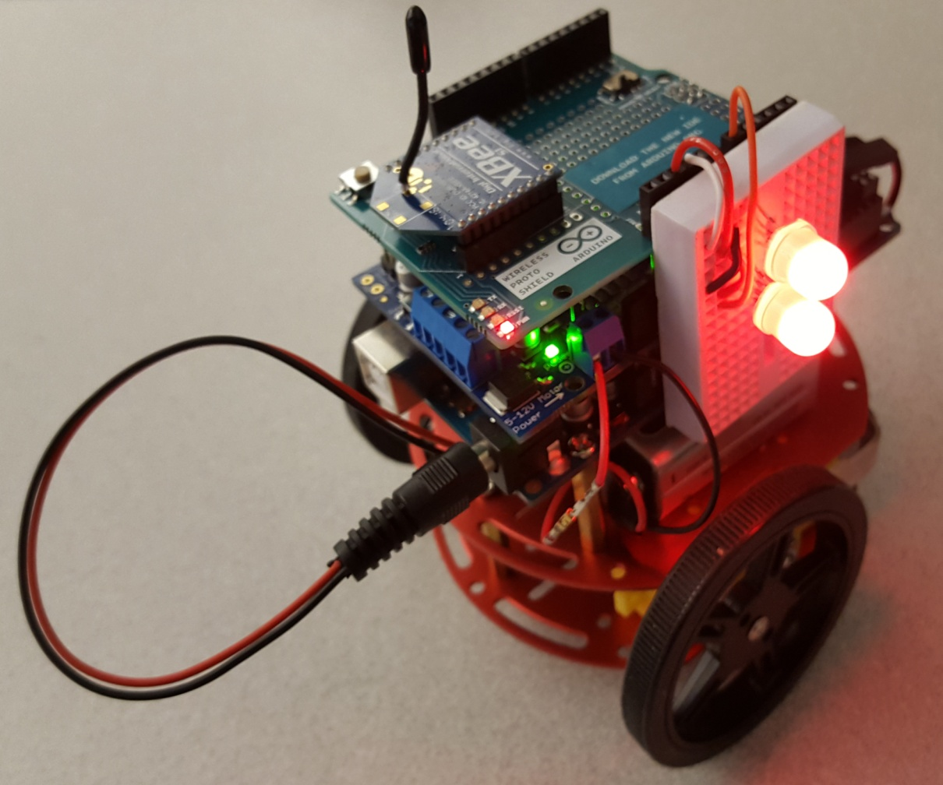
System Components:

Slide 6
System Components: Pricing
Stackable Headers 0.50 x 8 = $ 4.00
9v Battery Connectors 0.69 x 4 = $ 2.00
Infrared Line Sensors 2.95 x 4 = $11.80
LED RGB Addressable 5-pack 2.95 x 1 = $ 2.95
Mini Breadboards 3.99 x 2 = $ 7.98
9v Batteries 10-pack 10.00 x 2 = $20.00
Breadboard 10.00 x 1 = $10.00
XBee Shields 14.95 x 2 = $29.90
Rover Chassis Kits 19.99 x 2 = $39.98
Arduino Motor Shields 19.95 x 2 = $39.90
XBee Explorer USB 24.95 x 1 = $24.95
XBee Series 1 24.95 x 3 = $74.85
Arduino MEGA 2560 Boards 45.95 x 2 = $91.90
Accelerometer + compass 14.95 x 1 = $14.95
Total (approximately): $375.16

Slide 7
System Behavior:
Master reads sensor data, processes it to power settings, sets its own motors, and encodes navigation data for transmission.
Slave decodes navigation data, enqueues it, and executes based on the packet timestamp.
Modeled after a Finite State Machine to continuously work as long as there is good sensor data.

Slide 8
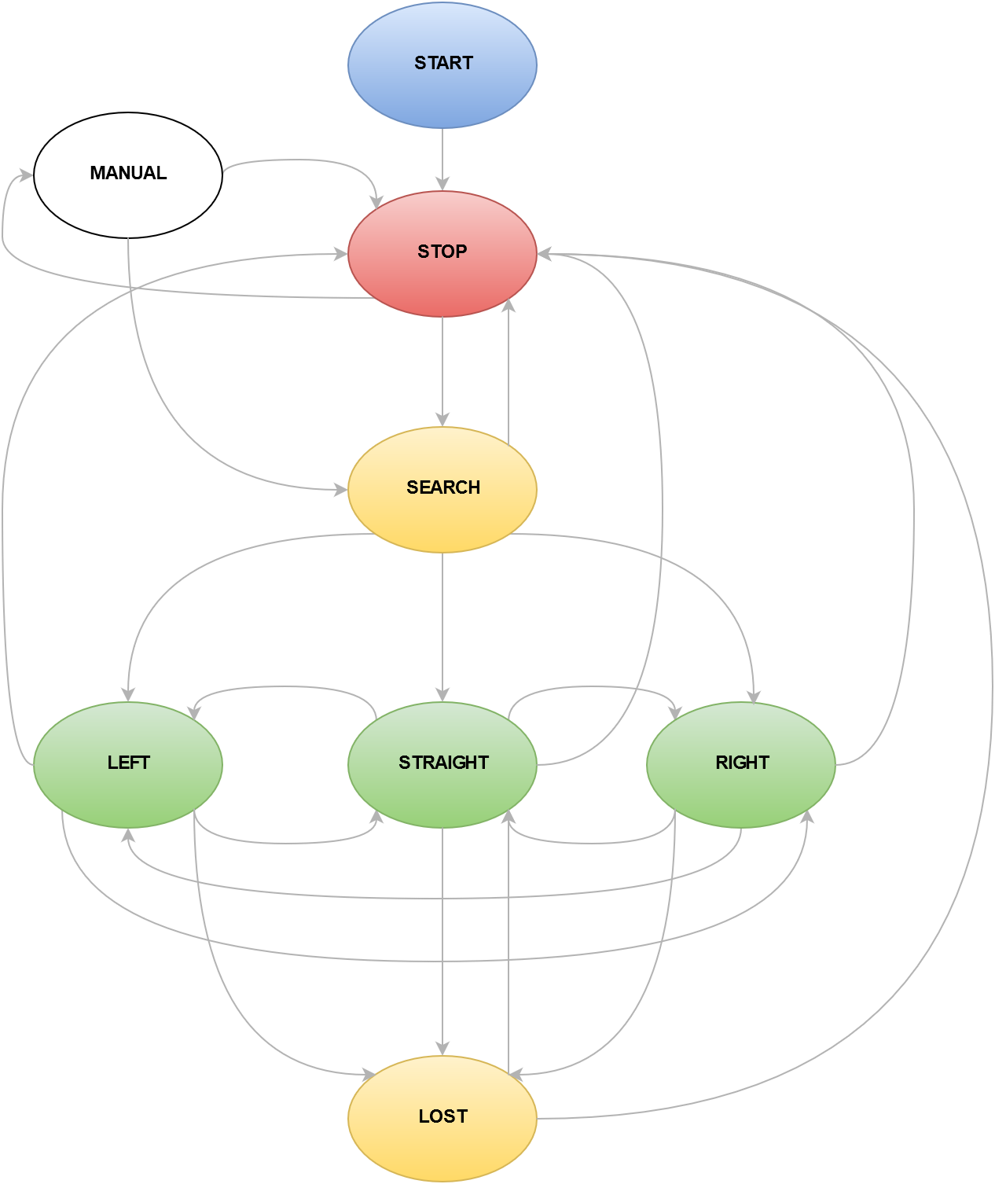
System Behavior: Master Rover

Slide 9
System Behavior: Master Rover
Stop State
Accepts any command.
Search State
Establishes an outer threshold after line is found.
Accepts stop, e-stop, and sensor requests.
Straight/Left/Right/Lost
Continues in a direction of the line.
Accepts stop, e-stop, and sensor requests.
Manual
Accepts any commands but may be moving.

Slide 10
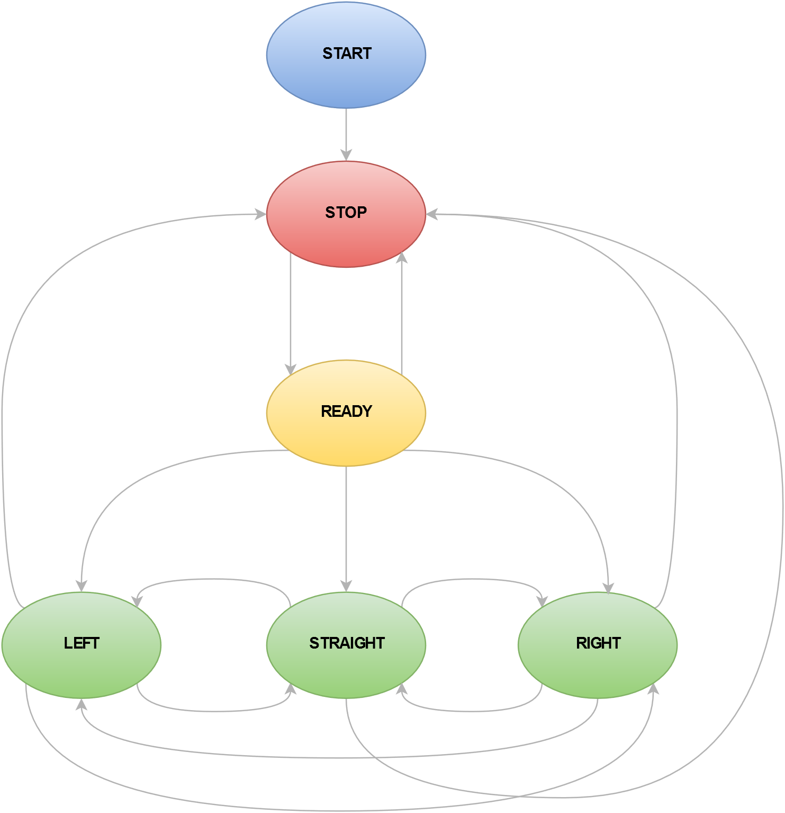
System Behavior: Slave Rover

Slide 11
System Behavior: Slave Rover
Stop State
Accepts any commands except follow.
Ready State
Continues enqueuing packets.
Accepts any command.
Straight/Left/Right
Checks queue for timestamped state transitions.
Accepts stop, e-stop, and sensor requests.
Manual
Accepts any commands but may be moving.

Slide 12
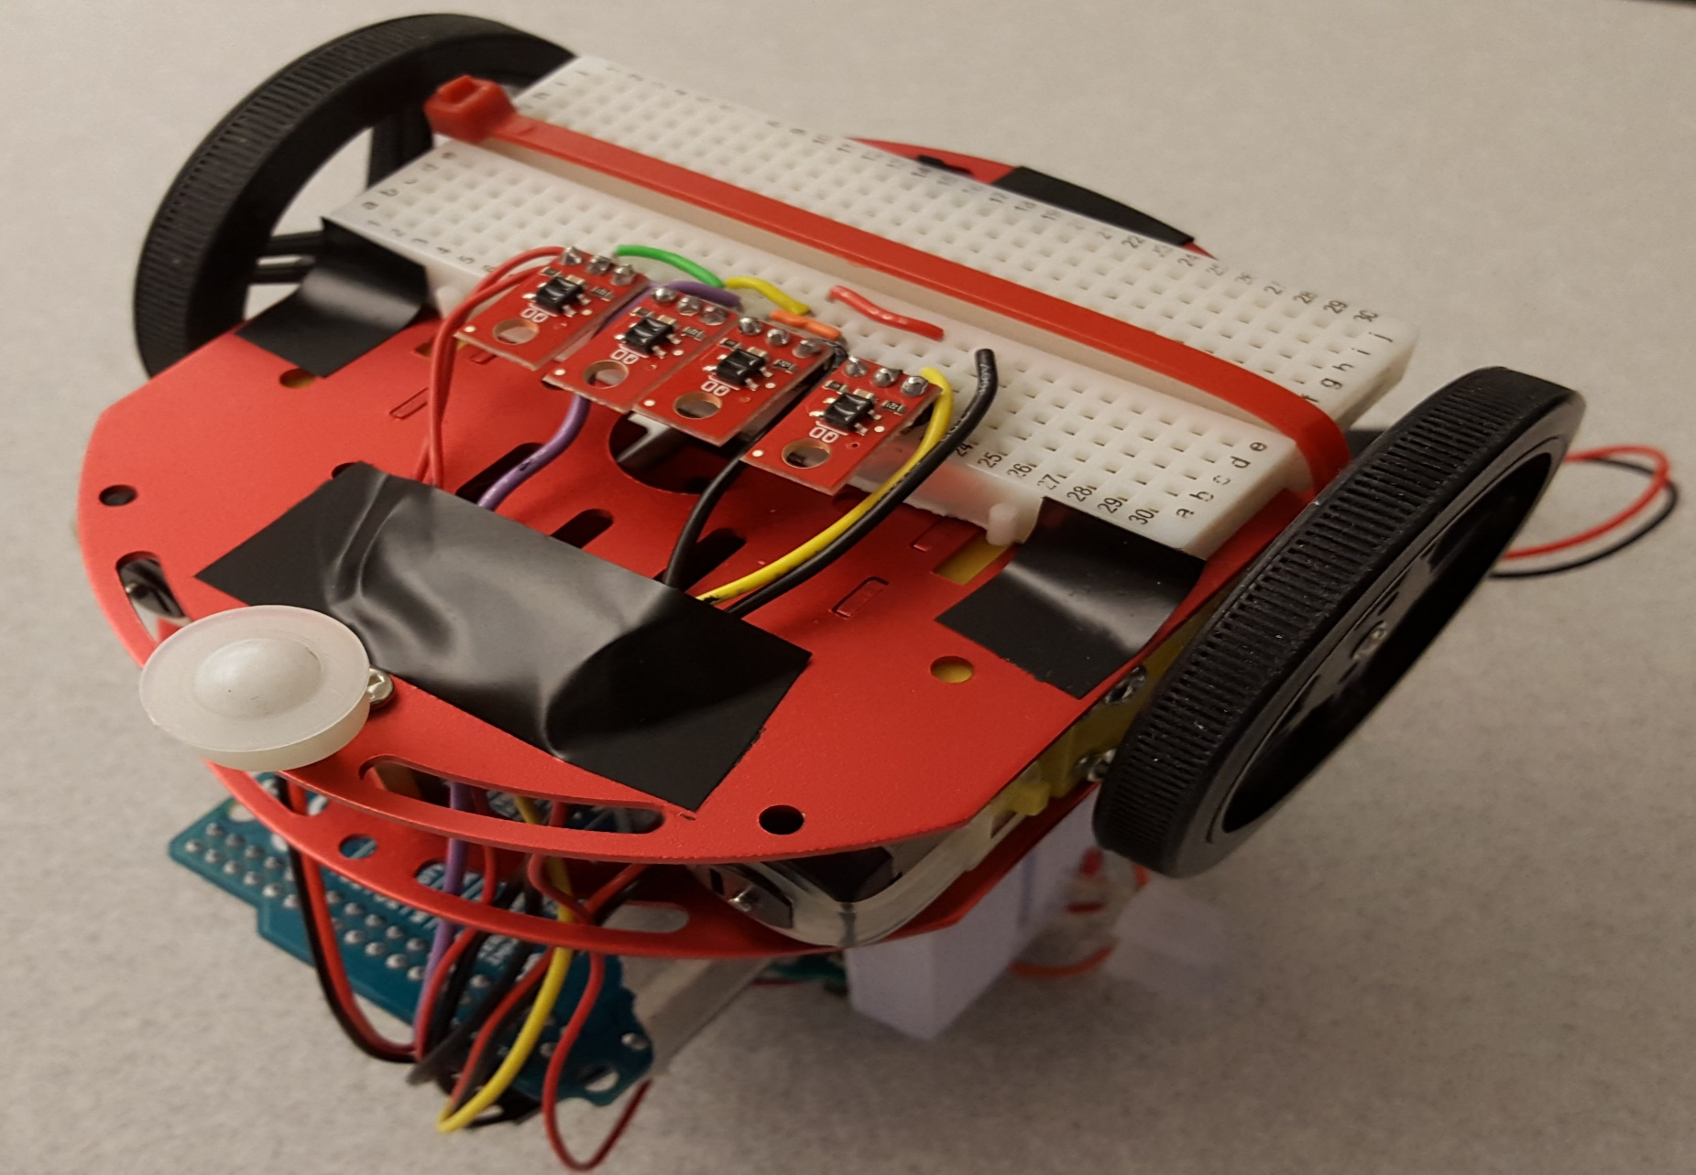
Sensors: IR Sensors

Slide 13
Sensors: IR Sensors Cont.
// sensor_getSensorVals() -- Get all current sensor values
void sensor_getSensorVals(int *arrSensorVals) {
arrSensorVals[0] = sensor_readSensorAt(IR_LL);
arrSensorVals[1] = sensor_readSensorAt(IR_L);
arrSensorVals[2] = sensor_readSensorAt(IR_R);
arrSensorVals[3] = sensor_readSensorAt(IR_RR);
} int leftDiff = arrSensorVals[0] - arrSensorVals[1] ; // outer - inner
...
case STATE_STRAIGHT: // moving forward // if left diff is greater, steer left
if (leftDiff > THRESHOLD && leftDiff < outlierThreshold) { enterLeftState();
}

Slide 14
Sensors: Magnetometer
// Get a new magnetic sensor direction (I2C) - Only Demand Only
sensors_event_t event;
s_mag.getEvent(&event);
x = event.magnetic.x;
z = event.magnetic.z;
z -= MAG_STR / 2; // East <0-Z-45> West
x -= MAG_STR / 2; // South <0-X-45> North
if (abs(z) > abs(x)) {
if (z >= 0) // West …
else // East …
} else {
if (x >= 0) // North …
else // South …
}

Slide 15
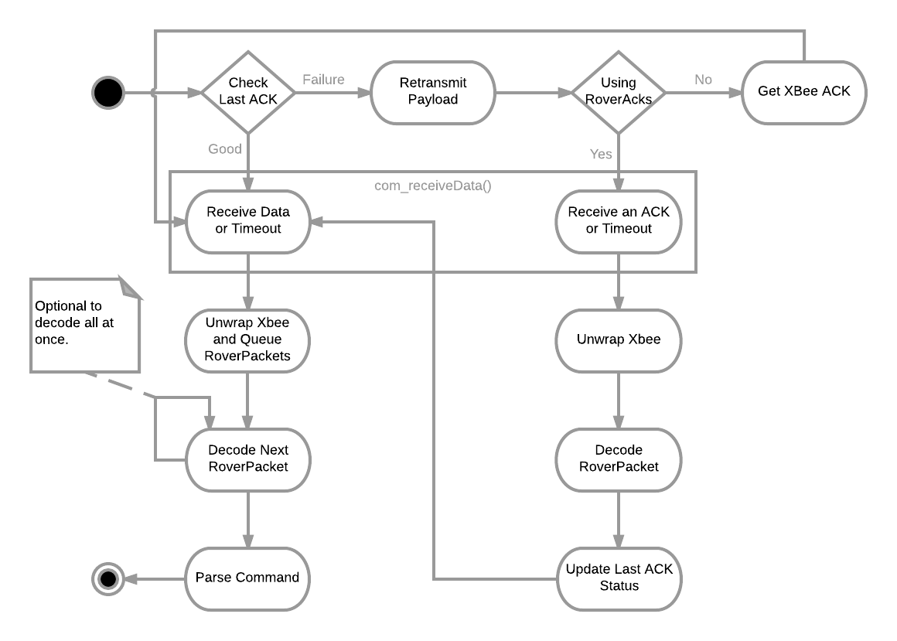
Communication: Sequence

Slide 16
Communication: Rover Packet
Byte 0 | Byte 1 | Byte 2 | Byte 3 | Byte 4 | Byte 5 | Byte 6
Time 0-7 | Time 8-15 | Time 16-23 | Time 24-31 | DataL 32-39 | DataL 40-41 DataR 42-47 | DataR 48-51 Cmd 52-55
Unsigned Long (32-bit)
7 Bytes in Length (12 Fit in Largest Payload).
DataL and DataR are only 10-bits in length, dropping 6 bits of data.
Data is treated as signed, using the 10th bit 10 as the sign bit when encoding/decoding.
Value range from -512 to 511.
Short (10-bit) | Short (10-bit) | Char

Slide 17
Communication: Rover Cmds
Timestamps with 0 are dropped.
Use FFFFFFFF time for general commands.
0000 (0x0) | Emergency Stop | 1000 (0x8) | Mag Sensor Data
0001 (0x1) | Slow Stop | 1001 (0x9)
0010 (0x2) | Forward | 1010 (0xA) | Navigation Data/ACK
0011 (0x3) | Backward | 1011 (0xB) | Packets Encoded/Decoded
0100 (0x4) | Turn left 90 | 1100 (0xC) | Msgs from Master/Slave
0101 (0x5) | Turn right 90 | 1101 (0xD) | Msgs to Slave/Acks from Slave
0110 (0x6) | Start Search/Follow | 1110 (0xE) | Msgs to Master/Acks from Master
0111 (0x7) | IR Sensor Data/Request | 1111 (0xF) | Failed Encodes/Packets Queued

Slide 18
Additional Installments:
Dual LED Lights to display states of rovers:
Blue: START + Received Packet (Flash)
Red: STOP
Yellow: SEARCH / LOST / READY
Green: STRAIGHT
Y + G: LEFT
G + Y: RIGHT
Purple: Emergency Stop (Flash)

Slide 19
Additional Installments:
Manual Control of Rovers:
Forward
Backward
Left
Right
Start Search / Follow
Sensor Reading (Anytime)
Slow Stop (Anytime)
Emergency Stop (Anytime)

Slide 20
Additional Installments:
Console Application for Rover Control
Receives any data transmitted and decodes them as rover packets to be human readable.
Executes any command to either rover.
Sequences commands from user as a character stream, one command at a time per second.
Retries cmd when Xbee/RoverPacket Acks fail.

Slide 21
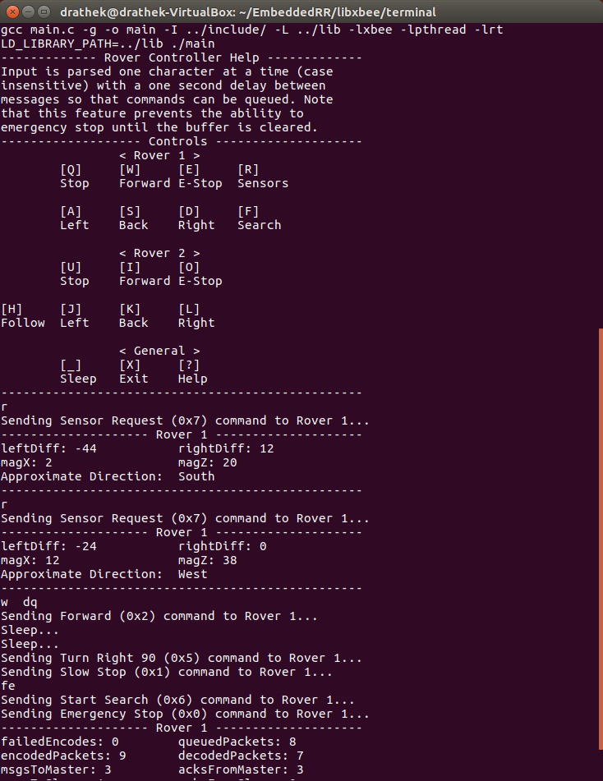
Rover Control: Help

Slide 22
Rover Control: Requests

Slide 23
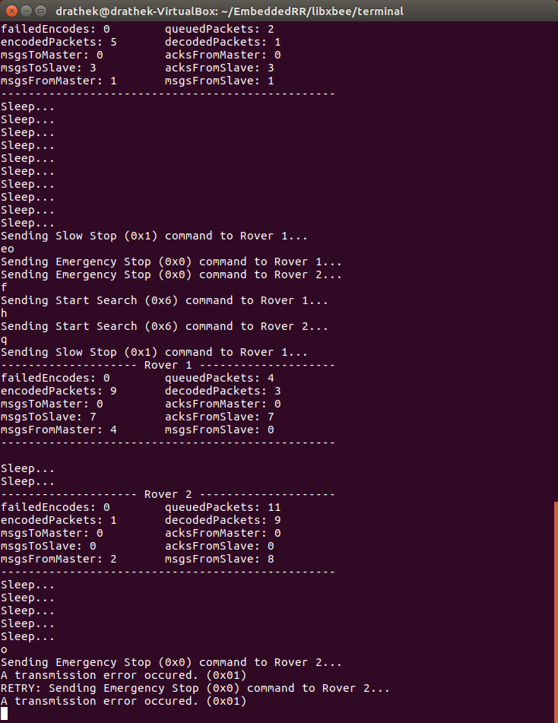
Rover Control: Stats & Retry

Slide 24
Limitations and Exceptions
Hardware:
Battery Power
Inconsistent Motor Power
Weight - Lighter on slave rover
Low clearance on master rover (Sensor Array)
Code:
Memory size for local variables (QueueArray of RoverPackets)
Stack Overflow at approx. 513 RoverPackets

Slide 25
Questions?
???

Slide 26
Credits
Arduino XBee Library (Andrew Rapp)
Arduino QueueArray Library (Efstathios Chatzikyriakidis)
Arduino Adafruit_MotorShield Library
Arduino Adafruit_Sensor Library
Libxbee - C/C++ Library (Attie Grand)
Professor Yang Peng

