Slide 1

Presented By : BISWAJIT SASMAL
Date : 14th February , 2026

Slide 2
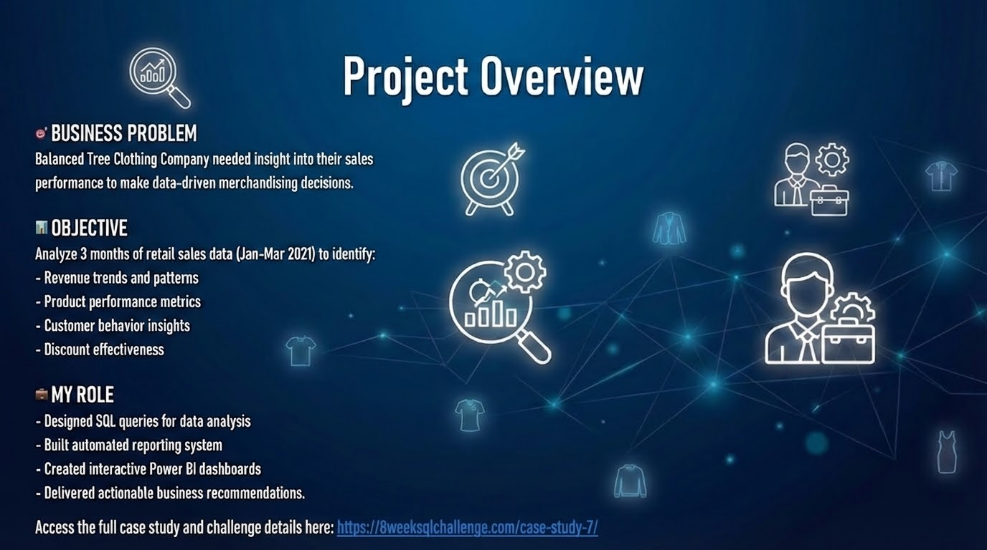

Slide 3
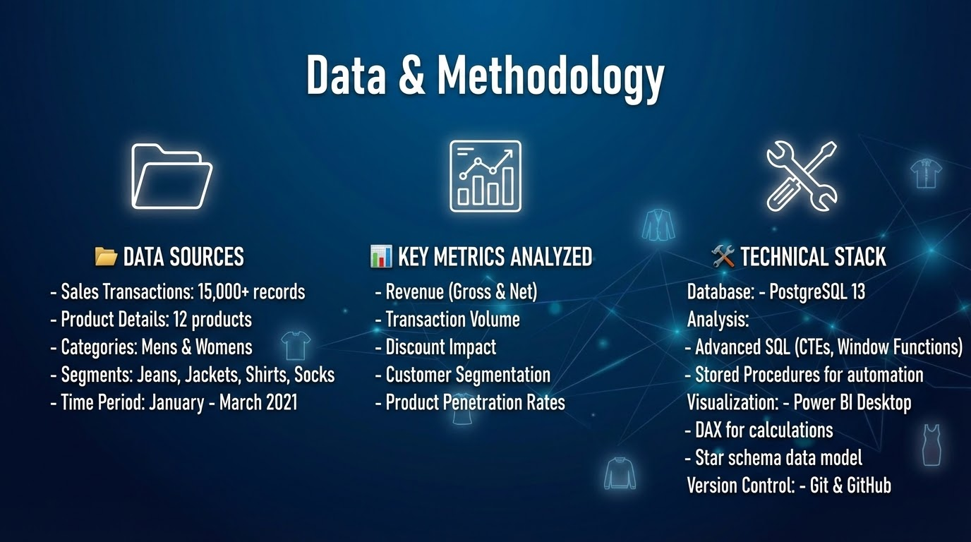

Slide 4
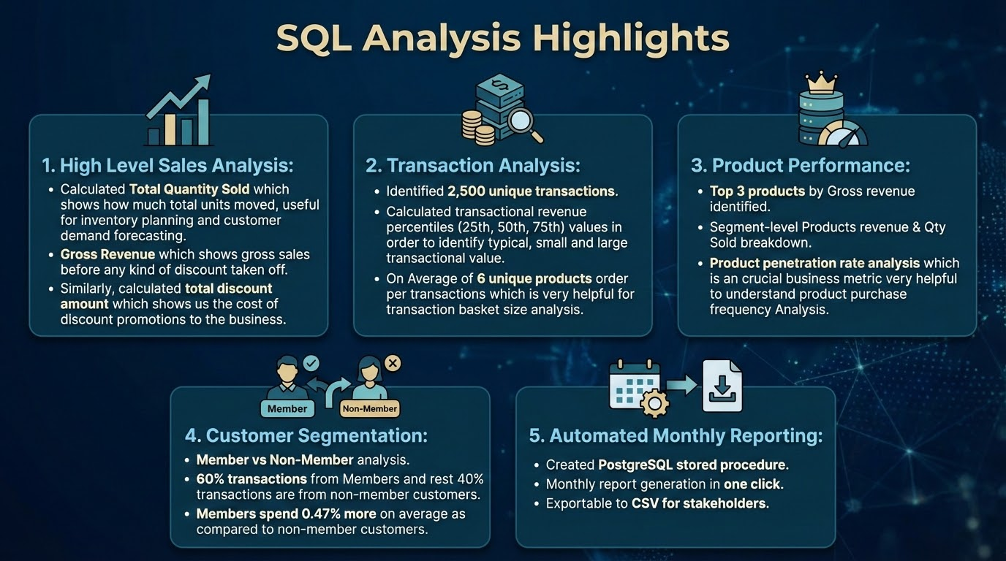

Slide 5
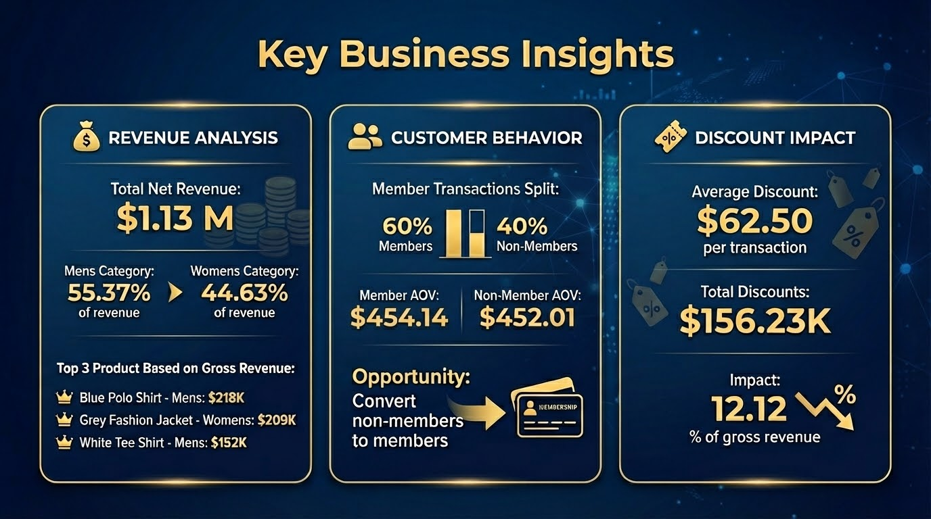

Slide 6
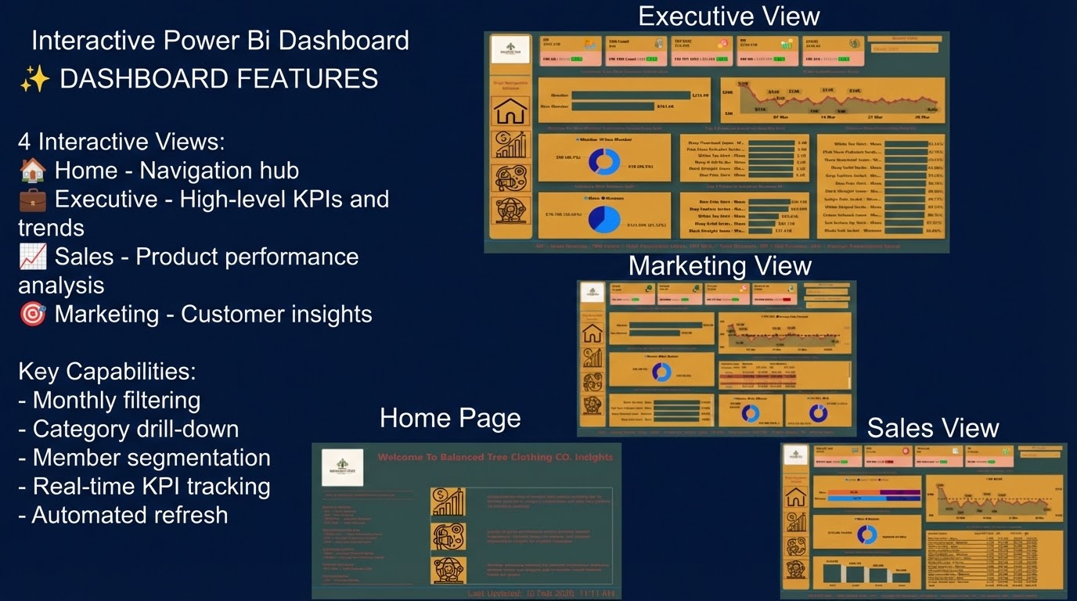

Slide 7
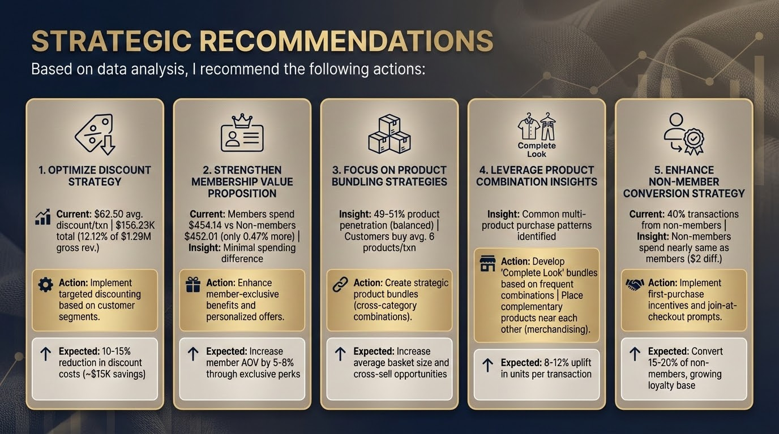

Slide 8
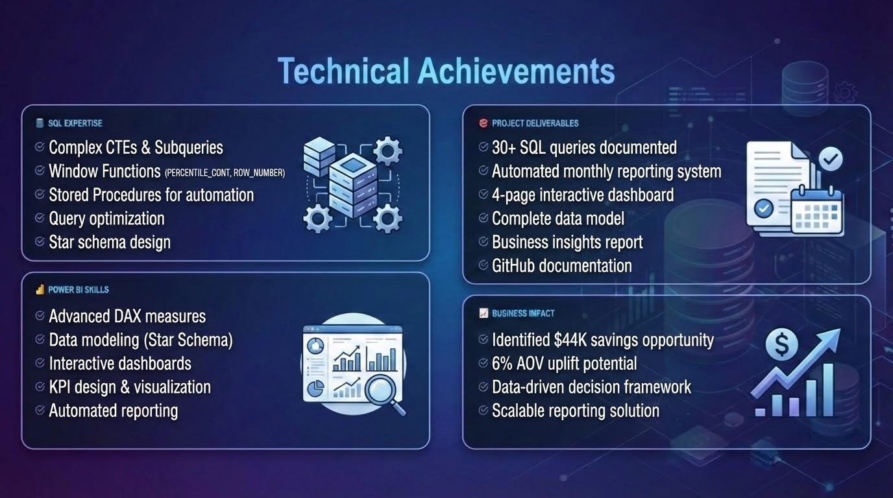

Slide 9
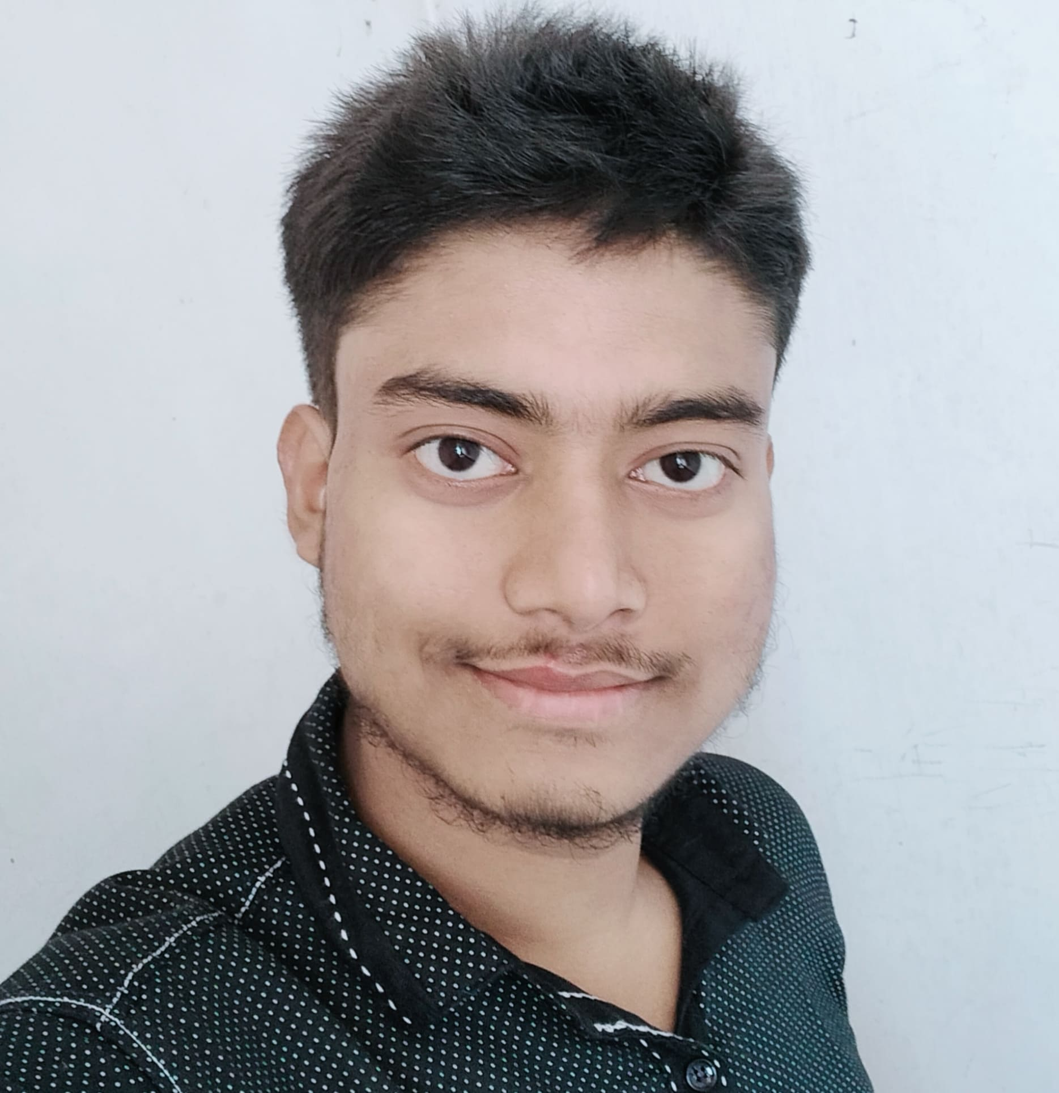



Thank You
BISWAJIT SASMAL
Aspiring Data Analyst
Connect With Me

