Slide 1

SMART INDIA HACKATHON 2026
Problem Statement ID – 26025
Problem Statement Title - Development of an AI-enabled Low Cost Real Time Mine Subsidence Monitoring, Prediction and Early Warning System for Underground Coal Mines in India
Theme – Disaster Management
PS Category- Hardware
Team ID-
Team Name : Bit Masters

Slide 2

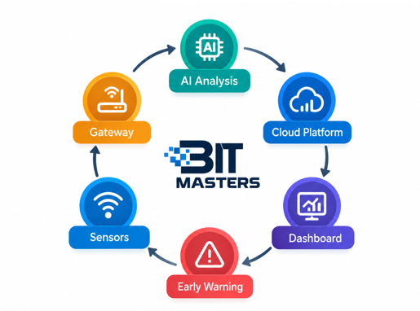
IDEA TITLE
Current Problems
Difficult to monitor mine subsidence continuously in real time
Early ground deformation may go undetected
Existing monitoring can be costly and periodic
Delayed detection can increase safety risks
Our Idea
Low-cost IoT sensor nodes for continuous monitoring
LoRa communication for long-range, low-power data transmission
Monitor tilt, vibration and ground movement
Real-time dashboard for monitoring and visualization
Early warning alerts for potential subsidence

Slide 3
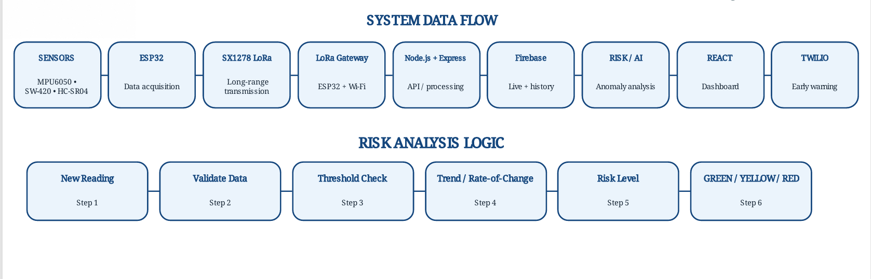
TECHNICAL APPROACH

Slide 4
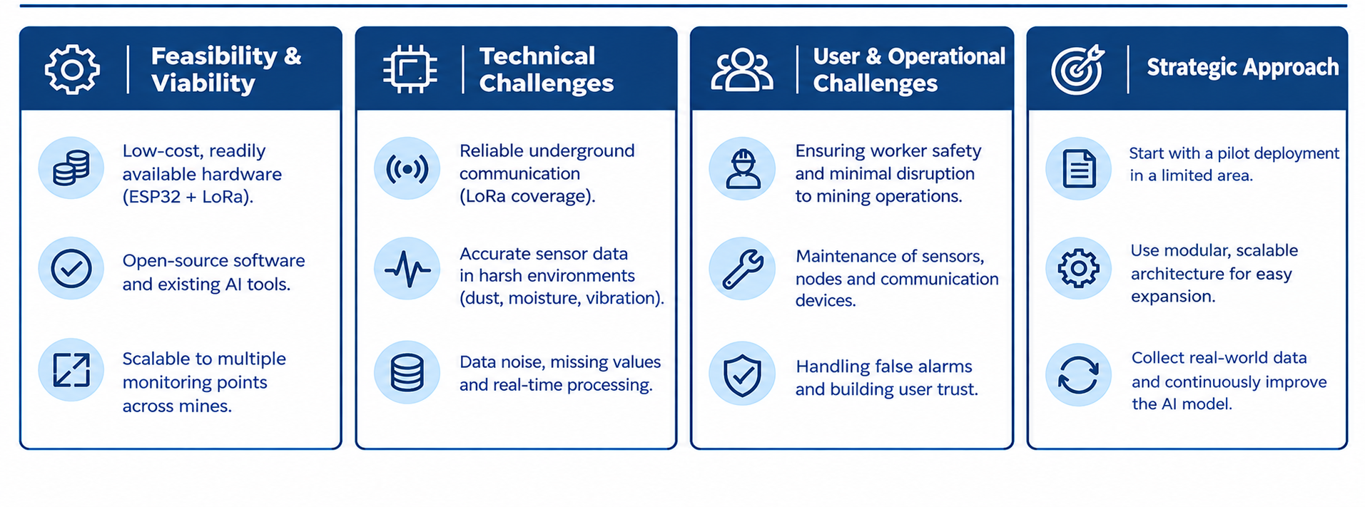
FEASIBILITY AND VIABILITY

Slide 5
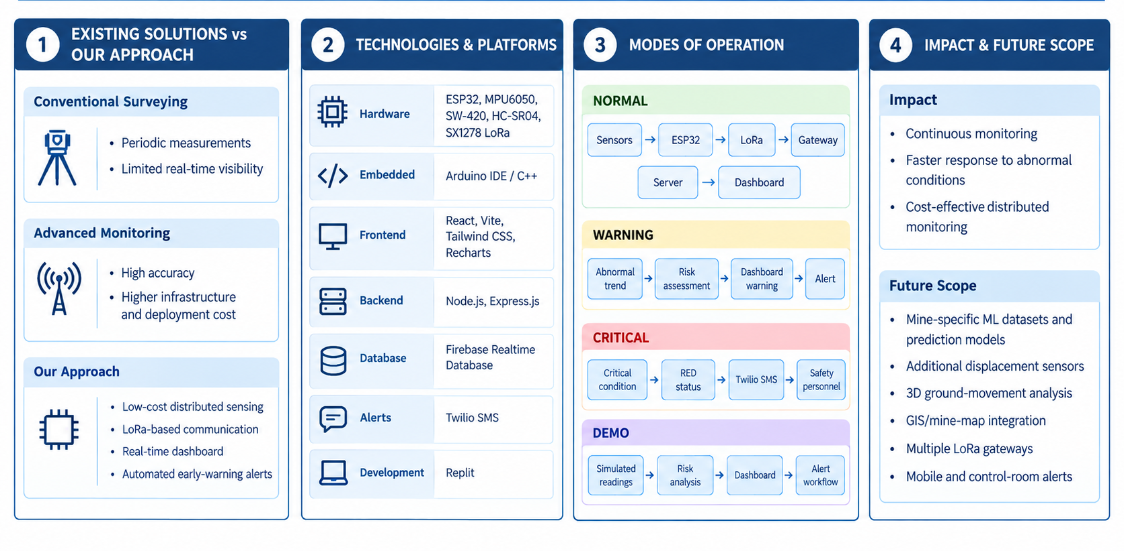
IMPACT AND BENEFITS

Slide 6
RESEARCH AND REFERENCES
IoT & LoRa-Based Underground Coal Mine Monitoring — Microsystem Technologies, 2023
Research Paper
LoRa Communication for Underground Coal Mines — Processes, 2023
Research Paper
LoRa-Based IIoT Network for Coal Mines — IEEE Access, 2024
Research Paper
IoT/LoRaWAN Wireless Sensor Networks for Mine Monitoring — Sensors, 2024
Research Paper
Technical References: ESP32 • MPU6050 • SX1278 LoRa • Firebase • React • Node.js/Express • Twilio
Research Foundation:
Sensors → LoRa → Data Analysis → Dashboard → Early Warning

