Slide 1
IBM University Engagement Project Submission
“Exploring the Power of Agentic AI with IBM Granite and LangFlow”

Slide 2

Project Tile – College Admission Agent ( RAG Based )
Domain of Project – Education
Student Name | Recent Passport Photo | Email ID | Mobile number [WhatsApp]
Aman kumar |  | nothingusual04@gmail.com | 9135132774

Slide 3
Problem Statement -
Problem Statement : College Admission Agent
The Challenge
During peak intake cycles, administrative support networks face a massive influx of repetitive operational inquiries from students and parents, creating severe friction. Critical data like eligibility percentages and Tuition Fee Waiver (TFW) rulesare buried deep inside lengthy, dense PDF policy files that applicants struggle to navigate. Standard AI chatbots fail to solve this because they rely purely on raw foundational knowledge; when asked specific local questions, they hallucinate false fees, wrong dates. This leaves institutional helpdesks completely overwhelmed with redundant manual queries, creating massive processing queues and critical support delays during strict verification deadlines.
The Objective
The primary objective of this project is to deploy an automated, reliable, and intelligent helpdesk solution that streamlines the chaotic government college admissions process for students and administrators. Core Project Goals:-
Automate High-Volume Inquiries: Provide instantaneous, round-the-clock support to students and parents regarding complex eligibility rules,
branch cutoffs, and uniform fee structures.
Eliminate AI Hallucinations: Use a rigid Retrieval-Augmented Generation (RAG) architecture to ensure the chatbot only provides answers
directly verified by the uploaded institutional documentation.
Streamline Document Compliance: Simplify the verification cycle by giving clear, step-by-step guidance on the 12 mandatory admission
documents, residential certificates, and gap-year affidavits.
Maximize Portability and Security: Deliver an infrastructure-as-code blueprint that completely scrubs developer billing credentials, making the
pipeline safe to share and instantly deployable for any evaluator.
Leverage the IBM Ecosystem: Optimize data retrieval and inference execution by utilizing high-performance IBM Slate embeddings and IBM
watsonx.ai language models via Langflow.

Slide 4
Technology Used
Tech Stack
I used LangFlow + IBM watsonx.ai + Granite Models
Langflow: Used as the low-code, visual development orchestration environment to build, manage, and seamlessly
connect the individual nodes of the RAG pipeline.
IBM watsonx.ai (LLM Engine): Utilized as the primary enterprise-grade Large Language Model inference engine to
process final prompt payloads and generate deterministic, context-grounded answers.
IBM Slate (ibm/slate-125m-english-rtrvr-v2): Deployed as the underlying high-performance model family from the IBM Granite
umbrella to generate dense mathematical text vector embeddings.
FAISS (Facebook AI Similarity Search): Implemented as the local vector storage database to host the compressed
document index matrix and execute high-speed cosine similarity searches.
Python Text Processing Nodes: Uses custom Recursive Character Text Splitter nodes for semantic chunk formatting
(1200 chunk size, 200 overlap) and Data Parser blocks to stringify retrieved context streams cleanly.
Infrastructure-as-Code (JSON Blueprinting): Leveraged to securely sanitize, serialize, and export the entire canvas
workflow for zero-trust portability without exposing developer billing credentials.

Slide 5
Proposed Solution -
Proposed Solution: RAG Admission Agent
To resolve this, we engineered a secure, production-ready Retrieval-Augmented Generation (RAG) pipeline designed inside Langflow and accelerated by the IBM watsonx.ai ecosystem. The system guarantees 100% deterministic, hallucination-free guidance by explicitly grounding the AI's intelligence within official institutional policy guidelines.
Core Pillars of the Solution:
Advanced Semantic Chunking:Uses a customized text splitter (1000-character chunk, 200-character overlap) to index complex pricing matrices, document checklists, and cutoff data as unified data assets—ensuring data transitions
never lose context.
IBM Granite & Slate Intelligence:Leverages the IBM Slate embedding engine (slate-125m-english-rtrvr-v2) to mathematically vectorize documents for a localized.
FAISS vector repository:Utilizes a deep search depth and a flattened parsing structure to provide the LLM with comprehensive context for every prompt.
Deterministic Guardrails: The final evaluation is executed via an elite IBM watsonx.ai LLM instruction model, strictly bound by custom system prompt engineering. If a fee or cutoff isn't written in the official text file, the model is restricted from making it up.
Zero-Trust Security Infrastructure: Built as an entirely secure, portable Infrastructure-as-Code schematic. The configuration layout completely strips out private developer billing credentials, allowing evaluating authorities to instantly import the JSON architecture and scale it securely using their own keys.

Slide 6
Langflow component Used -
File / Text Loader Component: Acts as the data ingestion gate; it takes your raw unstructured file and reads it
into the pipeline as an operational data stream.
Recursive Character Text Splitter Component: Handles the intelligent semantic chunking by analyzing text
breaks (\n\n, \n). It is configured with a Chunk Size of 1000 and a Chunk Overlap of 200 to keep tables, lists, and fees
safely bound together.
IBM watsonx.ai Embeddings Component: Translates human text chunks into dense mathematical vector arrays.
It connects directly to the IBM ecosystem using the specialized ibm/slate-125m-english-rtrvr-v2 retrieval model.
FAISS Vector Store (Ingestion & Search) Component: The centralized memory database of your bot. It
indexes your text embeddings, allows local loading via the Chat Input Component
allow_dangerous_deserialization: true safety bypass, and executes high-speed vector searches.
The primary listener node that captures the student's live queries (like asking about cutoffs or hostel fees)
from the Playground interface and passes them to the search database.
Parse Data Component: Acts as the data bridge between your database and your prompt.
It is explicitly set to Stringify mode to flatten multiple abstract vector chunks from FAISS into a single, clean plain-text paragraph.
Prompt Template Component: The engineering workspace where the system rules are defined. It takes the
text from the Parser.
IBM watsonx.ai (LLM) Component: The ultimate decision-making and generation engine. It receives the
complete payload from your Prompt Template, safely cross-references the verified guidelines,
and generates the definitive text answer.
Chat Output Component: The final delivery node that securely pipes the structured, hallucination-free
response from the IBM LLM back into the student's chat window.

Slide 7
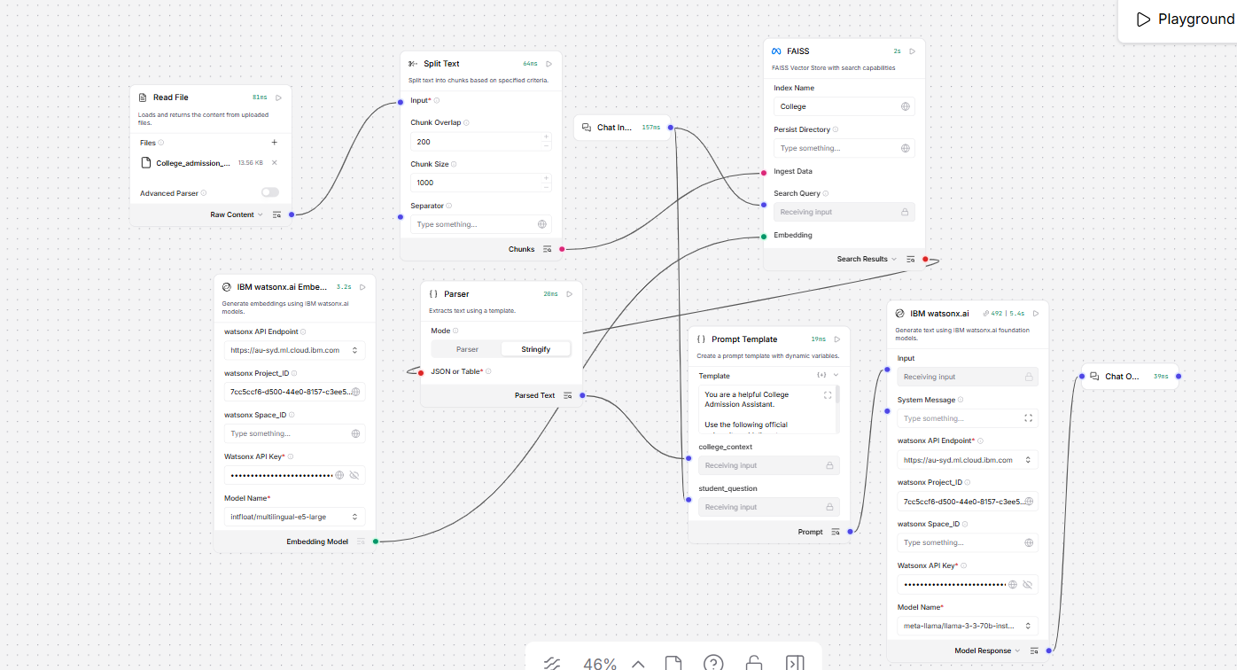
Langflow workflow -

Slide 8
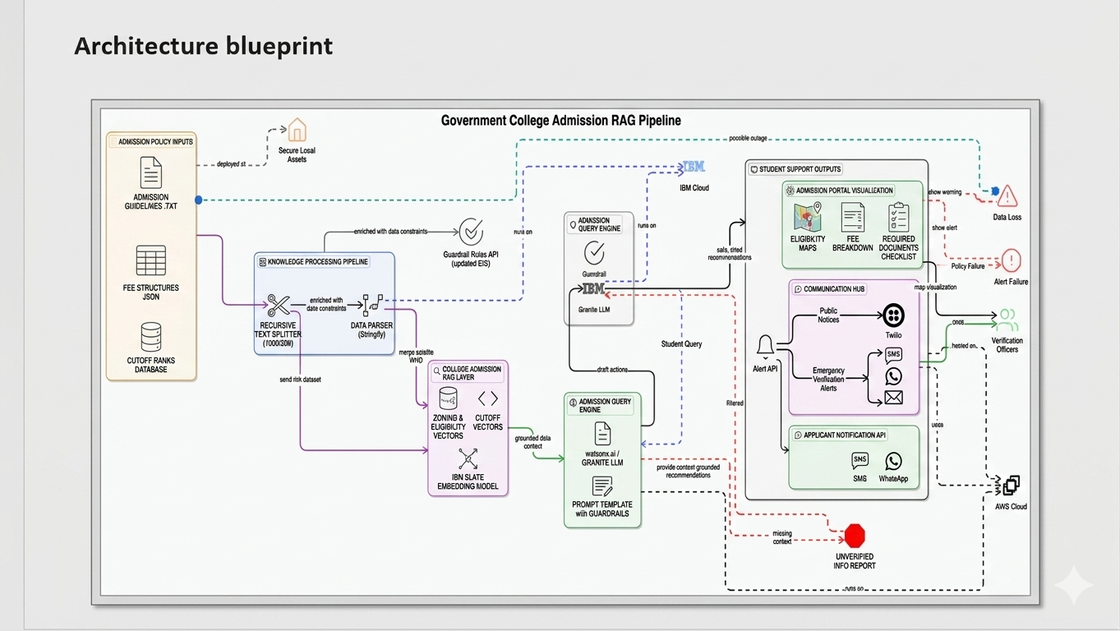
Architecture blueprint

Slide 9
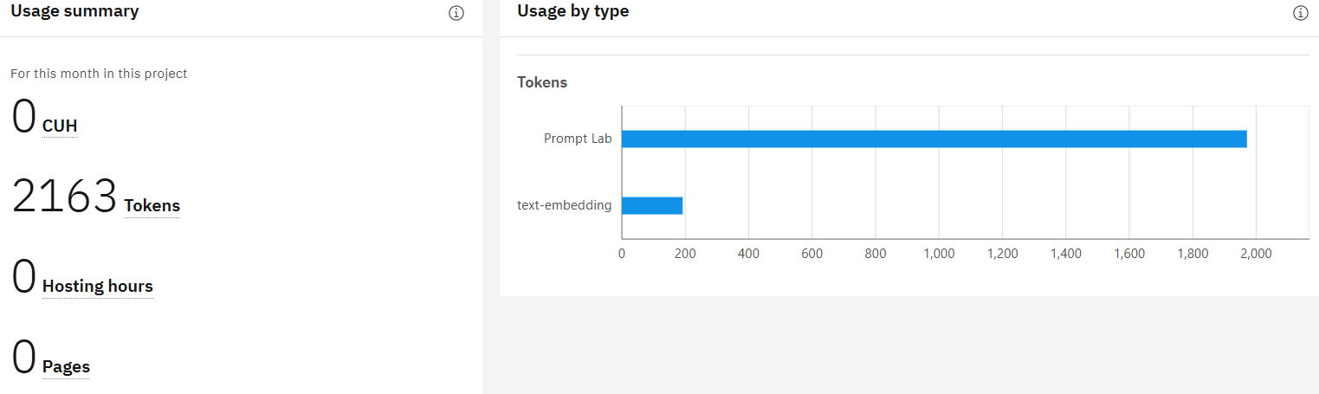
Token usage

Slide 10
Novelty and Uniqueness
Unlike generic chat assistants that offer speculative answers based on broad internet data, this solution introduces an elite level of predictability by enforcing strict factual grounding. The novelty lies in building a zero-trust, closed-loop retrieval environment where the underlying LLM is prohibited from generating responses outside the provided context matrix. By structurally embedding institutional logic—such as exact cutoff metrics and tiered fee structures—directly into a local vector pipeline, we eliminate the core flaw of traditional conversational interfaces: AI hallucinations. This ensures that every generated output acts as a true, legally compliant reflection of official institutional policy.
📌 What Makes This Solution Unique
Context-Enforced Guardrails: Integrates custom prompt constraints that actively strip away the model's tendency to guess, forcing it to politely decline to answer if a specific data point is missing from the underlying document.
Granite-Slate Pipeline Integration: Maximizes mathematical retrieval accuracy by utilizing enterprise-grade ibm/slate-125m-english-rtrvr-v2 models, making the system highly specialized for reading complex, tabular government college data streams.
Isolated Vector Parsing: Employs an explicit stringification parser block that flattens multi-layered semantic array chunks into single context payloads, avoiding the disjointed memory issues common in open-source chat setups.
Sanitized Infrastructure-as-Code: Delivers an entirely exportable workspace structure that completely hides developer billing credentials, offering an open-source template that evaluators can safely audit, clone, and deploy instantly.

Slide 11
Git Hub Link
· Please create public github repository (Enable Add README button while creating repository) with format –
Please test and Paste the working Github URL – Github_Repo_For_This_Project https://github.com/CoderforLife-AK/College_Admission_RAG_Bot.git
·
·
·

Slide 12
Future Scope
Transition to an Autonomous Agentic Framework: Upgrade the linear RAG pipeline into an Agentic AI system capable of multi-step reasoning, enabling the bot to dynamically select tools, validate inputs, and process complex mathematical eligibility calculations on its own.
Live API & Database Integration: Replace the static text-based knowledge source with live API connections to official state admission portals or institutional ERP databases, ensuring real-time retrieval of dynamic branch cutoffs, merit ranks, and seat vacancies.
OCR-Driven Document Verification: Integrate Optical Character Recognition (OCR) components into the intake stream, allowing applicants to upload certificates or transcripts that the AI can instantly analyze, cross-reference, and audit against the 12 mandatory admission checklists.
·
·
·

Slide 13


