Slide 1
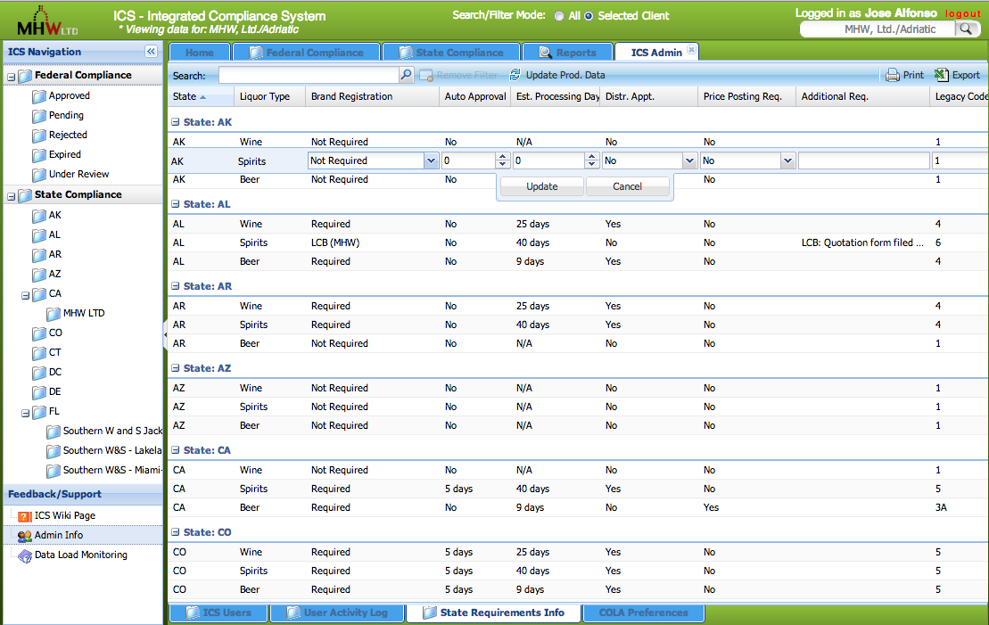
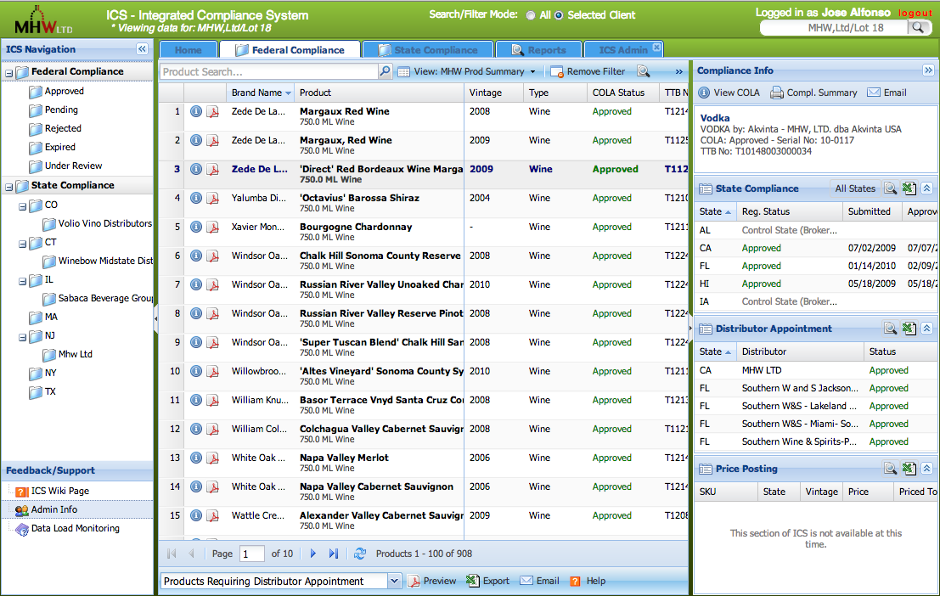
Jose G. Alfonso
415.532.9500 - jgalfonso@me.com
Resume screen shots. (Please keep information confidential)

Slide 2
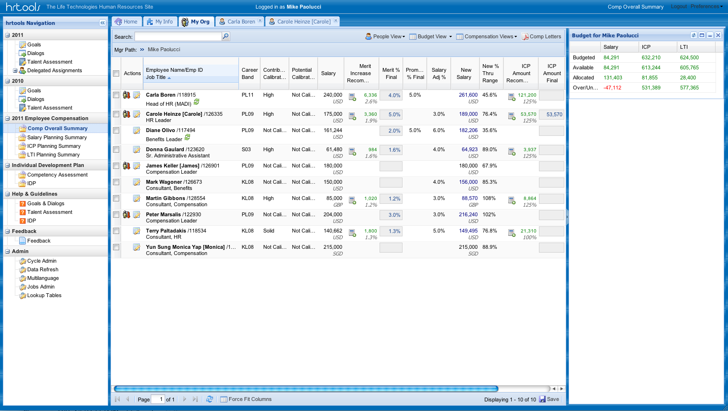
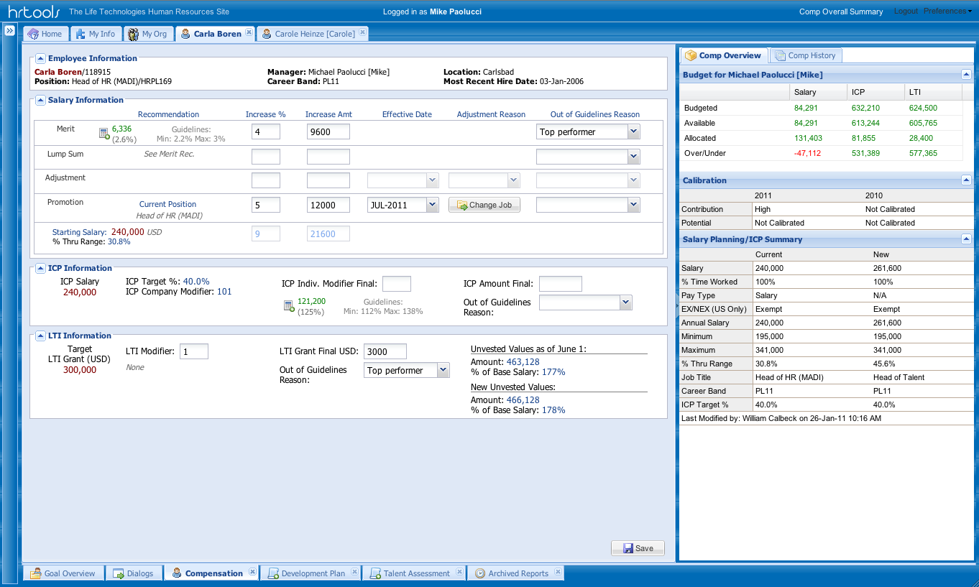
Jose G. Alfonso
415.532.9500 - jgalfonso@me.com
Resume screen shots. (Please keep information confidential)

Slide 3
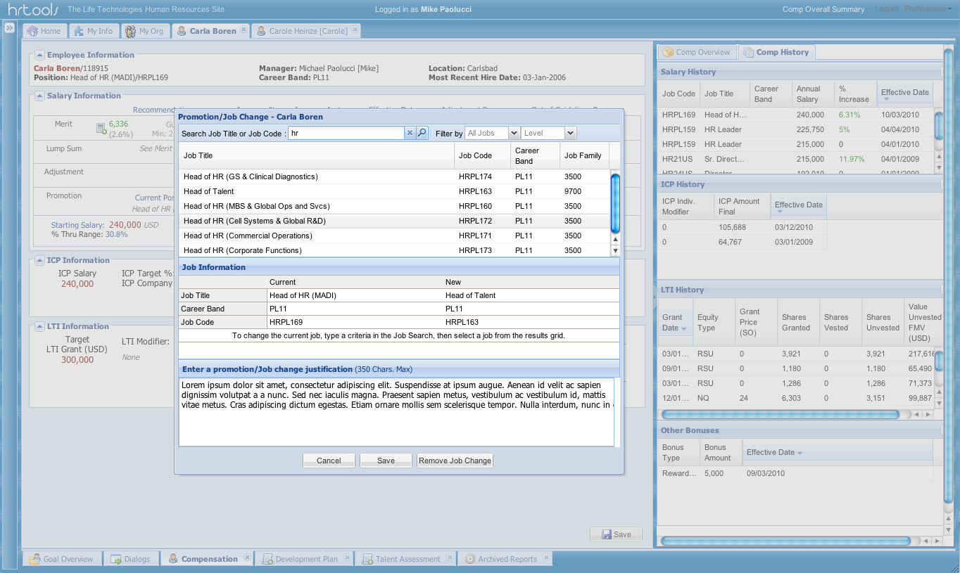
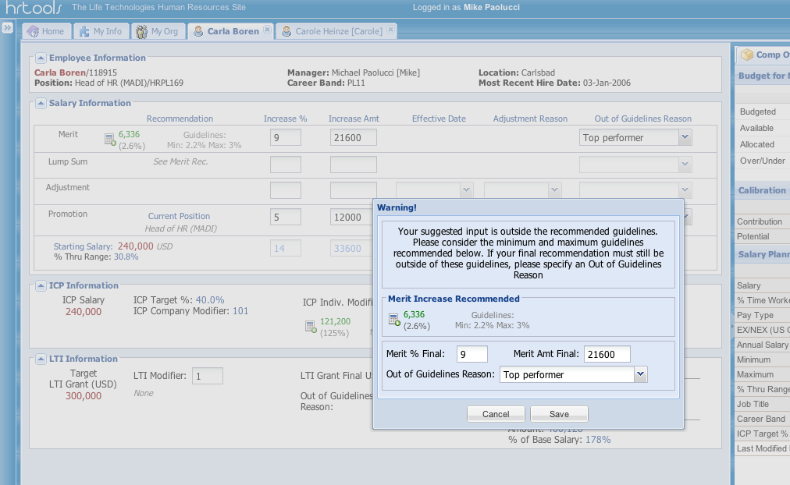
Jose G. Alfonso
415.532.9500 - jgalfonso@me.com
Resume screen shots. (Please keep information confidential)

Slide 4
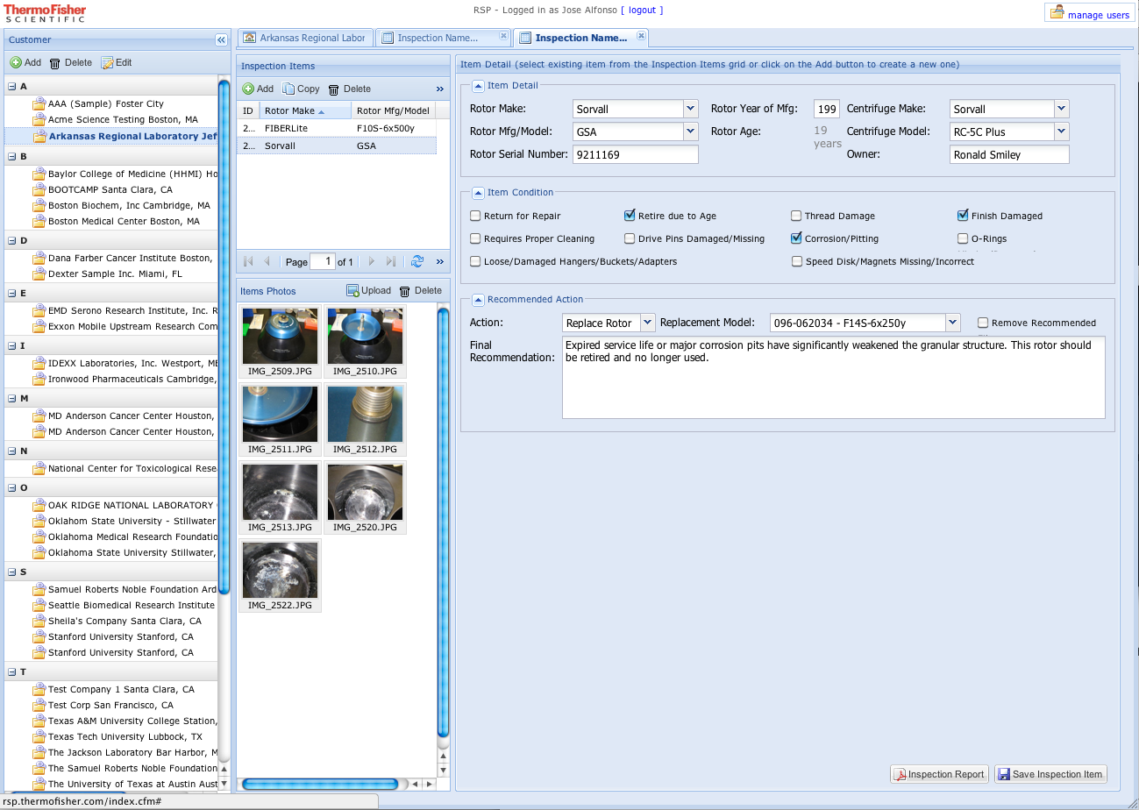
Jose G. Alfonso
415.532.9500 - jgalfonso@me.com
Resume screen shots. (Please keep information confidential)

Slide 5
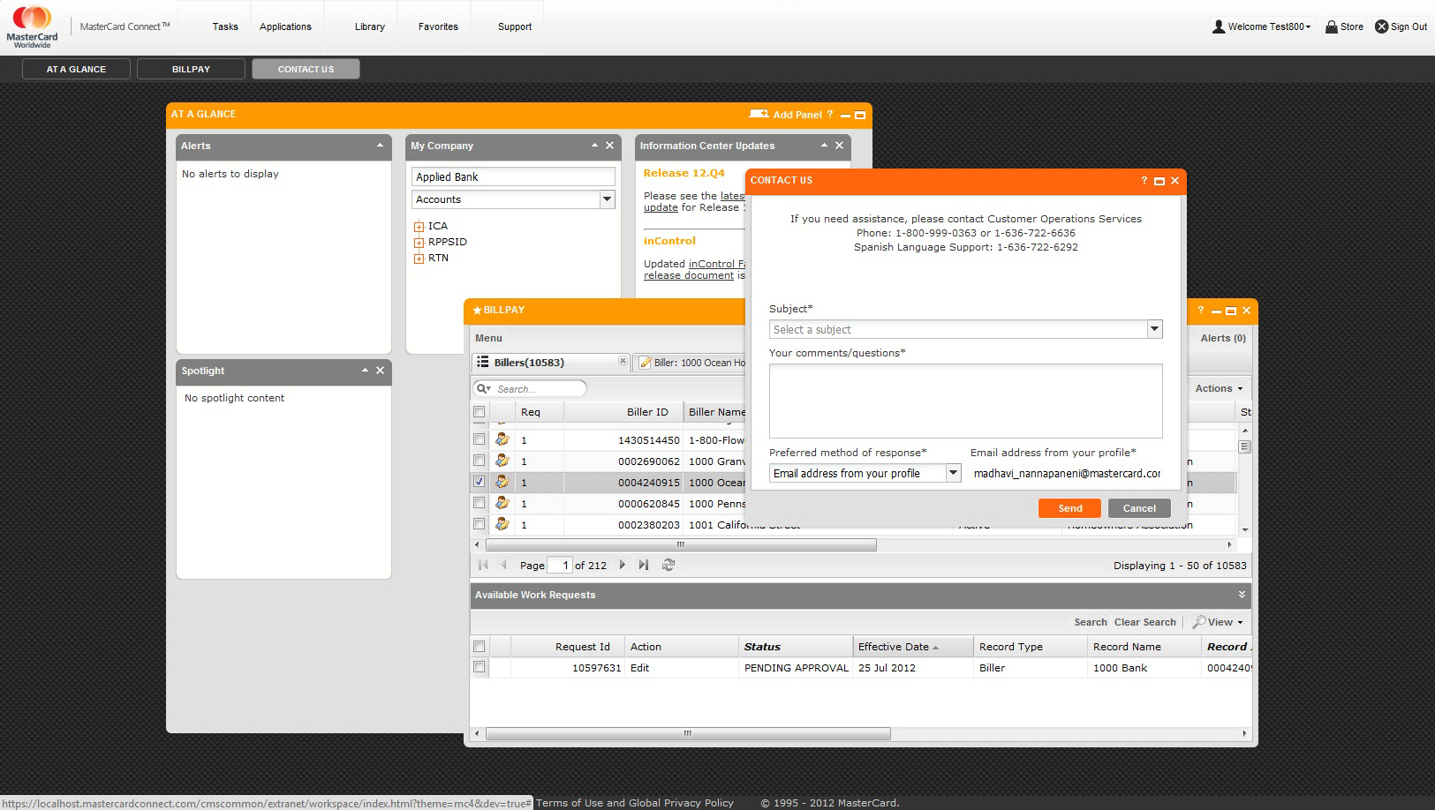
Jose G. Alfonso
415.532.9500 - jgalfonso@me.com
Resume screen shots. (Please keep information confidential)

Slide 6
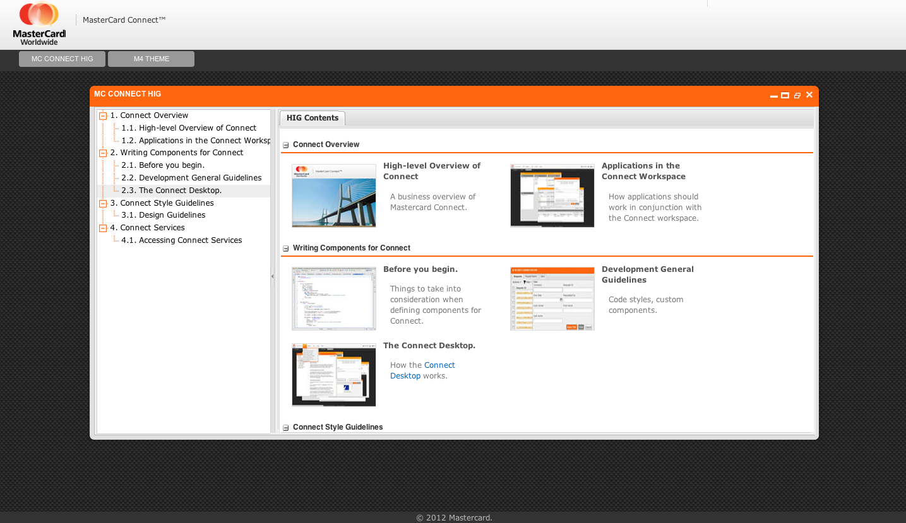
Jose G. Alfonso
415.532.9500 - jgalfonso@me.com
Resume screen shots. (Please keep information confidential)

