Slide 1
Spoiled Tomatillos wrap-up
Team 26: Coders Unlimited
Maddy Leger, George Abinader, Joe Donovan, Ben Faucher

Slide 2
System Functionality

Slide 3
Target Functionality
A social network platform centered around watching movies
User profiles, Friending, User groups, suggest movies to friends
Rate and review movies, see others’ reviews
Get movie suggestions based on personal taste in movies
An administrative back-end
Telemetry of effectiveness of suggestion algorithms
Control over end-user accounts
Notes:
Create a profile including information such as name, hometown, picture
Follow other users and view their interactions
Create "groups" to further organize your friends and encapsulate their interactions
Create a system to recommend movies to a user based on ratings of friends

Slide 4
Achieved Functionality
Profile creation
Logging in / out, security handled by Google
Searching movies
Rating and reviewing movies
Searching Users by Username
Friending*
Group creation
Pulling Additional information about movies in the form of "Now Playing" tab
* Backend logic for friending was written but not yet implemented in the frontend
Notes:
Log in to a secure system using verified credentials
Rate and review movies pulled from IMDB

Slide 5
Achieved Functionality
Source: https://cs5500-jira.ccs.neu.edu/secure/DataplaneReport!default.jspa?report=5bda7860-a571-42e5-af04-1878b24b752b
Notes:
Broke project down into 34 “use cases” to start, recorded in Jira
5 categories of use:
End User Profiles
End User Movie Interactions
Group Usage
Site Moderation
Administration

Slide 6
Utility to Client
Most core functionality implemented
Some features that make a social media website feel "social" not yet fully realized
Backend logic in place; front end not yet realized/debugged
Client will likely contract additional developers to take over
Frameworks used are well documented and the code is neat, maintainable, and correctly tested
Notes:
We feel that we have most of the functionality implemented that the client would need although there still a few features need some additional development
Some of the features that make a social media website feel "social" are not yet fully realized
The backend logic is already written but everything is not yet realized/debugged on the frontend
Overall, I would say our website is unfinished so if we were to hand it over to a client they would contract additional developers to take over
The frameworks that we used are well documented and the code is neat, maintainable, and correctly tested

Slide 7
Job Quality

Slide 8
Code Quality
Code coverage on SonarQube: 98.1% statement, 60.6% branch*
Backend logic developed uniformly and neat, contained to src folder
Database is easy to read and understand, SQL file under version control
Code is robust, website is not susceptible to SQL injection or data dictionary attacks (since we are not storing passwords in our database)
Continuous deployment process automatically builds and tests all code, automatically deploys master branch only
Pull requests required to merge into master branch
* Source: http://qube.codersunltd.me/component_measures?id=edu.northeastern.cs4500%3Ateam26-st-app-master&metric=coverage
Notes:
Final point: We learned more about the different systems (Jenkins, SonarQube, SonarLint) as we progressed through the semester. Before the first Sprint review, we had none of these frameworks set up to make sure that our code properly builds and is sufficiently tested. Using these frameworks, in turn, improved the quality of our work going forward

Slide 9
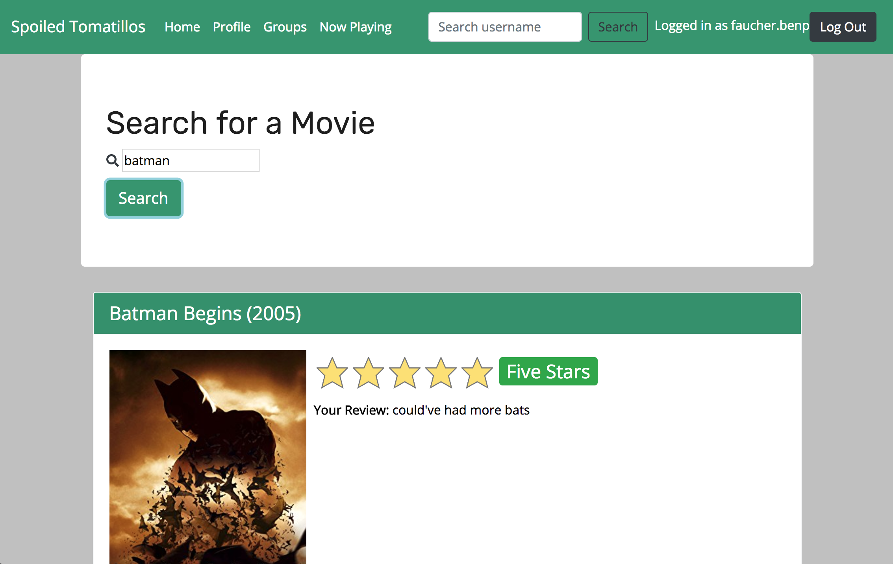
UX Quality
Clean and intuitive
Performed use case study with prototype on several testers to get feedback before development
Chose a simplistic feel (a la Google) with simple search bars so that our audience would be most receptive

Slide 10
Process and Teamwork

Slide 11
Teamwork
George worked on the database as well as partially on the backend
Joe worked heavily on the backend as well as partially on the database/frontend
Ben worked devops and was in charge of making sure Jenkins/SonarQube was running smoothly, assigning and creating Jira tickets, as well as leading the scrum and making sure tasks were completed on time
Maddy worked heavily on implementing features in the frontend/google authentication for login

Slide 12
Process
Our team utilized Jira effectively creating tickets and assigning them to developers
All development was developed in branches tagged with the ID of the Jira Issue being resolved
Our group used smart commits to keep track of which commits belong to which branch/issue
We did not use "Slack-ups" as suggested on the project guidelines although we were active on slack and utilized it to organize our development as well as monitor the status of Jenkins/Qube
Managed to automate build, test, deploy
Utilized PRs and protected our master branch
We adhered to our protocols strictly (2 peer reviews per PR)
Recognized shortcomings (lack of FE developers), but didn’t really address it

Slide 13
Technology Transfer

Slide 14
State of the System
App
Vertical prototype working
Some horizontal functionality
SpringBoot framework
Java code well documented
Front-end standard HTML, JS, CSS
Environment
Full CD workflow implemented
Jira, GitHub, Jenkins, and SonarQube
Easy to pass off code base
Notes:
So even though all of the desired functionality has not been implemented yet, the app does run in its current state. Using the springboot framework means a lot of the heavy lifting of configuring a web server and integrating a front-end and back-end together is already done. The code is mostly Java and well documented. The front-end is standard HTML and JavaScript.
We developed an entire continuous development workflow using Jira for tasks, GitHub for central code management, Jenkins for building and testing, and SonarQube for code quality analysis.
If they already use GitHub in their development workflow, we can simply transfer ownership of the repo to their organization. If they use another cvs, we can give them an archive of the entire source code package. Within that package, the README describes the steps necessary to get started developing the app locally.
If the client wants to continue using Jenkins, the entire build process is encapsulated in the repo’s Jenkinsfile. Certain variables in the Jenkinsfile as well as the project properties file may have to be changed as a result of the code base being moved to a different development team. These are detailed in the README. The client also does not have to use Jenkins. The only tool they must use is Maven for compilation as the maven pom.xml is a significant piece of the application.

Slide 15
Next Steps
More end-user functionality!
Friends, Group interactions, Recommendations, Moderation
UI Refinements, more original design
Administrator Panel (another project)
Better feature self-testing process
More thorough code metrics
Release process

