Slide 1
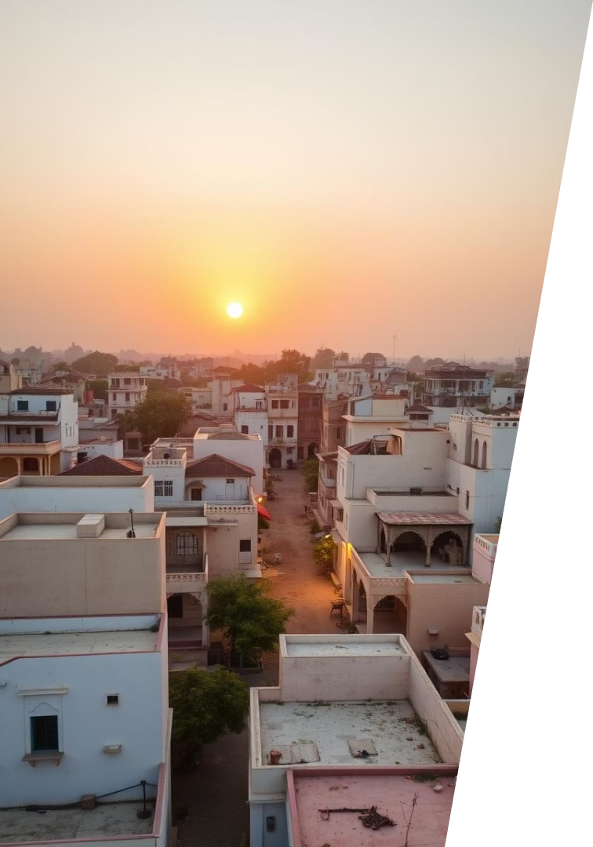

Tonk Vibes
By Technifyit
by Ghanshyam
Let’s Explore

Slide 2
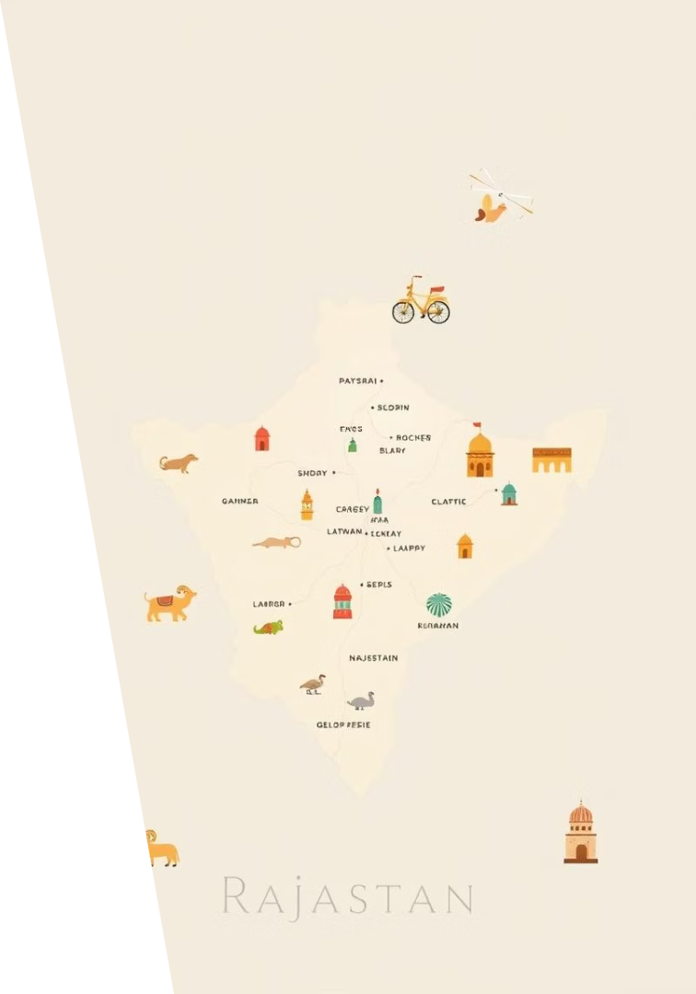
Index-1 Index-2
Authors Page
Sponsers Page
Sources
Tonk
History Of Tonk
Speciality of Tonk
Places to Visit
About the Author
Conclusion:Motivation

Slide 3


Download
Our Online Platform
Visit us at www.technifyit.ct.ws for more insights and updates about Tonk.

Slide 4
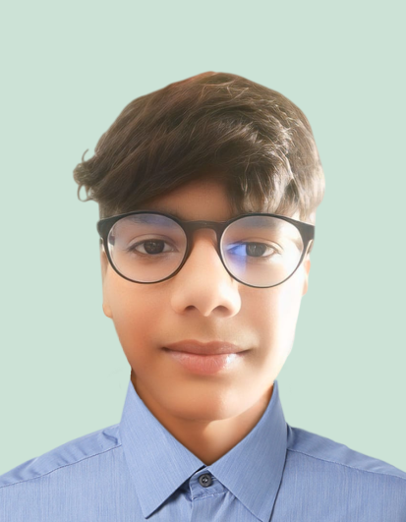
Meet the Creative Team
Ghanshyam
MD. Konain
Magazine and web design expert guiding the project vision.
Specialist in printing and finishing, ensuring top quality.
Sanjay Kumar Modi
The founder of Nearbook who sponsered this MAGAZINE.
GHANSHYAM

Slide 5
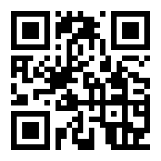


This Magazine is Sponsered By NearBook
Scan To Get Books
At Discount
NearBook
Kitaaben Fekho Nahi,Becho
Buy|Sell|Rent|Donate Books
Sanjay Kumar Modi
-Sponser

Slide 6
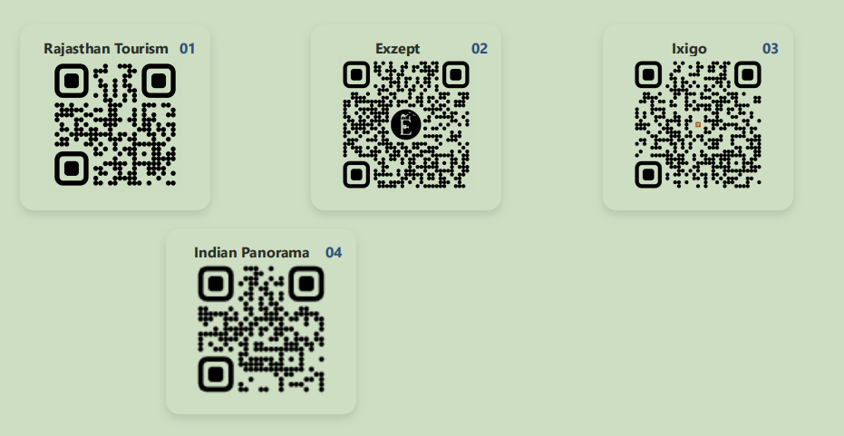
Sources of Content

Slide 7
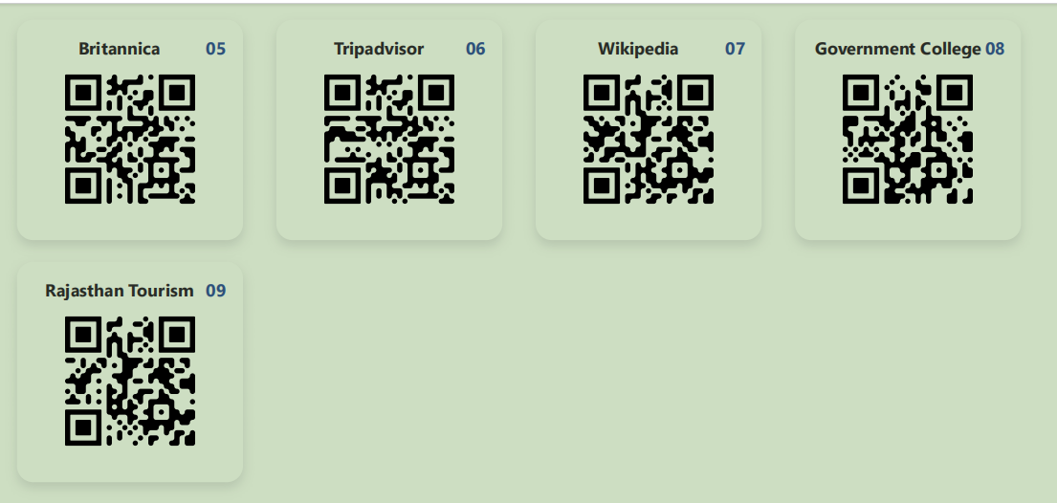
Sources of content

Slide 8
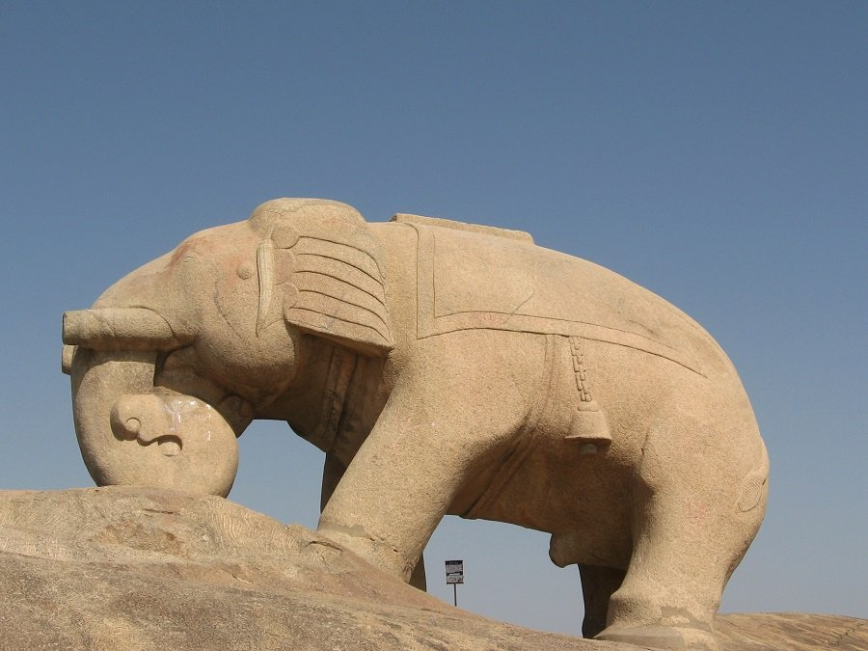
Tonk
Tonk, a lesser-known gem in Rajasthan, is a town rich in history, culture, and architectural marvels. Located about 100 km from Jaipur, Tonk is renowned for its unique blend of Rajput and Mughal influences, making it a fascinating destination for travelers and history enthusiasts alike.

Slide 9
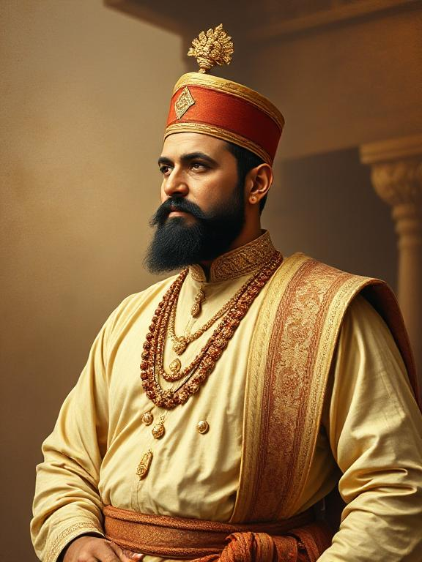
History of Tonk
Nawab Mohammed Amir Khan
The modern town was officially founded in 1818 by Nawab Mohammed Amir Khan, an Afghan military leader who was granted land by the ruler of Indore.[1][8]
Prior to this, the area comprised twelve villages given to Bhola Brahmin in 1643, who named them 'Tonk'.[1][8]

Slide 10
History of Tonk
Nawab Mohammed Amir Khan
Tonk became the capital of a princely state under British India from 1817 to 1947, ruled by Pathan chieftains. It joined Rajasthan state in 1948.[5][7]
Tonk is famed for its syncretic culture, where Hindu and Muslim traditions coexist, earning it nicknames like "Rajasthan ka Lucknow" and "Hindu Muslim Ekta ka Maskan".[1][3][8]

Slide 11
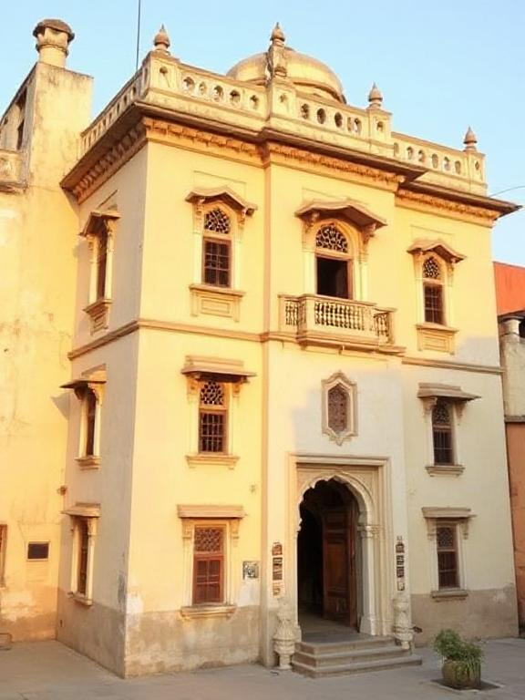
Specialities of Tonk
Sunheri Kothi
Tonk is celebrated for its old havelis (mansions), mosques, and a unique blend of Rajput and Mughal architecture[1][4]
Tonk is a center for cotton weaving, wool carding, leather tanning, and felt-handicraft production[5].

Slide 12
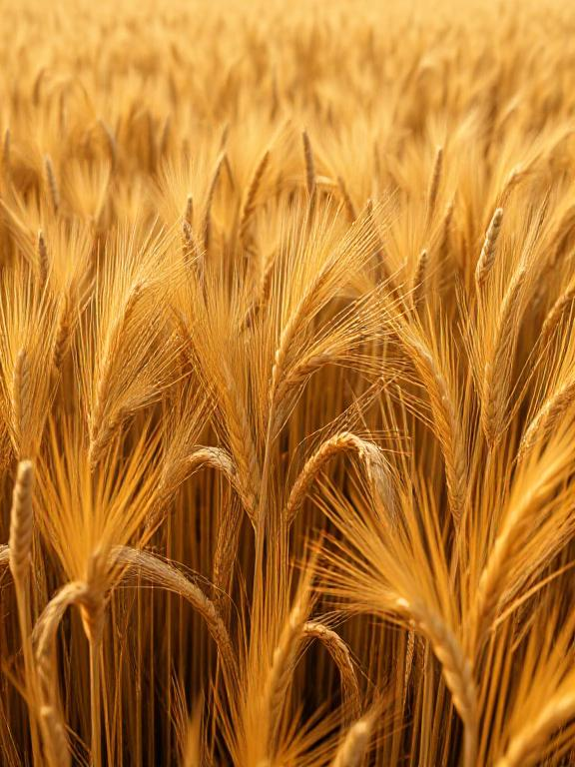
Specialities of Tonk
Agricultural Hub
The region is an agricultural hub, producing jowar, wheat, gram, corn, cotton, and oilseeds[5]
Cultural Identity
Tonk is known for its refined manners, Urdu literary tradition, and vibrant local crafts such as textiles, pottery, and woodwork.

Slide 13
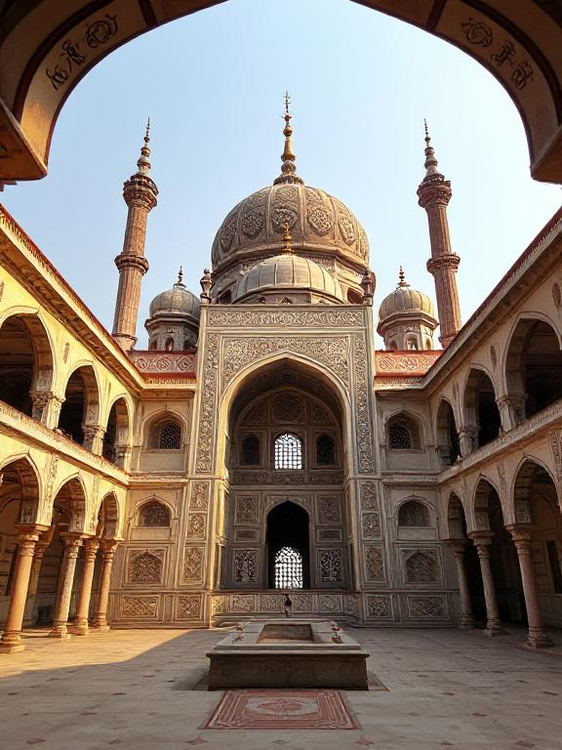
Places to Visit
Rani Mahal
A palace blending Mughal and Rajput styles, famous for its ornate interiors.[2]
Shahi Jama Masid
A significant mosque reflecting the town's Islamic heritage[6]

Slide 14
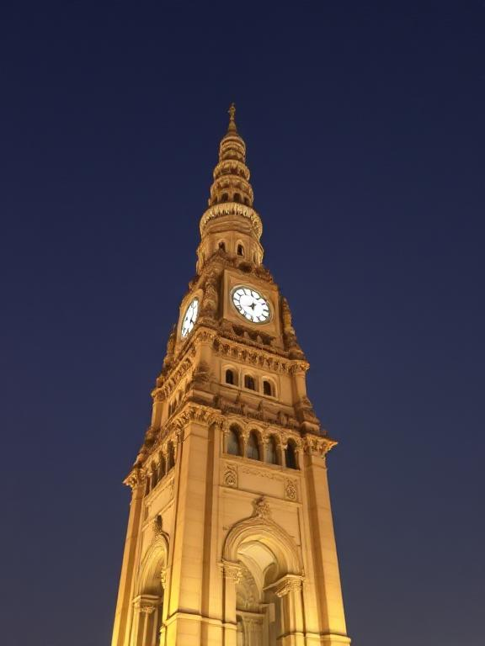
Places to Visit
Hathi Bhatta
A stone sculpture of an elephant, a unique historical landmark[3].
Bisalpur Dam
Built over the Banas River, this dam is a scenic spot and an important water source for Rajasthan.[6][9]
Ghanta Ghar

Slide 15
Exploring Author’s Life
Hey! I'm Ghanshyam from Tonk, Rajasthan 🇮🇳.
I'm a 10th-grade student at Emmanuel Sr. Sec. School, and my journey into the world of coding started when I was just 10 years old, out of pure curiosity and passion. Since then, I’ve explored multiple fields like web development, app development, AI integrations, and backend systems.
My family runs a small clinic to support our living, and that’s where I learned the value of hard work, hustle, and making things work with limited resources.
My ultimate goal? To build something big—something that not only solves real problems but also takes India ahead of the USA in innovation and technology.

Slide 16
Movitational End
"Success is not final, failure is not fatal: It is the courage to continue that counts."
“If you are born poor it's not your mistake, but if you die poor it is your mistake.”
"The people who are crazy enough to think they can change the world are the ones who do."
"I never dreamed about success. I worked for it."
Thanxs

Slide 17

Tonk Vibes
By Technifyit
by Ghanshyam
Thanks For Reading

