Slide 1


AI- BASED SYSTEM FOR DETECTING AND COMBINATING FAKE NEWS PROPAGATION
UNDER THE GUIDENCE OF
PRESENTED BY
MALARVIZHI.R (711021205013)
POOJASHREE.R (711021205017)
DINESH BALAJI.R(711021205302)
Mr. M. NAGARASAN , AP/CSE
ASSISTANT PROFESSOR,
DEPARTMENT OF COMPUTER SCIENCE OF ENGINEERING.

Slide 2
TABLE OF CONTENT
Abstract
Introduction
Objective
Problem identification
Research gaps
Literature Review
Algorithm
Modules
UML Diagrams
Conclusion
Future Enhancement

Slide 3
ABSTRACT
The rapid spread of misinformation on digital platforms has become a critical concern in today’s interconnected world. This project proposes an AI-based system to detect and mitigate fake news propagation using machine learning and natural language processing (NLP) techniques. The system leverages logistic regression, fact-checking algorithms, and user credibility analysis to identify and suppress false information.

Slide 4
INTRODUCTION
With the advent of social media and online news platforms, the dissemination of information has become instantaneous.
However, this also presents an opportunity for the rapid spread of false or misleading content.
Fake news can manipulate public opinion, impact elections, and incite violence. Traditional fact-checking methods are inefficient against the sheer volume of misinformation.
AI-driven solutions offer a scalable and efficient way to detect and combat fake news by analyzing textual patterns, sources, and dissemination behaviors.

Slide 5
OBJECTIVES
To develop an AI-driven system for detecting fake news using NLP and machine learning techniques.
To integrate fact-checking mechanisms with credible sources for verification.
To analyze and classify fake news based on linguistic patterns and source credibility.
To create a real-time monitoring system that alerts users and authorities about misinformation.
To raise awareness about misinformation and provide a tool to validate news credibility.

Slide 6
PROBLEM IDENTIFICATION
Language Barrier:
Primarily designed for English, lacking multilingual support.
No Real-Time Detection:
None of the papers address real-time fake news detection on social media.
Lack of Explainability:
Models are often black boxes, making it hard to trust their decisions.
Influence:
Fake news can influence public opinion, elections, and create social unrest.
Used multiple algorithms:
In previous papers, multiple algorithms are used and failed to improve understandibilty.

Slide 7
RESEARCH GAPS
User-Friendly Alerts: Provide easy-to-understand fake news alerts for end-users.
Social Impact Analysis: Measure how fake news influence's public opinion.
Probability: Measures the probability of 0 and1 with accuracy.
Contextual Understanding: Improve the system’s ability to understand context in fake news.
Real-time detection capabilities: It is for fast-spreading misinformation.

Slide 8
LITERATURE REVIEW
S.NO | YEAR | PROJECT TITLE | AUTHOR NAME | MERITS | DEMERITS
01 | 2023 | Big Data ML- Based Fake News Detection Using Distributed Learning | Alaa Altheneyan and Aseel Alhadlaq | The paper uses distributed machine learning with Apache Spark, making it highly scalable for handling large datasets, which is crucial for analyzing the massive volume of data on social media. | The model relies on batch processing, meaning it cannot perform real-time detection of fake news as it spreads on social media platforms.

Slide 9
02 | 2024 | Advancing Fake News Detection: Hybrid Deep Learning With FastText and Explainable AI | Ehtesham Hashmi, Sule Yildirim Yayilgan, Muhammad Mudassar Yamin | The paper proposes a hybrid deep learning model (CNN-LSTM) combined with FastText embeddings, which effectively captures both local features and sequential dependencies in text data, achieving high accuracy in fake news detection. | The model is limited to text-based fake news and does not address multimedia content (images, videos), which are increasingly used in fake news propagation.

Slide 10
03 | 2024 | Systematic Review of Fake News, Propaganda, and Disinformation: Examining Authors, Content, and Social Impact Through Machine Learning. | Darius Plikyns, Ieva Rizgeline | The paper provides a comprehensive review of fake news detection techniques, offering valuable insights into authorship, content, and social impact, which helps identify key challenges and gaps in the field. | The paper is theoretical and lacks practical implementation or experimental results, making it less useful for developing real-world solutions. .

Slide 11
ALGORITHM
NATURAL LANGUAGE PROCESSING (NLP) + LOGISTIC REGRESSION
NLP (Natural Language Processing): Converts raw text into numerical data for machine learning.
Logistic Regression: A machine learning algorithm for binary classification (Fake vs. Real News).
How You Are Using Them:
NLP Processing → Clean text (remove stopwords, stemming).
Feature Extraction → Convert text into numbers using TF-IDF (TEAM FREQUENCY INVERSE DOCUMENT FREQUENCY).
Logistic Regression → Classifies news as Fake or Real based on extracted features.

Slide 12
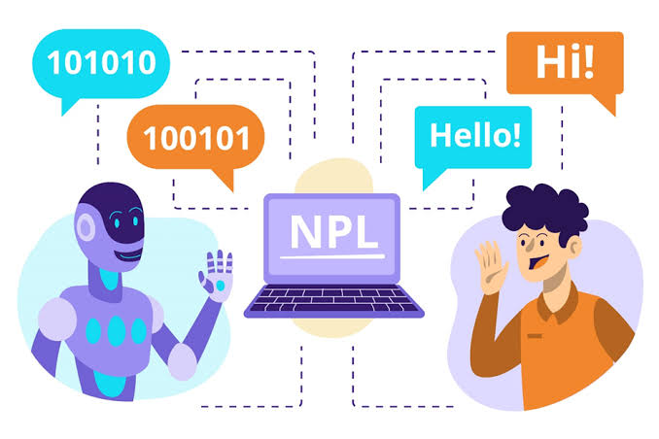
NATURE LANGUAGE PROCESSING
NATURE LANGUAGE PROCESSING
​Natural Language Processing (NLP) enables computers to comprehend and interact using human language. Its primary purpose is to bridge the communication gap between humans and machines, facilitating seamless interaction.
​
Automating repetitive tasks.
Enhancing data analysis.
Improving search functionalities
Generating content.

Slide 13
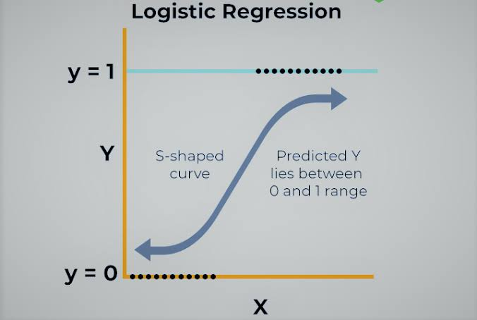
LOGISTIC REGRESSION
LOGISTIC REGRESSION
Logistic Regression is a statistical method used for analyzing datasets where the outcome variable is binary, meaning it has two possible outcomes such as "yes" or "no", "success" or "failure".
The primary goal is to model the probability that a given input point belongs to a particular category.
DECISION RULE FOR CLASSIFICATION
After calculating the probability P(Y=1 | X):
If P =1,
Classify the news as real.
If P =0,
Classify the news as fake.

Slide 14
WORK FLOW OF LOGISTIC REGRESSION
Data Collection:
Gather a dataset with relevant features and a binary outcome variable.​
Data Preprocessing:
Clean the data by handling missing values, encoding categorical variables, and normalizing numerical features if necessary.​
Model Training:
Split the data into training and testing sets. Use the training set to fit the Logistic Regression model by estimating the coefficients that best predict the outcome variable.​
Model Evaluation:
Assess the model's performance using metrics such as accuracy, precision.
Prediction:
Use the trained model to predict outcomes on new data instances by calculating the probability of the outcome variable and assigning class labels based on a chosen threshold.

Slide 15
BENEFITS OF LOGISTIC REGRESSION
Simplicity and Efficiency:
Logistic Regression is computationally less intensive compared to more complex models, making it suitable for large datasets.​
Interpretability:
The coefficients in Logistic Regression represent the relationship between each independent variable and the dependent variable, allowing for clear insights into how input features affect the outcome.​
Probability Estimation:
Unlike some classification methods that only provide a class label, Logistic Regression estimates probabilities, offering a measure of confidence in the predictions.​
Flexibility:
It can handle various types of relationships by applying appropriate transformations to the predictor variables.

Slide 16
METHODOLOGY
DATA COLLECTION
Use labelled datasets (e.g., Kaggle’s "Fake News Detection").
PROCESSING
Clean text (lowercase, remove stop words, tokenize, lemmatize) and apply TF-IDF.
FEATURE EXTRACTION
Extract TF-IDF scores, word count, sentence length, etc.
MODEL TRAINING
Split data (80/20), train Logistic Regression, optimize hyperparameters.
CLASSIFICATION
Preprocess input text, extract features, predict using the model.
FEEDBACK AND DEPLOYMENT
Allow user feedback for improvement.

Slide 17
MODULES
DATA SELECTION
DATA PROCESSING
STEMMING AND STOPWORDS REMOVAL
FEATURE EXTRACTION
CLASSIFIER
EXPERIMENTAL RESULTS
FAKE NEWS PREDICTION

Slide 18
MODULES
MODULE 1 : DATA SELECTION
This is the first step where we select only the relevant data needed for fake news detection. The dataset is chosen based on the objective of identifying misleading or false information. We ensured that the data includes both real and fake news articles for balanced analysis.
MODULE 2 : DATA PREPROCESSING
We clean the raw data by removing unwanted characters, handling missing values, and performing text normalization techniques such as tokenization. Exploratory Data Analysis (EDA) is also carried out to understand data quality and class distribution.
MODULE 3 : STOPWORD REMOVAL AND STEMMING
Focuses on refining the text by eliminating common, non-informative words (stopwords) and reducing words to their root form using stemming. This helps unify similar words and reduce noise in the data.

Slide 19
MODULES
MODULE 1 : DATA SELECTION
This is the first step where we select only the relevant data needed for fake news detection. The dataset is chosen based on the objective of identifying misleading or false information. We ensured that the data includes both real and fake news articles for balanced analysis.
MODULE 2 : DATA PREPROCESSING
We clean the raw data by removing unwanted characters, handling missing values, and performing text normalization techniques such as tokenization. Exploratory Data Analysis (EDA) is also carried out to understand data quality and class distribution.
MODULE 3 : STOPWORD REMOVAL AND STEMMING
Focuses on refining the text by eliminating common, non-informative words (stopwords) and reducing words to their root form using stemming. This helps unify similar words and reduce noise in the data.

Slide 20
MODULE 4 : FEATURE EXTRACTION
We convert the processed text into numerical form using techniques like Bag of Words and TF-IDF (Term Frequency-Inverse Document Frequency). These methods help highlight important terms in the data and form the basis for training machine learning models using scikit-learn.
MODULE 4 : CLASSIFIER
We implemented a Logistic Regression model using the features extracted from the previous step. This model was trained to differentiate between real and fake news articles. MODULE 5 : EXPERIMENTAL RESULTS
We analyzed the accuracy of the model on both the training and test datasets, helping us assess how well the model performs on known and unknown data.

Slide 21
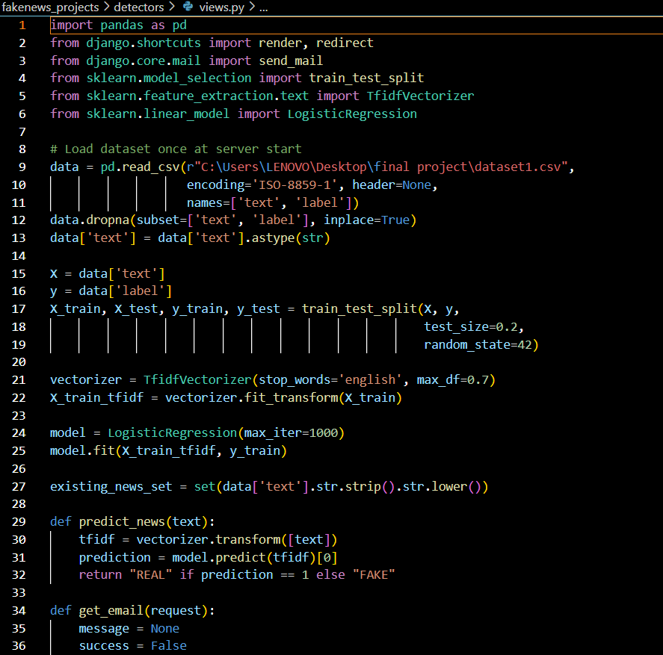
MODULE 6 : FAKE NEWS PREDICTION
The best-performing model was used to predict whether an input news article is real or fake.
The model provides a probability score, indicating the likelihood of the news being true or false, allowing for more informed decisions.

Slide 22
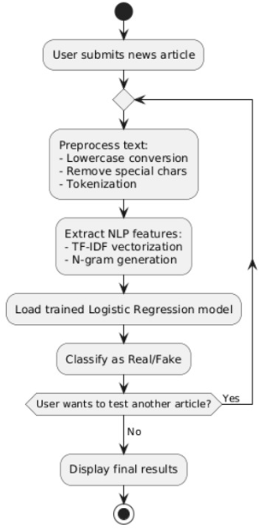
UML DIAGRAMS:ACTIVITY DIAGRAM

Slide 23
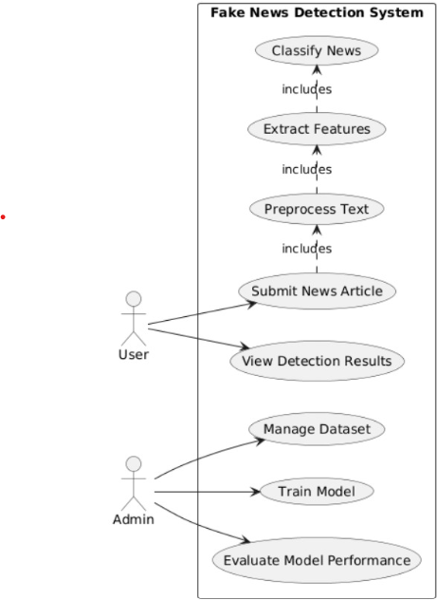
USE CASE DIAGRAM

Slide 24
DATA FLOW DIAGRAM
Text Data(Training)
Statement, Labels
Text Data (Text)
Statement ,Lables
Pre – Processing
Stemming Word / Stop
Word Removing
Logistic Regression classifier
User Input
Final Classification Model
Probability of Truth
True False

Slide 25
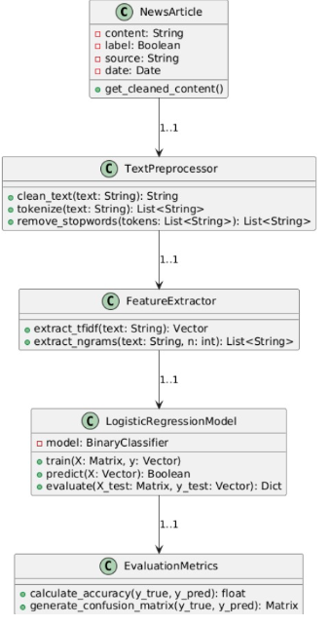
CLASS DIAGRAM

Slide 26
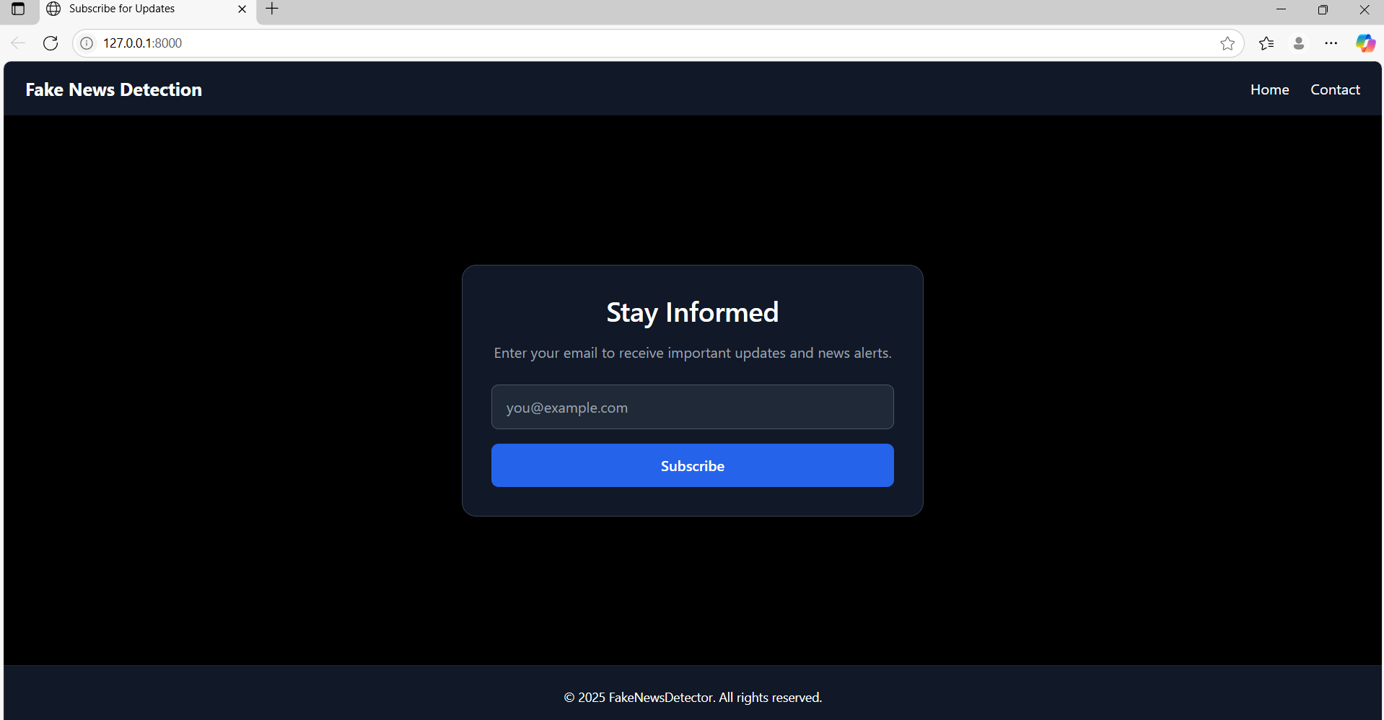
OUTPUT

Slide 27
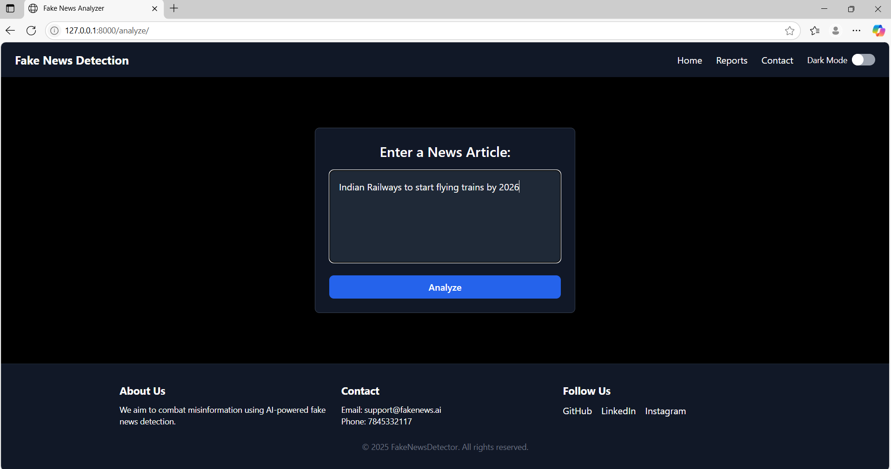
USER INPUT:

Slide 28
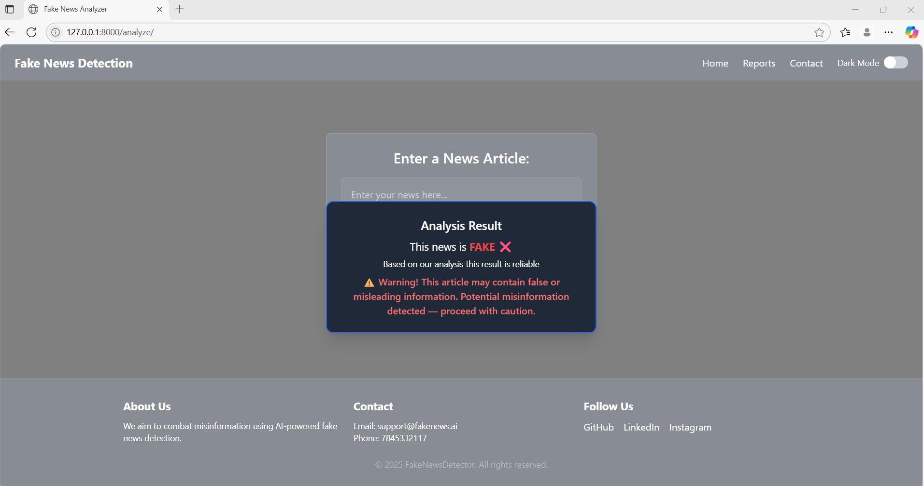
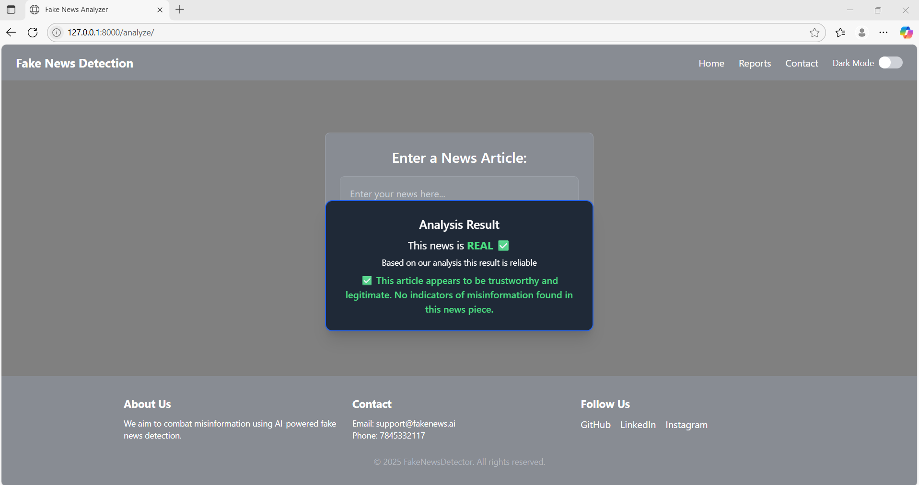
RESULT: REAL OR FAKE

Slide 29
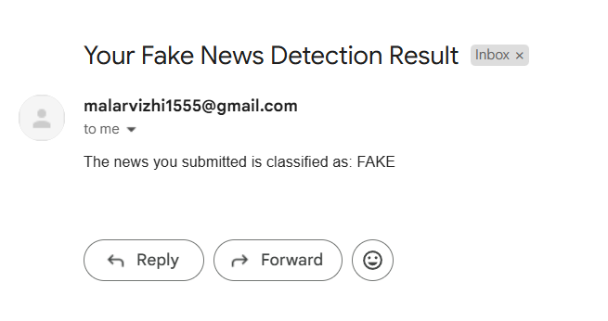
Integrated with the Email subscribed:

Slide 30
CONCLUSION
The Fake News Detection system successfully identifies fake and real news using machine learning and NLP techniques.
Logistic Regression provides a simple yet effective approach for binary classification of news content.
The project highlights the potential of automated tools to assist in reducing the spread of misinformation.
The web application makes the system accessible, allowing users to test news headlines or content instantly.
This project serves as a foundation for more advanced fake news detection solutions in the future.

Slide 31
FUTURE ENHANCEMENTS
Integrate support for multiple languages to detect fake news in regional and global contexts.
Add image and video content analysis using deep learning (e.g., CNNs for fake image detection).
Implement a browser extension for on-the-go verification of online news.
Integrate emotional tone analysis to detect sensational or misleading headlines
Add user feedback and reporting system to improvement over time
Use graph based analysis to study how fake news spread through social networks.

Slide 32
THANK YOU

