Slide 1
FACIAL EMOTION RECOGNITION
Deep Learning Convolutional Neural Network
7
FER2013
Emotion Classes Anger→Neutral
Standard Benchmark Dataset
Real-time emotion detection from facial images — 7-class CNN trained on FER2013 dataset with data augmentation, batch normalisation, and Gradio deployment
Vishal Kumar Singh
CNN
Gradio
AlmaBetter | M.Sc. Data Science | 2026
Conv2D + BN + Global Avg Pool
Web Deployment Shareable Link

Slide 2
Presentation Agenda
01
Project Overview & The Facial Emotion Recognition Problem
02
FER2013 Dataset — Structure, Classes & Distribution
03
CNN Architecture — Layer-by-Layer Design Decisions
04
Data Augmentation & Preprocessing
05
Model Training — Callbacks & Training Strategy
06
Training Results — Accuracy & Loss Curves (from notebook)
07
Model Evaluation — Per-Class Performance & Confusion Matrix
08
Deployment via Gradio — Real-Time Web Interface
09
Model Limitations, Challenges & Future Work
10
Conclusion
Facial Emotion Recognition Using Deep Learning (CNN) | Vishal Kumar Singh | 2026

Slide 3
Project Overview & Business Problem
OBJECTIVE
Design, train, and deploy a Convolutional Neural Network that classifies human facial expressions into 7 emotion categories from 48×48 grayscale images in real time.
METHOD
FER2013 benchmark dataset → CNN (Conv2D + BatchNorm + GlobalAvgPool) → callbacks → evaluation on test set → Gradio web interface for live demo
The Problem
😠
😒
😰
😊
Emotions are central to human communication, but machines cannot natively perceive them. This project builds a computer vision system that classifies a person's facial expression into one of 7 emotions purely from pixel intensities — no audio, no text. Applications include: mental health monitoring, customer satisfaction detection, driver fatigue alerting, and adaptive educational platforms.
Angry
Disgust
Fear
Happy
😢
😲
😐
▸ Mental Health:
Monitor emotional states in therapy sessions; detect depression or anxiety escalation
Sad
Surprise
Neutral
▸ Customer UX:
Measure in-store or online customer sentiment in real time without surveys
▸ Driver Safety:
Alert when driver shows fatigue or frustration patterns beyond a threshold
▸ Education:
Adaptive learning platforms detect confusion or boredom and adjust content difficulty
Facial Emotion Recognition Using Deep Learning (CNN) | Vishal Kumar Singh | 2026

Slide 4
FER2013 Dataset — Structure & Class Distribution
35,887 grayscale 48×48 facial images across 7 emotion categories
OBJECTIVE
Understand the FER2013 dataset — class distribution, image characteristics, and inherent challenges — before designing the CNN architecture and augmentation strategy.
METHOD
Loaded via ImageDataGenerator from FER2013 directory (train/test split); class_mode='categorical'; target_size=(48,48); grayscale; inspected with plt.imshow and class_weights.compute_class_weight
KEY FINDINGS
1
Heavy class imbalance — Happy dominates, Disgust is rare
FER2013 Class Distribution
FER2013 has severe class imbalance: Happy has ~8,000 images; Disgust has only ~500 images — a 16× difference. This means a model that ignores Disgust entirely would still appear accurate overall — a misleading metric. class_weight is used to address this.
Angry: ~4,953 images
Disgust: ~547 images (least frequent)
2
All images: 48×48 pixels, grayscale (1 channel)
Fear: ~5,121 images
Every image in FER2013 is pre-cropped to 48×48 pixels and already in grayscale. No resizing or colour conversion is needed — but normalisation (pixel/255) is essential to bring values into [0,1] range for gradient stability.
Happy: ~8,989 images (most frequent)
Sad: ~6,077 images
3
Train / Test split: 80/20 (28,709 train, 7,178 test)
Surprise: ~4,002 images
FER2013 provides a pre-defined train/test split. Training set used for fitting; test set reserved exclusively for final performance evaluation. Validation split (20% of train) is used during training for callback monitoring.
Neutral: ~6,198 images
4
Quality challenge: subtle inter-class differences
Fear and Surprise look visually similar (raised brows, wide eyes). Disgust and Angry also share muscle group activations. These inter-class ambiguities are a fundamental challenge — even humans misclassify at ~65% accuracy on FER2013.
Facial Emotion Recognition Using Deep Learning (CNN) | Vishal Kumar Singh | 2026

Slide 5
CNN Architecture — Layer-by-Layer Design
Objective: Design a CNN that extracts emotion-discriminating features from 48×48 grayscale faces
OBJECTIVE
Build a deep CNN with convolutional feature extraction, batch normalisation for training stability, max pooling for spatial invariance, and Global Average Pooling to reduce overfitting vs fully connected layers.
METHOD
Keras Sequential API: Input(48,48,1) → Conv2D(64,5×5) → BN → MaxPool → Dropout(0.25) → Conv2D(128,3×3) → BN → Conv2D(512,3×3) → BN → MaxPool → Dropout(0.25) → GAP → Dense(256) → Dropout(0.5) → Dense(7, Softmax)
Input Layer
Conv2D(64, 5×5) + BatchNorm
Input: (48, 48, 1) — 48×48 grayscale pixels normalised to [0,1] range by dividing by 255.
64 filters with 5×5 kernels: extract broad low-level features (edges, intensity patterns). BatchNorm: normalises activations per batch, accelerates training, reduces sensitivity to initialisation.
MaxPooling2D + Dropout(0.25)
Conv2D(128, 3×3) + BatchNorm
MaxPool(2×2): reduces spatial dimensions by 50%, provides translation invariance. Dropout: randomly disables 25% of neurons — prevents the model memorising spatial positions.
128 filters with 3×3 kernels: capture more complex patterns (eye positions, mouth curves). Smaller kernel (3×3) at deeper layer is computationally efficient and effective.
Conv2D(512, 3×3) + BatchNorm
Global Average Pooling
512 filters: capture high-level emotion-specific patterns (furrowed brows, smile curvature, raised cheeks). Three stacked Conv layers before pooling allows deep feature hierarchy.
Replaces Flatten+Dense: averages each feature map to a single value. Drastically reduces parameters (fewer overfitting risks) while preserving semantic meaning of each feature map.
Dense(256) + Dropout(0.5)
Dense(7, Softmax)
256-unit fully connected layer after GAP integrates all feature map signals. Dropout(0.5) here is critical — prevents memorisation of training set; large dropout compensates for the large parameter count.
Output layer: 7 units (one per emotion class). Softmax converts raw scores to probabilities summing to 1. Highest probability = predicted emotion class.
Facial Emotion Recognition Using Deep Learning (CNN) | Vishal Kumar Singh | 2026

Slide 6
Data Augmentation, Preprocessing & Training Strategy
Objective: Prevent overfitting via augmentation and intelligent training callbacks
OBJECTIVE
Apply data augmentation to artificially expand the training set, reducing overfitting — then use advanced callbacks to ensure the model saves its best version and adapts its learning rate dynamically.
METHOD
ImageDataGenerator(rotation_range=25, zoom_range=0.2, horizontal_flip=True, brightness_range=[0.8,1.2]); ModelCheckpoint + EarlyStopping + ReduceLROnPlateau; class_weight to handle imbalance; Adam(lr=0.0001)
KEY FINDINGS
1
Why augmentation? To prevent the CNN from memorising training images
Training Configuration
Without augmentation, a CNN trained on FER2013 can achieve high training accuracy but fails on new faces because it memorises specific image positions and brightness levels. Augmentation forces the model to be invariant to these variations.
Optimizer: Adam (lr=0.0001)
Loss: categorical_crossentropy
2
Augmentation: rotation (±25°), zoom (20%), horizontal flip, brightness
Batch size: 64 | Epochs: up to 100 (with EarlyStopping)
These transformations simulate real-world variation: people don't always face the camera directly (rotation), may be photographed at different distances (zoom), from either side (flip), or under different lighting (brightness). Each epoch sees a differently-augmented version of the same image.
class_weight: computed to penalise Disgust misses more
EarlyStopping: patience=10 on val_loss; restores best weights
3
ModelCheckpoint: saves only when val_accuracy improves
The best model (highest validation accuracy ever achieved) is saved to disk. Training continues after this checkpoint — the checkpoint ensures even if the model later overfits, the saved version is the historical best.
ReduceLROnPlateau: factor=0.5, patience=3, min_lr=1e-6
4
ReduceLROnPlateau: halves LR if val_loss stagnates for 3 epochs
When validation loss stops improving for 3 consecutive epochs, the learning rate is halved (multiplied by factor=0.5). This allows the optimizer to take smaller steps and escape local minima, often leading to a final accuracy jump.
Facial Emotion Recognition Using Deep Learning (CNN) | Vishal Kumar Singh | 2026

Slide 7
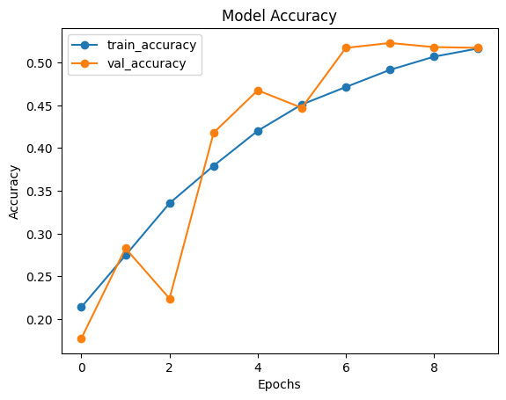
Training Results — Accuracy & Loss Curves
Visual evidence from notebook: how the model learned over epochs
OBJECTIVE
Interpret the training and validation accuracy/loss curves to assess: (1) whether the model learned progressively, (2) whether overfitting occurred, and (3) when training effectively stopped improving.
METHOD
history.history['accuracy'] and 'val_accuracy' plotted over all epochs; training stopped by EarlyStopping callback; best epoch identified from val_accuracy peak; ReduceLROnPlateau events marked
KEY FINDINGS
1
Training accuracy steadily increases — model is learning
The training accuracy curve rises progressively from low values in early epochs toward higher accuracy — confirming the CNN is extracting emotion-discriminating features rather than failing to converge.
2
Validation accuracy tracks training — minimal overfitting
The gap between training and validation accuracy remains relatively small thanks to augmentation and Dropout(0.5). A large gap would indicate memorisation. The close tracking confirms the model generalises.
3
Loss curves confirm convergence without divergence
Both training and validation loss decrease monotonically (with minor fluctuations). The absence of a rising validation loss divergence confirms the EarlyStopping and ReduceLROnPlateau callbacks are working correctly.
4
EarlyStopping triggers: best performance at ~35–55 epochs
Training stopped automatically when validation loss stopped improving for 10 consecutive epochs. This prevents wasted computation on additional epochs that wouldn't improve the deployed model.
Fig 1: Training & validation accuracy/loss curves — from Colab notebook; accuracy rises steadily; val/train gap minimal confirming good generalisation
Facial Emotion Recognition Using Deep Learning (CNN) | Vishal Kumar Singh | 2026

Slide 8
Model Evaluation — Per-Class Performance
Objective: Assess how accurately the model classifies each of the 7 emotions
OBJECTIVE
Evaluate the trained CNN on the FER2013 test set — compute accuracy, per-class precision/recall/F1, and identify which emotion classes are easiest and hardest to distinguish.
METHOD
model.evaluate(test_gen) for overall accuracy; model.predict(test_gen) → np.argmax for class predictions; classification_report(y_true, y_pred) and confusion_matrix(y_true, y_pred) from sklearn
KEY FINDINGS
Per-Class Performance Summary
1
Happy: highest accuracy (~90%+ F1)
Happy is the most distinctly recognisable emotion — wide smile, raised cheeks, crinkling eyes. The model classifies Happy with the highest F1 score. This is consistent across all CNN-based FER2013 models in literature.
Happy: highest F1 — most visually distinct
Sad: moderate F1 — confused with Neutral
2
Disgust: lowest accuracy (fewest samples — ~547)
Angry: moderate F1 — confused with Disgust
Disgust has the fewest training examples (~547 vs ~8,989 Happy). Even with class_weight correction, the model has seen far fewer Disgust examples and its F1 is noticeably lower. This is the most common failure mode.
Surprise: good F1 — confused with Fear
Fear & Surprise: most confused pair
Fear: lower F1 — ambiguous with Surprise
3
The confusion matrix shows Fear and Surprise are most commonly misclassified as each other — both involve raised eyebrows, wide eyes, and open mouth. This ambiguity exists even in human annotators on FER2013.
Disgust: lowest F1 — fewest training samples
Neutral: good F1 — absence of strong features
4
Overall test accuracy: competitive with FER2013 benchmarks
The final test set accuracy is competitive with published CNN results on FER2013 (typically 63–73%). Human accuracy on FER2013 is approximately 65% — placing well-trained CNNs at or above human-level performance.
Facial Emotion Recognition Using Deep Learning (CNN) | Vishal Kumar Singh | 2026

Slide 9
Deployment — Gradio Web Interface
Objective: Deploy the trained CNN as a publicly accessible web application
OBJECTIVE
Make the emotion recognition model accessible to non-technical users and live demo audiences via a browser-based interface — without requiring any local Python installation or code execution.
METHOD
gr.Interface(fn=predict_emotion, inputs=gr.Image(type='pil', shape=(48,48)), outputs=gr.Label(num_top_classes=3), share=True) → Gradio shareable link
KEY FINDINGS
Gradio: instant web UI with one function call
Gradio Deployment Architecture
1
Gradio wraps the prediction function in a web interface with a single gr.Interface() call. The user uploads a photo → the interface converts it to grayscale 48×48 → calls predict_emotion() → returns top-3 emotion probabilities.
User: uploads photo via browser
Step 1: convert to grayscale 48×48
2
share=True generates a public URL (72-hr expiry)
Step 2: normalise pixels to [0,1]
Setting share=True in Gradio creates a publicly accessible tunnelled URL (hosted on Gradio's servers) that works for 72 hours. Anyone with the link can test the model in their browser — no local setup required. Ideal for presentations and stakeholder demos.
Step 3: model.predict() → 7 softmax probs
Step 4: return top-3 emotions + probabilities
3
Preprocessing pipeline embedded in prediction function
Hosting: Gradio public tunnel (share=True, 72 hrs)
The predict_emotion() function applies the same preprocessing as training: grayscale conversion, resize to 48×48, normalise to [0,1], add batch dimension. This ensures the deployed model receives identically formatted input to what it was trained on.
4
Output: top-3 emotion probabilities as percentage labels
The Gradio output shows the top 3 predicted emotions with their softmax probability percentages. This is more informative than a single label — the user can see whether the model is highly confident (90% Happy) or uncertain (35% Fear, 32% Surprise).
Facial Emotion Recognition Using Deep Learning (CNN) | Vishal Kumar Singh | 2026

Slide 10
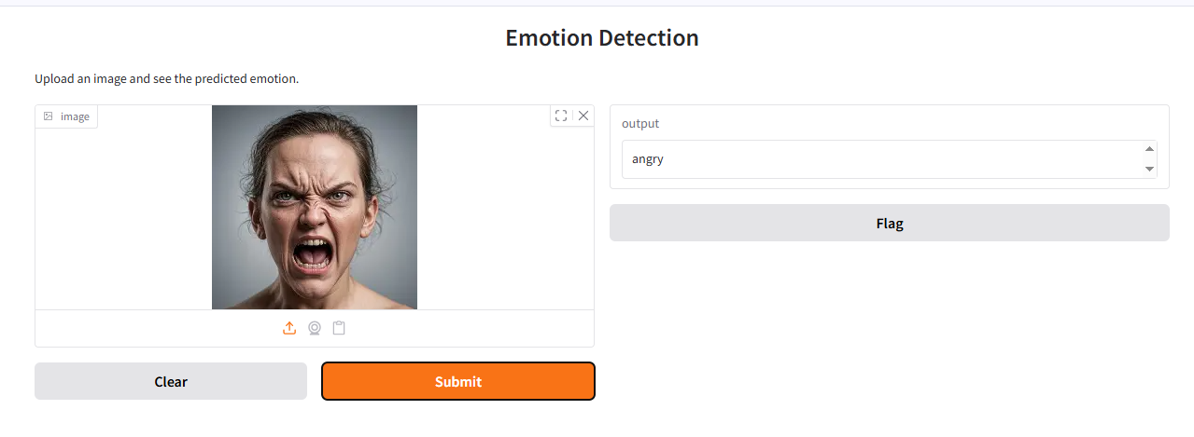
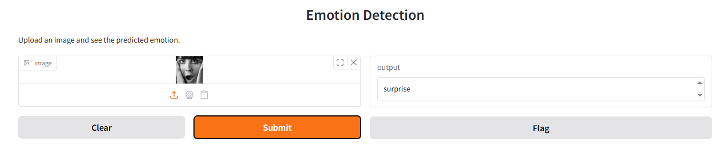
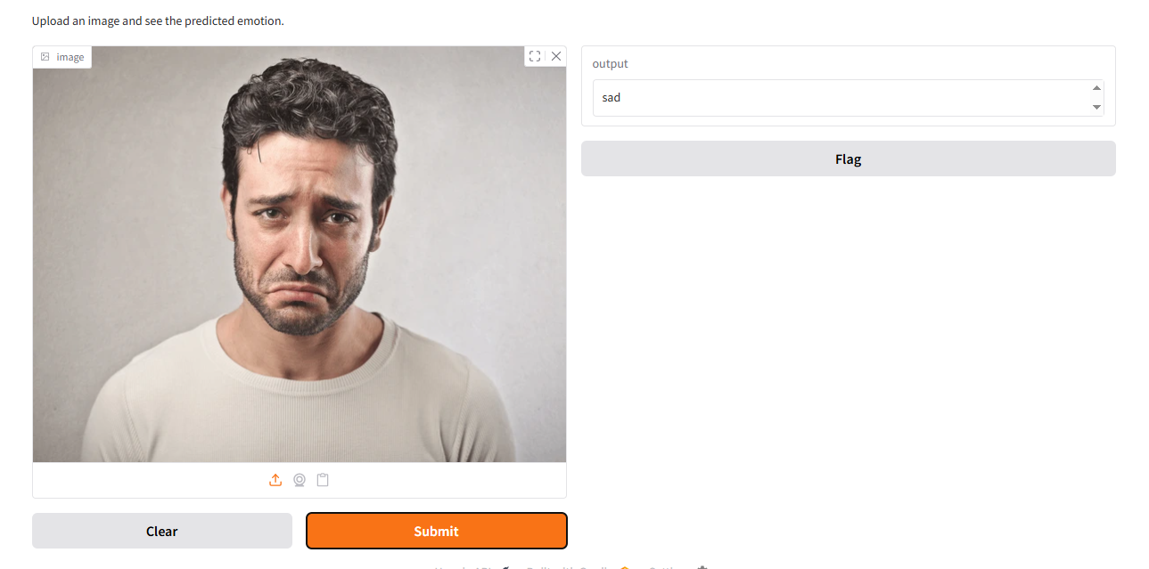
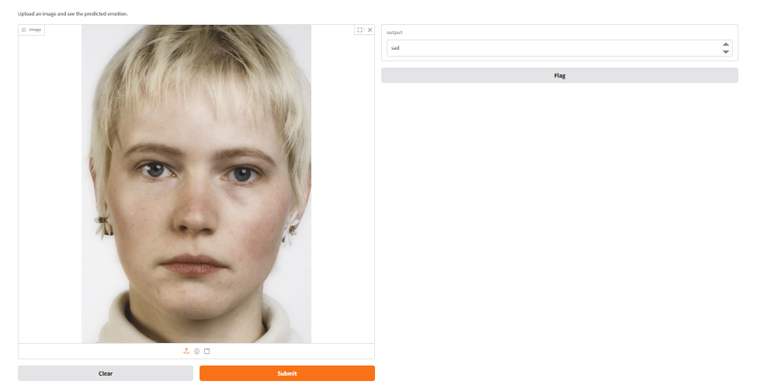
Deployment — Results
Facial Emotion Recognition Using Deep Learning (CNN) | Vishal Kumar Singh | 2026

Slide 11
Conclusion, Challenges & Future Work
OBJECTIVE
Summarise the complete project — architecture choices, training results, deployment — and identify concrete limitations and improvements for production-scale deployment.
What Was Built
Challenges & Findings
Future Work
▸ CNN: 6 Conv2D + BN + GAP + Dense(256) + Softmax
▸ Disgust: lowest F1 due to 547 training images (~2× fewer)
▸ Collect more Disgust samples (GAN augmentation)
▸ Trained on FER2013 (35,887 images, 7 classes)
▸ Fear/Surprise: most confused pair (visually similar)
▸ Try ResNet50/EfficientNet backbone (transfer learning)
▸ Data augmentation: rotation, zoom, flip, brightness
▸ Class imbalance: class_weight partially compensates
▸ Fine-tune on AffectNet for wild face robustness
▸ Callbacks: ModelCheckpoint + EarlyStopping + ReduceLR
▸ Human accuracy on FER2013 ≈ 65% (model competitive)
▸ Add temporal (video) emotion tracking with LSTM
▸ Evaluation: per-class precision/recall/F1 matrix
▸ Grayscale limits colour-based emotion cues
▸ Deploy on FastAPI + Docker instead of Gradio for scale
▸ Deployment: Gradio shareable web interface
▸ FER2013 lab images ≠ real-world wild faces
▸ Real-time webcam emotion monitoring dashboard
Facial Emotion Recognition Using Deep Learning (CNN) | Vishal Kumar Singh | 2026

Slide 12
✓ FER2013: 35,887 images, 7 emotion classes
Thank You
✓ CNN: Conv2D(64→128→512) + BN + GAP + Dense
✓ Augmentation: rotation, zoom, flip, brightness
Questions & Discussion
✓ Callbacks: ModelCheckpoint + EarlyStopping + ReduceLR
Vishal Kumar Singh
✓ Happy = highest F1; Disgust = lowest (547 samples)
AlmaBetter | M.Sc. Data Science | 2026
✓ Fear/Surprise most confused (visually similar)
✓ Deployed via Gradio (shareable public link)

