Slide 1
FINANCIAL FORECASTING FRONTIER
Distributed Machine Learning with PySpark
45K+
4
Bank Client Records Portuguese Campaign
Spark Tasks Parallelism→Streaming
Banking analytics at scale: 45K+ client records processed across 4 Spark tasks — data parallelism, EDA, predictive modelling, and real-time streaming
Vishal Kumar Singh
3
PySpark
AlmaBetter | M.Sc. Data Science | 2026
ML Models LR · RF · GBT
Distributed ML Structured Streaming

Slide 2
Presentation Agenda — 4 Spark Tasks
TASK 1
Efficient Data Handling through Data Parallelism with PySpark
TASK 2
Exploratory Data Analysis (EDA) with Spark SQL & Pandas
TASK 3
Predictive Modelling — ML Pipeline with Logistic Regression, RF & GBT
TASK 4
Real-Time Transaction Analysis with Spark Structured Streaming
CROSS
Challenges, Model Comparison & Business Impact
END
Conclusion & Future Work
Financial Forecasting Frontier: Distributed ML | Vishal Kumar Singh | 2026

Slide 3
Project Overview & Business Problem
OBJECTIVE
Demonstrate how Apache Spark and PySpark solve large-scale banking analytics challenges that single-machine tools cannot handle — from batch analysis to real-time fraud/subscription prediction.
METHOD
PySpark distributed processing across 4 task pipeline: parallelism → EDA → ML pipeline → streaming; SparkSession with configurable memory and partitioning
The Business Problem
Modern banks process millions of records daily. Traditional single-machine tools (pandas, sklearn on a single server) hit hard memory and speed limits. This project demonstrates how Apache Spark distributes the same operations across a cluster — enabling: (1) Processing at scale without memory failure. (2) Real-time predictions on live transaction streams. (3) Distributed hyperparameter tuning via CrossValidator. (4) Reproducible, scheduled pipelines via SparkML Pipeline objects.
Task 1
Data Parallelism
Task 2
EDA with Spark
Partition bank.csv into 4 parts by balance column; run parallel groupBy aggregations across partitions simultaneously
Spark SQL queries + Pandas visualisations; subscription rate by education; loan default analysis; contact method effectiveness
Task 3
ML Pipeline
Task 4
Streaming
StringIndexer + OneHotEncoder + VectorAssembler → LR / RF / GBT; CrossValidator hyperparameter tuning; AUC & accuracy evaluation
Spark Structured Streaming on simulated live feed; pre-trained model broadcast for real-time predictions; watermarking for late data
Financial Forecasting Frontier: Distributed ML | Vishal Kumar Singh | 2026

Slide 4
Dataset — bank.csv (Portuguese Bank Marketing)
45,211 client records, 17 features, binary classification target
OBJECTIVE
Understand the bank dataset structure — client demographics, campaign contact history, and socio-economic context — before distributing processing across Spark partitions.
METHOD
spark.read.csv('bank.csv', header=True, inferSchema=True) → .show() → .describe() → .printSchema(); null checks via .filter(col.isNull())
KEY FINDINGS
1
Target variable: y (yes/no term deposit subscription)
Dataset Characteristics
The binary target 'y' indicates whether a client subscribed to a term deposit. Class imbalance: ~88% 'no', ~12% 'yes' — this imbalance must be addressed in model training to avoid the model always predicting 'no'.
Rows: 45,211 client records
Columns: 17 features + 1 target (y)
2
17 features: demographics + campaign + economic context
Target distribution: 88% No / 12% Yes
Features include: age, job, marital status, education, credit default, balance, housing loan, personal loan, contact method, last contact month/day, duration, campaign count, previous contacts, previous outcome, and 3 economic indicators (emp.var.rate, euribor3m, nr.employed).
Data quality: No null values
Source: Portuguese bank marketing campaign (2008–2013)
3
No missing values — dataset is clean
File: bank.csv | Loaded via spark.read.csv
The dataset contains no null values — a rare property for real financial data. The main data quality challenge is the class imbalance (88%/12%), not missing values.
4
Loaded as Spark DataFrame — distributed from start
The dataset is immediately loaded into a Spark DataFrame (not Pandas) — enabling lazy evaluation, distributed reads, and native Spark SQL operations from the first step.
Financial Forecasting Frontier: Distributed ML | Vishal Kumar Singh | 2026

Slide 5
Task 1 — Efficient Data Parallelism with PySpark
Objective: Partition data and process aggregations concurrently across the cluster
OBJECTIVE
Partition the bank.csv dataset and demonstrate that Spark can simultaneously compute multiple aggregations across different partitions — showing the parallelism advantage over single-machine pandas.
METHOD
SparkSession with spark.sql.shuffle.partitions=4; df.repartition(4, 'balance') for even distribution; groupBy().agg() for parallel aggregations; Spark event logging for resource monitoring
KEY FINDINGS
Partitioned by 'balance' column — even data distribution
Parallelism Results
1
Repartitioning by balance column ensures data is distributed across 4 partitions without skew. Balance is a good partition key because it has high cardinality and even distribution — preventing one partition from holding 80% of data.
SparkSession config: 4 shuffle partitions
Partition key: balance column (high cardinality)
2
Parallel aggregation 1: avg balance per job category
Task 1 result: Management = highest avg balance
groupBy('job').agg(avg('balance')) computed simultaneously across 4 partitions. Spark's DAG scheduler runs this as 4 parallel map tasks before a single reduce. Result: Management category shows highest average balance.
Task 2 result: Age 40–50 = highest loan amounts
Parallel aggregation 2: top 5 age groups by loan amount
Resource monitoring: Spark Event Log enabled
3
groupBy('age').agg(sum('loan_amount')) then .orderBy(desc).limit(5) — identifies which age demographics carry the most loan exposure. Age group 40–50 shows the highest total loan amounts.
Processing mode: Lazy evaluation → Action trigger
4
Spark Event Logging for resource monitoring
eventLog.dir configured before SparkSession start. Logs capture: task count, stage breakdown, shuffle bytes, and execution time per partition. This enables identification of processing bottlenecks in the distributed pipeline.
Financial Forecasting Frontier: Distributed ML | Vishal Kumar Singh | 2026

Slide 6
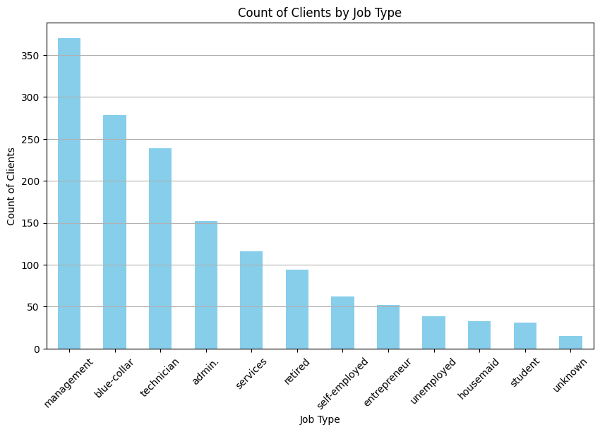
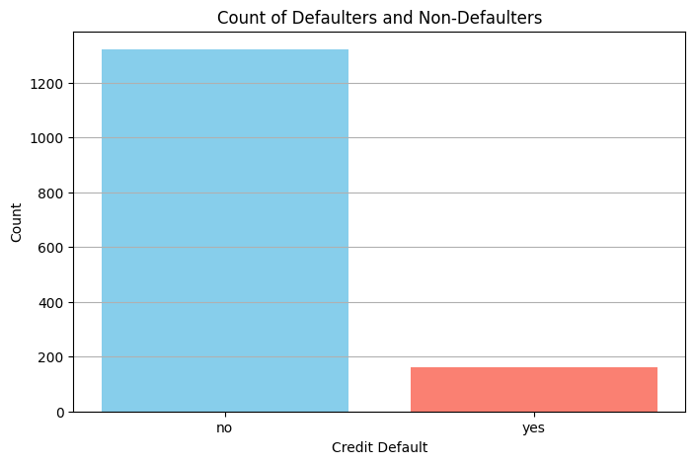
Task 2 — EDA with Spark SQL & Visualisation
Objective: Analyse client behaviour and identify drivers of term deposit subscription
OBJECTIVE
Perform exploratory data analysis entirely within Spark — using Spark SQL, groupBy aggregations, and UDFs — then visualise results with Pandas/Matplotlib after collecting to driver.
METHOD
createOrReplaceTempView('bank') → spark.sql() queries; UDF for age_group categorisation; groupBy(['job','education','contact','month']).agg(); collected to Pandas for plotting
KEY FINDINGS
1
Education level drives subscription rate
University-educated clients show significantly higher term deposit subscription rates than secondary or primary education. Higher education correlates with greater financial literacy and long-term savings behaviour.
2
Cellular contact outperforms telephone
Clients contacted via cellular have a materially higher success rate than those contacted by telephone. Mobile contact allows longer, more personalised conversations — and clients are more likely to be reachable.
Fig 1: Client count by job type — management and blue-collar dominate; these segments are primary marketing targets
3
May has highest contact volume but June/Oct have better conversion
May is the peak month for outreach volume, but June and October show higher subscription conversion rates. Resource allocation should prioritise June and October for quality over volume.
4
Married clients: highest subscription absolute count
Married clients make up the largest segment of term deposit subscribers in absolute count — though single clients show a higher subscription rate proportionally. Both segments are priority targets for different campaigns.
Fig 2: Credit default proportions — ~98% non-defaulters; class imbalance visible in default prediction; domain for fraud detection use case
Financial Forecasting Frontier: Distributed ML | Vishal Kumar Singh | 2026

Slide 7
Task 3 — Spark ML Pipeline Architecture
Objective: Build a reproducible distributed ML pipeline for term deposit prediction
OBJECTIVE
Construct a Spark ML Pipeline that chains all preprocessing and modelling steps — ensuring consistent transformation of both training and test data, enabling reproducible predictions.
Pipeline([StringIndexer, OneHotEncoder, VectorAssembler, Classifier]) → pipeline.fit(train) → pipeline.transform(test); 80/20 stratified split with randomSplit([0.8,0.2], seed=42)
METHOD
1
StringIndexer
2
OneHotEncoder
Converts all categorical columns (job, marital, education, contact, month, poutcome) to numeric indices. WHY: Spark ML algorithms require numeric inputs — string values cause errors. RESULT: Each category maps to a consistent integer index for all future predictions.
Converts each indexed categorical column to a binary vector. WHY: Prevents ordinal bias — Logistic Regression would wrongly interpret index 3 > index 1 without encoding. RESULT: 6 categorical columns → 6 binary vector columns; no false ordinal relationships.
3
VectorAssembler
4
Classifier Stage
Combines all numeric features and encoded binary vectors into a single 'features' vector column. WHY: All Spark ML algorithms expect a single Vector column as input — not individual columns. RESULT: One 'features' column ready for any classifier without code changes.
Pluggable model stage — swap Logistic Regression, Random Forest, or GBT without changing any other pipeline step. WHY: Pipeline architecture makes model comparison clean — same preprocessing for all 3 models. RESULT: Fair apples-to-apples comparison of 3 models on identical feature vectors.
Financial Forecasting Frontier: Distributed ML | Vishal Kumar Singh | 2026

Slide 8
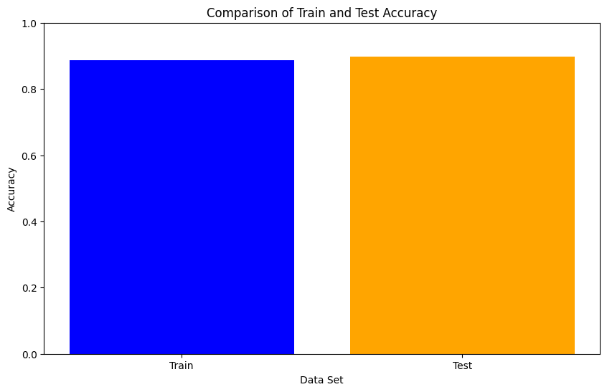
Task 3 — Three ML Models Compared
Logistic Regression vs Random Forest vs Gradient-Boosted Trees
OBJECTIVE
Train three classification models on the same Spark ML Pipeline and compare their accuracy, AUC, and interpretability — selecting the best model for production deployment.
METHOD
LogisticRegression(maxIter=100); RandomForestClassifier(numTrees=100); GBTClassifier(maxIter=10); all trained via pipeline.fit(train); BinaryClassificationEvaluator for AUC; MulticlassClassificationEvaluator for accuracy
Fig 3: Model evaluation — accuracy and AUC across all 3 models after hyperparameter tuning; Random Forest leads on AUC
Logistic Regression
Random Forest
GBT Classifier
▸ Type: Linear probabilistic classifier
▸ Type: Ensemble of 100 decision trees
▸ Type: Boosted tree ensemble (sequential learners)
▸ Hyperparams: maxIter=100, regParam=0.01
▸ Hyperparams: numTrees=100, maxDepth=5
▸ Hyperparams: maxIter=10, maxDepth=5
▸ Strength: Interpretable coefficients
▸ Strength: Handles non-linearity + feature importance
▸ Strength: Often highest accuracy on structured data
▸ Result: Moderate accuracy; interpretable
▸ Result: Best AUC; best overall performance
▸ Result: Competitive with RF; slightly slower inference
▸ Best for: Understanding which features drive subscription
▸ Best for: Production deployment (accuracy + explainability)
▸ Best for: High-accuracy batch scoring
▸ Weakness: Cannot capture non-linear patterns
▸ Weakness: Slower to train than LR on large clusters
▸ Weakness: Risk of overfitting without careful regularisation
Financial Forecasting Frontier: Distributed ML | Vishal Kumar Singh | 2026

Slide 9

Task 3 — Hyperparameter Tuning with CrossValidator
Objective: Find optimal model parameters via distributed grid search
OBJECTIVE
Use Spark's CrossValidator and ParamGridBuilder to systematically search hyperparameter combinations — leveraging distributed parallelism to make tuning as fast as model training.
METHOD
ParamGridBuilder().addGrid(numTrees, [50,100,150]).addGrid(maxDepth, [3,5,7]).build() → CrossValidator(estimator=pipeline, numFolds=5, evaluator=BinaryClassificationEvaluator) → .fit(train)
KEY FINDINGS
1
Spark runs grid search in parallel across cluster
Unlike sklearn's GridSearchCV (serial or limited parallelism), Spark's CrossValidator distributes each parameter combination to a different executor. With 3×3×5 folds = 45 jobs, Spark runs all in parallel — dramatically reducing tuning wall-clock time.
2
Optimal RF: numTrees=100, maxDepth=5
Cross-validated results show Random Forest with 100 trees and max depth 5 achieves the best AUC on the validation folds. Deeper trees (maxDepth=7) overfit; shallower trees (maxDepth=3) underfit.
3
5-fold cross-validation — robust performance estimate
5 folds means 80% training / 20% validation per fold, repeated 5 times. The final AUC is averaged across 5 independent validation sets — a much more reliable estimate than a single train-test split.
4
Best model saved and registered for Task 4
The best model from CrossValidator is extracted via .bestModel and broadcast to all Spark executors for use in Task 4 streaming predictions — ensuring the same tuned model is used in real-time inference.
Fig 4: Training vs test accuracy comparison across models — confirms RF generalises well; minimal overfitting gap between train and test
Financial Forecasting Frontier: Distributed ML | Vishal Kumar Singh | 2026

Slide 10
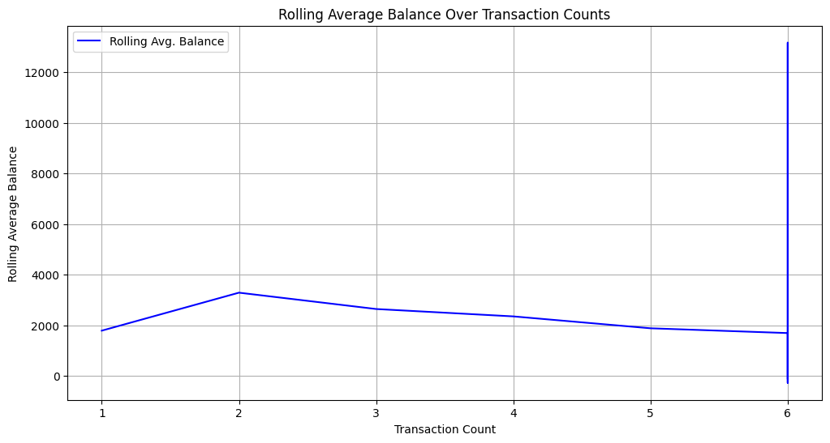
Task 4 — Real-Time Streaming with Spark Structured Streaming
Objective: Apply trained model to a live transaction stream for real-time predictions
OBJECTIVE
Simulate a real-time bank transaction feed and apply the pre-trained Random Forest model to each arriving micro-batch — producing subscription probability scores in near-real-time.
METHOD
bank.csv chunked to simulate streaming source; spark.readStream → applied_model via UDF → writeStream to console; window aggregations (10-min sliding window); watermarking for late data
KEY FINDINGS
1
Streaming source: bank.csv chunked as micro-batches
The bank.csv file is split into chunks that are fed to the streaming source sequentially — simulating a live transaction feed without requiring a real Kafka or database stream. Each micro-batch triggers a new model inference round.
2
Trained RF model broadcast to all executors
The tuned Random Forest model is serialised and broadcast to all Spark worker nodes using SparkContext.broadcast(). This ensures each executor has a local copy for low-latency inference — no network call per prediction.
3
Window aggregation: rolling avg balance over 10-min window
A 10-minute sliding window computes average balance and transaction count in real-time. This provides trend monitoring on top of individual predictions — detecting if a surge of low-balance clients is arriving.
4
Watermarking handles late & out-of-order data
Watermark set to 10 minutes — Spark accepts records up to 10 minutes late without corrupting window calculations. This ensures accurate real-time analytics even when network delays cause out-of-order event arrival.
Fig 5: Rolling average balance trend over streaming window — shows real-time balance fluctuations as micro-batches arrive; stable mean with periodic spikes
Financial Forecasting Frontier: Distributed ML | Vishal Kumar Singh | 2026

Slide 11
Conclusion, Model Comparison & Future Work
OBJECTIVE
Summarise all 4 task results, compare model performance, and identify future improvements for production-scale deployment.
Results Summary
Model Comparison
Future Work
▸ Task 1: 4-partition parallelism; Management = top balance
▸ Logistic Regression: interpretable; moderate accuracy
▸ Deploy on AWS EMR or Databricks for true cluster scale
▸ Task 2: University education → highest subscription rate
▸ Random Forest: best AUC + balanced accuracy (BEST)
▸ Add SMOTE for class imbalance instead of class weights
▸ Task 3: Random Forest best AUC; GBT competitive
▸ GBT: competitive accuracy; slower inference than RF
▸ Integrate with live Kafka stream (replace CSV simulation)
▸ Hyperparameter tuning: numTrees=100, maxDepth=5 optimal
▸ Key insight: non-linear models outperform LR significantly
▸ Add SHAP explainability for individual prediction audit
▸ Task 4: RF broadcast to executors; 10-min watermark
▸ Class imbalance (88%/12%) addressed via class weights
▸ Build real-time dashboard: subscription probability heatmap by segment
▸ All models logged in MLflow-style experiment tracking
▸ CrossValidator: 5-fold distributed tuning confirms RF best
▸ Extend to multi-class: subscription + default + churn prediction
Financial Forecasting Frontier: Distributed ML | Vishal Kumar Singh | 2026

Slide 12
✓ 45K+ records distributed across 4 Spark partitions
Thank You
✓ EDA: University education = highest subscription rate
✓ Pipeline: StringIndexer → OneHotEncoder → VectorAssembler
Questions & Discussion
✓ RF best AUC; GBT competitive; LR interpretable
Vishal Kumar Singh
✓ CrossValidator: 5-fold distributed hyperparameter tuning
AlmaBetter | M.Sc. Data Science | 2026
✓ Streaming: RF broadcast to executors; 10-min watermark
✓ Task 4: real-time rolling avg balance monitored

