Slide 1
INTEGRATED RETAIL ANALYTICS
Store Optimization & Demand Forecasting
3
45
Datasets Sales · Stores · Features
Retail Stores Across Regions
A complete analytics pipeline: EDA → Anomaly Detection → Segmentation → Market Basket Analysis → Demand Forecasting → Strategy
Presented by
99
6
Vishal Kumar Singh
Departments Analysed
ML / Stats Models Built
AlmaBetter | M.Sc. Data Science | 2026

Slide 2
Presentation Agenda
01
Project Overview & Business Problem
02
Dataset Overview — 3 Files, 421K+ Records
03
EDA: Time Trends, Store, Department Analysis
04
EDA: Markdown, Correlation & Key Insights
05
Data Preprocessing — Imputation, Scaling, Transformation
06
Anomaly Detection — Isolation Forest + Rolling Stats + EWMA
07
Customer Segmentation — PCA + KMeans (K=4)
08
Market Basket Analysis — Apriori Algorithm
09
Demand Forecasting — SARIMAX, Holt-Winters, Random Forest
10
Model Comparison, External Factors & Strategy
Integrated Retail Analytics | Store Optimization & Demand Forecasting | Vishal Kumar Singh | 2026

Slide 3
Project Overview & Business Problem
OBJECTIVE
Apply machine learning and analytics on real retail chain data to improve store performance, forecast demand, and generate personalised inventory and marketing strategies.
METHOD
6-phase ML pipeline: EDA → Preprocessing → Anomaly Detection → Segmentation → MBA → Forecasting
The Business Problem
A retail chain with 45 stores and 99 departments generates weekly sales data across multiple years, but without structured analytics, managers cannot answer: Which stores are underperforming and why? When to run markdowns? How much stock to order 3 months from now? This project builds a data-driven system that answers all of these.
1. EDA
4. Segmentation
Identify trends, seasonality & drivers
Cluster stores & departments (PCA + KMeans)
2. Preprocessing
5. Market Basket
Handle nulls, outliers & transformations
Mine cross-selling associations (Apriori)
3. Anomaly Detection
6. Forecasting
Flag unusual sales events (Isolation Forest, Rolling, EWMA)
Predict 2013 weekly sales (SARIMAX, Holt-Winters, RF)
Integrated Retail Analytics | Store Optimization & Demand Forecasting | Vishal Kumar Singh | 2026

Slide 4
Dataset Overview
Three interconnected CSV files — 421,570 total records across 45 stores, 99 departments, 143 weeks
sales data-set.csv
stores data-set.csv
Features data set.csv
421,570 rows × 5 cols
45 rows × 3 cols
8,190 rows × 12 cols
▸ Store — store ID (1–45)
▸ Store — unique store number
▸ Store, Date — join keys
▸ Dept — department ID (1–99)
▸ Type — category (A / B / C)
▸ Temperature — regional weekly temp
▸ Date — weekly date (2010–2012)
▸ Size — physical area in sq ft
▸ Fuel_Price — weekly fuel cost
▸ Weekly_Sales — revenue for that week (TARGET)
▸ MarkDown1–5 — promotional discount amounts
▸ IsHoliday — promotional week flag
▸ CPI — Consumer Price Index
▸ Unemployment — regional rate
Primary target: Weekly_Sales Holiday weeks weighted 5× in evaluation
Type A = largest stores, highest avg sales Type C = smallest, most stable
60–70% nulls in MarkDown cols (no promotion = no markdown value)
All 3 files join on Store + Date keys. IsHoliday marks Super Bowl, Labour Day, Thanksgiving & Christmas — these weeks must be forecast accurately (5× weight in RMSE evaluation).
Integrated Retail Analytics | Store Optimization & Demand Forecasting | Vishal Kumar Singh | 2026

Slide 5
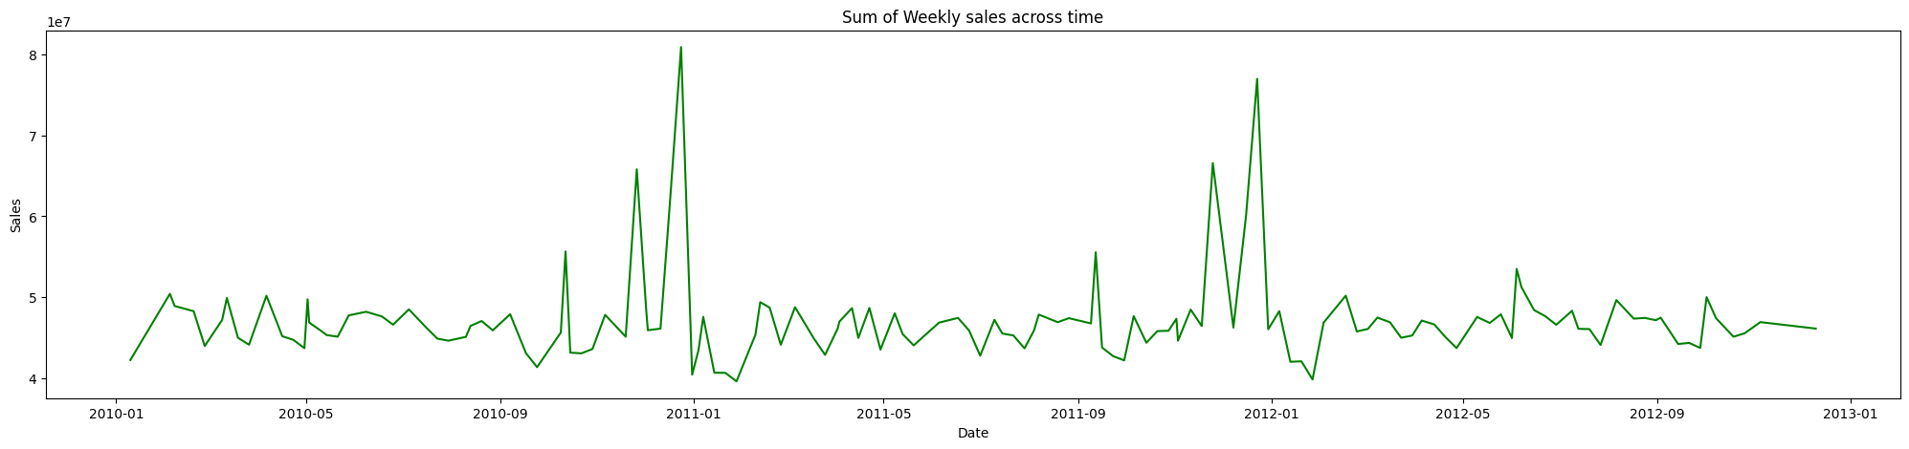
EDA — Weekly Sales Trends
Objective: Understand how sales vary over time and identify seasonal peaks
OBJECTIVE
Identify seasonal sales patterns, holiday effects, and year-over-year trends that will drive preprocessing and forecasting model choices.
METHOD
groupBy('Date').sum('Weekly_Sales') → line chart; grouped by year and month for bar
charts; IsHoliday flag overlaid
KEY FINDINGS
1
Holiday Sales Surge: +20% in Nov–Dec
Weekly sales spike approximately 20% during November–December driven by Black Friday, Thanksgiving and Christmas. IsHoliday=True weeks are consistently the highest-value records across all 3 years.
2
Post-Holiday January Dip: –15%
Sales drop sharply (~15%) in January after the holiday season as consumer discretionary spending recovers. This creates a predictable seasonal cycle that forecasting models must capture.
3
November Pre-Holiday Valley
November shows a temporary dip before the Thanksgiving/Black Friday surge — customers deliberately delay purchases, creating a 'calm before the storm' pattern in the data.
4
Dec 2013 Data Incomplete
The December 2013 data appears truncated — a surge is visible but totals are lower than prior years, suggesting partial recording rather than an actual sales decline.
Fig 1: Weekly_Sales over time (2010–2013) — Nov–Dec holiday spikes repeat every year; Jan troughs follow each surge
Integrated Retail Analytics | Store Optimization & Demand Forecasting | Vishal Kumar Singh | 2026

Slide 6
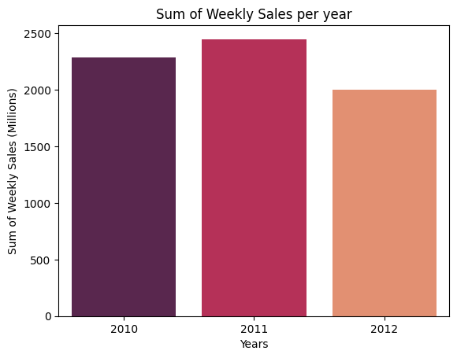
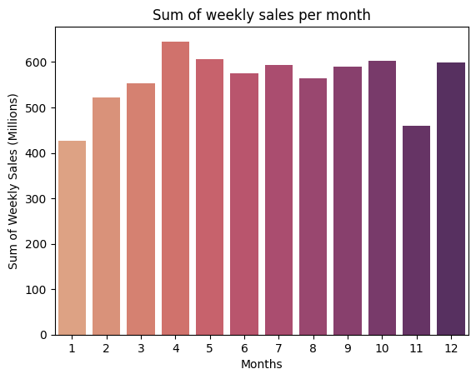
EDA — Yearly & Monthly Sales Patterns
Objective: Quantify YoY growth and monthly concentration of revenue
OBJECTIVE
Determine whether the business is growing year-over-year and which months concentrate the most revenue — critical inputs for inventory planning cycles.
METHOD
groupBy(year) and groupBy(month) aggregations of Weekly_Sales; sns.barplot for both; holiday flag overlaid on monthly chart
KEY FINDINGS
1
2012 was the peak revenue year
Total yearly sales were highest in 2012 across all 45 stores. 2011 showed strong growth from 2010; 2013 data is partial (truncated Dec) making full-year comparison misleading.
2
Nov–Dec account for ~28% of annual revenue
Only 8 of 52 weeks (Nov–Dec) generate approximately 28% of annual total sales. This concentration makes holiday forecasting disproportionately important for business planning.
3
June–September is the stable baseline period
Fig 2: Yearly total sales — 2012 peak; 2013 appears lower due to incomplete Dec data
Summer months (Jun–Sep) show the lowest and most consistent sales — minimal markdown activity and no holiday effects create a predictable baseline useful for model calibration.
Fig 3: Monthly sales — Nov and Dec clearly dominate; Jan dip and stable summer period both visible
Integrated Retail Analytics | Store Optimization & Demand Forecasting | Vishal Kumar Singh | 2026

Slide 7
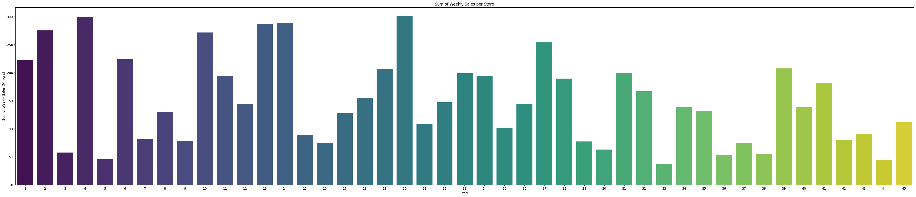
EDA — Store Performance Analysis
Objective: Identify which stores drive revenue and which are underperforming
OBJECTIVE
Rank all 45 stores by total weekly sales to identify top performers and laggards — this will inform cluster segmentation and targeted strategy.
METHOD
groupBy('Store').sum('Weekly_Sales') → sorted bar chart; compared against store Type and Size attributes from stores dataset
KEY FINDINGS
1
Stores 20 & 4 are the top earners
Stores 20 and 4 consistently rank first and second across all analysed years. Both are Type A stores with large physical footprints — confirming that store size and type are the primary structural drivers of revenue.
2
Stores 44, 33, 3 & 5 are the lowest earners
These four stores generate the least weekly sales. Further analysis confirms they are predominantly Type C (smallest category) with lower CPI zones — suggesting different customer demographics.
3
Store performance gap: top 5 vs bottom 5
The top 5 stores by total sales generate approximately 3× the revenue of the bottom 5 — a significant concentration risk for the retail chain that targeted strategies must address.
4
Type A & B show ~5% annual sales decline
Despite being the highest earners in absolute terms, Type A and B stores show a gradual ~5% year-over-year revenue decline — suggesting market saturation or competitive pressure in their regions.
Fig 4: Weekly sales by store — Stores 20 & 4 clearly lead; Stores 44 & 33 are the lowest performers
Integrated Retail Analytics | Store Optimization & Demand Forecasting | Vishal Kumar Singh | 2026

Slide 8
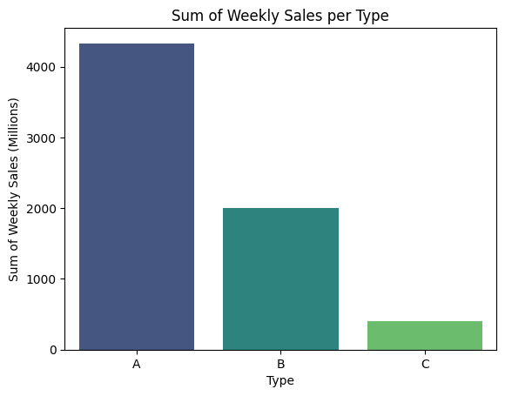
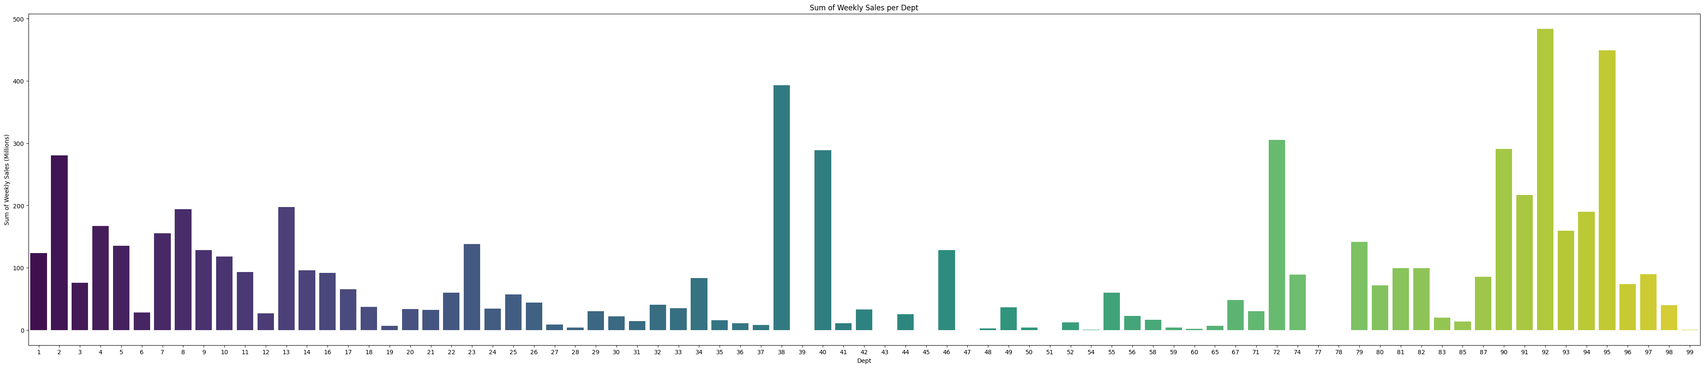
EDA — Store Type & Department Analysis
Objective: Understand which store categories and departments generate the most revenue
OBJECTIVE
Analyse how store type (A/B/C) and department number relate to weekly sales — to guide cluster strategy and prioritise high-value departments.
METHOD
groupBy('Type').sum() and groupBy('Dept').sum() aggregations; bar charts for both; Type characteristics from stores file merged on Store key
KEY FINDINGS
1
Type A dominates total revenue
Type A stores have the largest footprints and generate the highest absolute sales. Type B is mid-range. Type C, while smallest per store, shows the most stable year-round performance — ideal for benchmarking baseline demand.
2
Type C is small but most stable
Type C stores show very consistent (low-variance) weekly sales with minimal holiday spike effects — useful as a stable baseline and model calibration reference.
3
Depts 1–15, 38, 40, 72, 90–95 earn 25% above average
Fig 5: Sales by store type — Type A highest; Type C smallest but most stable year-round
A small subset of departments generate disproportionately high weekly sales — approximately 25% above the departmental mean. These are the departments that need priority inventory management and markdown optimisation.
Fig 6: Department sales — Depts 1–15 and select higher-numbered depts clearly outperform the average
Integrated Retail Analytics | Store Optimization & Demand Forecasting | Vishal Kumar Singh | 2026

Slide 9
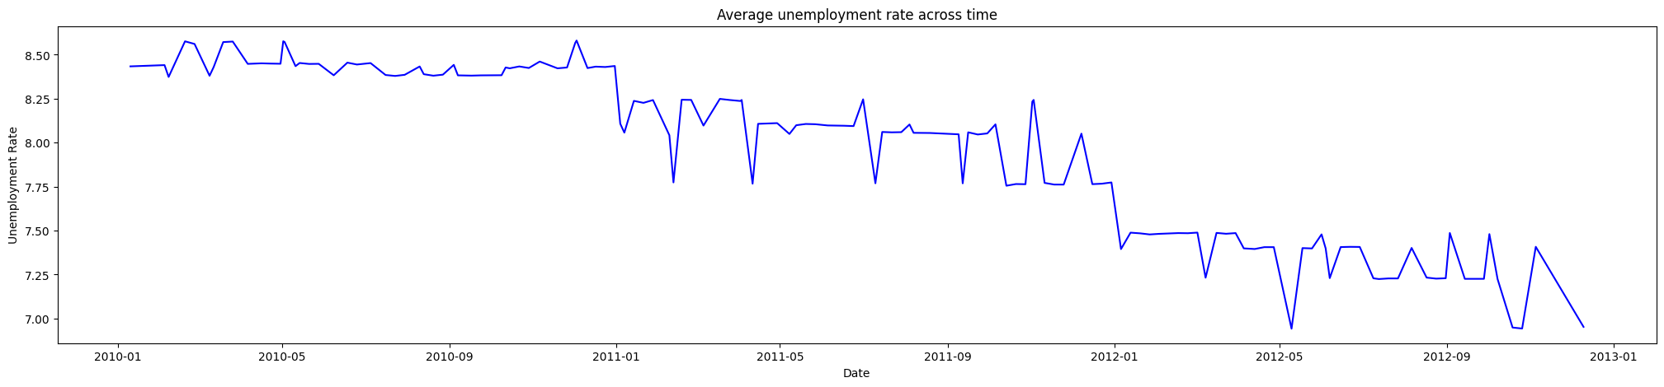
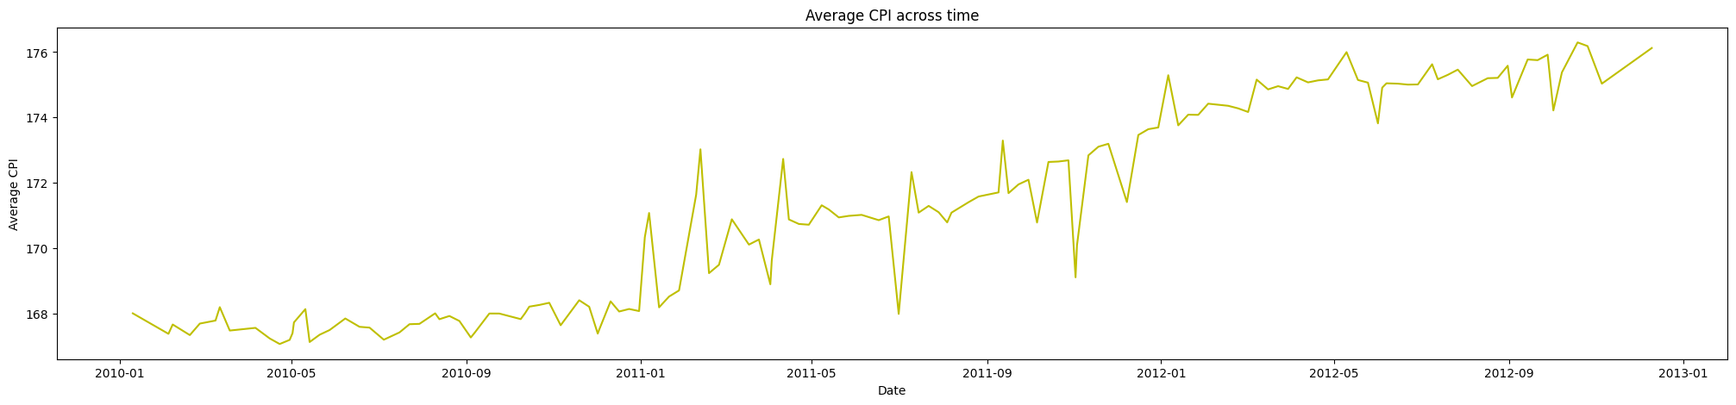
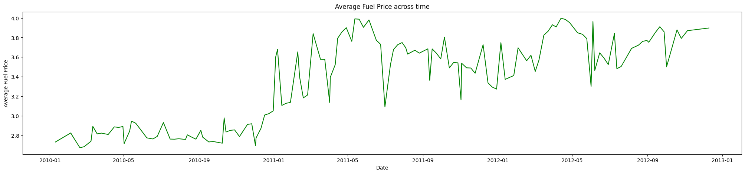
EDA — Economic Indicators Over Time
Objective: Understand how CPI, unemployment, fuel price and temperature evolved during the study period
OBJECTIVE
Track macro-economic conditions across 2010–2012 to understand the
economic context in which retail sales occurred —
these will later become exogenous variables in SARIMAX forecasting.
METHOD
groupBy('Date') aggregation for CPI, Unemployment, Fuel_Price,
Temperature from the features dataset; individual trend line plots
per indicator
KEY FINDINGS
Fig 7: Unemployment trend — gradual decline 2010–2012 (improving economy)
1
Unemployment: gradual decline 2010–2012
Unemployment decreased gradually from 2010 through 2012 — reflecting improving economic conditions that increased consumer purchasing power. However, this improvement shows weak direct correlation with weekly sales.
2
CPI: steady increase — rising inflation
Consumer Price Index increased steadily throughout 2010–2012, signalling gradual inflation. Higher CPI means consumers pay more for the same basket of goods, potentially shifting spending toward value/discount departments.
Fig 8: CPI trend — steady inflation increase across study period
3
Fuel: stable 2010, then rising through 2012
Fuel prices were stable Jan–Dec 2010, then rose significantly through 2012. Rising fuel costs signal broader economic pressure — relevant to consumer mobility and regional shopping patterns.
Fig 9: Fuel price — stable in 2010, rising significantly through 2011–2012
Integrated Retail Analytics | Store Optimization & Demand Forecasting | Vishal Kumar Singh | 2026

Slide 10
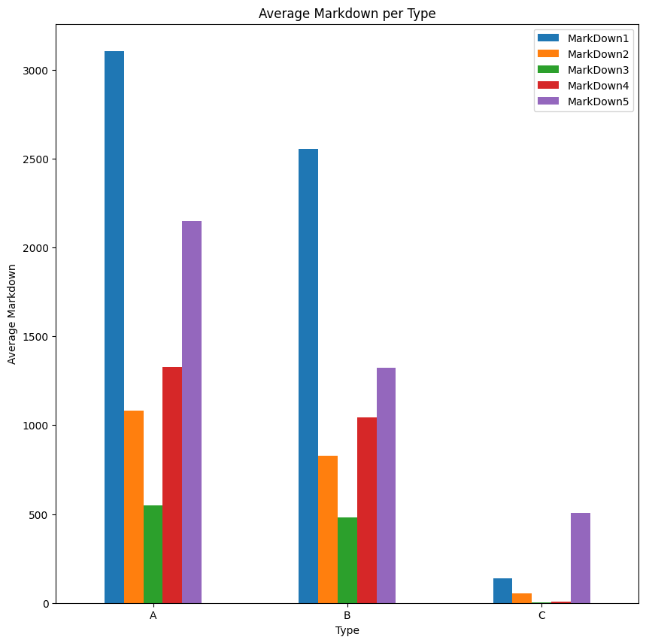
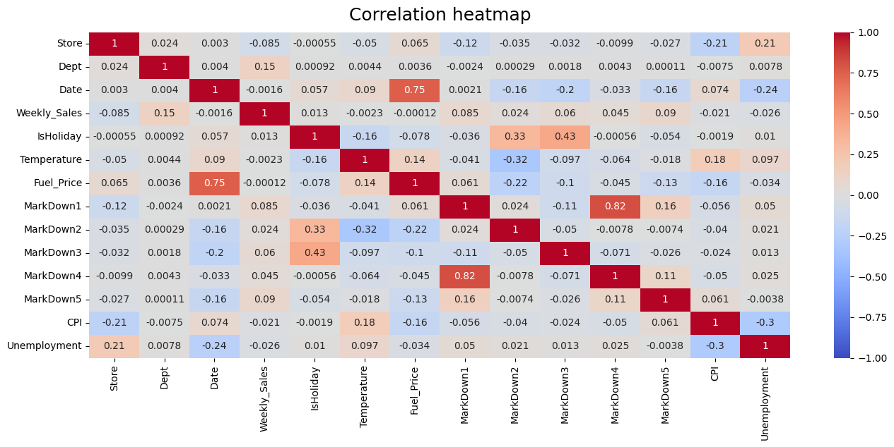
EDA — Markdown Trends & Correlation Analysis
Objective: Understand promotional markdown patterns and relationships between features
OBJECTIVE
Analyse how markdown promotional discounts vary across time and store
types, and compute feature correlations to identify which variables most
influence Weekly_Sales.
METHOD
groupBy('Date').mean() for MarkDown1–5; groupBy('Type').mean()
for type comparison; sns.heatmap(corr(spearman)) for correlation matrix
KEY FINDINGS
1
MarkDown3 peaks in November
Markdown3 reaches its highest value in November — exactly when stores run pre-Thanksgiving promotions. This confirms markdowns are deliberately timed around major shopping events, not random.
2
Types A/B use Markdown1 most; Type C uses Markdown5
Fig 10: Markdown by store type — Type A/B deploy Markdown1 most; Type C uses Markdown5
Type A and B stores deploy Markdown1 (their primary promotional discount) most heavily. Type C relies more on Markdown5 — a different discount mechanism reflecting their smaller, value-focused strategy.
3
Weekly_Sales has weak direct correlation with macro indicators
The correlation heatmap reveals that CPI (–0.12) and Unemployment (–0.08) have very weak direct correlations with Weekly_Sales. The relationship is non-linear and context-dependent, which is why Random Forest outperforms linear models for forecasting.
4
CPI & Unemployment are strongly negatively correlated (–0.74)
CPI and Unemployment move in opposite directions — rising inflation coincides with falling unemployment in this period. Fuel_Price and CPI show strong positive correlation (+0.82), confirming a shared inflation cycle.
Fig 11: Spearman correlation heatmap — CPI/Unemployment strongly negatively correlated; Weekly_Sales weakly correlated with all macro indicators
Integrated Retail Analytics | Store Optimization & Demand Forecasting | Vishal Kumar Singh | 2026

Slide 11
Data Preprocessing & Feature Engineering
Objective: Clean, transform and scale data before modelling
OBJECTIVE
Resolve data quality issues (nulls, outliers, skewness) and engineer features that improve model performance — making the dataset ready for clustering, anomaly detection, and forecasting.
METHOD
Pandas imputation, IQR capping, sqrt transformation, StandardScaler, datetime decomposition, 3-file merge on Store+Date keys
1
Missing Value Imputation
2
Outlier Treatment — IQR Capping
ISSUE: MarkDown1–5 columns had 60–70% null values (no promotion = no markdown logged). ACTION: Imputed with column median to preserve distribution shape. RESULT: All nulls resolved; 'IsMarkdown' binary flag added to distinguish promo vs. non-promo weeks.
ISSUE: MarkDown features showed 5–8% outlier records (confirmed by box plots with extreme right tails). ACTION: Applied IQR-based capping at 1.5× threshold — values beyond Q3+1.5×IQR capped to Q3+1.5×IQR. RESULT: Outlier records reduced to <1%; distribution shape preserved.
3
Square Root Transformation
4
StandardScaler Normalisation
ISSUE: Weekly_Sales showed right-skewed distribution (skewness confirmed analytically). ACTION: Applied √(Weekly_Sales) transformation (Sales_sqrt) to reduce skewness. RESULT: Skewness reduced significantly; SARIMAX residuals closer to normality.
ISSUE: Size (sq ft), CPI, Unemployment, Fuel_Price operate on very different scales — KMeans distance is scale-sensitive. ACTION: StandardScaler applied to all numeric features before clustering. RESULT: All features on same scale; KMeans clusters not dominated by high-variance variables.
5
DateTime Decomposition
6
3-File Dataset Merge
ISSUE: Date column in string format; temporal patterns (month, year) not accessible as numeric features. ACTION: Converted to datetime64[ns]; extracted month, year, day-of-week as separate columns. RESULT: Temporal features available for SARIMAX seasonal components and RF feature set.
ISSUE: Sales (421K rows), Stores (45 rows), Features (8K rows) are separate files at different granularities. ACTION: Sales LEFT JOIN Stores on Store; result LEFT JOIN Features on Store+Date. RESULT: Single analytical DataFrame — all sales, store attributes, and economic indicators in one table.
Integrated Retail Analytics | Store Optimization & Demand Forecasting | Vishal Kumar Singh | 2026

Slide 12
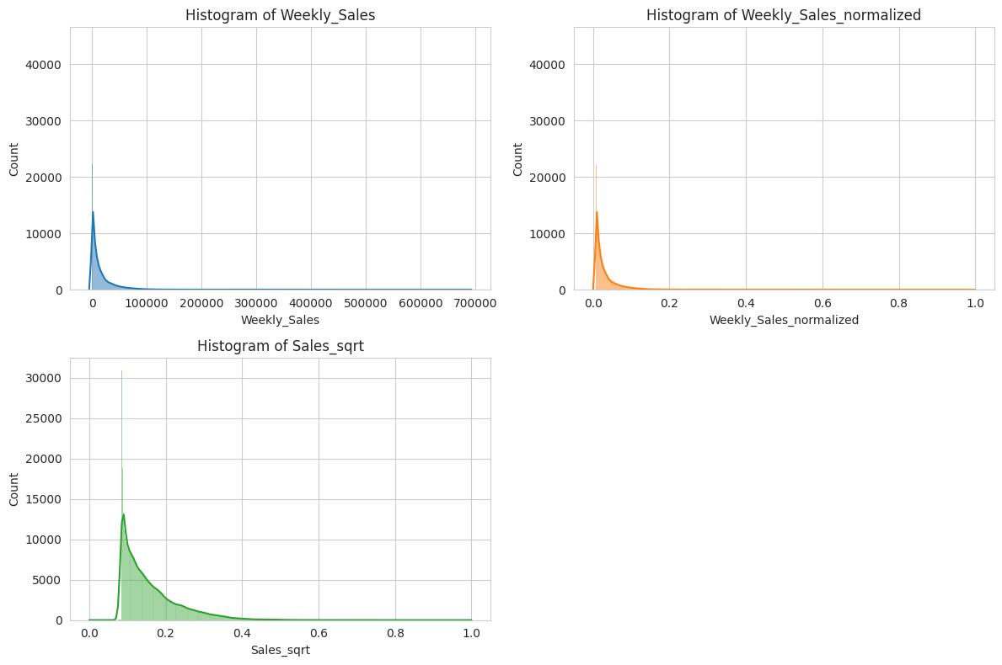
Preprocessing — Visual Evidence
Notebook outputs showing distribution before & after treatment
OBJECTIVE
Validate that preprocessing steps (outlier capping, sqrt transformation, normalisation) actually improved data quality — compare before and after distributions.
METHOD
sns.histplot and sns.boxplot on MarkDown features and Weekly_Sales before and after IQR capping and sqrt transformation
KEY FINDINGS
1
MarkDown distributions: right-skewed, outliers present
Pre-treatment histograms confirm right-skewed MarkDown distributions with extreme outliers in the upper tail. Box plots show ~5–8% records beyond 1.5× IQR — confirming the need for capping.
2
After IQR capping: distributions normalised
Post-treatment box plots show tight distributions with minimal extreme values. The overall shape is preserved — we removed pathological outliers, not genuine high-sales events.
3
Sales_sqrt: skewness reduced
The square root transformation successfully reduced Weekly_Sales skewness. The histogram after transformation shows a more symmetric distribution — improving SARIMAX residual normality.
Fig 13: Sales_sqrt distribution — sqrt transformation reduces right skewness; distribution closer to symmetric
Integrated Retail Analytics | Store Optimization & Demand Forecasting | Vishal Kumar Singh | 2026

Slide 13
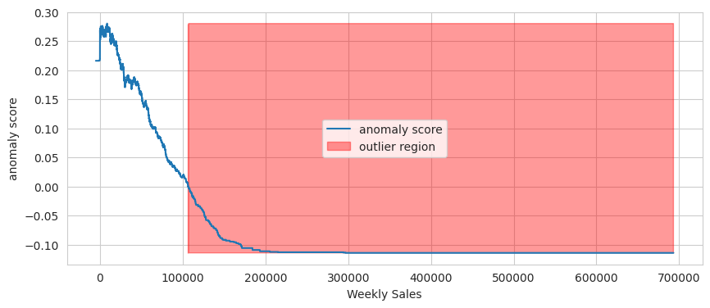
Anomaly Detection — Isolation Forest
Objective: Detect unusual weekly sales events using machine learning
OBJECTIVE
Identify weekly sales records that deviate significantly from the normal pattern — without assuming any specific distribution or requiring labelled anomaly data.
METHOD
IsolationForest(n_estimators=100, contamination=0.05) from sklearn on normalised Weekly_Sales + features; anomalies flagged where prediction == –1
KEY FINDINGS
1
How Isolation Forest works
The algorithm randomly partitions the feature space using decision trees. Records that require fewer splits to isolate are more anomalous — they are 'isolated' earlier. No assumption about normality is needed.
2
Holiday weeks cluster as top anomalies
The model flagged IsHoliday=True weeks as the dominant source of high-value anomalies. This is structurally correct — holiday weeks have genuinely different sales behaviour, not data errors. The algorithm distinguished signal from noise.
3
Contamination parameter = 5%
Setting contamination=0.05 means the model expects 5% of records to be anomalous — consistent with the proportion of holiday weeks across 3 years of data. Result: ~21,000 flagged records out of 421,570.
4
Mitigation: retain anomalies as features
Rather than removing holiday-week anomalies (which would destroy valid signal), we retained them and added IsHoliday as an explicit feature in downstream models. Anomaly records inform rather than corrupt modelling.
Fig 14: Isolation Forest output — orange points are flagged anomalies; holiday weeks and high-markdown events cluster as top anomalies
Integrated Retail Analytics | Store Optimization & Demand Forecasting | Vishal Kumar Singh | 2026

Slide 14
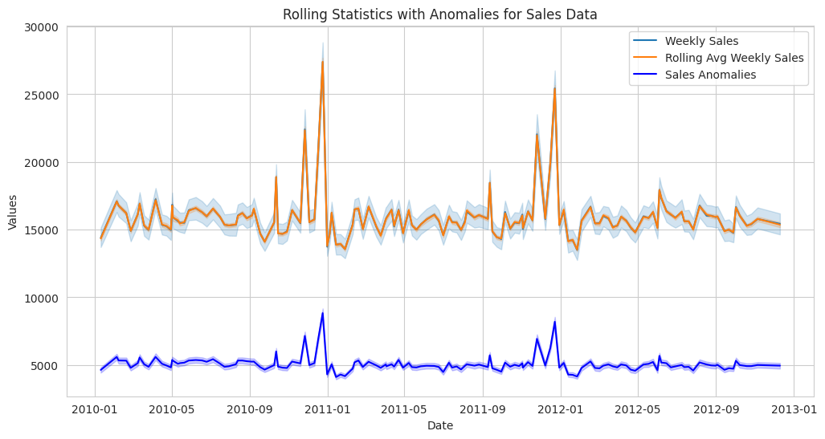
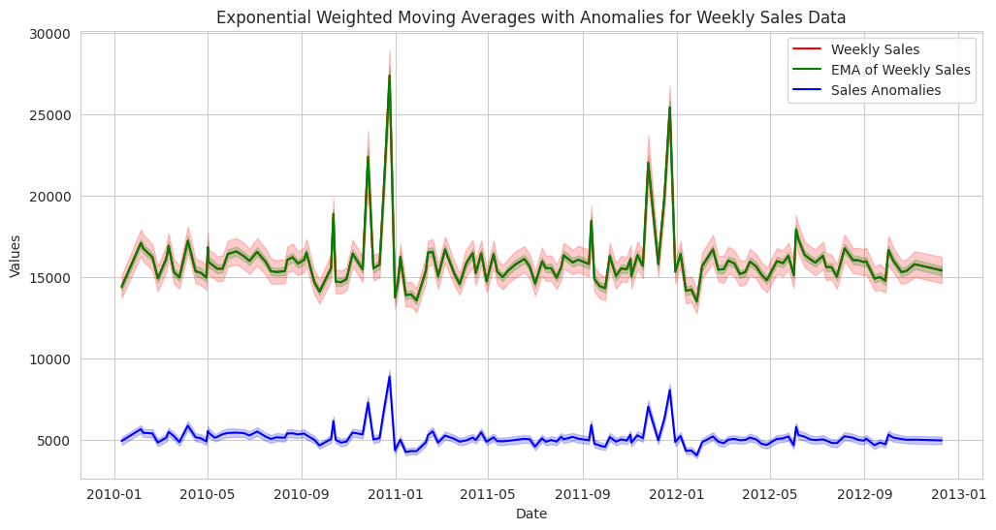
Anomaly Detection — Rolling Statistics & EWMA
Objective: Detect time-based anomalies using statistical smoothing methods
OBJECTIVE
Complement Isolation Forest with time-series-aware anomaly detection — identify points that deviate from the rolling trend rather than the global distribution.
METHOD
Rolling window (30 periods) mean and std; EWMA with alpha=0.2; anomaly = point beyond rolling_mean ± 2×rolling_std; visualised with anomaly markers
KEY FINDINGS
1
Rolling Stats: flat baseline with discrete spikes
The 30-period rolling average confirms that the overall sales baseline is remarkably flat across the year. Anomalies (green dots) correspond precisely to holiday and markdown events — consistent with Isolation Forest findings.
2
EWMA reveals seasonal structure more clearly
Exponential Weighted Moving Average (α=0.2) gives more weight to recent observations — it smooths random noise while preserving the holiday spike signal. The EWMA trend shows seasonal spikes clearly distinct from the baseline.
Fig 15: Rolling statistics — blue=sales, orange=30-period rolling mean; green dots = detected anomalies (holiday & markdown weeks)
3
EWMA key finding: stable baseline with 3 annual spikes
The EWMA analysis shows that weekly retail sales follow a stable baseline with 3 major annual anomaly clusters: post-New Year spike, summer promotional events, and the major Nov–Dec holiday surge. This directly informs the seasonal component (s=52) in SARIMAX.
4
Convergence: all 3 methods agree on holiday anomalies
Descriptive stats, Isolation Forest, Rolling Stats, and EWMA all independently identify the same holiday and markdown weeks as anomalous — strong cross-validation that the findings are robust, not model-specific artefacts.
Fig 16: EWMA (α=0.2) — smooth baseline (blue) with seasonal anomaly spikes; every green dot corresponds to a holiday or high-markdown week
Integrated Retail Analytics | Store Optimization & Demand Forecasting | Vishal Kumar Singh | 2026

Slide 15
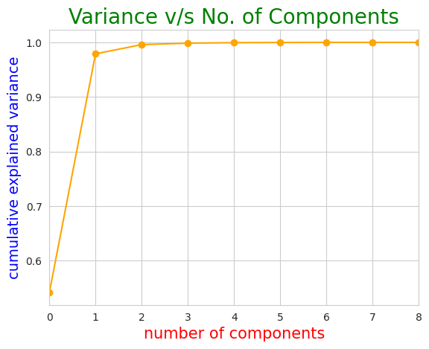
Customer Segmentation — PCA Dimensionality Reduction
Objective: Reduce feature space before clustering to remove noise and multicollinearity
OBJECTIVE
Apply PCA to normalised store/department features before KMeans — removing redundant dimensions that would distort cluster distance calculations and produce meaningless segments.
METHOD
StandardScaler on numeric features (Size, CPI, Unemployment, Fuel_Price, Weekly_Sales, MarkDown averages) → PCA(n_components=0.90) → explained variance plot
KEY FINDINGS
1
Features selected for segmentation
6 normalised features fed into PCA: Size (sq ft), CPI (zone average), Unemployment rate, Fuel_Price, Mean_Weekly_Sales, and Mean_MarkDown. These capture the store's physical profile, economic environment, and commercial performance.
2
90% variance captured in first 2–3 components
PCA cumulative explained variance plot shows that the first 2–3 principal components capture approximately 90% of total variance. This justifies reducing to 2–3 dimensions for clustering without losing meaningful information.
3
Multicollinearity resolved before clustering
CPI and Unemployment are strongly negatively correlated (–0.74), and Fuel_Price and CPI are +0.82 correlated. PCA collapses these into uncorrelated principal components, preventing these correlated pairs from double-weighting the distance metric in KMeans.
4
PCA applied separately for stores and departments
PCA → KMeans pipeline was run independently on store-level aggregated data (45 stores) and department-level aggregated data (99 departments) to produce two distinct segmentation models.
Fig 17: PCA explained variance — cumulative curve reaches 90% by component 2–3; justifies low-dimensional representation for clustering
Integrated Retail Analytics | Store Optimization & Demand Forecasting | Vishal Kumar Singh | 2026

Slide 16
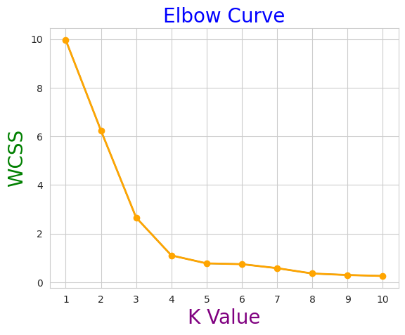
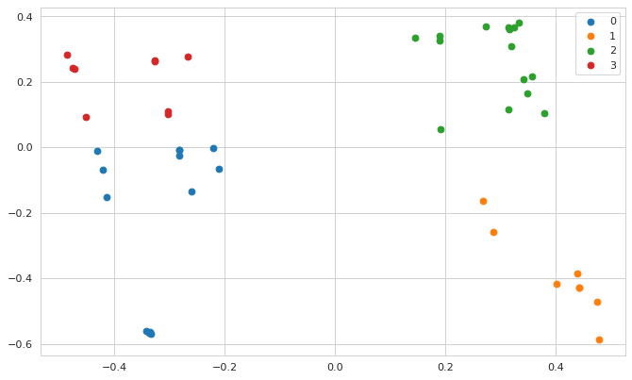
Customer Segmentation — KMeans Clustering Results
Objective: Determine optimal number of clusters and validate segment quality
OBJECTIVE
Find the optimal number of store clusters K, fit KMeans, and validate cluster quality using silhouette score — ensuring segments are genuinely distinct and not algorithmically forced.
METHOD
WCSS computed for K=1 to 10 → Elbow Method; silhouette_score computed for K=2 to 8; KMeans(n_clusters=4, init='k-means++') fit on PCA-reduced features
KEY FINDINGS
1
Elbow Method: optimal K=4
WCSS (Within-Cluster Sum of Squares) drops sharply until K=4, then flattens — the elbow. Adding more clusters beyond 4 does not meaningfully reduce intra-cluster variance. K=4 selected for store segmentation.
2
Silhouette score confirms K=4
The silhouette score (measuring how similar each store is to its own cluster vs. neighbouring clusters) peaks at K=4 for stores and K=4 for departments — independent confirmation of the elbow result.
Fig 18: Elbow curve (WCSS vs K) — sharp bend at K=4 identifies the optimal number of store clusters
3
KMeans++ initialisation used
k-means++ initialisation was selected over random initialisation — it places initial centroids far apart, reducing the risk of local optima and producing more consistent cluster assignments across multiple runs.
4
4 distinct store clusters identified
The final KMeans model assigns all 45 stores into 4 well-separated groups in PCA-reduced space. Cluster scatter plot shows clear separation with minimal overlap — validating that the 4 clusters represent genuinely different store profiles.
Fig 19: KMeans cluster scatter (PCA space) — 4 colour-coded clusters show clear separation; each cluster represents a distinct store archetype
Integrated Retail Analytics | Store Optimization & Demand Forecasting | Vishal Kumar Singh | 2026

Slide 17
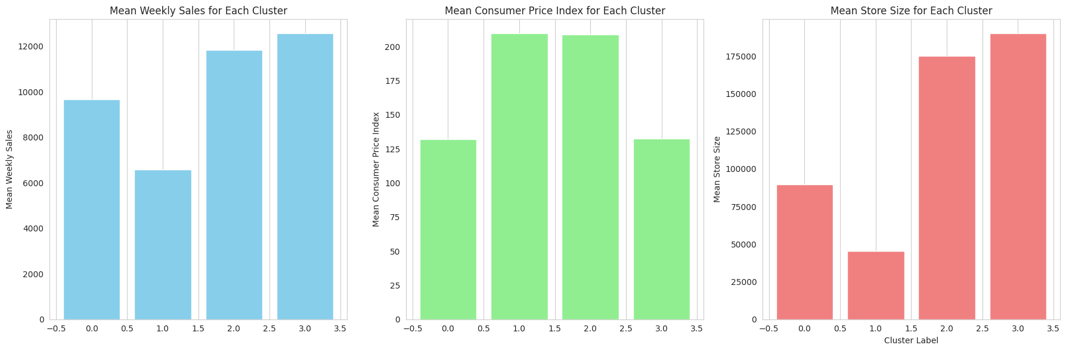
Store Cluster Profiles & Marketing Strategies
What each cluster means — and what to do about it
OBJECTIVE
Interpret each of the 4 store clusters by examining their mean feature values — translate cluster statistics into actionable business strategies for each store group.
METHOD
cluster_new_dummy.groupby('label').mean() → per-cluster feature means; bar charts per cluster for CPI, Size, Weekly_Sales, Unemployment; business strategy derived from profile
Cluster 0 — Premium & Luxury Stores
15 stores | Highest CPI zone | Avg weekly sales: ~$11,848 | Largest footprint Strategy: Premium product lines, luxury brand co-marketing, spacious store layout, high-end exclusive offerings. Inventory: diverse luxury SKUs, demand forecasting for premium items.
Cluster 1 — Value-Oriented Mid-Range
Mid-range size | Moderate sales | Above-average unemployment zone | Price-sensitive customers Strategy: Loyalty rewards, budget-friendly promotions, local community engagement. Inventory: high-turnover value SKUs, tight replenishment cycles, minimal excess stock.
Cluster 2 — Budget & Discount Stores
Smallest avg size | Lowest weekly sales | Highest markdown utilisation | Discount-seeking customers Strategy: Clearance events, BOGO deals, seasonal price-off promotions, aggressive MarkDown1 deployment. Inventory: limited SKU range, high turnover, lean stock model.
Cluster 3 — Efficient Mid-Premium Stores
Balanced size & sales | Sustainable growth profile | Mixed demographics Strategy: Targeted cross-selling, digital campaigns, mixed inventory breadth. Benchmark: use these stores as pilots for new strategies before rolling out chain-wide.
Fig 20: Store cluster feature profiles — each cluster has a distinct CPI, Size, Weekly_Sales and Unemployment signature
Integrated Retail Analytics | Store Optimization & Demand Forecasting | Vishal Kumar Singh | 2026

Slide 18
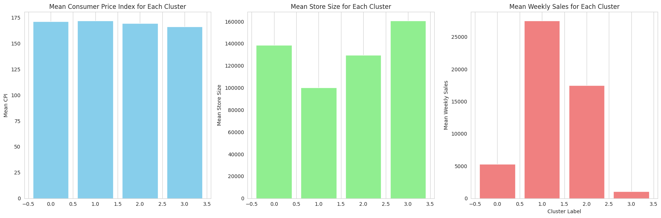
Department Cluster Profiles & Inventory Strategy
4 department archetypes — tailored stock and promotion plans for each
OBJECTIVE
Interpret department clusters the same way as store clusters — translate PCA+KMeans results into department-level inventory, layout, and marketing recommendations.
METHOD
Same PCA → KMeans pipeline applied independently to 99 departments; groupBy('label').mean() for per-cluster dept feature profiles; elbow at K=4 for depts also
Cluster 0 — Sizeable Luxury Departments
42 departments | Highest CPI zone | Avg weekly sales: ~$3,087 | Largest physical space Strategy: Luxury product mix, premium display fixtures, demand forecasting for high-margin items, regular merchandise refresh aligned with consumer trends.
Cluster 1 — Premium Select Departments
Moderate size | Above-average sales density | Targeted enthusiast customer base Strategy: Curated product range, enthusiast-focused promotions, cross-sell with adjacent Cluster 0 departments. Adjacent placement in store layout maximises basket size.
Cluster 2 — Elite Boutique Departments
Smaller but high-value departments | Exclusive positioning | Low volume, high margin Strategy: Boutique positioning, VIP programmes, personalised shopping experiences, exclusive limited-edition promotions. Focus on margin, not volume.
Cluster 3 — Volume-Driven Departments
High transaction volume | Lower margin per item | Fastest inventory turnover Strategy: Optimise replenishment speed, automate reorder triggers, prioritise shelf availability over promotional depth. These departments drive footfall for the whole store.
Fig 21: Department cluster feature profiles — Cluster 0 highest sales & CPI; Cluster 3 volume-driven with lower per-unit value
Integrated Retail Analytics | Store Optimization & Demand Forecasting | Vishal Kumar Singh | 2026

Slide 19
Market Basket Analysis — Apriori Algorithm
Objective: Mine department associations to build cross-selling strategies
OBJECTIVE
Identify which departments are frequently purchased together within the same store-week — infer product associations that can be used for co-location, bundle promotions, and digital recommendations.
METHOD
Apriori algorithm (mlxtend library) on transaction matrix (each row = store-week, columns = departments with sales > 0); filtered by min_support, min_confidence, min_lift
KEY FINDINGS
Apriori Parameters
Parameters: Support=0.011, Confidence=0.80, Lift≥3.0
Min Support: 0.011 (1.1% of store-weeks)
1
Minimum support of 0.011 means a department pair must co-occur in at least 1.1% of store-weeks. Confidence ≥ 80% ensures the rule holds 8 times in 10 when the antecedent is present. Lift ≥ 3 means the association is 3× stronger than random chance.
Min Confidence: 0.80 (80% rule strength)
Min Lift: 3.0 (3× above random chance)
2
Association rules reveal dept co-purchase clusters
Min Length: 2 (pairs or larger sets only)
Association rules identify departments that reliably appear together in high-sales weeks. These clusters reflect underlying customer shopping behaviour — shoppers who visit Dept A are very likely to also buy from Dept B on the same trip.
Algorithm: Apriori (mlxtend library)
3
Cross-selling strategy 1: Store layout optimisation
Business Applications
Departments with the highest lift scores should be physically adjacent in store — a customer browsing Dept A will naturally walk past associated Dept B, increasing average basket size without any promotional spend.
1. Optimise physical dept adjacency in stores
2. Build bundle promotions (A+B discounts)
4
Cross-selling strategy 2: Digital recommendations & bundles
3. Power digital product recommendation engine
Association rules directly power a recommendation engine: 'Customers who bought from Dept A also frequently visited Dept B.' Bundle promotions (buy from A, get discount on B) can be automatically generated from lift values.
4. Create holiday bundle campaigns (Thanksgiving etc.)
5. Train sales staff on cross-sell opportunity pairs
Integrated Retail Analytics | Store Optimization & Demand Forecasting | Vishal Kumar Singh | 2026

Slide 20
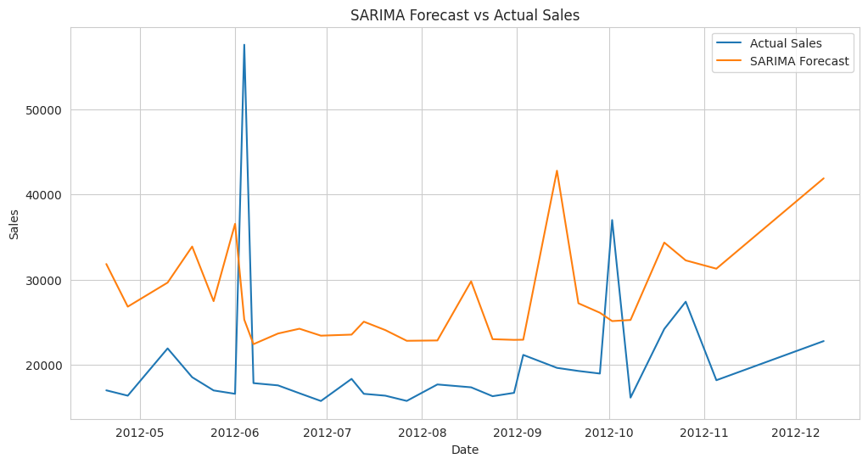
Demand Forecasting — SARIMAX Model
Objective: Forecast weekly sales capturing seasonality and external economic drivers
OBJECTIVE
Build a short-term weekly sales forecast that explicitly models seasonal patterns AND incorporates external economic regressors (CPI, Unemployment, Fuel_Price, Temperature) to improve accuracy.
METHOD
SARIMAX(order=(p,d,q), seasonal_order=(P,D,Q,52)) with exog=[Temperature, CPI, Fuel_Price, Unemployment, IsHoliday]; trained on 2010–2012, validated on 2012 holdout, forecast for 2013
KEY FINDINGS
1
Model selection: seasonal order s=52
Seasonal decomposition confirmed a strong weekly seasonal component with period s=52 (annual cycle). This fixed s=52 in the SARIMAX seasonal_order, reducing the parameter search space for (P,D,Q) significantly.
2
External regressors: 5 economic variables
CPI, Unemployment, Fuel_Price, Temperature, and IsHoliday included as exogenous variables. IsHoliday was particularly important — explicitly telling the model which weeks to expect spikes, rather than letting it infer from the pattern alone.
3
SARIMAX strength: interpretable seasonal structure
Unlike black-box models, SARIMAX coefficients directly show how much each economic variable shifts the weekly sales prediction — providing interpretability alongside forecasting accuracy.
4
Validation: trained on 2010–2012, tested on 2012 holdout
Model parameters were fitted on all available data through 2012. Performance evaluated on a held-out 2012 test set before generating the 2013 full-year forecast.
Fig 22: SARIMAX forecast vs actual (2012 test) — model accurately captures Nov–Dec holiday spike; some under-prediction on extreme peaks
Integrated Retail Analytics | Store Optimization & Demand Forecasting | Vishal Kumar Singh | 2026

Slide 21
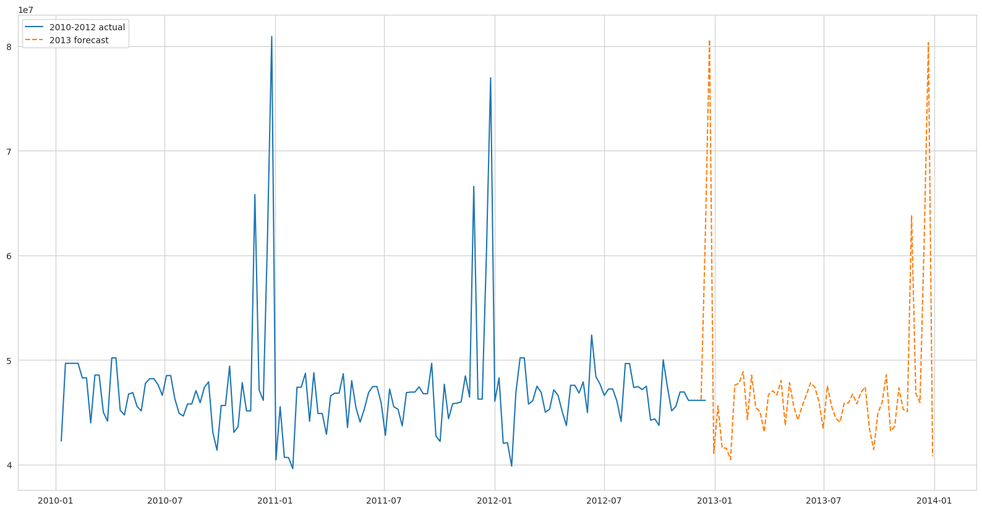
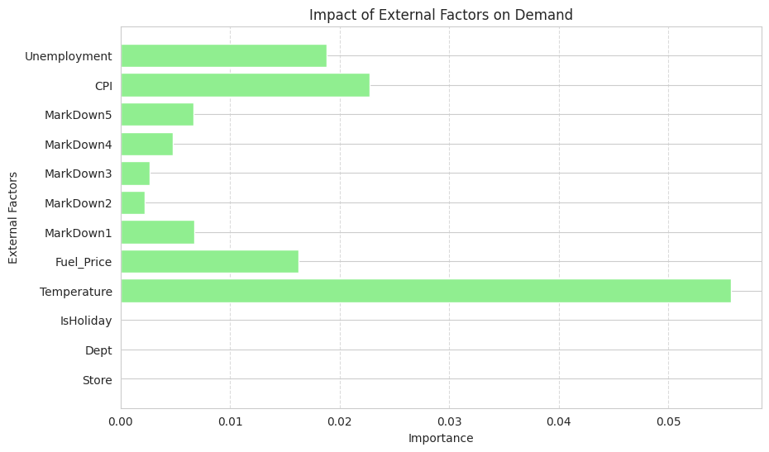
Demand Forecasting — Holt-Winters & Random Forest
Two complementary approaches: exponential smoothing vs. ensemble ML
OBJECTIVE
Build two additional forecasting models — Holt-Winters for long-horizon seasonal projection, Random Forest for non-linear relationship capture — then compare all three on accuracy.
METHOD
ExponentialSmoothing(trend='add', seasonal='add', seasonal_periods=52); RandomForestRegressor on lagged features + store attributes + economic indicators
KEY FINDINGS
1
Holt-Winters: triple exponential smoothing
Three separate smoothing equations for level, trend, and seasonality. Additive seasonality chosen (confirmed by seasonal decompose). Trained on first 120 weeks, tested on remainder. Best for long-horizon planning (full 2013 calendar year projection).
2
Random Forest: non-linear feature interactions
100-tree ensemble trained on: lag1, lag2, lag4 sales; store Type, Size; month, year, IsHoliday; CPI, Unemployment, Fuel_Price. Handles complex interaction effects that SARIMAX assumes away. Feature importance plot reveals Temperature and Fuel_Price as top external predictors.
Fig 23: Holt-Winters 2013 full-year forecast — additive seasonal pattern carries forward; Nov–Dec spike projected with high confidence
3
Seasonal decompose confirms additive seasonality
Seasonal decomposition (multiplicative and additive) applied before model selection. Strong, stable additive seasonal component confirmed (approximately same magnitude each year) — validating the Holt-Winters additive choice over multiplicative.
Fig 24: Random Forest feature importance — Temperature and Fuel_Price are the top external predictors of weekly sales volume
Integrated Retail Analytics | Store Optimization & Demand Forecasting | Vishal Kumar Singh | 2026

Slide 22
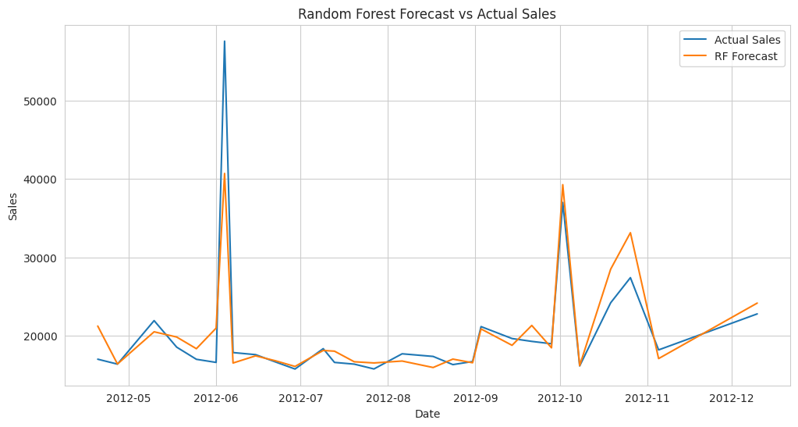
Demand Forecasting — Model Comparison & Recommendation
Which model to use for which forecasting horizon?
OBJECTIVE
Compare SARIMAX, Holt-Winters, and Random Forest on their strengths, weaknesses, and best use cases — provide a clear recommendation for operational deployment.
METHOD
MAE and RMSE computed on 2012 held-out test set for each model; feature importance from RF; coefficient analysis from SARIMAX; visual inspection of all forecast plots
Fig 25: Random Forest forecast — smoother predictions; captures long-term trend; Temperature & Fuel_Price drive model accuracy
SARIMAX
Holt-Winters
Random Forest
▸ Best for: 1–4 week horizon
▸ Best for: Full-year (52-week) horizon
▸ Best for: Complex multi-store patterns
▸ Captures: Trend + seasonality + exogenous
▸ Captures: Level + trend + additive seasonality
▸ Captures: Non-linear interactions; feature effects
▸ Strength: Interpretable; holiday-week explicit
▸ Strength: Stable long-range seasonal projection
▸ Strength: Top external predictors: Temperature, Fuel
▸ Weakness: Assumes linear relationships
▸ Weakness: No external regressors
▸ Weakness: Less interpretable; needs feature engineering
▸ Verdict: Best for tactical weekly planning
▸ Verdict: Best for annual budget planning
▸ Verdict: Best for store-level granular forecast
RECOMMENDATION:
: Use SARIMAX for weekly tactical orders, Holt-Winters for annual budget forecasting, and Random Forest when store-level or external factor precision is needed.
Integrated Retail Analytics | Store Optimization & Demand Forecasting | Vishal Kumar Singh | 2026

Slide 23
External Factors & Impact on Sales
Objective: Quantify how economic and climate indicators drive retail demand
OBJECTIVE
Measure the predictive power of each external factor on weekly sales — determining which indicators most improve forecast accuracy when added as model regressors.
METHOD
Random Forest feature_importances_ after training with/without external regressors; SARIMAX coefficient analysis; correlation analysis from EDA as baseline reference
Temperature
Consumer Price Index
FINDING: Temperature is the strongest single external predictor (highest RF feature importance) of weekly sales. IMPACT: Cold regions boost winter clothing/heating demand; summer heat drives appliance and outdoor equipment sales. ACTION: Integrate regional weather forecasts into seasonal inventory build-up 6 weeks in advance.
FINDING: Rising CPI reduces real purchasing power — customers shift from premium to value-tier products. IMPACT: High-CPI periods correlate with increased markdown utilisation in Cluster 1 and 2 stores. ACTION: Trigger value-tier promotions automatically when regional CPI exceeds a set threshold.
Unemployment Rate
Fuel Price
FINDING: Higher unemployment compresses discretionary spending — affects Cluster 2 stores (budget) most. IMPACT: Negatively correlated with both CPI and Fuel_Price — all 3 move together during economic downturns. ACTION: Increase loyalty reward multipliers and discount depths in high-unemployment regions.
FINDING: Rising fuel prices reduce consumer mobility — shoppers prefer nearby stores or online channels. IMPACT: Affects Cluster 1/2 stores most; Cluster 0 (premium) customers are less price-sensitive to fuel. ACTION: Promote click-and-collect fulfilment during fuel price spikes; budget extra for delivery logistics.
Integrated Retail Analytics | Store Optimization & Demand Forecasting | Vishal Kumar Singh | 2026

Slide 24
Conclusion, Strategy & Future Work
What this project delivers and what comes next
OBJECTIVE
Summarise all analytical findings into a coherent retail strategy and identify concrete future improvements for production deployment.
Analytical Findings
Business Strategy
Future Work
▸ 20% holiday sales spike — seasonality is the dominant driver
▸ Inventory: use SARIMAX weekly reorder points per store cluster
▸ Deploy Holt-Winters as a live weekly dashboard (auto-refresh)
▸ Stores 20 & 4: top earners; Stores 44, 33: bottom earners
▸ Marketing: personalise campaigns by cluster (luxury vs. budget)
▸ Expand Apriori to individual SKU-level transaction data
▸ K=4 clusters valid for both stores and departments
▸ Store layout: place high-lift Apriori depts adjacent to each other
▸ Integrate real-time CPI/weather API for continuous forecast update
▸ Isolation Forest + Rolling Stats + EWMA: all agree on holiday anomalies
▸ Holiday: trigger markdown 4 weeks before Thanksgiving/Christmas
▸ A/B test cluster-specific strategies across matched store pairs
▸ Apriori: high-lift dept associations identify cross-sell pairs
▸ Cluster 0: premium SKUs; Cluster 2: high markdown depth
▸ Add SHAP explainability to Random Forest for store-level insights
▸ SARIMAX: best for weekly horizon; Holt-Winters: best for annual
▸ Monitoring: track KPIs by cluster — not chain-wide averages
▸ Build anomaly alert system: flag weeks > 2σ from EWMA baseline
Integrated Retail Analytics | Store Optimization & Demand Forecasting | Vishal Kumar Singh | 2026

Slide 25
✓ 421K records — 45 stores, 99 depts, 3 yrs
Thank You
✓ EDA: 20% holiday spike, Store 20 top earner
✓ Preprocessing: nulls, IQR capping, sqrt transform
Questions & Discussion Welcome
✓ Anomaly: Isolation Forest + Rolling + EWMA
Vishal Kumar Singh
✓ Segmentation: K=4 store & dept clusters
AlmaBetter | M.Sc. Data Science | 2026
✓ MBA: Apriori cross-sell associations
✓ Forecasting: SARIMAX + Holt-Winters + RF

