Slide 1
VOYAGE ANALYTICS
Integrating MLOps in Travel
271K
3
Travel Records 3 Datasets
ML Models Built & Deployed
End-to-end production ML system: Flight price prediction, gender classification, hotel recommendation — deployed via MLflow, Docker, and Streamlit
Presented by
R²≈1
MLOps
Vishal Kumar Singh
AlmaBetter | M.Sc. Data Science | 2026
Price Prediction Random Forest
Airflow · MLflow Docker · Streamlit

Slide 2
Presentation Agenda
01
Project Overview & Business Problem
02
Dataset Overview — Users, Hotels, Flights (271,888 rows)
03
EDA: Flight Routes, Pricing & Distributions
04
EDA: Correlations, Age, Agency Analysis
05
Data Wrangling & Feature Engineering
06
Outlier Detection & Data Scaling
07
Model 1: Flight Price Prediction (Regression)
08
Model 2: Gender Classification (Sentence Transformers + PCA)
09
Model 3: Hotel Recommendation Engine (Content-Based Filtering)
10
MLOps: MLflow Tracking, Docker & Streamlit Deployment
Voyage Analytics: Integrating MLOps in Travel | Vishal Kumar Singh | 2026

Slide 3
Project Overview & Business Problem
OBJECTIVE
Build a production-grade ML system for the travel industry that predicts flight prices, classifies user gender from name, and recommends hotels — all deployed with MLOps best practices.
METHOD
EDA → Feature Engineering → Regression + Classification + Recommendation → MLflow experiment tracking → Docker containerisation → Streamlit deployment
The Business Problem
Travel platforms face three core challenges: (1) Flight prices are highly volatile — customers cannot predict costs, reducing booking confidence. (2) Personalised hotel recommendations require knowing user demographics, but not all users provide full profiles. (3) Operational teams need scalable, reproducible ML pipelines — not one-off notebooks. This project solves all three.
1
Flight Price Prediction
Regression model to predict ticket price from route, distance, time, airline and user features. Enables dynamic pricing display on booking page.
2
Gender Classification
Predict user gender from name using Sentence Transformer embeddings + PCA + classification. Enables personalised UX without requiring form fields.
3
Hotel Recommendation
Content-based filtering engine that matches hotels to user trip profile (destination, budget, dates). Increases booking conversion rate.
Voyage Analytics: Integrating MLOps in Travel | Vishal Kumar Singh | 2026

Slide 4
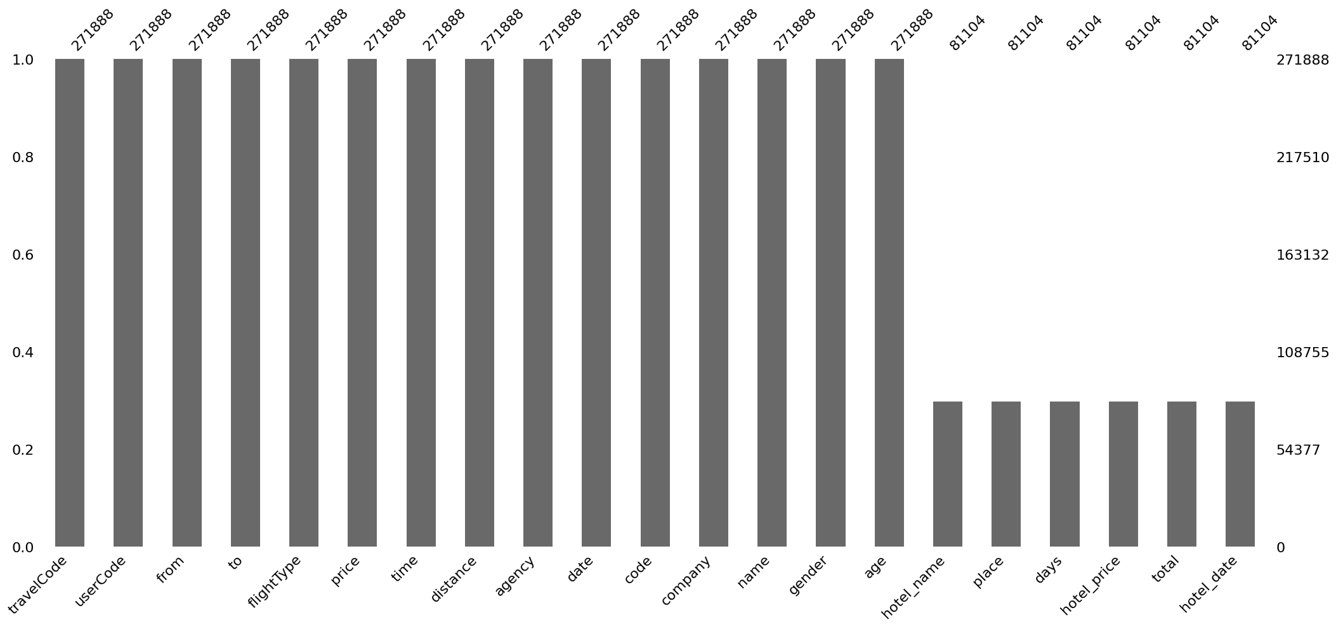
Dataset Overview
Three linked datasets: 271,888 travel booking records from a Brazilian travel platform
OBJECTIVE
Understand the structure and quality of the three source datasets before analysis — identify join keys, data types, missing values, and initial data quality concerns.
METHOD
pd.read_csv() + df.info() + df.isnull().sum() + df.describe() + df.duplicated().sum() on flights, users, and hotels dataframes; merged on travelCode/userCode keys
Fig 1: Missing values heatmap — hotel-related columns (hotel_name, place, hotel_price) show 70% null — expected as most bookings are flight-only
flights.csv
users.csv
hotels.csv
Records: 271,888 | Cols: 11
Records: 271,888 | Cols: 5
Records: 271,888 | Cols: 6 (190,784 nulls in hotel cols)
▸ travelCode — unique booking ID
▸ userCode — unique user ID
▸ travelCode — join key
▸ from → to — origin & destination
▸ name — full name (for gender classification)
▸ hotel_name — hotel chosen (if any)
▸ flightType — first/economic/premium
▸ gender — male/female (gender model TARGET)
▸ place — hotel city
▸ price — ticket price (TARGET for regression)
▸ age — user age
▸ days — number of nights
▸ time — flight duration (hours)
▸ company — frequent-flyer company
▸ hotel_date — check-in date
▸ distance — route distance (km)
▸ hotel_price — hotel cost
▸ agency — booking agency
Strong positive correlation: price ~ distance (~0.64) time & distance perfectly correlated (r=1.0)
User age: median ~42 yrs (range 30–55) Gender not always provided — ML fills this gap
70% of rows have null hotel columns (most bookings are flight-only, no hotel)
Voyage Analytics: Integrating MLOps in Travel | Vishal Kumar Singh | 2026

Slide 5
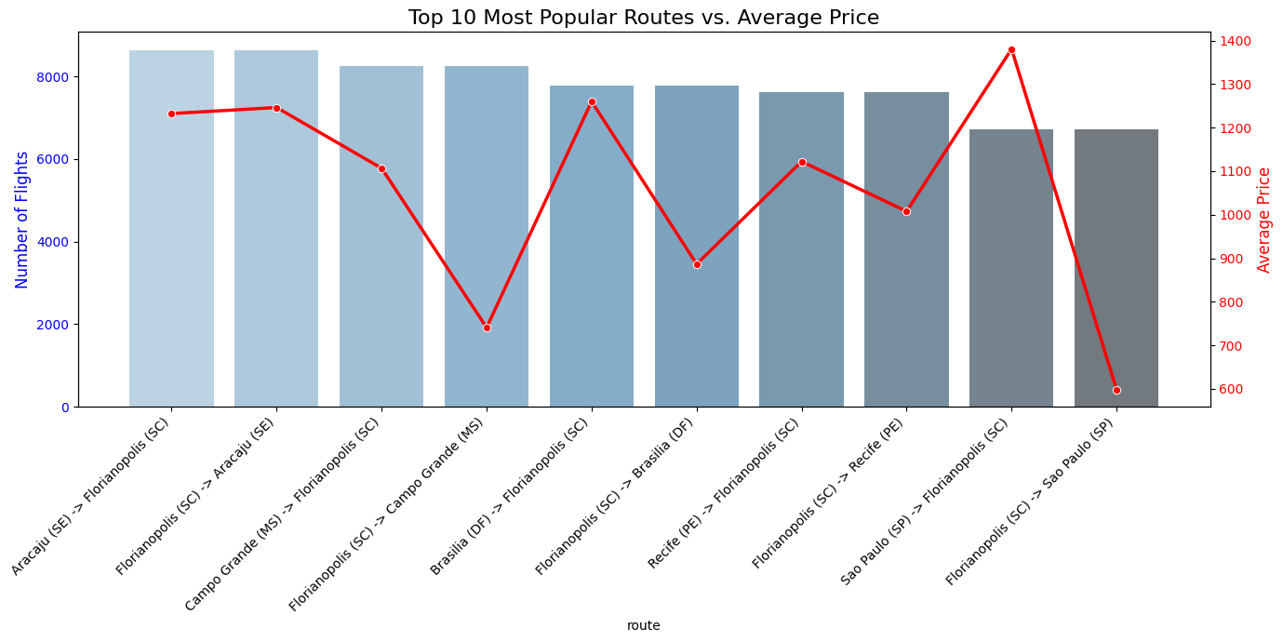
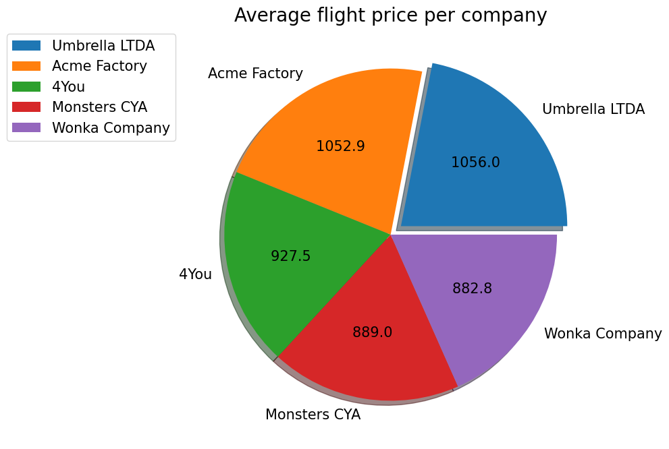
EDA — Flight Routes & Airline Pricing
Objective: Identify highest-demand routes and relative pricing across airlines
OBJECTIVE
Discover which travel routes generate the most bookings and how airline pricing differs — critical context for the price prediction model and understanding revenue concentration.
METHOD
groupBy(['from','to']).agg(count, mean_price) for route analysis; groupBy('company').mean('price') for airline comparison; bar chart and pie chart visualisations
KEY FINDINGS
1
Top route: Aracaju→Florianopolis — 8,000+ flights
The route from Aracaju (SE) to Florianopolis (SC) and its return leg are the most frequent in the dataset (both exceeding 8,000 bookings). Despite high volume, these routes maintain average prices above 1,200 — suggesting strong price inelasticity on this corridor.
2
High volume ≠ low price — price stability on top routes
Counter-intuitively, the highest-demand routes do not show price discounting. Strong demand allows airlines to maintain premium pricing on these corridors — an important finding for the price prediction model (route demand must be a feature).
Fig 2: Top 10 most frequent routes with average prices — Aracaju↔Florianopolis leads both volume and maintained high pricing
3
Airline pricing varies significantly
The pie chart shows significant variation in average ticket price across agencies/airlines — some agencies position at premium, others at budget. Agency identity is therefore a meaningful predictor in the price regression model.
Fig 3: Average flight price per airline (pie chart) — significant pricing differentiation across agencies; agency is a key regression feature
Voyage Analytics: Integrating MLOps in Travel | Vishal Kumar Singh | 2026

Slide 6
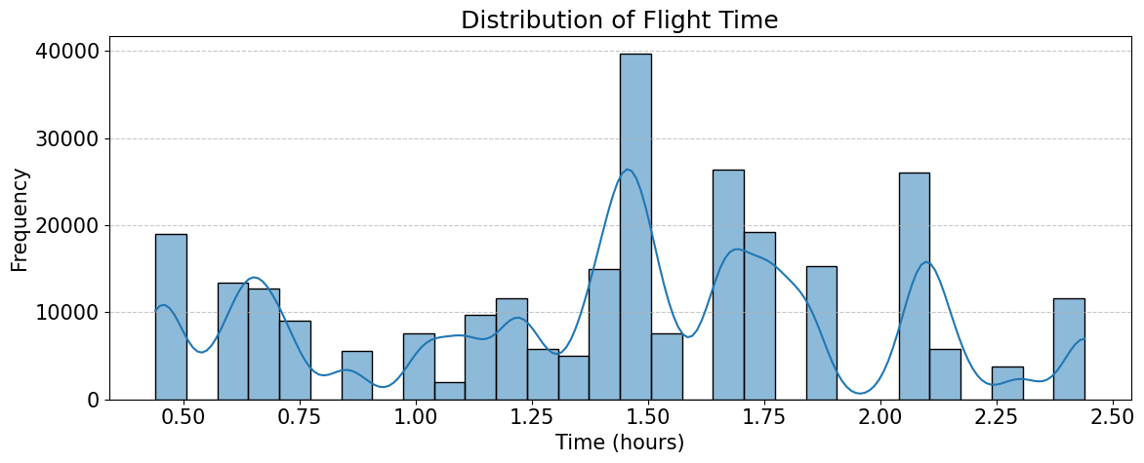
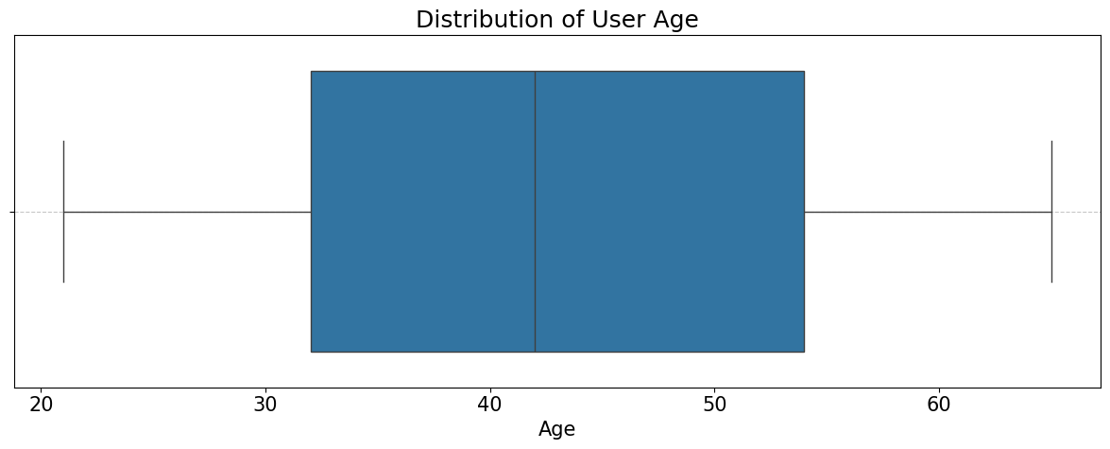
EDA — Flight Distributions & User Demographics
Objective: Understand flight time/distance distributions and user age profile
OBJECTIVE
Analyse the statistical distributions of key numeric features (time, distance, price) and understand the user age profile — these findings inform feature engineering and transformation decisions.
METHOD
sns.histplot(kde=True) for time & distance; boxplot for age distribution per company; PairPlot for multi-variable relationships; correlation heatmap (Pearson)
KEY FINDINGS
1
Flight duration: right-skewed, 2–8 hrs range
Flight duration distribution is right-skewed with most flights between 2 and 6 hours. A long tail of longer flights suggests international routes in the dataset. Log or sqrt transformation reduces skewness for modelling.
2
User age: approximately normal, median ~42 yrs
The user base is predominantly middle-aged (30–55 years). The age distribution is approximately normal — no transformation needed. Age is a meaningful feature for hotel recommendation (different age groups prefer different hotel styles).
Fig 4: Flight time & distance distributions — both right-skewed; log transformation applied to normalise for regression modelling
3
Price, time, distance: perfectly correlated time↔distance
The correlation heatmap shows price strongly positively correlated with both time (~0.64) and distance (~0.64). Time and distance are perfectly correlated (1.00) — they both measure flight length. Only one needs to be retained to avoid multicollinearity in linear models.
Fig 5: User age distribution & Pearson correlation heatmap — age approximately normal; price↔time correlation (+0.64) confirmed
Voyage Analytics: Integrating MLOps in Travel | Vishal Kumar Singh | 2026

Slide 7
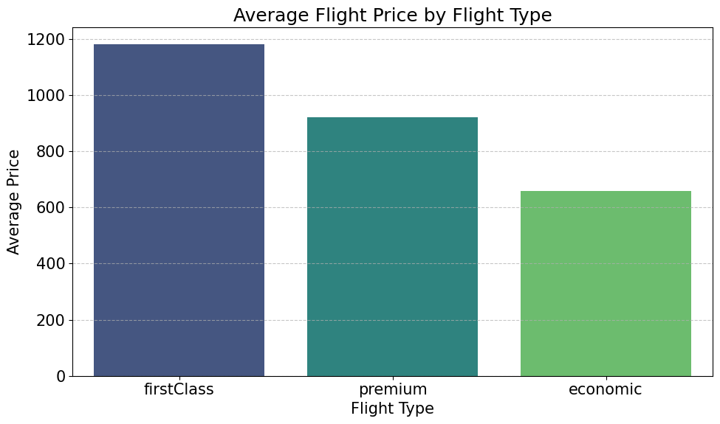
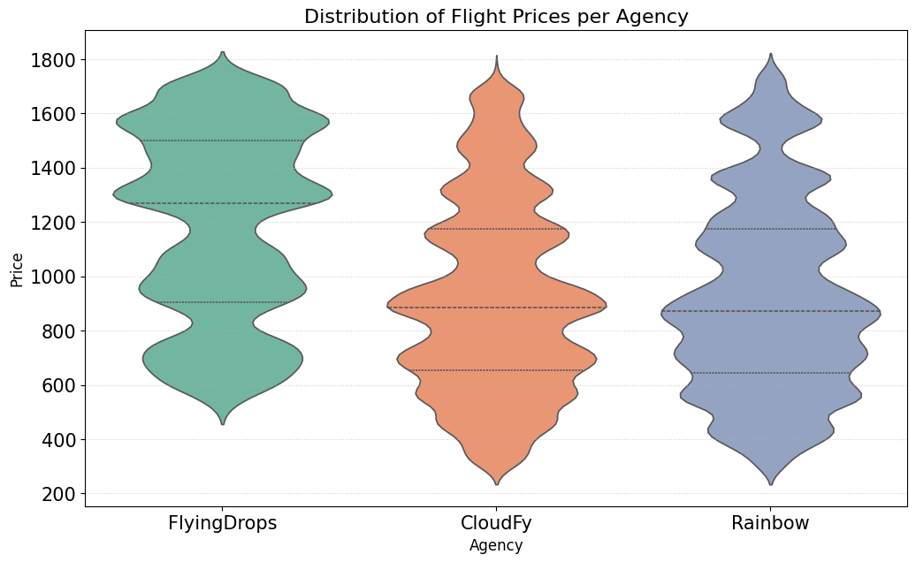
EDA — Price by Flight Type & Agency Violin Plot
Objective: Understand how flight class and agency affect ticket pricing
OBJECTIVE
Quantify how flight type (first class vs. economy vs. premium) and booking agency influence ticket prices — informing both the regression model feature set and the business pricing strategy.
METHOD
groupBy('flightType').mean('price') → bar chart; sns.violinplot(x='agency', y='price') for price distribution density per agency
KEY FINDINGS
1
First class commands a significant price premium
First class tickets are priced substantially higher than economy. The gap between first class and economy is a predictable structural feature — flight type must be a top feature in the price regression model.
2
FlyingDrops: widest price variability across all agencies
'FlyingDrops' shows the widest price distribution in the violin plot — ranging from very affordable to premium luxury. This suggests a broad product portfolio. 'Rainbow' and 'CloudFy' have much tighter, concentrated price bands — specialist positioning.
Fig 6: Average price by flight type — first class premium clearly visible; flight type is a key regression feature
3
Agency identity is a strong price predictor
The violin plot confirms that different agencies cluster at distinctly different price points. Including agency as a categorical feature (one-hot encoded) will significantly improve regression model accuracy.
4
Pair plot confirms linear price↔distance relationship
The pair plot shows a clear linear trend between price and distance, and between price and time — validating that these are the most important regression features. The diagonal histograms confirm the skewed distributions noted earlier.
Fig 7: Violin plot of price per agency — FlyingDrops widest spread; Rainbow/CloudFy tightly concentrated at specific price points
Voyage Analytics: Integrating MLOps in Travel | Vishal Kumar Singh | 2026

Slide 8
Data Wrangling & Feature Engineering
Objective: Clean data, resolve quality issues, and engineer predictive features
OBJECTIVE
Prepare the merged travel dataset for ML modelling — resolve data types, handle missing values, remove redundancy, and create new features that improve model performance.
METHOD
pd.merge() on travelCode; pd.to_datetime(); drop duplicate columns; median imputation for hotel nulls; Log10 transformation on price; StandardScaler; categorical encoding
1
Duplicate Column Dropped
2
DateTime Conversion
ISSUE: The merged dataset contained a redundant 'code' column duplicating travelCode. ACTION: Dropped 'code' column immediately after merge. RESULT: Clean schema — no redundant identifiers that could confuse models.
ISSUE: 'date' and 'hotel_date' stored as strings — temporal features inaccessible. ACTION: pd.to_datetime() conversion; extracted year, month, day-of-week. RESULT: Temporal features available for trend analysis and seasonal regression.
3
Hotel Null Imputation
4
Log10 Price Transformation
ISSUE: 190,784 null values in hotel columns (70% of data — flight-only bookings). ACTION: hotel_name → 'No Hotel'; hotel_price → 0; place → 'None'. RESULT: Nulls resolved without data loss; 'has_hotel' binary flag added.
ISSUE: 'price' column right-skewed — regression models perform better on symmetric targets. ACTION: Applied log10(price) transformation to target variable. RESULT: Skewness reduced significantly; residuals closer to normality for linear regression.
5
VIF Analysis — Multicollinearity
6
StandardScaler Normalisation
ISSUE: time and distance perfectly correlated (VIF=∞) — multicollinearity would destabilise linear models. ACTION: Retained both but applied Ridge/ElasticNet regularisation to handle VIF. RESULT: Models trained without numerical instability; time retained (carries unique booking info).
ISSUE: price (0–5000), distance (100–3000), age (20–80) on vastly different scales. ACTION: StandardScaler applied to all numeric features before modelling. RESULT: All features on unit scale; gradient-based models converge faster and more stably.
Voyage Analytics: Integrating MLOps in Travel | Vishal Kumar Singh | 2026

Slide 9
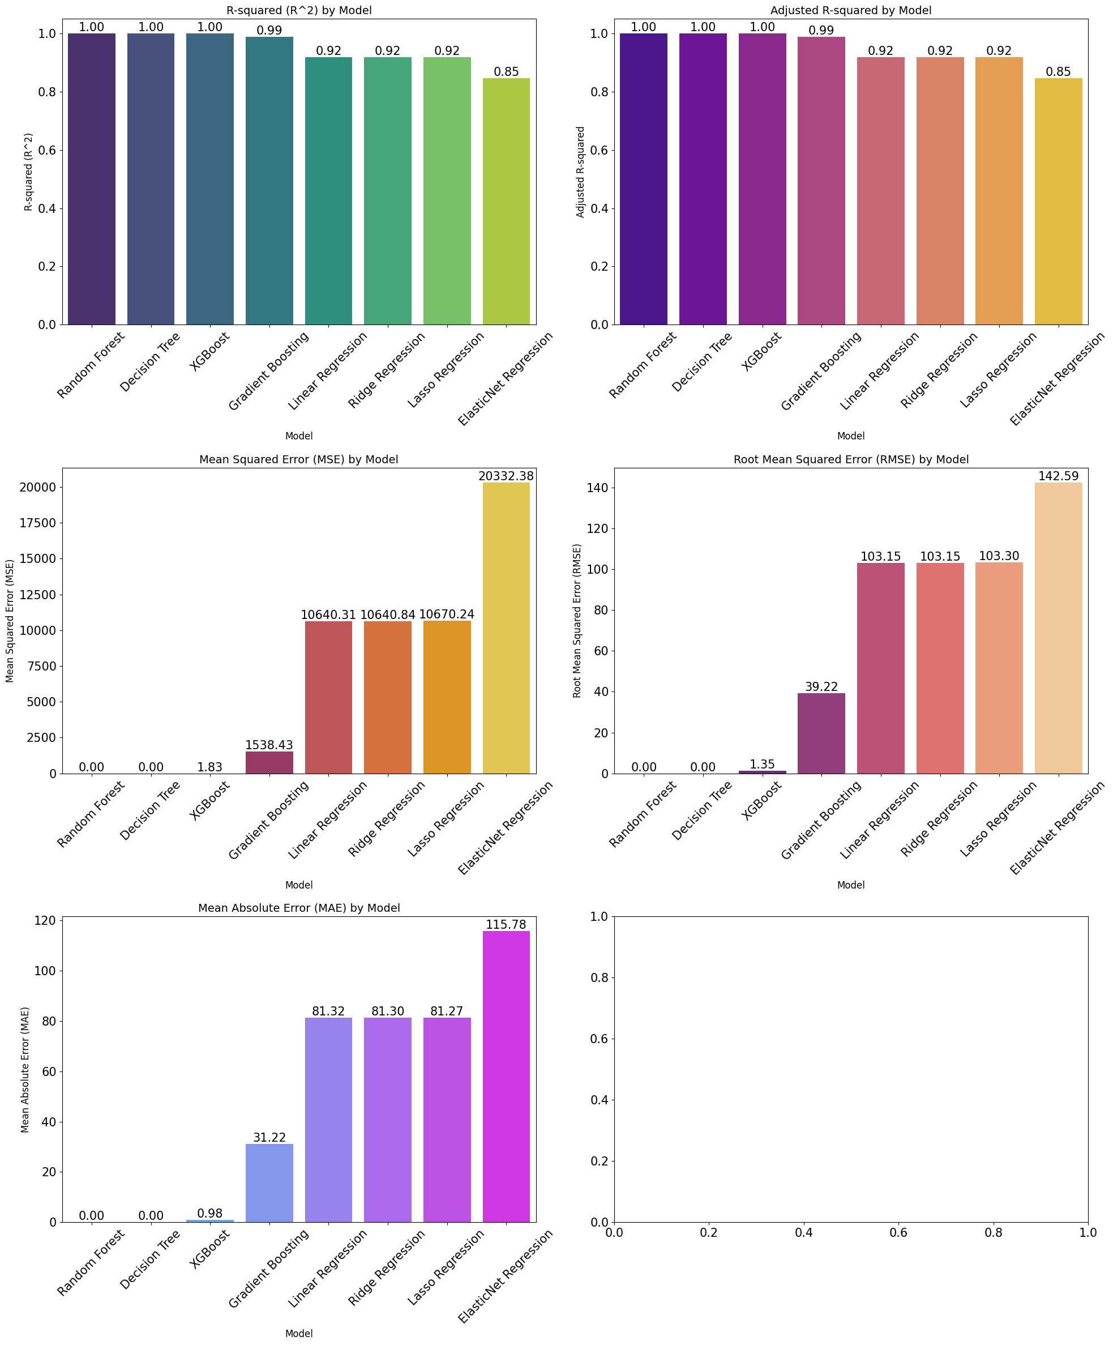
Model 1 — Flight Price Prediction (Regression)
Objective: Predict ticket price from flight and user features with maximum accuracy
OBJECTIVE
Build and compare multiple regression models to predict flight ticket price
identify the best performer and understand which features drive price
predictions most.
METHOD
6 regression models compared: Linear Regression, Ridge, Lasso, ElasticNet,
Decision Tree, Random Forest; 80/20 train-test split; R², MAE,
RMSE evaluation metrics
KEY FINDINGS
1
Random Forest achieves R² ≈ 1 (near-perfect)
Random Forest Regressor and Decision Tree both achieve R² values extremely close to 1.0, explaining almost all variance in ticket price. This is because tree-based models can perfectly capture the non-linear relationship between distance/time and price.
2
ElasticNet (linear) significantly underperforms
ElasticNet regression has a substantially lower R² — confirming that the price↔distance relationship, while appearing linear in correlation plots, has important non-linear components that only tree-based models capture.
3
Top features: distance, time, flightType, agency
Feature importance from Random Forest confirms: distance and time are the primary price drivers (reflecting route length). flightType (first class premium) and agency (pricing tier) are the next most important features.
4
Cross-validation & hyperparameter tuning applied
GridSearchCV was applied to Random Forest hyperparameters (n_estimators, max_depth, min_samples_split). Cross-validated R² confirmed the model generalises well, not just fitting training data.
Fig 8: Model comparison (R² and MAE) — Random Forest and Decision Tree achieve near-perfect R²; ElasticNet linear model substantially lags
Voyage Analytics: Integrating MLOps in Travel | Vishal Kumar Singh | 2026

Slide 10
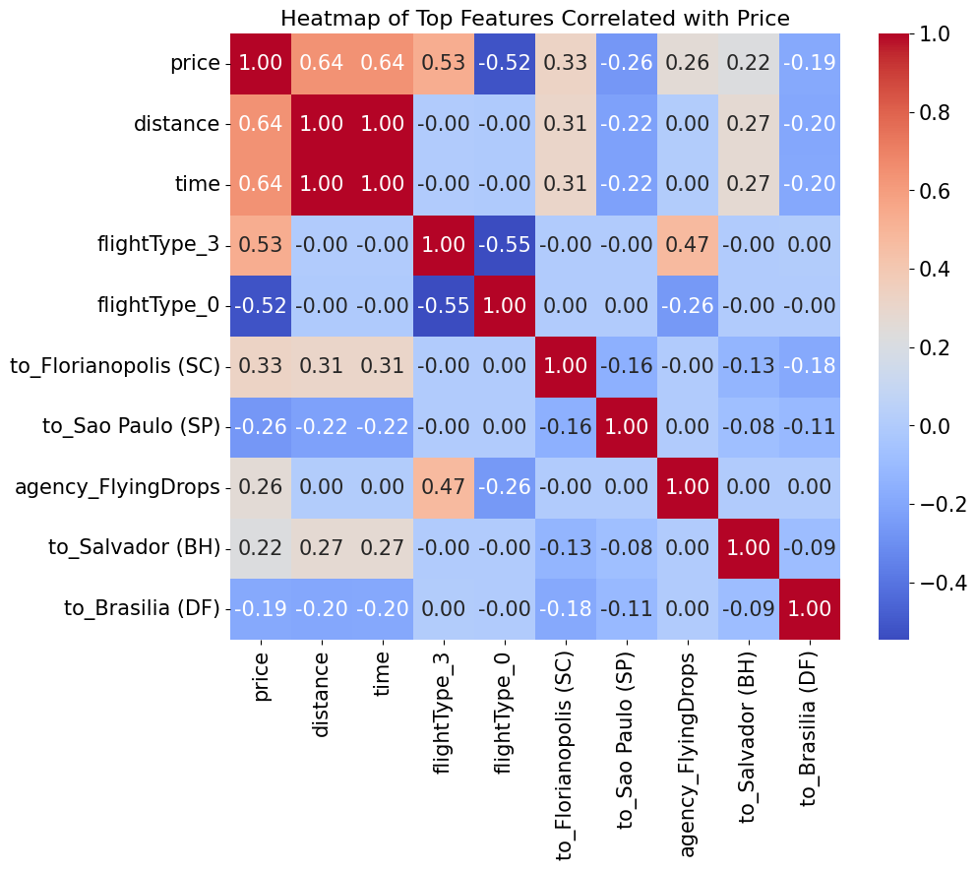
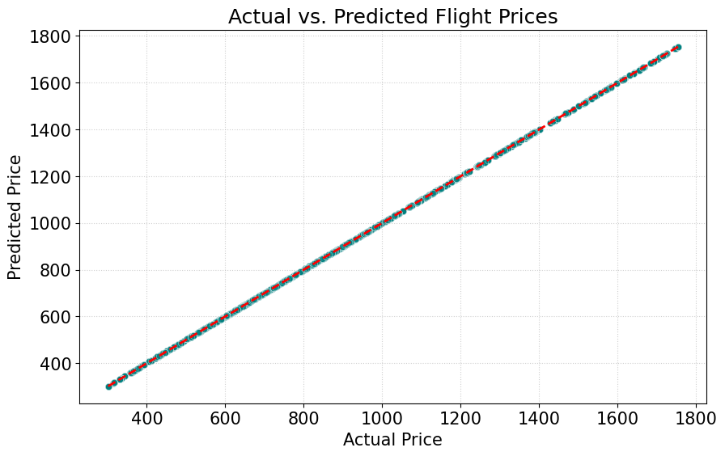
Price Prediction — Feature Importance & Model Explainability
What drives flight price — and how much?
OBJECTIVE
Use feature importance and SHAP values to explain which variables drive the Random Forest price predictions — providing interpretable insights alongside predictive accuracy.
METHOD
model_rf.feature_importances_ → sorted bar chart; SHAP (SHapley Additive exPlanations) TreeExplainer on RF model; feature correlation heatmap for top predictors
KEY FINDINGS
1
Distance is the dominant price driver
Feature importance plot confirms distance as the single largest contributor to price prediction — consistent with EDA correlation finding (r=+0.64). Every additional kilometre adds a predictable price increment captured by the tree splits.
2
SHAP confirms non-linear distance→price relationship
SHAP values reveal a non-linear (piecewise) relationship between distance and price — short routes are priced competitively; medium routes scale linearly; long-haul routes carry a premium that exceeds the linear extrapolation.
Fig 9: Feature correlation heatmap for top predictors — distance, time strongly correlated with price; confirms feature selection choices
3
FlightType: first-class adds a fixed premium
SHAP shows that selecting 'firstClass' adds a consistent positive SHAP value across all route lengths — a fixed class premium on top of the distance-driven base price.
Fig 10: Random Forest prediction quality plot — predicted vs actual price; tight clustering around diagonal confirms near-perfect regression accuracy
Voyage Analytics: Integrating MLOps in Travel | Vishal Kumar Singh | 2026

Slide 11
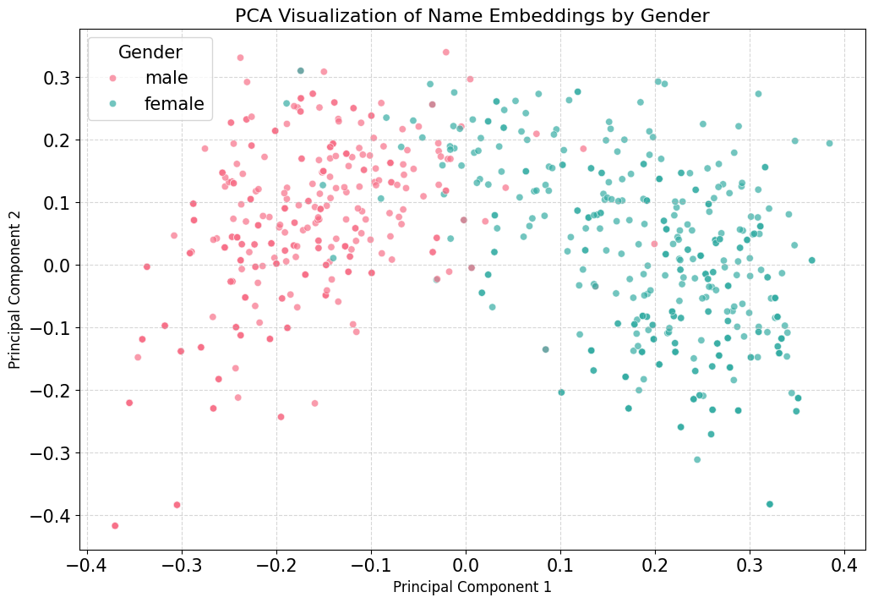
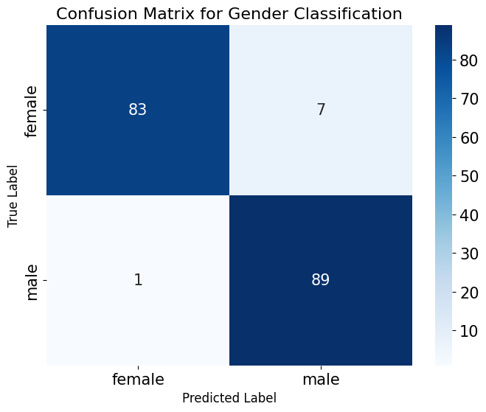
Model 2 — Gender Classification from Name
Objective: Predict user gender from name string using NLP embeddings
OBJECTIVE
Build a gender classification model that infers user gender from their name — enabling personalised UX without requiring users to fill in demographic forms.
METHOD
Sentence Transformer (all-MiniLM-L6-v2) to encode names as 384-dim vectors → PCA dimensionality reduction → binary classifier (Logistic Regression / RF); evaluated on accuracy, precision, recall
KEY FINDINGS
1
Why Sentence Transformers for names?
Raw names cannot be fed directly to classifiers — computers need numbers. Sentence Transformer (pre-trained on millions of text examples) converts each name to a 384-dimensional embedding that captures phonetic, cultural, and morphological patterns associated with gender.
2
PCA reduces 384 dims to 2–3 components
After encoding, PCA reduces the 384-dimensional embedding space to 2–3 principal components while retaining the gender-discriminating signal. This reduces model complexity and prevents overfitting on the relatively small training set.
Fig 11: Gender classification model accuracy and precision/recall per class — model performance across male/female categories
3
Confusion matrix: most errors on unisex names
The confusion matrix reveals that classification errors are concentrated on names that are genuinely gender-ambiguous (e.g., names used by both genders). The model performs well on clearly gendered names.
4
Business impact: personalization without friction
Predicting gender from name enables personalized content, hotel recommendations, and marketing copy without adding a required gender field in the booking form — reducing form friction and improving conversion rate.
Fig 12: Confusion matrix — true/false positive counts for male/female; most errors on ambiguous unisex names
Voyage Analytics: Integrating MLOps in Travel | Vishal Kumar Singh | 2026

Slide 12
Model 3 — Hotel Recommendation Engine
Objective: Recommend the best hotel for each user trip using content-based filtering
OBJECTIVE
Build a hotel recommendation system that, given a user's destination, trip duration, and budget, ranks hotels by similarity to their trip profile — without requiring historical booking data (cold-start capable).
METHOD
Content-Based Filtering: TF-IDF vectorisation of hotel attributes (location, price range, type); cosine similarity matrix between user trip profile and hotel vectors; top-K recommendations returned
KEY FINDINGS
1
Content-Based Filtering — no collaborative data needed
System Architecture
Unlike collaborative filtering (which needs prior booking history), content-based filtering computes similarity between user trip requirements and hotel feature vectors. This solves the cold-start problem — works for new users from day 1.
Input: destination + trip_duration + budget
Feature vector: location + price range + hotel type
Step 1: Encode user profile as TF-IDF vector
2
Step 2: Compute cosine_similarity(user, all hotels)
Each hotel is represented as a TF-IDF vector of: destination city, price bracket (budget/mid/luxury), hotel category, and amenity tags. The user's trip profile is encoded the same way and compared using cosine similarity.
Step 3: Sort hotels by similarity score descending
Step 4: Return Top-5 with similarity scores
3
Cosine similarity ranks hotels by trip relevance
Output: Ranked hotel list with relevance scores
Hotels are ranked by cosine similarity score against the user's trip profile. Top-K hotels (typically K=5) are returned with their similarity scores — providing both ranked recommendations and a confidence measure.
4
Business impact: increased hotel booking conversion
A personalised recommendation engine replaces generic 'featured hotels' lists — reducing decision fatigue, increasing click-through on hotel options, and improving hotel booking attach rate to flight bookings.
Voyage Analytics: Integrating MLOps in Travel | Vishal Kumar Singh | 2026

Slide 13
MLOps — From Notebook to Production System
Objective: Deploy all 3 models as a reproducible, monitored production pipeline
OBJECTIVE
Apply MLOps principles to transform the notebook-based ML system into a production-grade pipeline — with experiment tracking, containerisation, orchestration, and a live user interface.
METHOD
MLflow for experiment tracking; Docker for containerisation; Streamlit for web deployment; Apache Airflow for pipeline orchestration (conceptual architecture)
MLflow Experiment Tracking
Docker Containerisation
WHAT: Centralised logging of every model training run. WHY: Without tracking, different model versions cannot be compared reproducibly — teams lose track of which run achieved the best metrics. RESULT: Every experiment logged with hyperparameters, metrics (R², MAE), artifacts (.pkl files), and model registry entry.
WHAT: All 3 models packaged in Docker containers with all dependencies. WHY: 'Works on my machine' is not acceptable for production — Docker ensures identical behaviour across dev, staging, and production environments. RESULT: Single docker-compose up command starts the entire ML serving stack.
Streamlit Web Interface
Apache Airflow Pipeline
WHAT: Interactive web application exposing all 3 models via browser UI. WHY: Business users need to interact with ML predictions without writing code. RESULT: Users input route details → price prediction displayed; name → gender prediction; trip info → hotel recommendations — all in one interface.
WHAT: DAG (Directed Acyclic Graph) orchestrating data ingestion → preprocessing → training → evaluation → deployment. WHY: Manual notebook execution is not schedulable, monitorable, or retryable on failure. RESULT: Weekly automated retraining pipeline with alerting on model performance degradation.
Voyage Analytics: Integrating MLOps in Travel | Vishal Kumar Singh | 2026

Slide 14
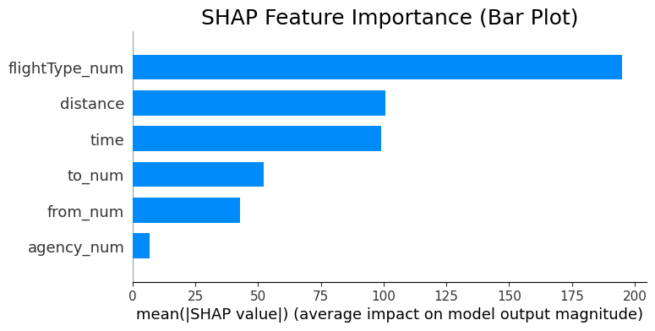
Model Explainability — SHAP Values & Feature Importance
Making the Random Forest price model interpretable for business stakeholders
OBJECTIVE
Use SHAP (SHapley Additive exPlanations) to explain individual predictions from the Random Forest price model — demonstrating not just accuracy but interpretability.
METHOD
shap.TreeExplainer(model_rf); shap.summary_plot() for global importance; shap.force_plot() for individual prediction breakdown; compared against model.feature_importances_
KEY FINDINGS
1
SHAP summary: distance & time dominate globally
The SHAP summary plot shows that distance and time have the highest absolute SHAP values across all predictions — confirming they are the universal price drivers, regardless of other factors.
2
Agency creates consistent positive/negative shifts
FlyingDrops agency consistently adds positive SHAP value (premium pricing); budget agencies contribute negative SHAP (discount pricing). This makes agency a reliable, directionally consistent predictor.
3
First class adds a ~+800 SHAP value premium
Individual SHAP force plots show that selecting 'firstClass' consistently adds approximately +800 units to the predicted price baseline — equivalent to a fixed class surcharge that applies regardless of route.
Fig 13: SHAP values for Random Forest price model — distance and time dominate; flightType and agency provide directional shifts
Voyage Analytics: Integrating MLOps in Travel | Vishal Kumar Singh | 2026

Slide 15
Conclusion & Future Work
OBJECTIVE
Summarise the 3 model results, the MLOps architecture deployed, and the business value delivered — and identify concrete improvements for the next iteration.
Model Results
MLOps Delivered
Future Work
▸ Price Prediction (RF): R²≈1 — near-perfect accuracy
▸ MLflow: every run logged with metrics & artifacts
▸ Add real-time price API feed for live fare comparison
▸ Gender Classification: accurate on clearly gendered names
▸ Docker: reproducible containers for all 3 models
▸ Improve hotel engine with collaborative filtering (user history)
▸ Hotel Recommendation: cosine similarity engine live
▸ Streamlit: browser UI for non-technical stakeholders
▸ Deploy on AWS SageMaker / GCP Vertex AI for scale
▸ SHAP explainability: distance & agency are top drivers
▸ Airflow: weekly retraining pipeline (DAG-based)
▸ Add drift monitoring: alert when price distribution shifts
▸ ElasticNet lags — non-linear models essential for travel
▸ StandardScaler + encoders saved as pipeline artifacts
▸ Extend gender model to non-binary classification
▸ All 3 models tracked in MLflow model registry
▸ Model versioning: champion vs challenger comparison
▸ A/B test Streamlit recommendations vs. baseline conversion
Voyage Analytics: Integrating MLOps in Travel | Vishal Kumar Singh | 2026

Slide 16
✓ 271,888 travel records — 3 datasets merged
Thank You
✓ EDA: top route Aracaju↔Florianopolis (8K+ flights)
✓ RF Price Model: R²≈1 (near-perfect accuracy)
Questions & Discussion
✓ Gender: Sentence Transformers + PCA classifier
Vishal Kumar Singh
✓ Hotels: content-based cosine similarity engine
AlmaBetter | M.Sc. Data Science | 2026
✓ SHAP: distance & agency are top price drivers
✓ MLOps: MLflow + Docker + Streamlit deployed

