Slide 1
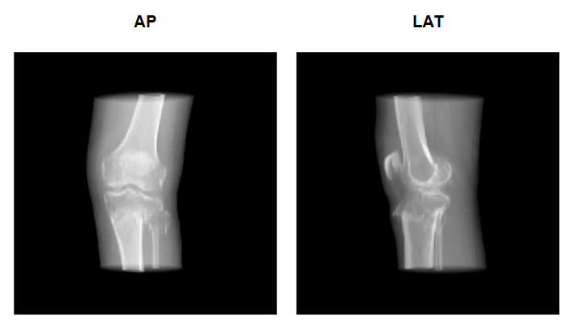
CAPSTONE PROJECT 2
Fracture-Preserving
3D Knee Reconstruction
A controlled comparison of U-Net-style and V-Net-style decoder blocks
Paired AP + lateral projections
→ four-bone 3D occupancy
CHAN ZHENG SHAO · 24020059
Supervisor: Prof. Ts. Dr Lee Yun Li
01
Notes:
Timing: 0:30
Talk track:
Introduce the project as a controlled computing experiment, not a clinically deployable system. State the central result only as a preview: residual topology mattered more than activation choice.
[Sources]
- 24020059_Capstone_2.docx, pp. 1–2; title page and abstract; Figure 33 on p. 88

Slide 2
TOPIC KNOWLEDGE
Two X-rays are accessible—but 3D fracture morphology remains ambiguous
AP and lateral views are complementary, but the inverse problem remains underdetermined.
CT reveals fragments and articular geometry, but adds radiation, cost, infrastructure and segmentation work.
The intended role is an adjunct: more 3D information from common radiographs—not a replacement for CT in complex trauma.
Each view loses depth; overlap means several 3D anatomies can produce similar projections.
Report pp. 10–11, 22–23
02
Notes:
Timing: 1:00
Talk track:
Explain why two projections do not uniquely determine a volume. Contrast the accessibility of radiography with CT’s detailed 3D evidence and resource burden. Emphasise the project’s careful adjunct framing.
[Sources]
- 24020059_Capstone_2.docx, pp. 10–11, 22–23; background and domain background; Figure 33 on p. 88

Slide 3
TOPIC KNOWLEDGE
Literature proves feasibility, not a fair decoder comparison
Feasible
Incomparable
Prior systems reconstruct bone from one or two radiographs using voxel, registration, transformer and implicit methods.
Anatomy, datasets, geometry, capacity, preprocessing and evaluation protocols differ across studies.
Metrics diverge
Research gap
High Dice can coexist with clinically important landmark or surface error; subgroup averages can hide failure.
No matched 2×2 decoder study isolates residual topology and activation while holding the full upstream pathway fixed.
Report pp. 20–21, 38–51
03
Notes:
Timing: 1:10
Talk track:
Synthesize the literature rather than listing papers. The key implication is experimental: reported model rankings cannot identify which decoder property caused an improvement. Mention that Dice and clinical/surface accuracy can diverge.
[Sources]
- 24020059_Capstone_2.docx, pp. 20–21, 38–51; literature review introduction, comparative benchmarks, metrics, decoder lineages and research gap

Slide 4
TECHNICAL APPROACH
The research question isolates topology and activation
How do decoder-block topology and activation influence overlap, surface accuracy and robustness—under one shared, leakage-controlled bi-planar front end?
01
02
03
04
Cohort
Fair front end
Complementary metrics
Controlled comparison
Verify geometry, laterality and subject-level separation.
Hold encoder, fusion and 2D→3D lifting constant.
Use Dice + ASSD with bone and cohort analysis.
Evaluate four decoder arms over five grouped folds.
Report pp. 12–15
04
Notes:
Timing: 0:55
Talk track:
Read the research question, then connect each objective to a threat to validity: leakage, upstream confounding, metric blindness and unfair model comparison.
[Sources]
- 24020059_Capstone_2.docx, pp. 12–15; problem statement, research question, aim, objectives and scope

Slide 5
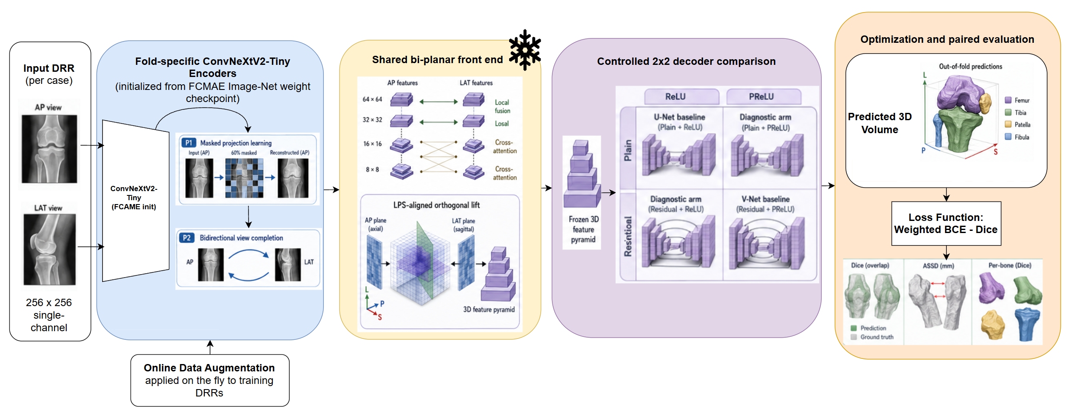
TECHNICAL APPROACH
A geometrically controlled pipeline makes the experiment auditable
Fold-specific representation learning → shared fusion/lifting → controlled decoder comparison → subject-level evaluation
Report pp. 58–60, 90–104
05
Notes:
Timing: 1:05
Talk track:
Use the report’s modelling-plan figure to walk left to right. Highlight that the encoder is trained within each fold, then frozen; all arms receive the same feature pyramid, and evaluation uses held-out subjects.
[Sources]
- 24020059_Capstone_2.docx, pp. 58–60, 90–104; CRISP-DM, methodology flow and Figure 34 on p. 90

Slide 6
TECHNICAL APPROACH
The cohort is small, mixed and leakage-controlled
Quantitative cohort after eligibility and quality checks
43
71
58
13
subjects
knees
healthy knees
fractured knees
5 subject-grouped folds · every fold contains healthy and fractured anatomy · bilateral knees stay together
Interpretation boundary: healthy and fractured cases come from different datasets, so pathology is confounded with acquisition domain.
Report pp. 14, 76–77, 110
06
Notes:
Timing: 0:45
Talk track:
Explain why subject grouping matters: bilateral knees are correlated and must not cross train/test boundaries. Then acknowledge the 4.5-to-1 imbalance and the dataset-domain confounding.
[Sources]
- 24020059_Capstone_2.docx, pp. 14, 76–77, 110; scope, cohort construction and leakage audit

Slide 7
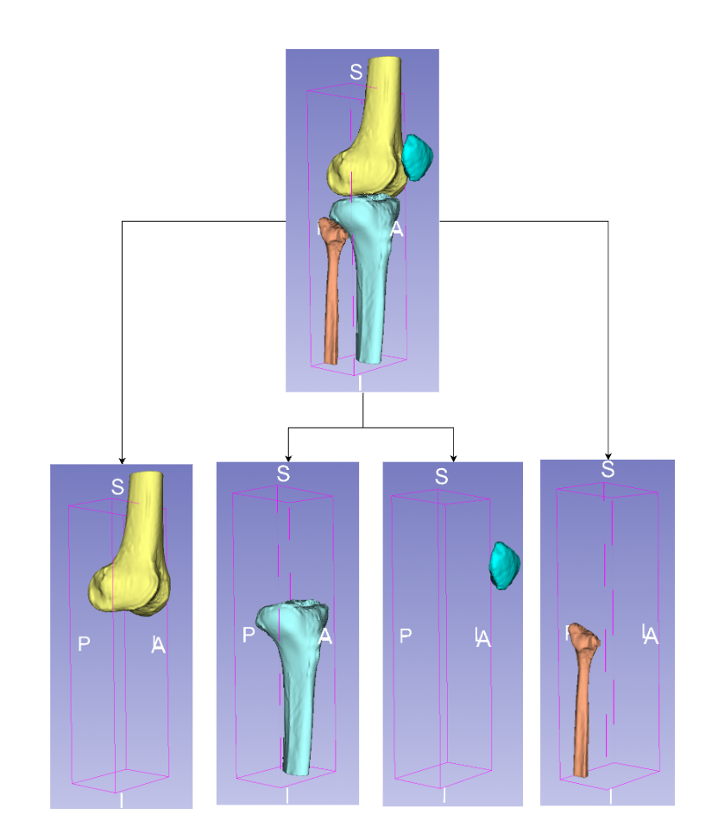
TECHNICAL APPROACH
Ground-truth meshes become four-channel targets
Segment the CT
1
3D Slicer labels the complete four-bone anatomy; TotalSegmentator accelerates the initial segmentation.
Refine and export
2
Apply 2-3 mm Gaussian smoothing, then export one STL surface for each bone.
Align and voxelise
3
Transform every STL into the same LPS-aligned 200 mm, 256³ grid as four fixed-order binary channels.
Train and evaluate
4
Paired DRRs are inputs; voxel masks supervise reconstruction and provide per-bone Dice and ASSD references.
Femur | Tibia | Patella | Fibula
Limitation: meshes were manually prepared without radiologist or orthopaedic-specialist validation.
Report pp. 83-85, 109-110
07
Notes:
Timing: 0:50
Talk track:
Explain the full target lineage. CT volumes were segmented into the four bones in 3D Slicer, assisted by TotalSegmentator and surface smoothing, then exported as STL meshes. Each surface was transformed into one common LPS grid and voxelised as a separate binary channel. These masks supervise decoder training and act as the held-out reference for Dice and ASSD. State the annotation-validation limitation clearly.
[Sources]
- 24020059_Capstone_2.docx, pp. 83-85, 109-110; four-bone target construction and Figure 37

Slide 8
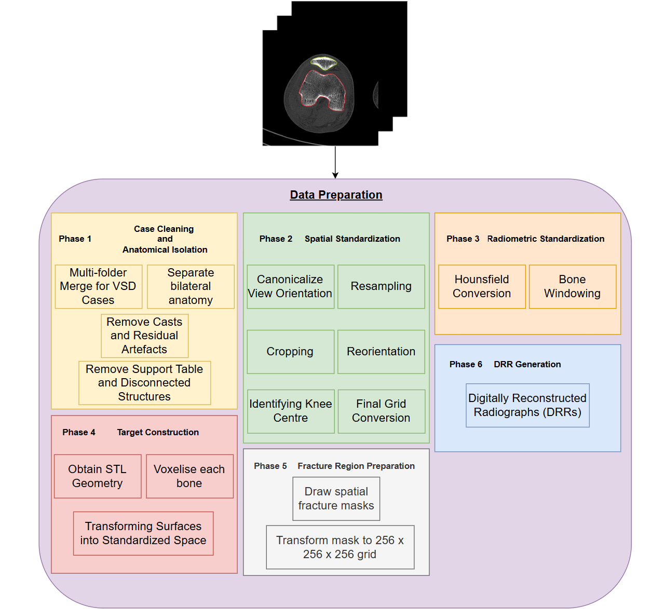
TECHNICAL APPROACH
Six phases align every input, target and mask
1
Clean + isolate
Merge cases, separate knees and remove casts, tables and disconnected artefacts.
2
Standardise space
Canonicalise, resample, crop, reorient, centre and convert to the final grid.
3
Standardise intensity
Convert to Hounsfield units and apply bone windowing.
4
Construct targets
Transform and voxelise the four STL bone surfaces.
5
Prepare fracture regions
Map spatial fracture masks onto the 256³ grid.
6
Generate model inputs
Create aligned AP and lateral DRRs from the same anatomy.
Report pp. 78-88
08
Notes:
Timing: 0:50
Talk track:
Use Figure 30 as the visual summary of the complete preprocessing pipeline. Move through the six phases quickly, stressing that the AP/LAT inputs, four-bone targets and fracture masks all share the same physical coordinate system.
[Sources]
- 24020059_Capstone_2.docx, pp. 78-88; Figure 30 on p. 80

Slide 9
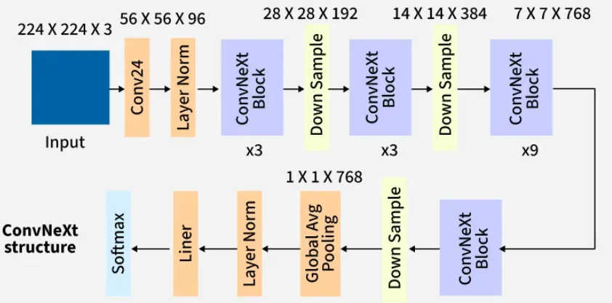
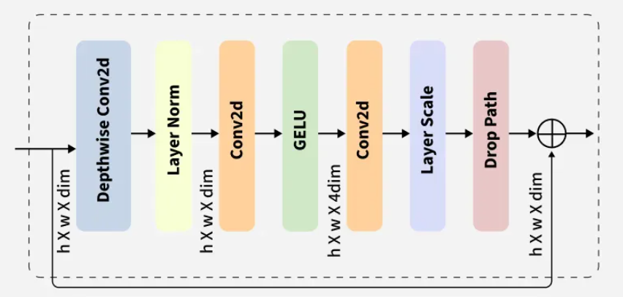
TECHNICAL APPROACH
ConvNeXt builds a multiscale feature pyramid
Spatial context
Channel mixing
Residual learning
Four resolutions
A 7x7 depthwise convolution captures neighbourhood structure efficiently.
LayerNorm and 1x1 layers expand, activate with GELU and project the features.
The shortcut preserves the incoming representation while the block learns a refinement.
Downsampling trades spatial size for channels; AP and LAT pyramids are extracted separately, then fused.
Result: shallow maps retain local cortical detail; deeper maps encode broader anatomical relationships for cross-view fusion.
Report pp. 91, 93-96
09
Notes:
Timing: 1:00
Talk track:
Explain ConvNeXt from left to right. The stem and downsampling stages create four feature resolutions. Inside each block, depthwise convolution captures spatial context, one-by-one layers mix channels, GELU adds non-linearity and the residual path stabilises learning. The project extracts these feature pyramids independently from AP and lateral DRRs before fusion.
[Sources]
- 24020059_Capstone_2.docx, pp. 91, 93-96; Figures 35 and 36

Slide 10
TECHNICAL APPROACH
P1 learns structure; P2 links both views
Five fold-specific ConvNeXtV2 encoders | test-fold subjects excluded from both phases
P1 | Single-view FCMAE
P2 | Bidirectional completion
Mask 60% of patches
Reconstruct one AP or LAT DRR
No bone, fracture or 3D labels
Keep the masked objective
Add AP → LAT and LAT → AP
Still no 3D reconstruction target
Validation loss
0.3788 → 0.1032
Validation loss
0.4774 → 0.4298
Feature SD 0.448-0.463: activations did not collapse.
Correct-pair margins were positive in all folds, but Fold 4 was weak.
P1 and P2 losses measure different tasks and should not be compared directly; neither alone proves accurate 3D reconstruction.
Report pp. 91-92, 114-118
10
Notes:
Timing: 1:15
Talk track:
P1 performs label-free adaptation to DRR appearance by reconstructing masked single views. P2 keeps that objective and adds bidirectional AP-lateral completion so the encoder must learn complementary view information. Report both loss reductions, then state the interpretation boundary: the tasks differ, no CT target enters either phase, and Fold 4 showed much weaker pairing evidence.
[Sources]
- 24020059_Capstone_2.docx, pp. 91-92, 114-118; Figures 40-42 and Table 12

Slide 11
TECHNICAL APPROACH
A 2×2 factorial design separates topology from activation
Decoder arm
Block topology
Activation
Interpretation
U-style
Plain
ReLU
Historical reference condition
Plain-PReLU
Plain
PReLU
Activation-only change
Residual-ReLU
Projected residual
ReLU
Topology-only change
V-style
Projected residual
PReLU
Historical reference condition
Held constant: fold-specific encoder · AP/LAT fusion · 2D→3D lift · decoder skeleton · data split · loss · optimiser · seed · output processing
Report pp. 59, 98–102
11
Notes:
Timing: 1:10
Talk track:
Show how the two extra arms isolate causal factors descriptively. The residual-ReLU arm asks what happens when topology changes alone; plain-PReLU asks what happens when activation changes alone.
[Sources]
- 24020059_Capstone_2.docx, pp. 59, 98–102; Tables 5, 10 and 11; controlled factorial decoder design

Slide 12
TECHNICAL APPROACH
Fairness is enforced before results are compared
01
02
03
Train within fold
Freeze and match
Evaluate out of fold
Exclude test subjects from encoder, fusion and decoder optimisation.
Same front-end hash, initial state, loss, optimiser, seed and schedule.
20 runs → 71 knees per arm → 43 subject-level comparisons.
Primary evidence: Dice (overlap) + ASSD in mm (surface) + bone/cohort breakdown + explicit empty-prediction penalties
Report pp. 102–105
12
Notes:
Timing: 0:50
Talk track:
Walk through the evaluation contract. Dice alone is insufficient; ASSD and explicit empty-prediction handling stop catastrophic small-bone failures from disappearing inside an average.
[Sources]
- 24020059_Capstone_2.docx, pp. 102–105; decoder training protocol and controlled out-of-fold evaluation

Slide 13
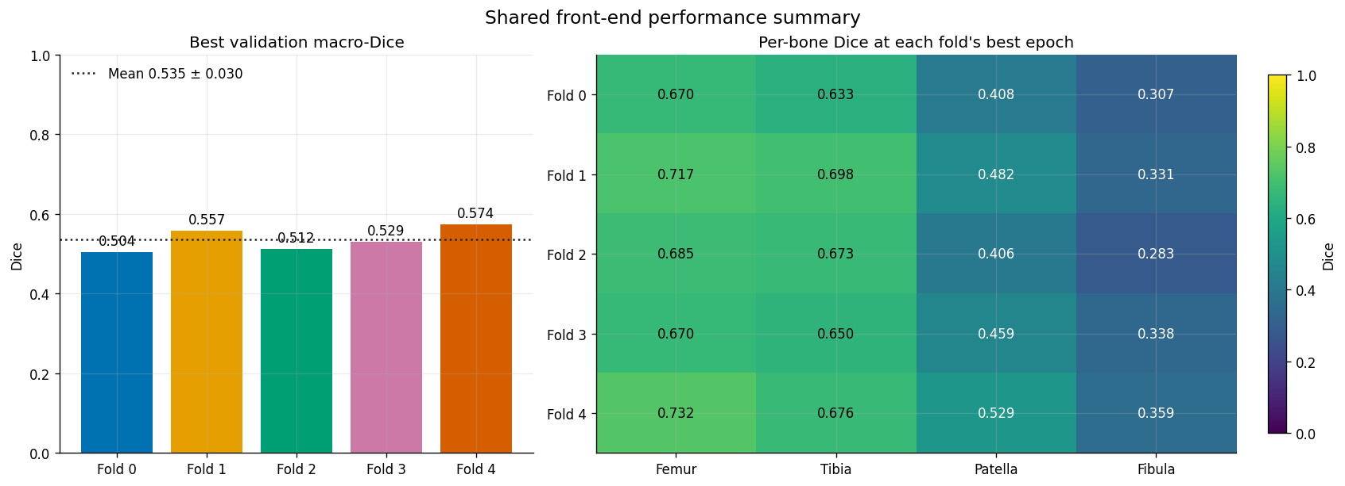
CRITICAL THINKING
The shared front end was fair—but small bones set the ceiling
0.574
best validation macro-Dice
Femur 0.732 · Tibia 0.676
Patella 0.529 · Fibula 0.359
The same size-dependent hierarchy later appears in every decoder—evidence of a pipeline-level limit, not a decoder-only defect.
Fair representation ≠ high-quality representation
Report pp. 114–120
13
Notes:
Timing: 1:10
Talk track:
Explain that identical front-end checkpoints establish fairness, but do not guarantee that the representation is strong. Fold 4 had weak cross-view evidence, and small bones were already the hardest before decoder comparison.
[Sources]
- 24020059_Capstone_2.docx, pp. 114–120; Figures 40–44; encoder pretraining and shared front-end results

Slide 14
CRITICAL THINKING
Residual-ReLU leads the controlled decoder test
+0.049
Dice: residual added under ReLU
−2.44 mm
ASSD: residual added under ReLU
≈2.1% more decoder parameters
Training time remained ~37.5–38.3 minutes/run
Report pp. 123–126
14
Notes:
Timing: 1:30
Talk track:
Present the overall subject-level result. V-style beats U-style, but the factorial arms reveal why: residual topology drives the gain. PReLU alone is neutral, and slightly worsens the residual condition. Avoid claiming that full V-Net universally beats 3D U-Net.
[Sources]
- 24020059_Capstone_2.docx, pp. 123–126; Figure 45 and Tables 14–15

Slide 15
CRITICAL THINKING
Fold 4 lowered accuracy—not the conclusion
Why Fold 4 was weak
P2 pairing margin was 0.000079, only 5/9 subjects were positive, and feature retrieval/dimensionality were poorer. All decoders therefore reached their lowest Dice.
What was done
Fold 4 was retained and reported. Removing it changed the residual Dice gain only from about 0.044 to 0.043, so the decoder ordering remained robust.
Surface caution: a separate Fold-2 empty-patella case produced ~177 mm subject ASSD and was retained to avoid optimistic results.
Report pp. 116-118, 127-128
15
Notes:
Timing: 1:25
Talk track:
Fold 4 had the weakest cross-view evidence and the lowest absolute Dice for every arm, so it exposed a shared-front-end quality ceiling. The fold was not discarded. A leave-Fold-4-out sensitivity check changed the residual advantage only from about 0.044 to 0.043, preserving the descriptive conclusion. Also distinguish the Fold-2 empty-patella surface failure: it explains ASSD inconsistency and was retained under the predefined penalty.
[Sources]
- 24020059_Capstone_2.docx, pp. 116-118, 127-128; Tables 12, 16 and 17

Slide 16
CRITICAL THINKING
Small bones remain the bottleneck
Fibula
Dice improves 0.106 → 0.183
ASSD falls 25.93 → 17.51 mm
Meaning
A substantial error reduction is not the same as accurate reconstruction. The small-bone ceiling persists.
Report pp. 129–131
16
Notes:
Timing: 1:20
Talk track:
Compare large and small bones. The fibula gains are large in relative terms, but its absolute performance remains unsuitable. This distinction demonstrates critical interpretation rather than simply celebrating improvement.
[Sources]
- 24020059_Capstone_2.docx, pp. 129–131; Table 18 and bone-specific discussion

Slide 17
CRITICAL THINKING
Fractured anatomy remains harder across every decoder
0.377
best fractured-cohort Dice
Residual-ReLU vs U-style
+0.041 Dice · −3.28 mm ASSD
Caution: fracture status is confounded with dataset and scanner domain; this is a cohort difference, not a causal fracture effect.
Report pp. 132–134
17
Notes:
Timing: 1:20
Talk track:
Show that residual decoding helps both cohorts, yet none closes the fractured performance gap. State the domain-confounding limitation clearly: the result cannot isolate fracture status from dataset acquisition effects.
[Sources]
- 24020059_Capstone_2.docx, pp. 132–134; Table 19 and healthy/fractured discussion

Slide 18
CRITICAL THINKING
Geometry-inconsistent lifting is the plausible system bottleneck
Current lift
Matched future test
Finite-source DRRs contain divergent rays
But AP/LAT features are copied along Cartesian axes
→ fused voxels may not represent the same physical point
Projection-matrix-aware ray lifting
or differentiable DRR reprojection loss
Keep encoder, decoder, cohort, folds and training fixed
This is a supported hypothesis—not a demonstrated causal result—because no matched lift ablation was run.
Report pp. 139–143
18
Notes:
Timing: 1:05
Talk track:
Explain the mismatch between finite-source projection geometry and Cartesian feature broadcasting. Be precise that this is a plausible bottleneck, not a causal finding. The proposed experiment changes only the lift.
[Sources]
- 24020059_Capstone_2.docx, pp. 139–143; integrated limitations and projection-aware lifting future work

Slide 19
CONCLUSION
Residual topology matters more than activation choice
Residual-ReLU was the strongest tested condition—but the project establishes a controlled evaluation method, not clinical readiness.
Next: projection-aware lifting · balanced fractured cohorts · expert fracture evaluation · real paired X-ray/CT validation
Best defensible claim: residual decoding uses the available 3D features more effectively, while absolute and fracture-specific performance remain limited.
19
Notes:
Timing: 0:35
Talk track:
Close by answering the research question directly. Reiterate the boundary between a controlled architecture result and a clinically valid reconstruction system. Invite questions on the experiment, failure analysis or proposed ablations.
[Sources]
- 24020059_Capstone_2.docx, pp. 143–147; future work and conclusion

