Slide 1
5-BIT ALU
MUHAMMAD USMAN SHAHID (20I-1787)
MUSAAB IMRAN (20I-1794)

Slide 2
ALU
Arithmetic logic unit (ALU) is a combinational digital circuit that performs arithmetic and bitwise operations on integer binary numbers.
Addition
Multiplication
Division
Subtraction
Comparator

Slide 3
5-BIT ALU

Slide 4
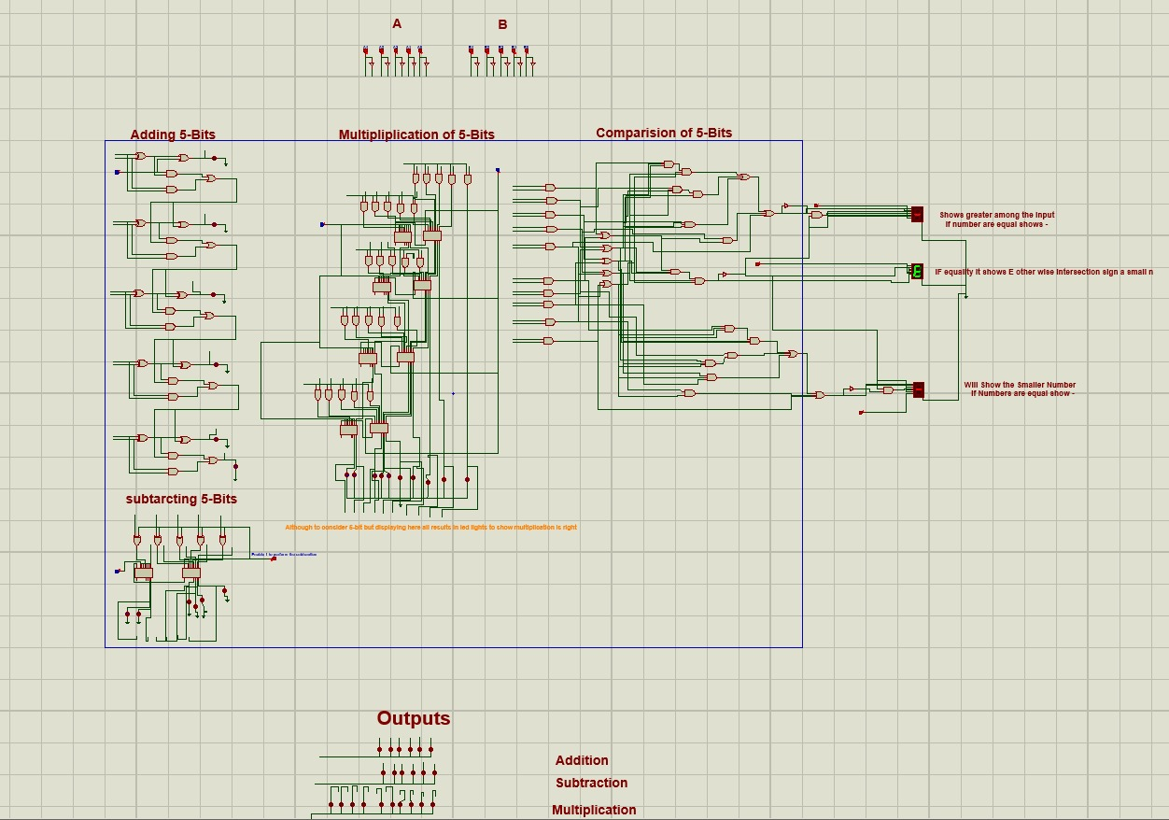

Slide 5
Components
4008 Full Adder
7SEG-COM-CAT-G
XOR
NOR
NAND
AND_3
OR_3

Slide 6
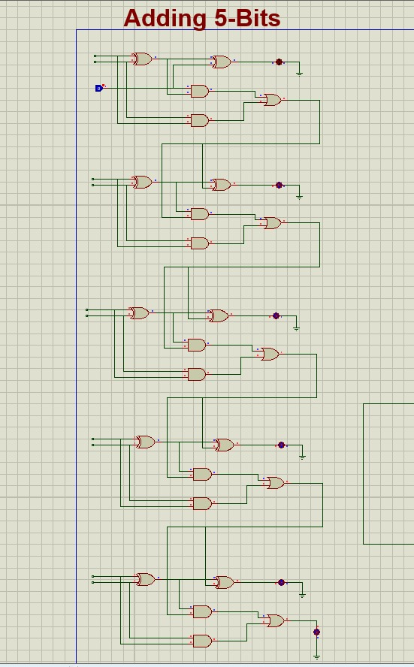
5-BIT ADDER

Slide 7
ADDITION truth table
A | B | Sum | Carry
0 | 0 | 0 | 0
0 | 1 | 1 | 0
1 | 0 | 1 | 0
1 | 1 | 1 | 1

Slide 8
ADDITION truth table
Carry-In | A | B | Sum | Carry-Out
0 | 0 | 0 | 0 | 0
0 | 0 | 1 | 1 | 0
0 | 1 | 0 | 1 | 0
0 | 1 | 1 | 0 | 1
1 | 0 | 0 | 1 | 0
1 | 0 | 1 | 0 | 1
1 | 1 | 0 | 0 | 1
1 | 1 | 1 | 1 | 1

Slide 9
EXPRESSIONS
SUM = X0R (A, B, Cin).
Carryout = AB +Cin (XOR (A, B))
In the start Cin is given as 0, in start there is no carry in.

Slide 10
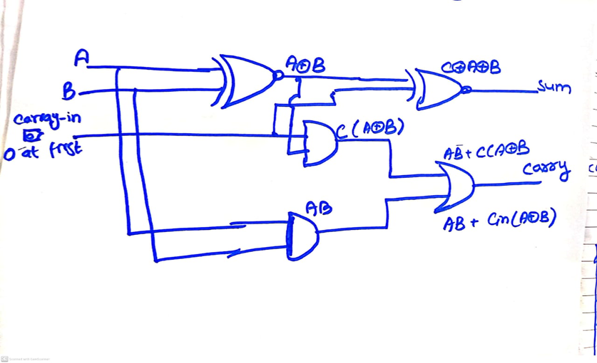

Slide 11
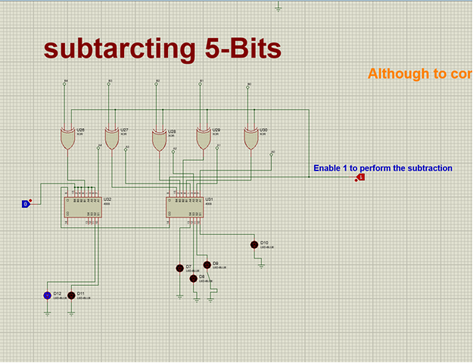
5-BIT SUBTRACTOR

Slide 12
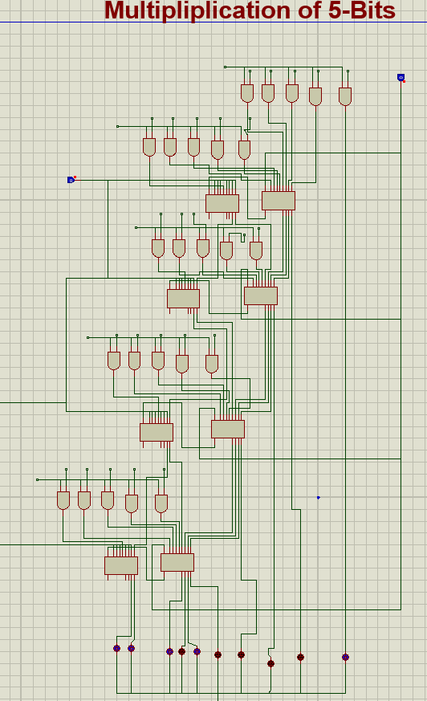
5-BIT MULTIPLIER

Slide 13
Multiplication truth table
A | B | A.B
0 | 0 | 0
0 | 1 | 0
1 | 0 | 0
1 | 1 | 1

Slide 14
EXPLANATION
It is the AND gate expression, A.B since Multiplication can be done simply by Adding the bits, we will multiply the bits starting from the most significant bit, with all bits of A and then add them by using the adders. For adding we are using the 4-bit adders and making two 4-bit adders to add the 5-bits. The adder will be receiving the 5 bits and three other will be made off and will be adding 5-Bits.

Slide 15
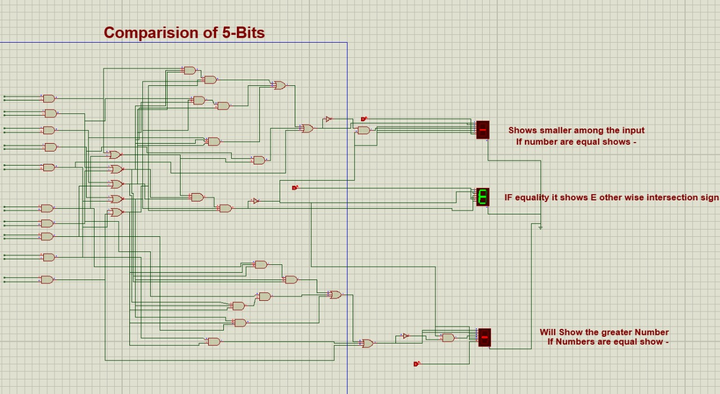
5-Bit comparator

Slide 16
5-BIT Comparator Truth-TABLE
A | B | A<B | A>B | A==B
0 | 0 | 0 | 0 | 1
0 | 1 | 1 | 0 | 0
1 | 0 | 0 | 1 | 0
1 | 1 | 0 | 0 | 0

Slide 17
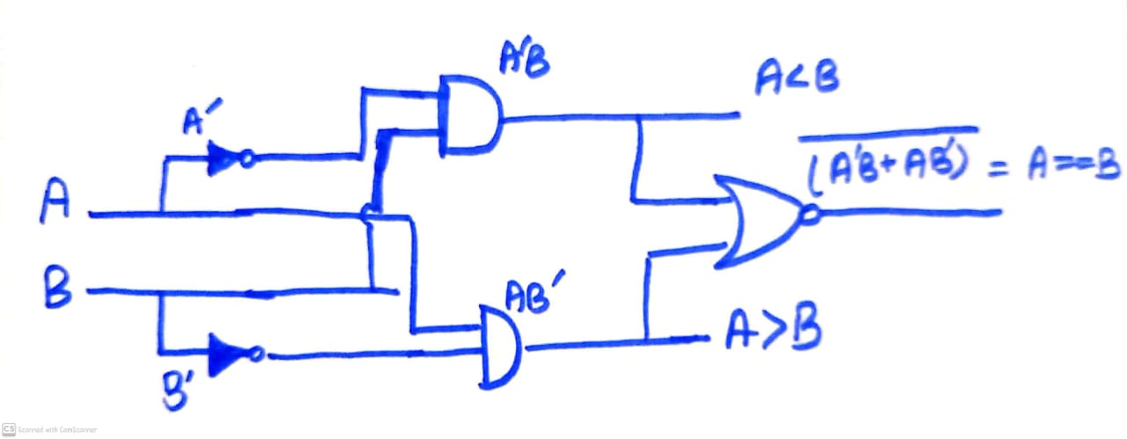
CIRCUIT DIAGRAM

Slide 18
Expressions
A==B: (A₄’B₄ +A₄B₄’)’. (A₃’B₃ +A₃B₃’)’. (A₂’B₂ +A₂B₂’)’. (A₁’B₁ +A₁B₁’)’. (A₀’B₀ +A₀B₀’)’
A<B: (A₄’B₄) + X₄(A₃’B₃) + X₄ X₃(A₂’B₂) + X₄ X₃X₂(A₁’B₁) + X₄ X₃X₂ X₁(A₀’B₀)
A<B: (A₄B₄’) + X₄(A₃B₃’) + X₄ X₃(A₂B₂’) + X₄ X₃X₂(A₁B₁’) + X₄ X₃X₂ X₁(A₀B₀’)

Slide 19
For Equality:
Output y | a |  | b | c | d | e | f | g
0 (not equal) | 1 |  | 1 | 1 | 0 | 1 | 1 | 0
1 (equal) | 1 |  | 0 | 0 | 1 | 1 | 1 | 1
Expressions
a, e, f | 1
b, c | Y’
d, g | Y

Slide 20
For lesser:
Output y equality | Y2 | a | b | c | d | e | f | g
0 (not equal) | 0 | 0 | 0 | 1 | 1 | 1 | 1 | 1
0 (not equal) | 1 | 1 | 1 | 1 | 0 | 1 | 1 | 1
1 (equal) | X | 0 | 0 | 0 | 0 | 0 | 0 | 1
Expressions
a, b, | Y’ Y2
g | 1
c, e, f | Y’
d | Y’Y2’

Slide 21
Greater:
Output y equality | Y2 | a | b | c | d | e | f | g
0 (not equal) | 0 | 1 | 1 | 1 | 0 | 1 | 1 | 1
0 (not equal) | 1 | 0 | 0 | 1 | 1 | 1 | 1 | 1
1 (equal) | X | 0 | 0 | 0 | 0 | 0 | 0 | 1
Expressions
a, b, | Y’Y2’
g | 1
c, e, f | Y’
d | Y’Y2

Slide 22
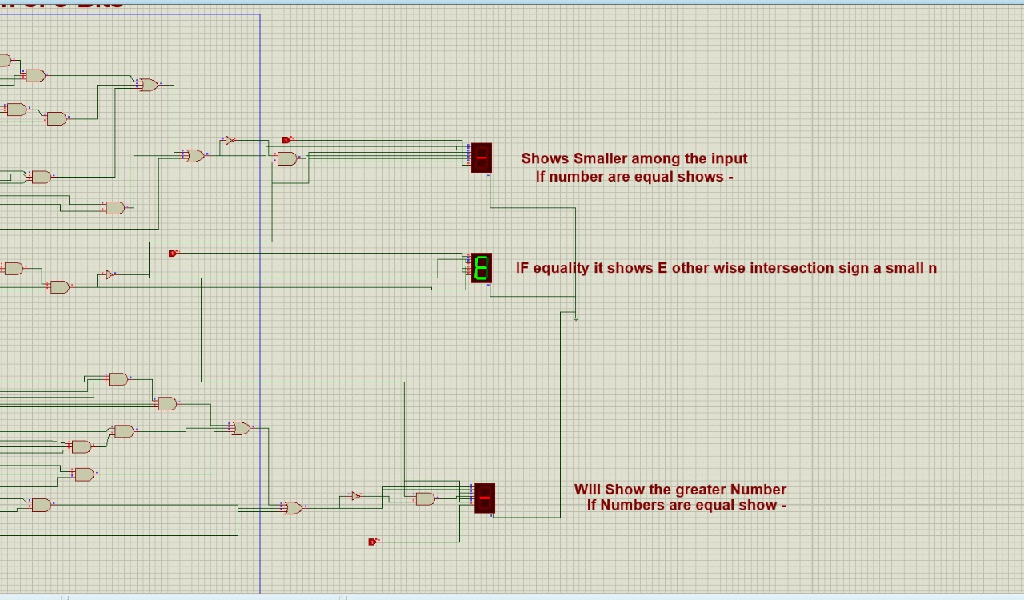
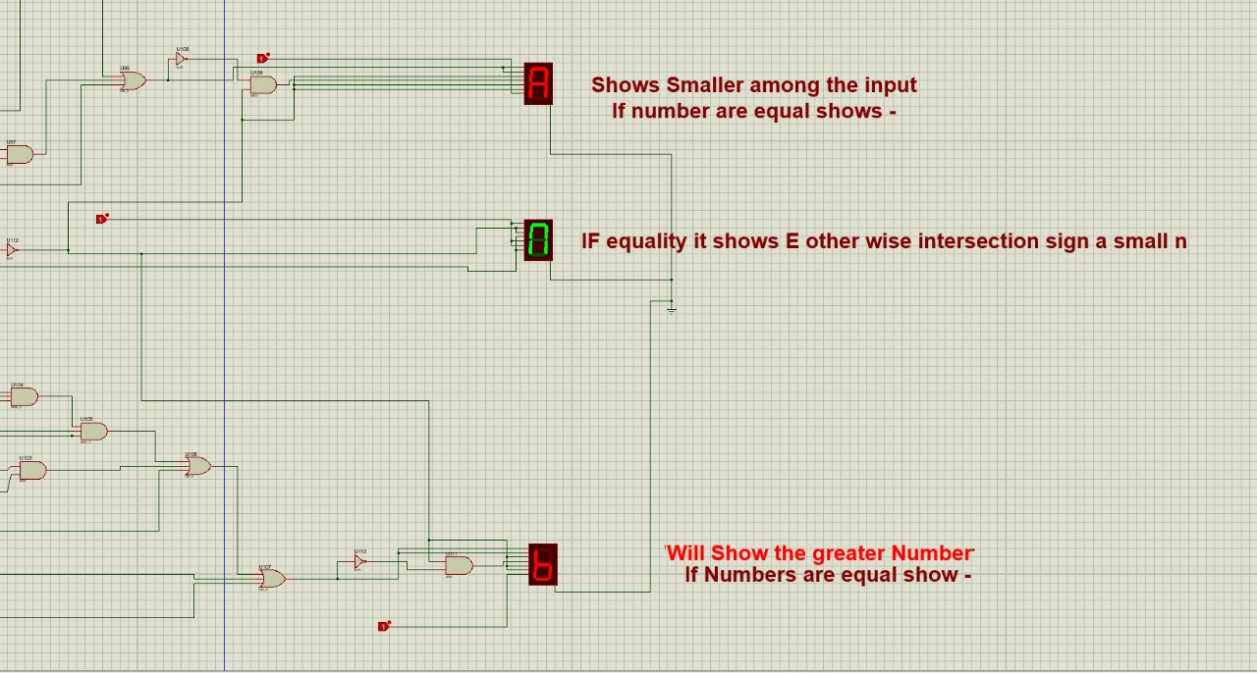

Slide 23
Individual contribution
Muhammad Usman Shahid
Comparator
Multiplier
Musaab Imran
Addition
Subtraction

Slide 24
THANK YOU!

