Slide 1


Coding Made Easy!

Slide 2

Getting to know your keys
Keyboard shortcuts

Slide 3

Exclamation Point
!

Slide 4
Tilde
~

Slide 5
Brackets
()

Slide 6
Square Brackets
[]

Slide 7
Curly Brackets
{}

Slide 8
Angle Brackets
<>

Slide 9
Colon
:

Slide 10
Semicolon
;

Slide 11
Caret
^

Slide 12
Vertical Bar
|

Slide 13
Forward Slash
/

Slide 14
Backwards Slash
\

Slide 15
Addition
+

Slide 16
Minus
-

Slide 17
Multiplication
*

Slide 18
Equal Sign
=

Slide 19
Number Sign
#

Slide 20
At Sign
@

Slide 21
SHORTCUTS
Most Important

Slide 22
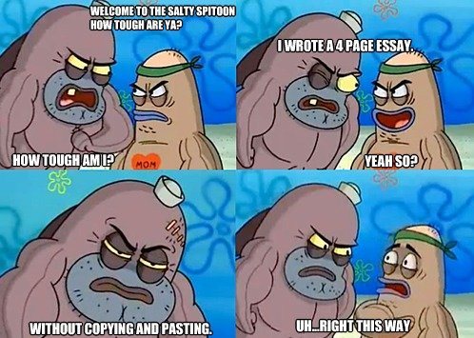
Ctrl+C or Ctrl+Insert and Ctrl+X
Control Copy & Control Cut

Slide 23
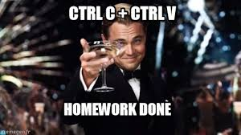
Ctrl+V or Shift+Insert
Pasting

Slide 24
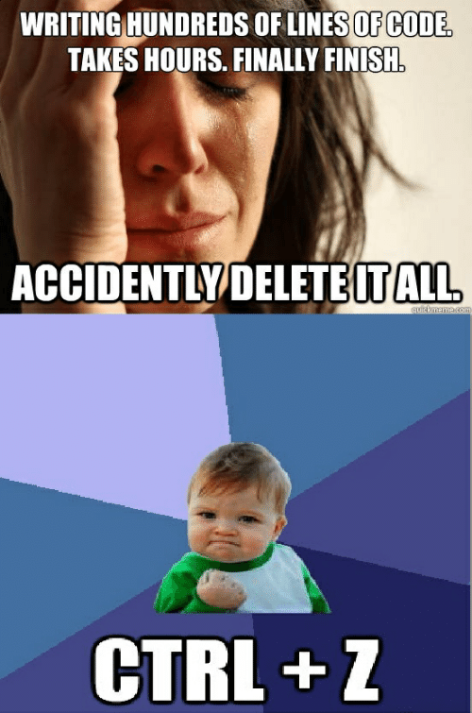
Ctrl+Z and Ctrl+Y
Undo & Redo

Slide 25

Ctrl+F
FIND

Slide 26
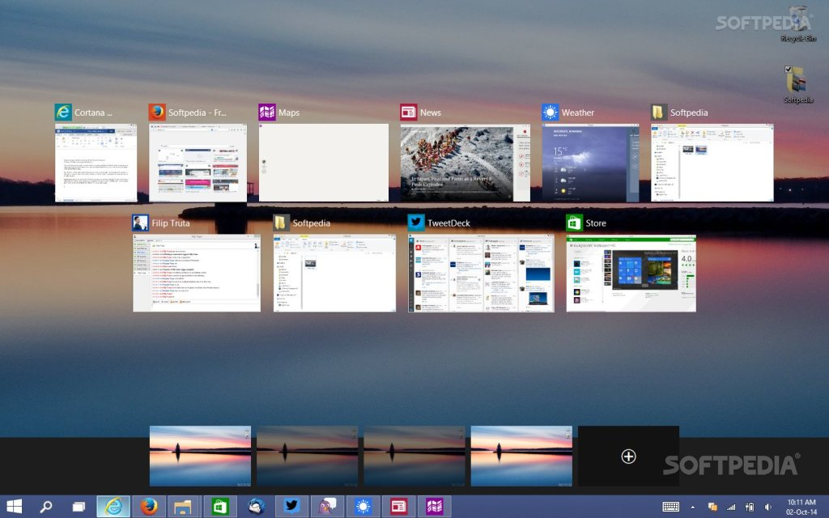
Alt+Tab or Ctrl+Tab
Switch Screens

Slide 27

Ctrl+S
SAVE

Slide 28
Coding Tools

Slide 29
Tools of the trade
IDE
Browser
Developer Tools
Photo Editor
Brackets
Atom
Chrome
Firefox
Chrome
Firefox
Photoshop
Paint

Slide 30
Introduction to HTML

Slide 31

Objectives
Write simple HTML documents
Understand the difference between closing and self closing tags
Write tags with attributes
Use MDN as a reference
Given an image, write the corresponding HTML

Slide 32

History of HTML
Created in 1989/1990 by Tim Berners Lee
Allowed publishing and exchanging of scientific and
Technical documents
Allowed electronic linking of documents via hyperlinks

Slide 33
HTML by the parts
HTML
Elements
Attributes
Heading
Paragraphs
Formatting
Images
Lists
Tables
Forms

Slide 34
MDN HTML Reference

Slide 35
Every HTML Document - Boilerplate
<!DOCTYPE html>
<html>
<head>
<!-- Our metadata goes here -->
<title></title>
</head>
<body>
<!-- Our content goes here -->
</body>
</html>

Slide 36
Every HTML Document - Boilerplate
<HTML>
<Head>
<Body>
<Title>
<H1>
<P>

Slide 37
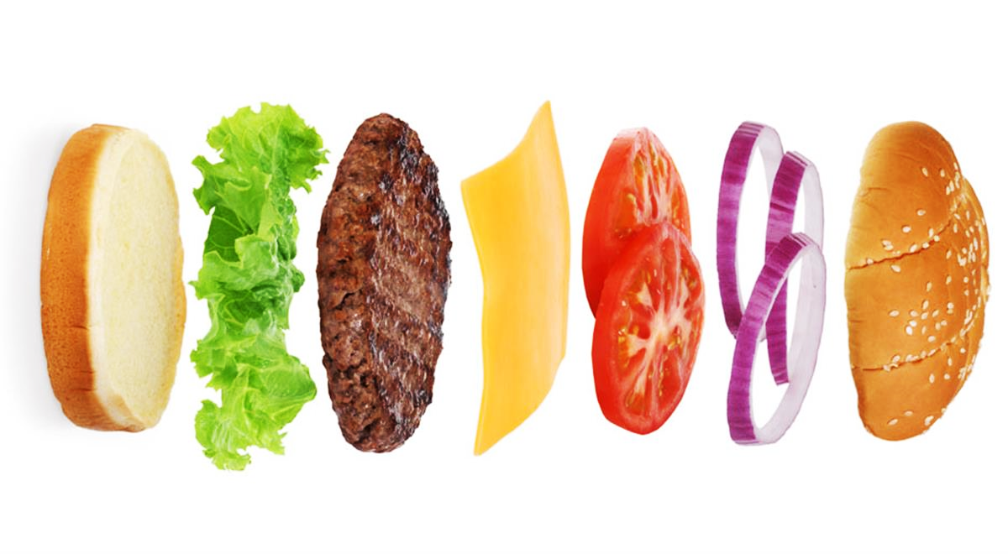
Every HTML Document - Boilerplate
<HTML>
<Head>
<Title>
<Body>
<H1>
<P>

Slide 38
General Rule
<tagName> Some Content </tagName>
<h1>Coding is for winners</h1>
<p>I love to code!</p>

Slide 39
Tags & Elements
<tagName> Some Content </tagName>
<h1>Coding is for winners</h1>
<p>I love to code!</p>

Slide 40
Comments
<!-- This is a comment. It doesn't do anything! -->

Slide 41
Common Tags
<h1>I'm a header </h1>
<h2>I'm a slightly smaller header </h2>
<h6>I'm the smallest header </h6>
<p>I'm a paragraph</p>
<button>I'm a button!</button>

Slide 42
Common Tags – Cont.
Ordered List
Unordered List
<ol>
<li>List Item 1</li>
<li>List Item 2</li>
</ol>
<ul>
<li>List Item 1</li>
<li>List Item 2</li>
</ul>

Slide 43
Closing Tags
<h1>I need a closing tag </h1>
<p>Me too!</p>

Slide 44
Self Closing Tags
<!-- No closing tag or inner text needed -->
<img src=“dog.png">
<link href="style.css">
<!-- Don't worry about what these tags do yet -->

Slide 45
Attributes
Adding Additional Information To Tags
<tag name="value"></tag>
<img src=“puppy.png">
<p class="selected">woof woof</p>
<a href="www.google.com">Click me to go to Google</a>
<link rel="stylesheet" type="text/css" href="style.css">

Slide 46
MDN Attribute Reference

Slide 47

Images
<img src=“balloons.png">

Slide 48
Links
<a href="url">Link Text</a>
<a href="www.google.com">Click me to go to Google</a>
<a href="www.reddit.com">Click me to go to Reddit</a>

