Slide 1
ENR497: B.Tech. Engg. Project
School of Engineering & Applied Science
(Winter 2026)

Slide 2



Agentic Cloud Cluster
Final Project Presentation
Sarthak Siddhpura
Mentor: Professor Sanjay Chaudhary
Jan 2026 - April 2026
Notes:
Good morning everyone. Today I will be presenting my B.Tech final engineering project titled "Agentic Cloud Cluster."
This project was completed under the guidance of Professor Sanjay Chaudhary at Ahmedabad University.
I will walk you through the system architecture, the integration of reinforcement learning for task scheduling, and our final benchmark results.

Slide 3
Outline
Motivation
Literature survey
Overall objectives of the project
Tools and Architecture
Methodology
Progress and final results
Novelty in the project
Gantt chart for the project
Who will benefit from your work ?
26-02-23
Notes:
Speaker notes:
Here is the roadmap for today's presentation.
We will begin by discussing the motivation behind the project and the current landscape of cluster scheduling.
Then, we will dive deep into the Go-based methodology and the reinforcement learning architecture.
Finally, we will review the performance benchmarks and discuss the future scope of this work.

Slide 4
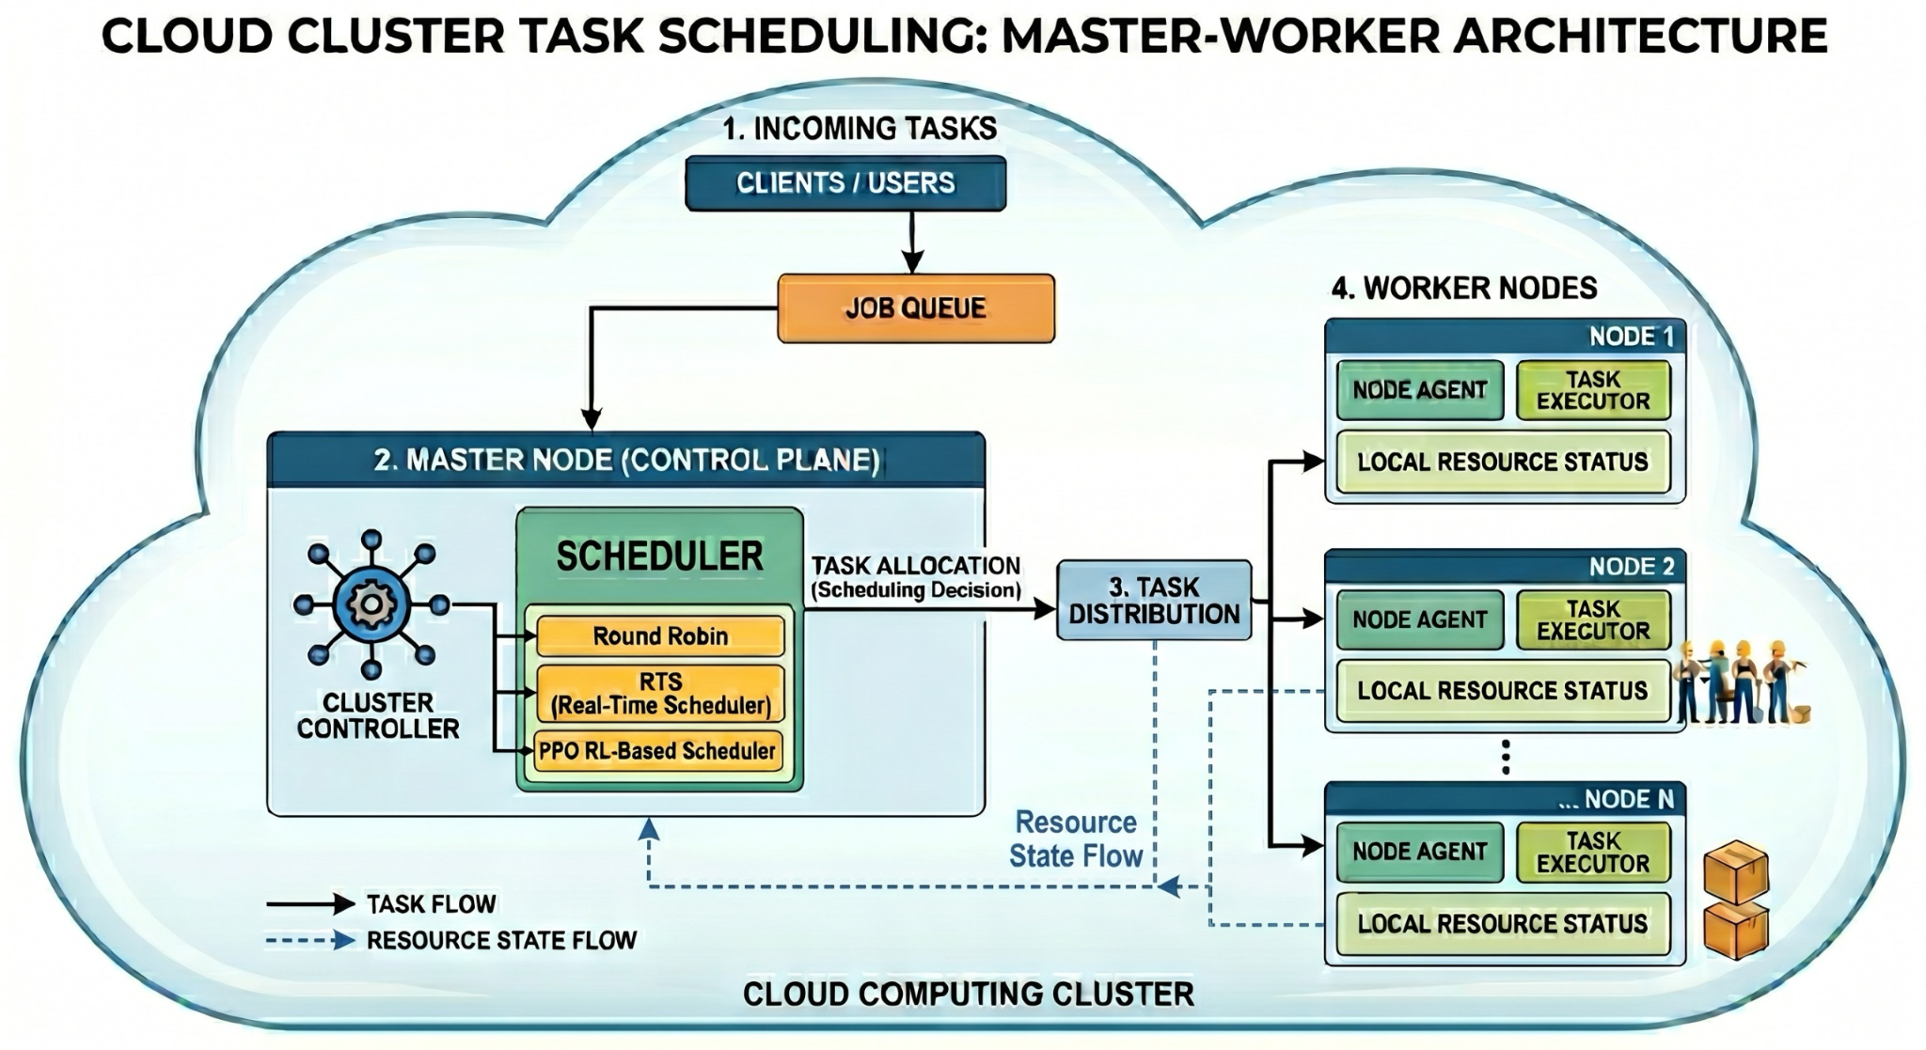
Agentic Cloud Cluster
A distributed task execution system built in Go.
Master-worker architecture coordinating Docker-based jobs.
Task placement decisions enhanced with Proximal Policy Optimization (PPO).
Clean separation between worker execution logic and the scheduling algorithm.
26-02-23
Notes:
At its core, the Agentic Cloud Cluster is a custom distributed execution framework.
The system uses a Go-based control plane to manage a master node and multiple worker nodes.
Instead of running tasks directly on the host, all jobs are containerized using Docker for isolation.
The defining feature of this cluster is that scheduling is treated as a learning problem, driven by a Proximal Policy Optimization (PPO) agent.

Slide 5

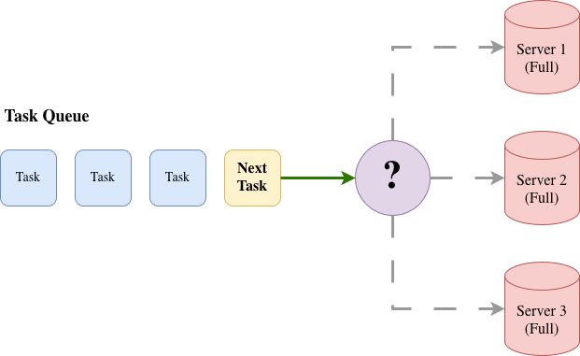
The Motivation for Intelligent Scheduling
rule
tune
dynamic_form
Rigid Rules Fail
Simple scheduling like Round-Robin ignores worker capacity and task urgency, leading to inefficiencies.
Tuning Complexity
Heuristics are notoriously hard to tune for mixed workloads (e.g., CPU vs. memory intensive tasks).
Dynamic Drift
In heterogeneous clusters, the "optimal" choice shifts dynamically every few seconds.
26-02-23
Notes:
Why did we build this? In modern computing, workloads are complex, and workers are often heterogeneous—some have more memory, others have more CPU.
Basic schedulers like Round-Robin simply cycle through workers, which can lead to overloaded nodes and missed deadlines.
Even heuristic schedulers struggle because hardcoded rules cannot adapt to sudden bursts of different task types.
We needed a scheduler that could dynamically learn the best trade-offs based on the actual cluster state.

Slide 6

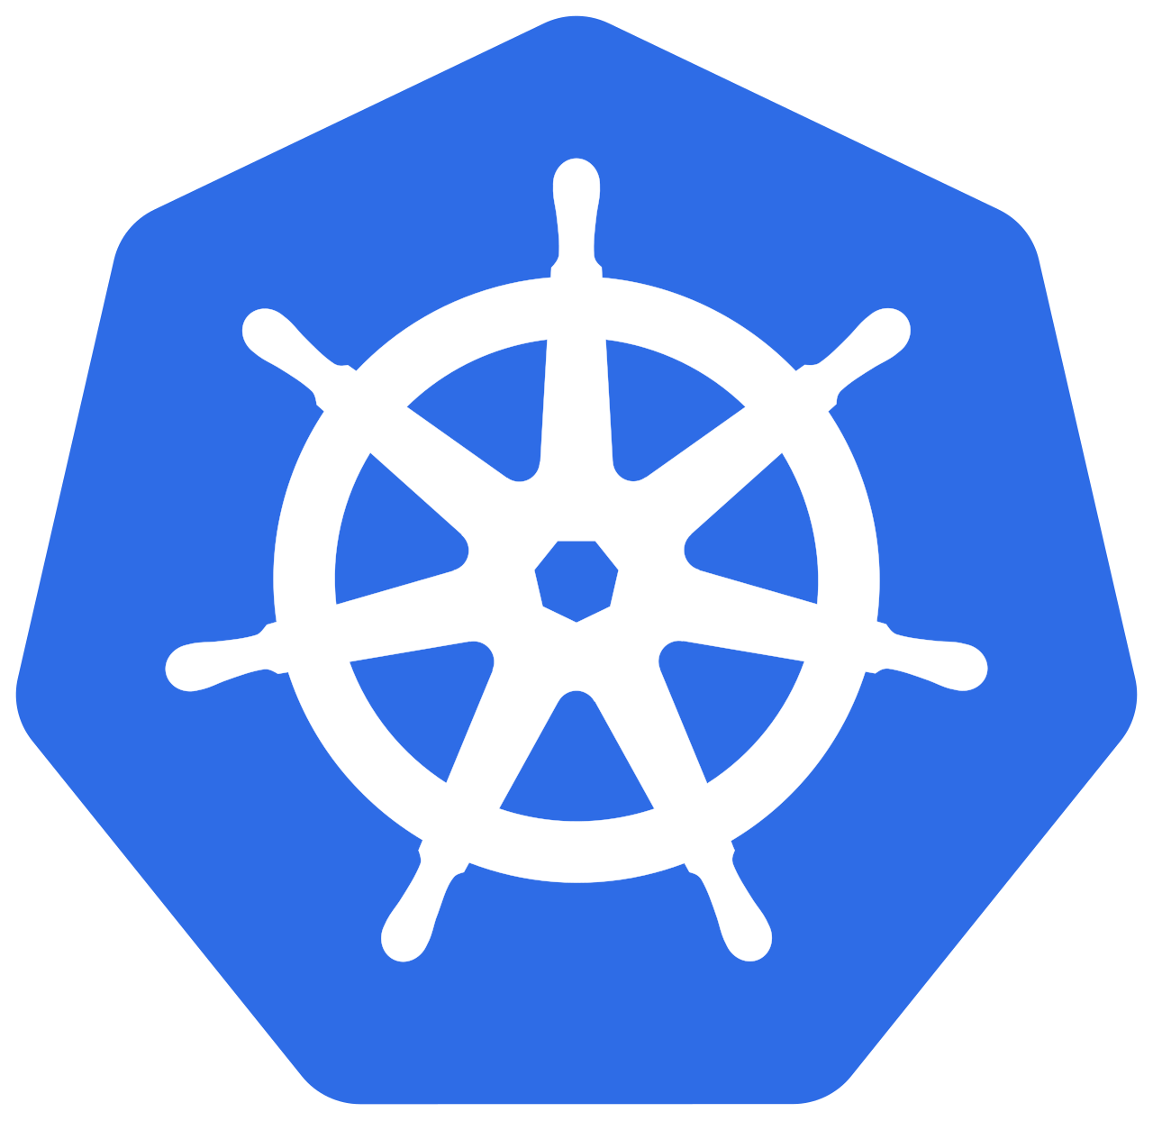

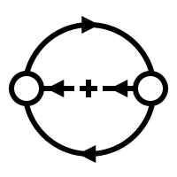
Literature Survey
Kubernetes (Borg)
Utilizes internal heuristics based on complex scoring and filtering mechanisms to manage large-scale container orchestration.
Apache Yunikorn
Comprehensive scheduling with:
Hierarchy queues
Resource fairness
Pluggable sorting
Job ordering (FIFO/FAIR)
Deep RL Evolution
Shift from simple rules to Deep RL (DQN to PPO).
Primary Objectives:
Optimizing Makespan, SLA compliance, and cluster balance.
26-02-23
https://yunikorn.apache.org/
https://kubernetes.io/

Slide 7
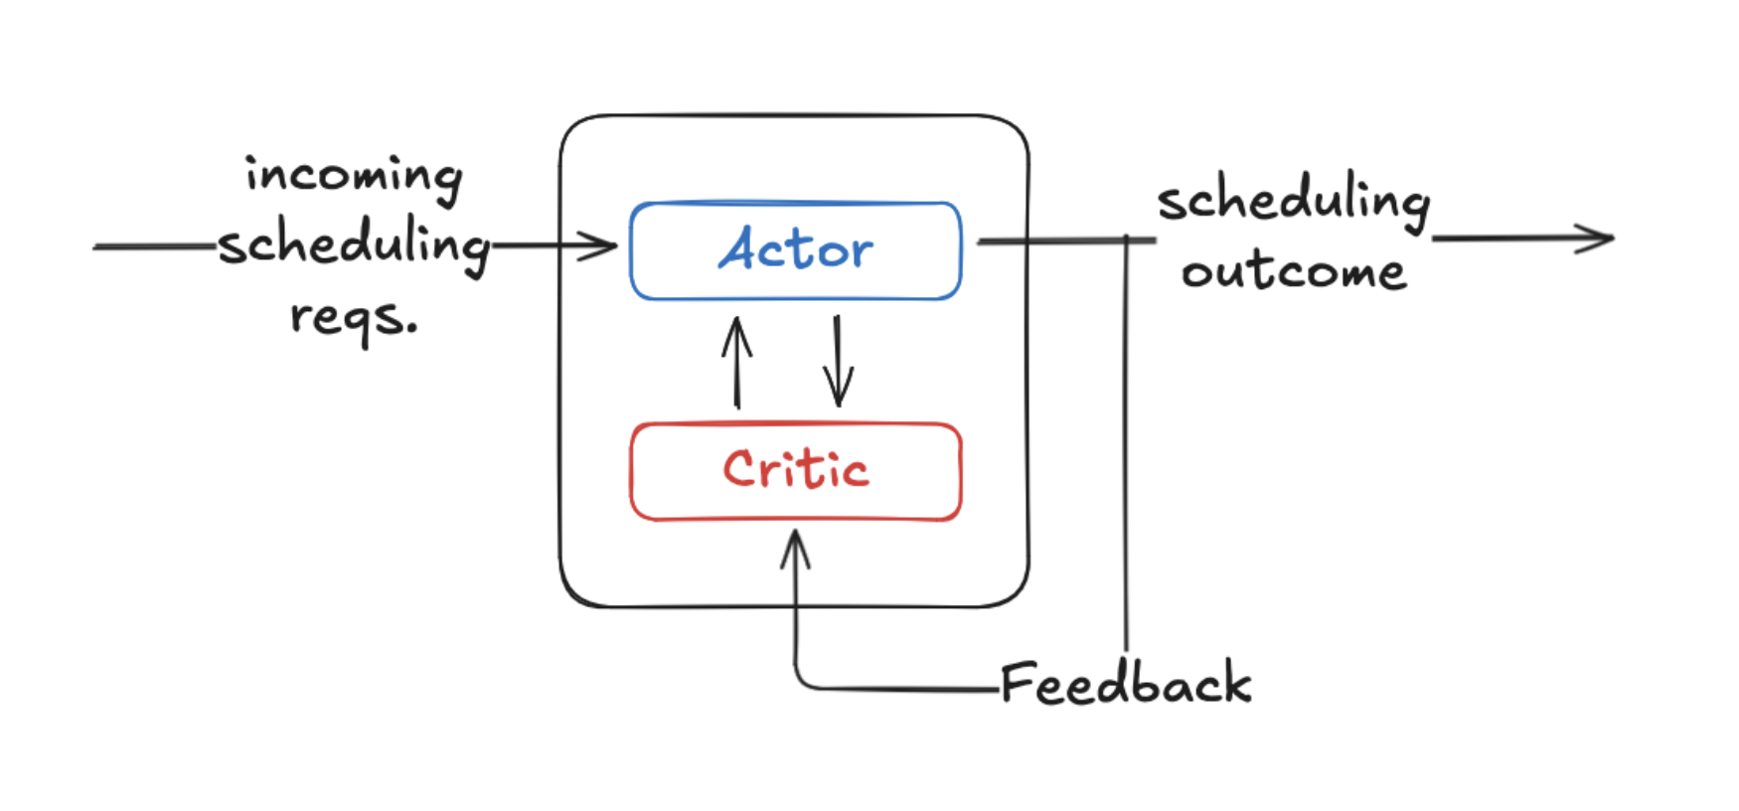
Why Reinforcement learning ?
Scheduling is a repeated decision problem modifying future cluster state.
State: Current task requirements and worker resources.
Action: The selected worker node.
Reward: Feedback on placement feasibility, delay risk, and cluster balance.
26-02-23
Notes:
This brings us to Reinforcement Learning.
Scheduling fits perfectly into the RL paradigm because every placement alters the future state of the cluster.
If we place a massive task on our only high-memory node, subsequent memory-heavy tasks will fail.
In our setup, the "State" is what the scheduler sees, the "Action" is picking a worker, and the "Reward" evaluates how good that placement was for the cluster's health.

Slide 8
Objectives
hub
Execution Cluster: Build a functional Go master-worker execution cluster.
badge
Worker Management: Implement worker registration, heartbeats, and resource tracking.
schedule
Scheduling Interface: Create a clean scheduling interface supporting both baselines and PPO.
model_training
Agent Training: Train the PPO agent on realistic cluster traces with a comprehensive reward function.
analytics
System Analysis: Conduct end-to-end benchmark campaigns to analyze system behavior.
26-02-23
Notes:
Our core objectives were clear. First, build the fundamental Go cluster from scratch.
Second, ensure robust worker lifecycle management, including heartbeats and resource accounting.
Third, establish a clean boundary so we can plug and play different schedulers for comparison.
Fourth, train the PPO model on real-world cluster traces rather than just synthetic data.
And finally, stress-test the entire system to measure the real-world impact.

Slide 9


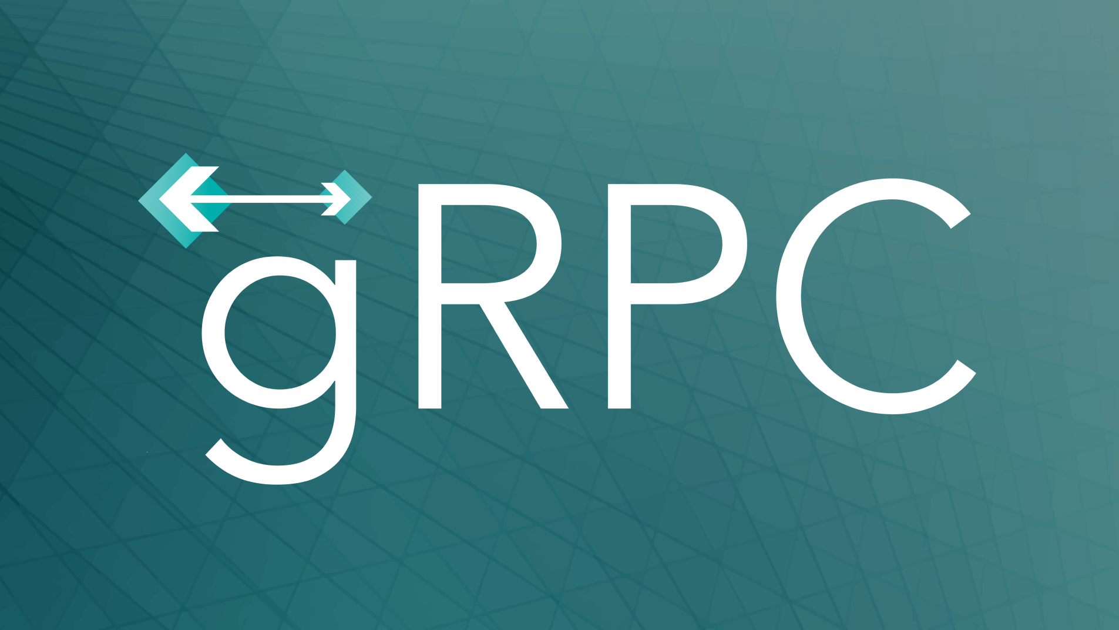

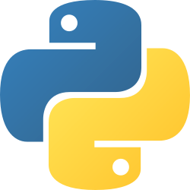
Tools
Go: Powers the highly concurrent master-worker control plane.
Docker: Provides isolated, repeatable container execution environments.
gRPC & Protocol Buffers: Ensures rigid, typed, and high-performance communication.
MongoDB: Acts as the persistent storage layer for tasks, workers, and metadata.
Python/PyTorch: Drives the decoupled PPO scheduling service.
26-02-23
Notes:
The technology stack was chosen for performance and clear boundaries.
Go handles the core distributed cluster because of its excellent concurrency model with goroutines.
Workers execute tasks inside Docker containers for perfect portability.
We use gRPC for fast, strictly typed communication between the Go cluster and the Python-based PPO service.
Finally, MongoDB persists the lifecycle state of tasks and worker metadata.

Slide 10
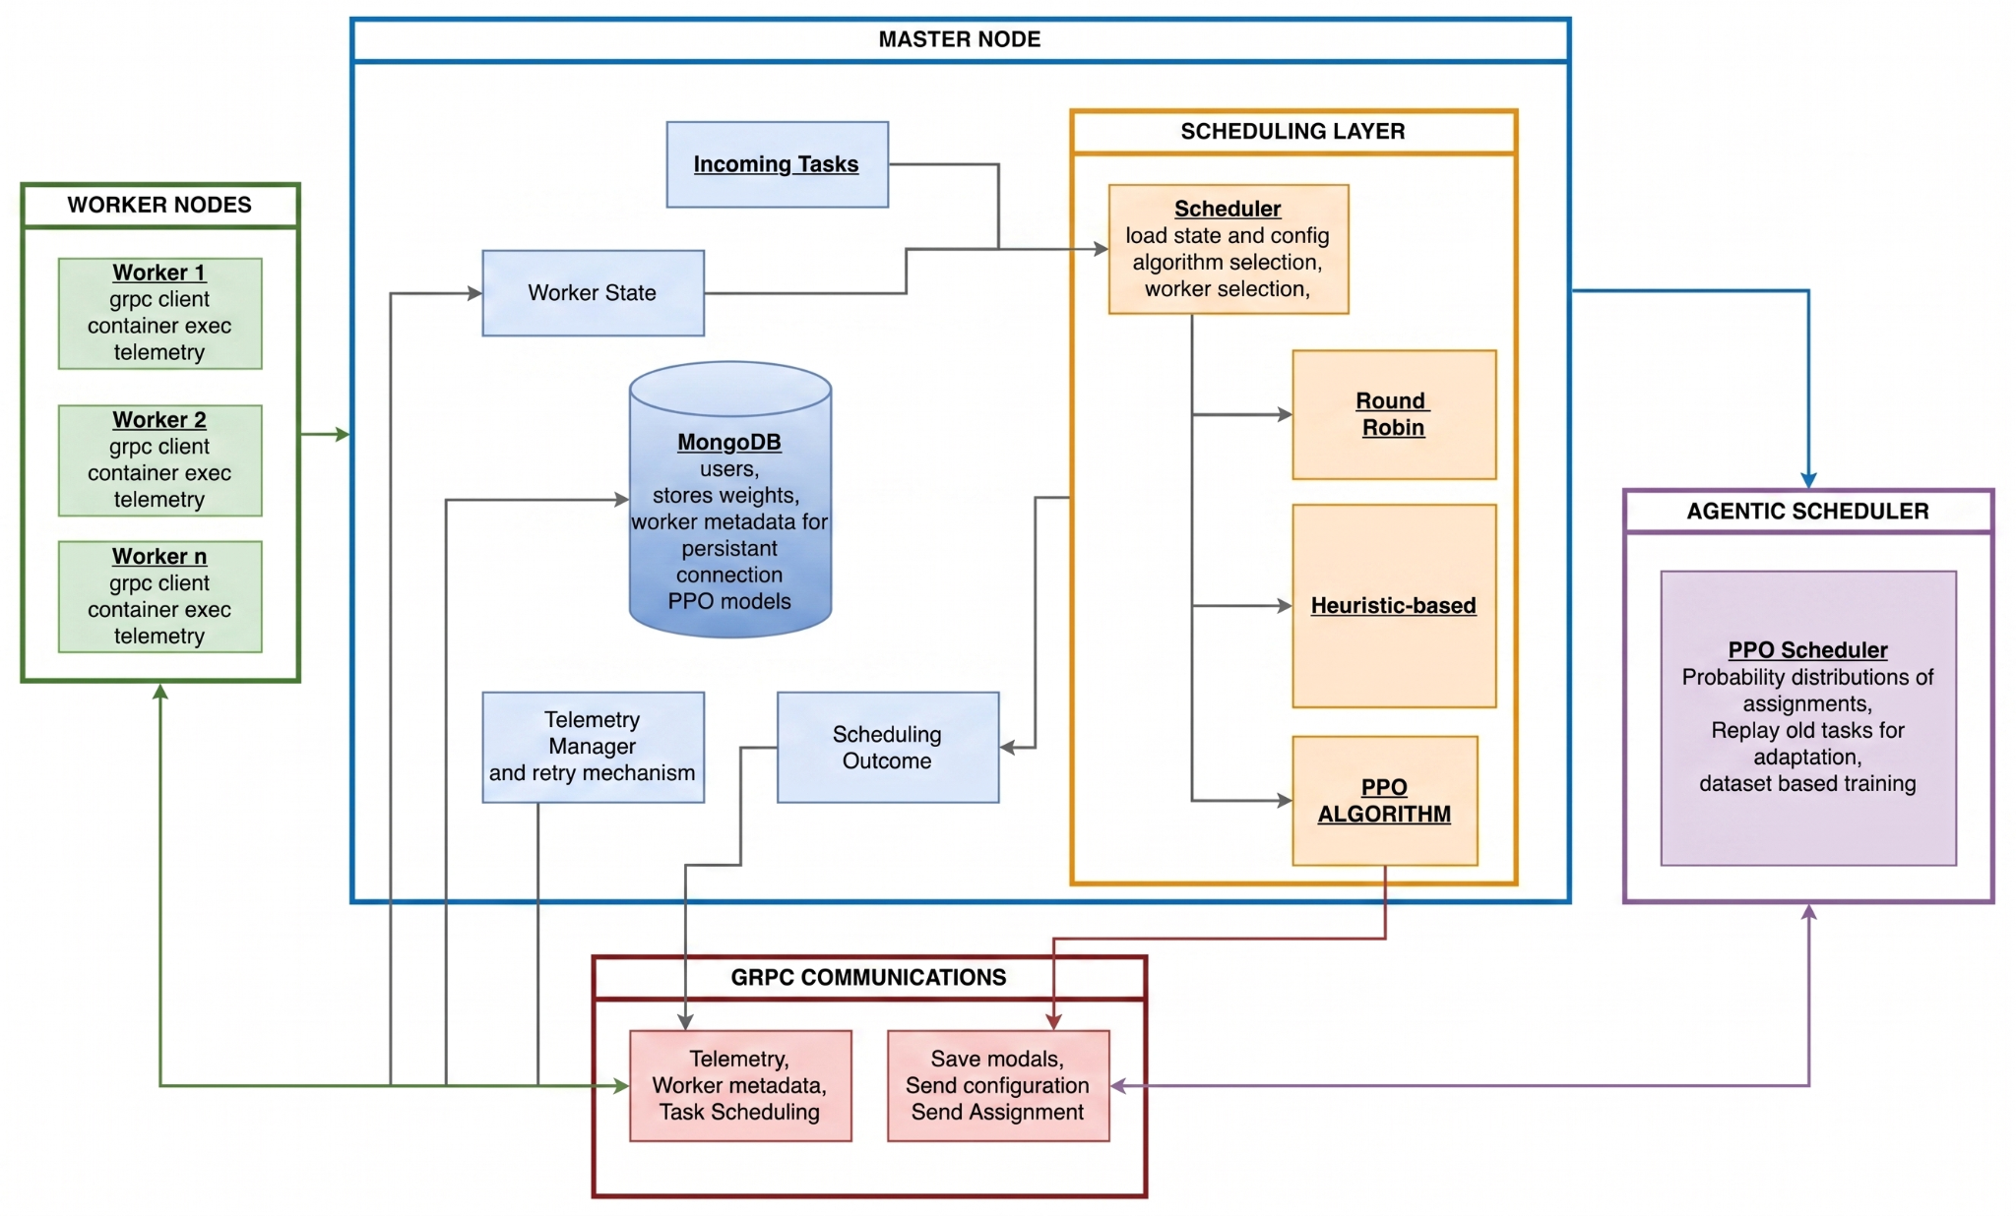
High Level Architecture
26-02-23
Notes:
Here is the high-level architecture of the Agentic Cloud Cluster.
Task submissions come into the Master Node, which logs them into MongoDB and assesses worker telemetry.
The Master then asks the Scheduling Layer for a decision. The Scheduling Layer reaches out to the separate Python Agentic Scheduler via gRPC.
Once a decision is made, the Master dispatches the job to the selected Worker Node, which executes the Docker container and reports back.

Slide 11
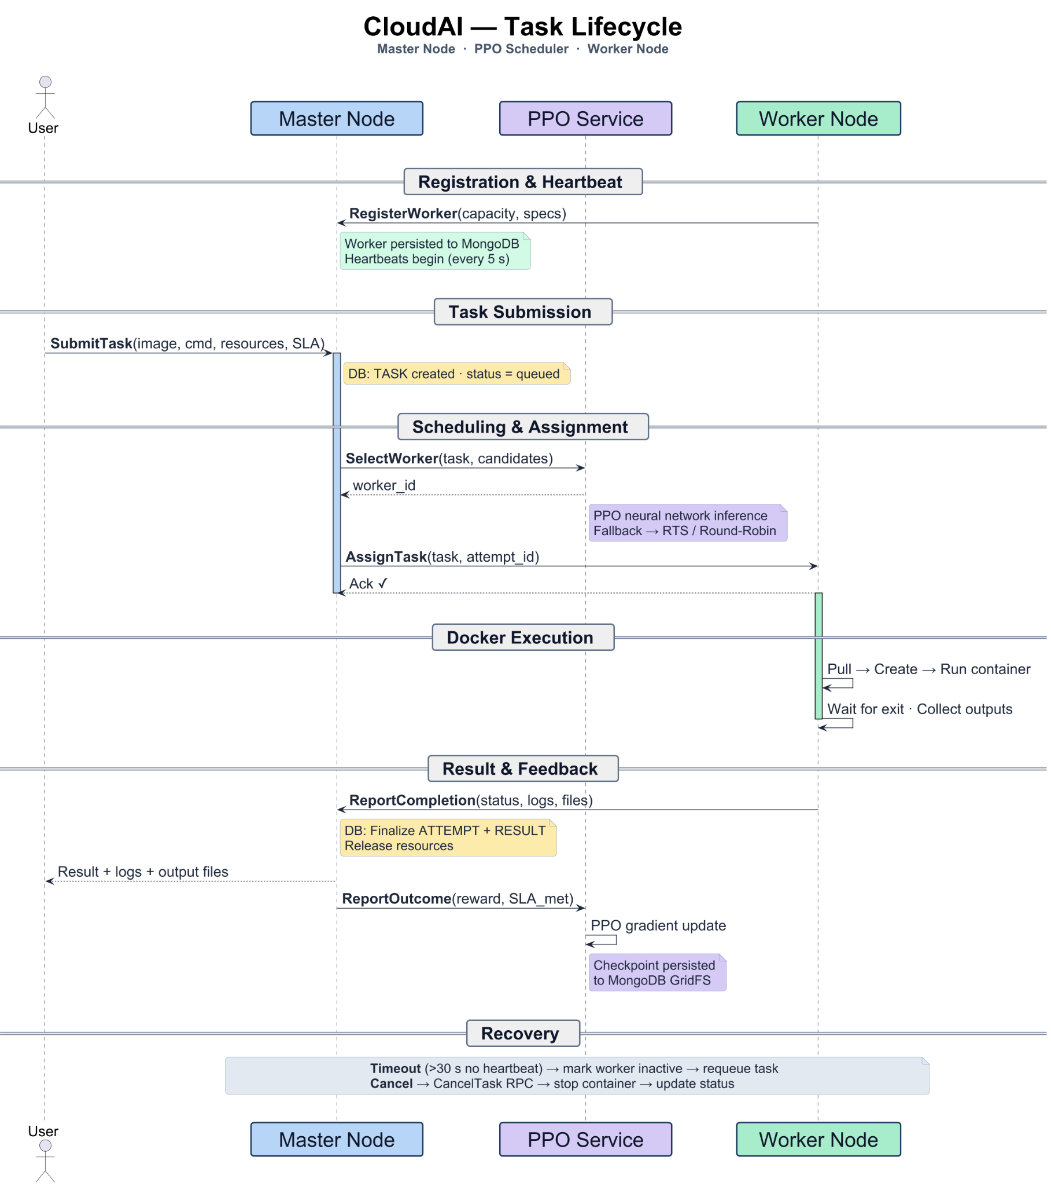
Task LifeCycle - Ideal
26-02-23
Notes:
Here is the high-level architecture of the Agentic Cloud Cluster.
Task submissions come into the Master Node, which logs them into MongoDB and assesses worker telemetry.
The Master then asks the Scheduling Layer for a decision. The Scheduling Layer reaches out to the separate Python Agentic Scheduler via gRPC.
Once a decision is made, the Master dispatches the job to the selected Worker Node, which executes the Docker container and reports back.

Slide 12
Task LifeCycle - Ideal
26-02-23
Notes:
Here is the high-level architecture of the Agentic Cloud Cluster.
Task submissions come into the Master Node, which logs them into MongoDB and assesses worker telemetry.
The Master then asks the Scheduling Layer for a decision. The Scheduling Layer reaches out to the separate Python Agentic Scheduler via gRPC.
Once a decision is made, the Master dispatches the job to the selected Worker Node, which executes the Docker container and reports back.

Slide 13
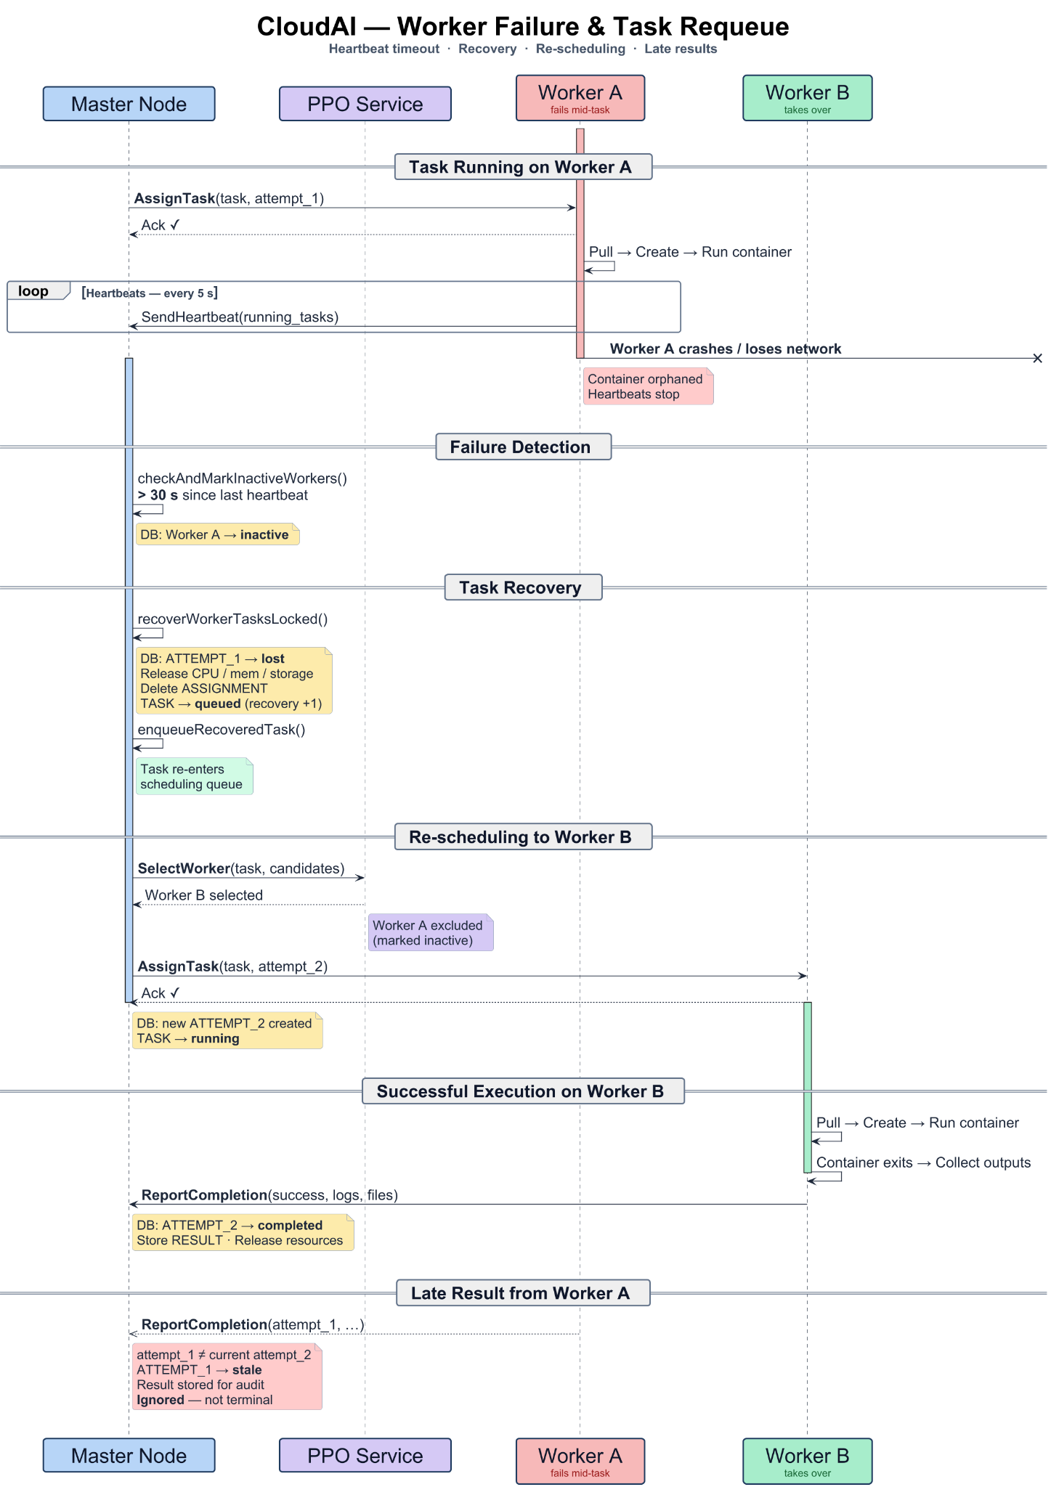
Task LifeCycle - Retry Mechanism
26-02-23
Notes:
Here is the high-level architecture of the Agentic Cloud Cluster.
Task submissions come into the Master Node, which logs them into MongoDB and assesses worker telemetry.
The Master then asks the Scheduling Layer for a decision. The Scheduling Layer reaches out to the separate Python Agentic Scheduler via gRPC.
Once a decision is made, the Master dispatches the job to the selected Worker Node, which executes the Docker container and reports back.

Slide 14
Task LifeCycle - Retry Mechanism
26-02-23
Notes:
Here is the high-level architecture of the Agentic Cloud Cluster.
Task submissions come into the Master Node, which logs them into MongoDB and assesses worker telemetry.
The Master then asks the Scheduling Layer for a decision. The Scheduling Layer reaches out to the separate Python Agentic Scheduler via gRPC.
Once a decision is made, the Master dispatches the job to the selected Worker Node, which executes the Docker container and reports back.

Slide 15
Task LifeCycle - Retry Mechanism
26-02-23
Notes:
Here is the high-level architecture of the Agentic Cloud Cluster.
Task submissions come into the Master Node, which logs them into MongoDB and assesses worker telemetry.
The Master then asks the Scheduling Layer for a decision. The Scheduling Layer reaches out to the separate Python Agentic Scheduler via gRPC.
Once a decision is made, the Master dispatches the job to the selected Worker Node, which executes the Docker container and reports back.

Slide 16

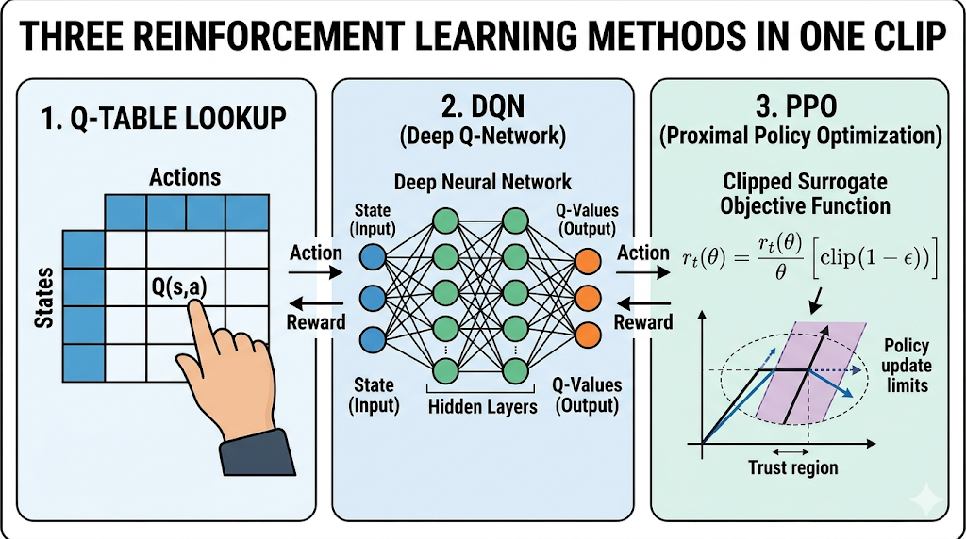
Evolution of Agentic Scheduling
grid_on
hub
rocket_launch
Deep Q-Networks
Difficult to handle dynamic action sets and masking invalid workers.
PPO
Directly learns a policy, supports action masks, and uses stable clipped updates.
Q-Tables
Unsuitable due to massive, continuous state spaces in cluster environments.
26-02-23
Notes:
In designing the RL agent, we evaluated several approaches.
Q-Tables were too simplistic because a cluster has a massive, continuous state space—you can't just bucket CPU percentages easily.
Deep Q-Networks were better, but they struggle when the number of available workers changes dynamically.
We settled on Proximal Policy Optimization because it directly outputs a probability distribution for worker selection, allows us to mask out nodes that lack resources, and updates conservatively to prevent sudden catastrophic failures.

Slide 17
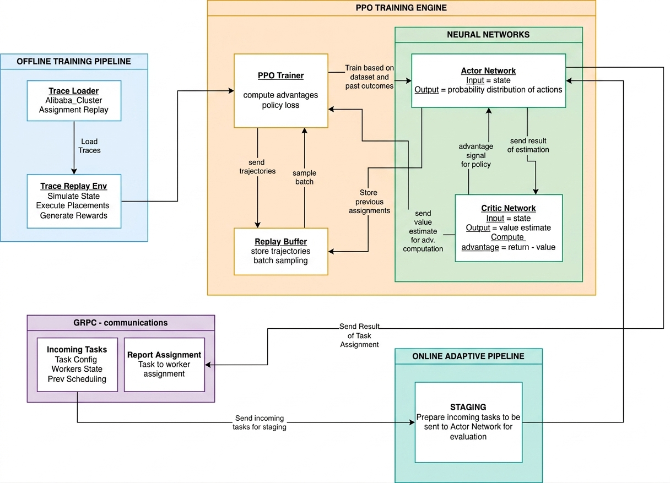
High Level Architecture: Agentic Scheduler
26-02-23
Notes:
Here is the high-level architecture of the Agentic Cloud Cluster.
Task submissions come into the Master Node, which logs them into MongoDB and assesses worker telemetry.
The Master then asks the Scheduling Layer for a decision. The Scheduling Layer reaches out to the separate Python Agentic Scheduler via gRPC.
Once a decision is made, the Master dispatches the job to the selected Worker Node, which executes the Docker container and reports back.

Slide 18
Methodology: Trace-Driven Training
storage
settings_backup_restore
track_changes
Dataset Source
Trained using the Alibaba Cluster Trace v2018 (Production workload data).
Replay Environment
Simulates sequential task arrivals, resource reservations, and completions.
Resource Tracking
Lifecycle Resource Tracking: Matches actual simulated runtimes rather than inaccurate exponential decay.
26-02-23
Notes:
To ensure the scheduler works in the real world, we trained it offline using the Alibaba Cluster Trace, which contains real production workload patterns.
We built a custom trace replay environment that feeds tasks to the model chronologically.
A critical methodology decision was using lifecycle resource tracking—reserving resources for the exact simulated runtime—rather than simple decay formulas, ensuring accurate state representation.

Slide 19
State Representation & Action Masking
Task Vector (5 features)
CPU
Memory
Storage
SLA Multiplier
Task Type
Worker Vector (9 features)
Ratios for CPU, Memory, and Storage across three dimensions:
Available Resources
Total Capacity
Used Resources
Action Masking
Infeasible workers lacking required resources are mathematically hidden from the policy, ensuring valid scheduling decisions.
26-02-23
Notes:
Here is the high-level architecture of the Agentic Cloud Cluster.
Task submissions come into the Master Node, which logs them into MongoDB and assesses worker telemetry.
The Master then asks the Scheduling Layer for a decision. The Scheduling Layer reaches out to the separate Python Agentic Scheduler via gRPC.
Once a decision is made, the Master dispatches the job to the selected Worker Node, which executes the Docker container and reports back.

Slide 20
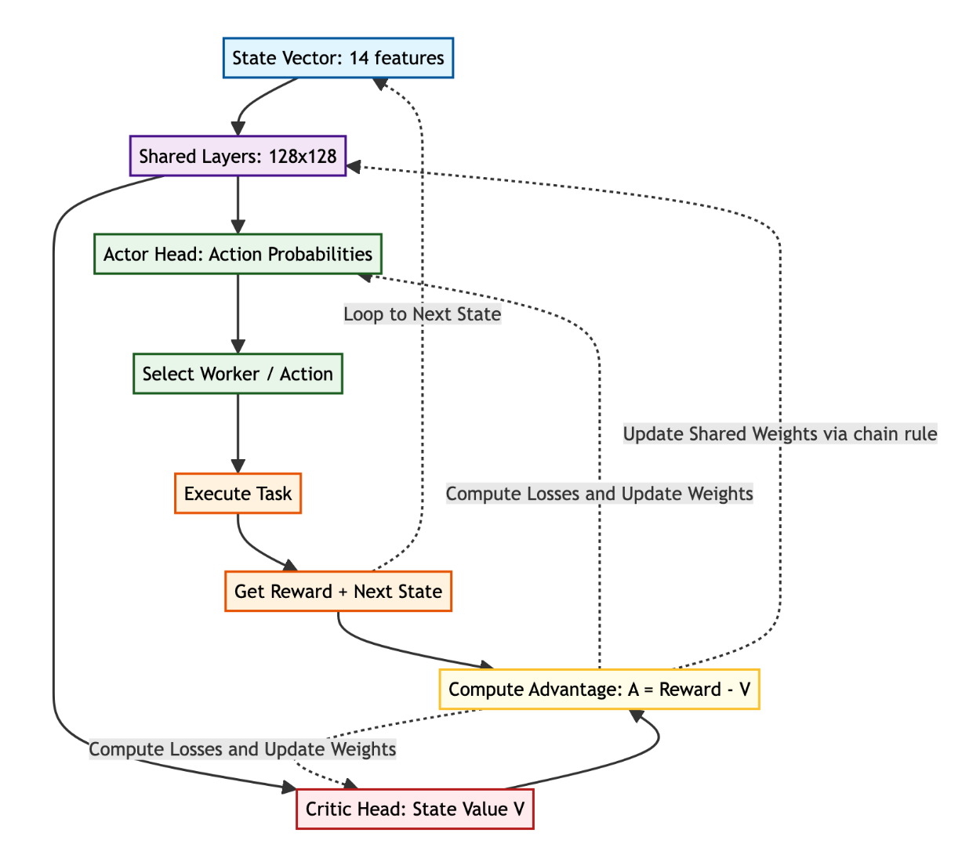
PPO Scheduler Design (Actor & Critic)
26-02-23
Notes:
Here is the high-level architecture of the Agentic Cloud Cluster.
Task submissions come into the Master Node, which logs them into MongoDB and assesses worker telemetry.
The Master then asks the Scheduling Layer for a decision. The Scheduling Layer reaches out to the separate Python Agentic Scheduler via gRPC.
Once a decision is made, the Master dispatches the job to the selected Worker Node, which executes the Docker container and reports back.

Slide 21
The Reward Function
R = 1.4 + 0.25H - 0.35Qp - 0.55Tp - 0.20Ip - 0.40ΔI - Rq
H (Headroom Bonus)
Rewarded by selection of workers who have space vacant.
Qp (Queue Pressure)
Punishes anticipated waiting time.
Tp (Tail Pressure)
Penalizes likely SLA or tail-latency risk.
Ip (Imbalance Penalty)
Discourages overworking of already overworked workers.
ΔI (Change in Imbalance)
Punishes behaviors that worsen cluster balance.
Rq (Requeue Penalty)
Discourages constantly dangerous placements.
26-02-23
Notes:
Term How it is computed and what it means
H 1−Lselected. A lightly loaded selected worker gives a higher headroom bonus.
If the worker is almost full, this value becomes small.
Qp min(queueWaitProxy/slaBudget,3.0). The proxy is trace queue wait plus
runtime×Lselected. It estimates how much waiting pressure the placement
creates relative to the SLA budget.
Tp max(turnaroundProxy/slaBudget−1,0). Turnaround proxy is queue wait
proxy plus runtime. This term becomes positive only when expected turnaround
crosses the SLA budget.
Ip max(Lselected−Lcluster,0). This is imbalance in the system. It means the
selected worker is more loaded than the cluster average. If the selected worker
is below or equal to average load, the penalty is zero.
∆I σ(loadsafter)−σ(loadsbefore). This measures change in imbalance using the
standard deviation of worker loads. Positive means the action made the cluster
less balanced. Negative means it made the cluster more balanced.
Rq 0.05 ×min(requeueCount,4). A task that has already been requeued receives
a small extra penalty so the scheduler avoids repeating risky placements.

Slide 22
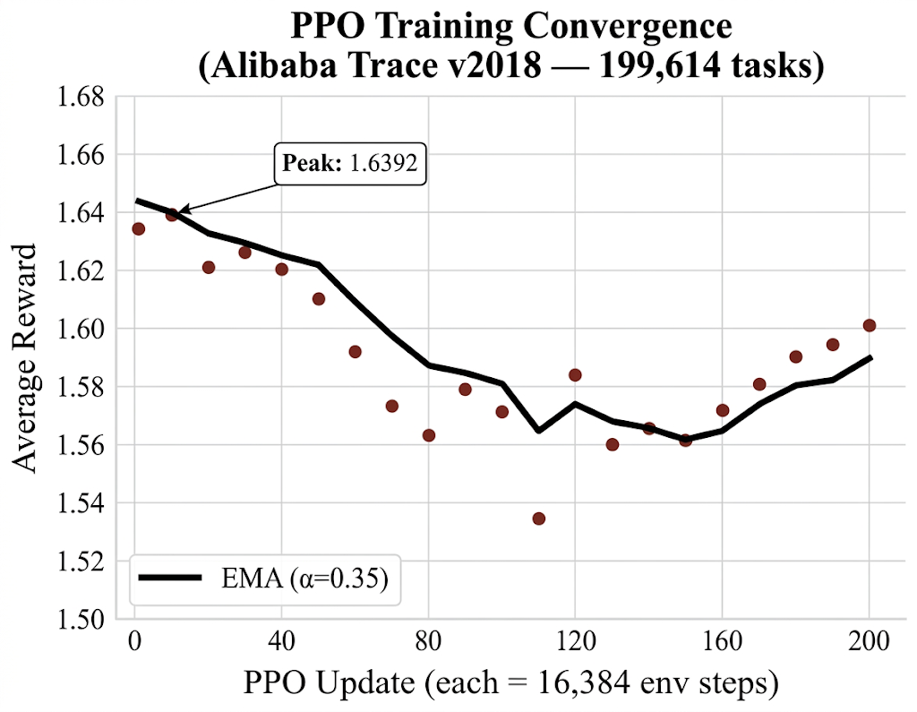
Training Convergence
26-02-23
Notes:
Looking at the training curves, we successfully achieved convergence.
The average reward steadily climbed and stabilized around 1.63.
Simultaneously, we observed policy loss and entropy dropping. The drop in entropy is exactly what we want to see—it proves the model stopped guessing randomly and learned concrete, reliable scheduling strategies.

Slide 23
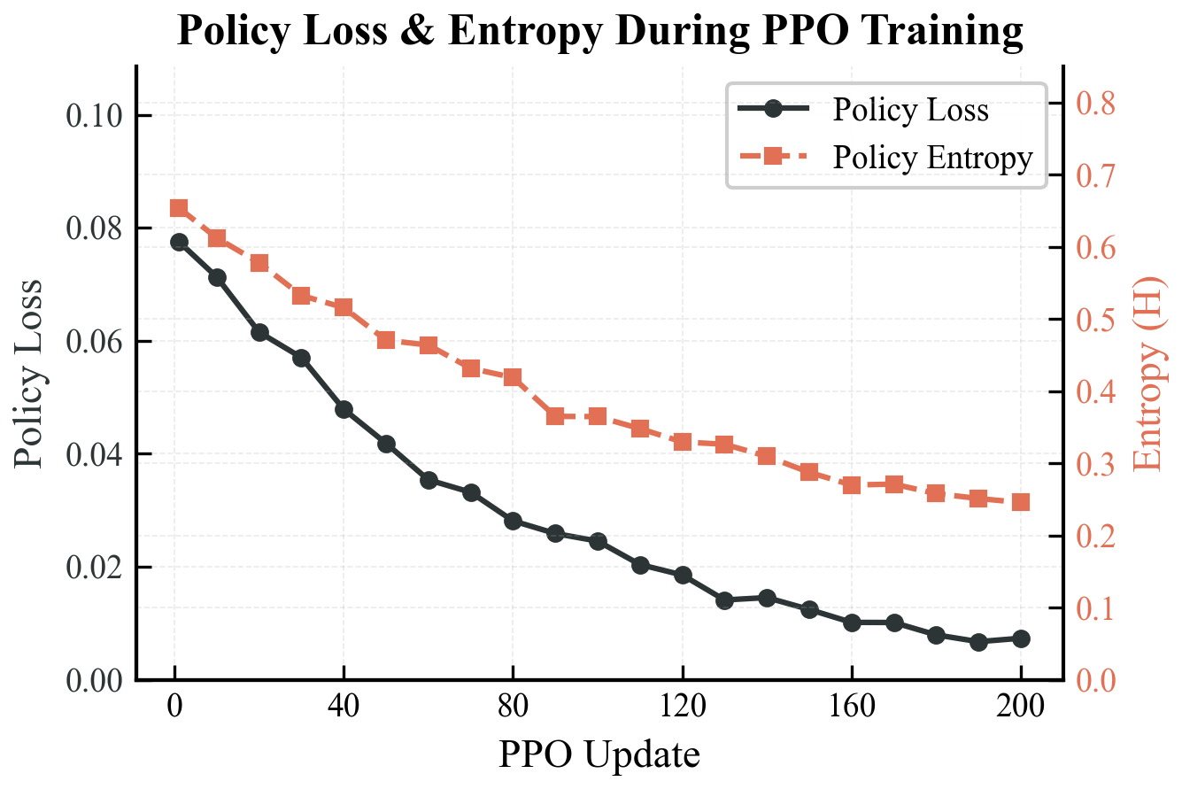
Training Convergence
26-02-23
Notes:
Looking at the training curves, we successfully achieved convergence.
The average reward steadily climbed and stabilized around 1.63.
Simultaneously, we observed policy loss and entropy dropping. The drop in entropy is exactly what we want to see—it proves the model stopped guessing randomly and learned concrete, reliable scheduling strategies.

Slide 24
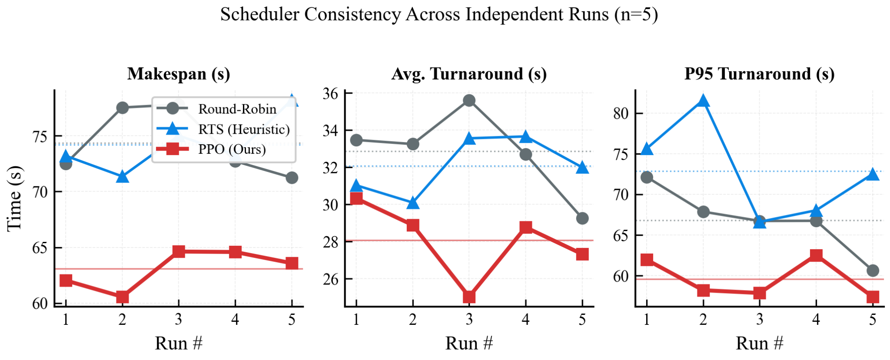
Results: KPI Benchmarking
26-02-23
Notes:
Looking at the training curves, we successfully achieved convergence.
The average reward steadily climbed and stabilized around 1.63.
Simultaneously, we observed policy loss and entropy dropping. The drop in entropy is exactly what we want to see—it proves the model stopped guessing randomly and learned concrete, reliable scheduling strategies.

Slide 25
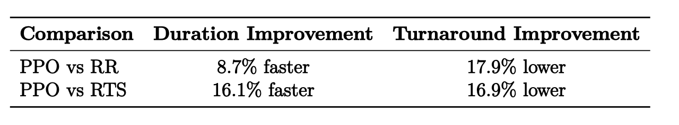
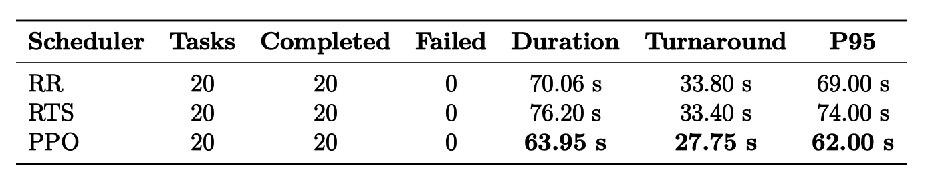
Pressure Scenarios & Cumulative Completion
Under bursty traffic
26-02-23

Slide 26
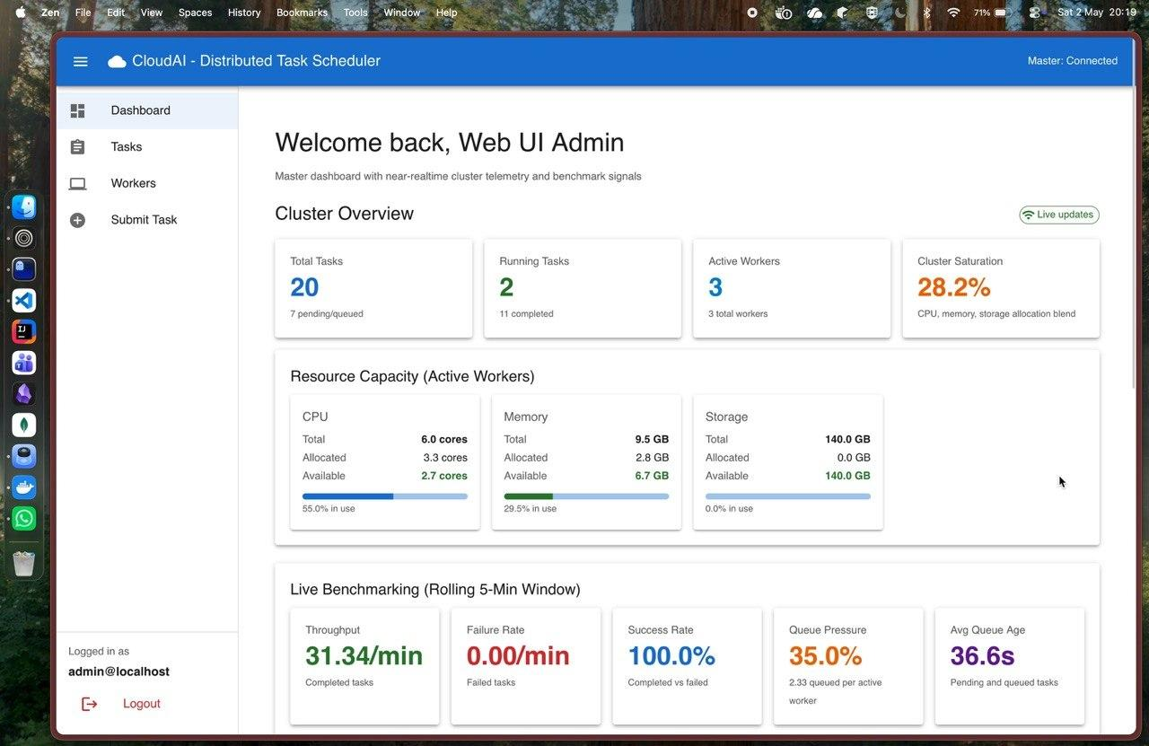
Project Outcomes
26-02-23
Notes:
Web UI

Slide 27
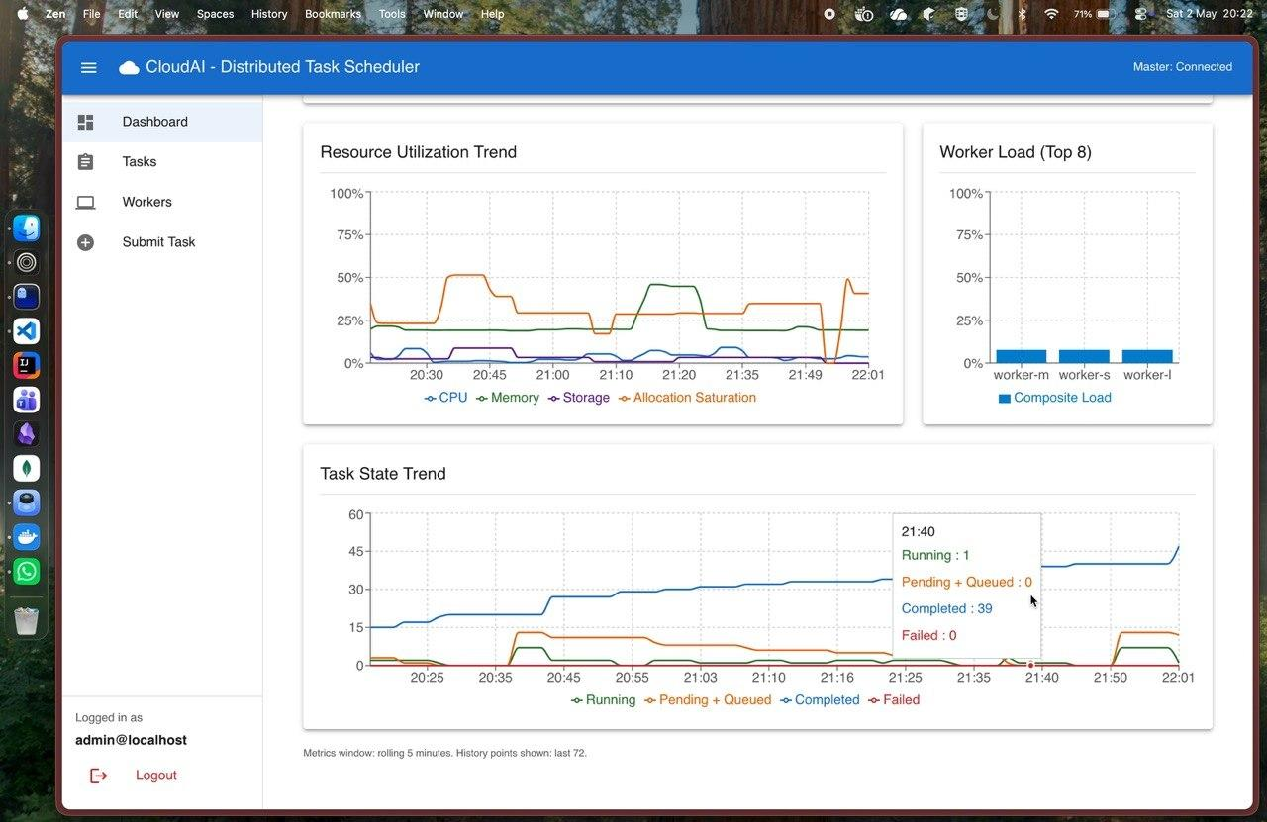
Project Outcomes - Live Timeseries Plot
26-02-23
Notes:
Web UI

Slide 28

Project Outcomes - Demo
26-02-23
Notes:
Web UI

Slide 29
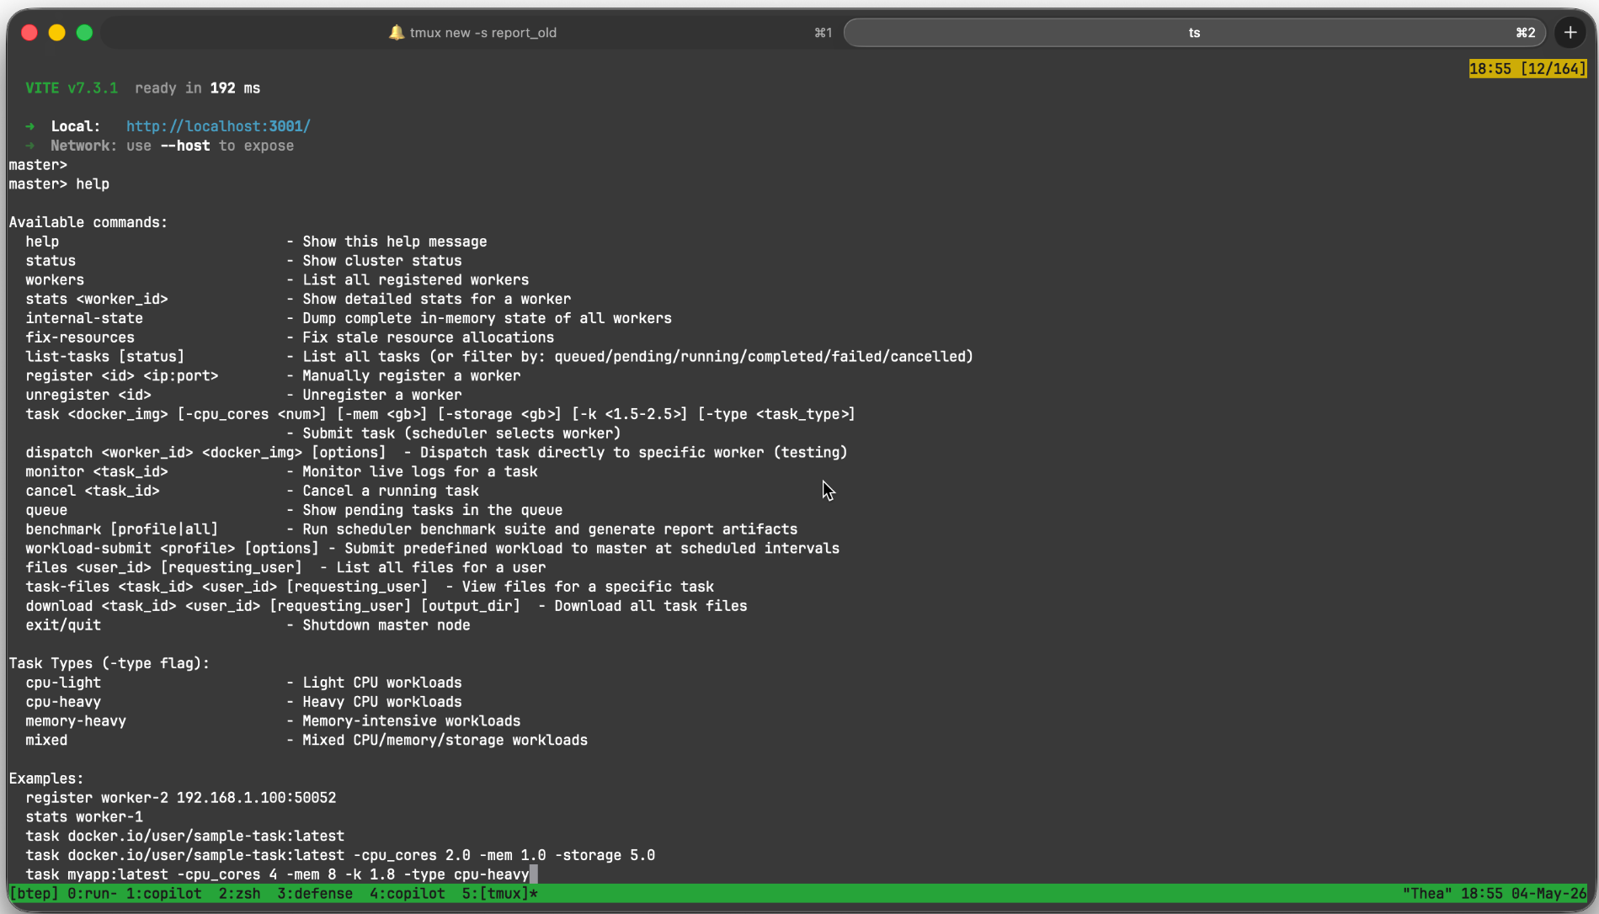
Project Outcomes - Masternode CLI
26-02-23
Notes:
Web UI

Slide 30
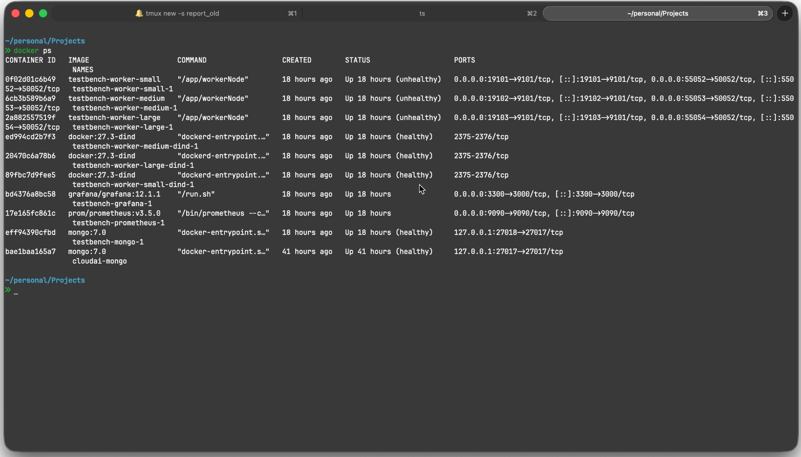
Project Outcomes - Docker Machines
26-02-23
Notes:
Web UI

Slide 31
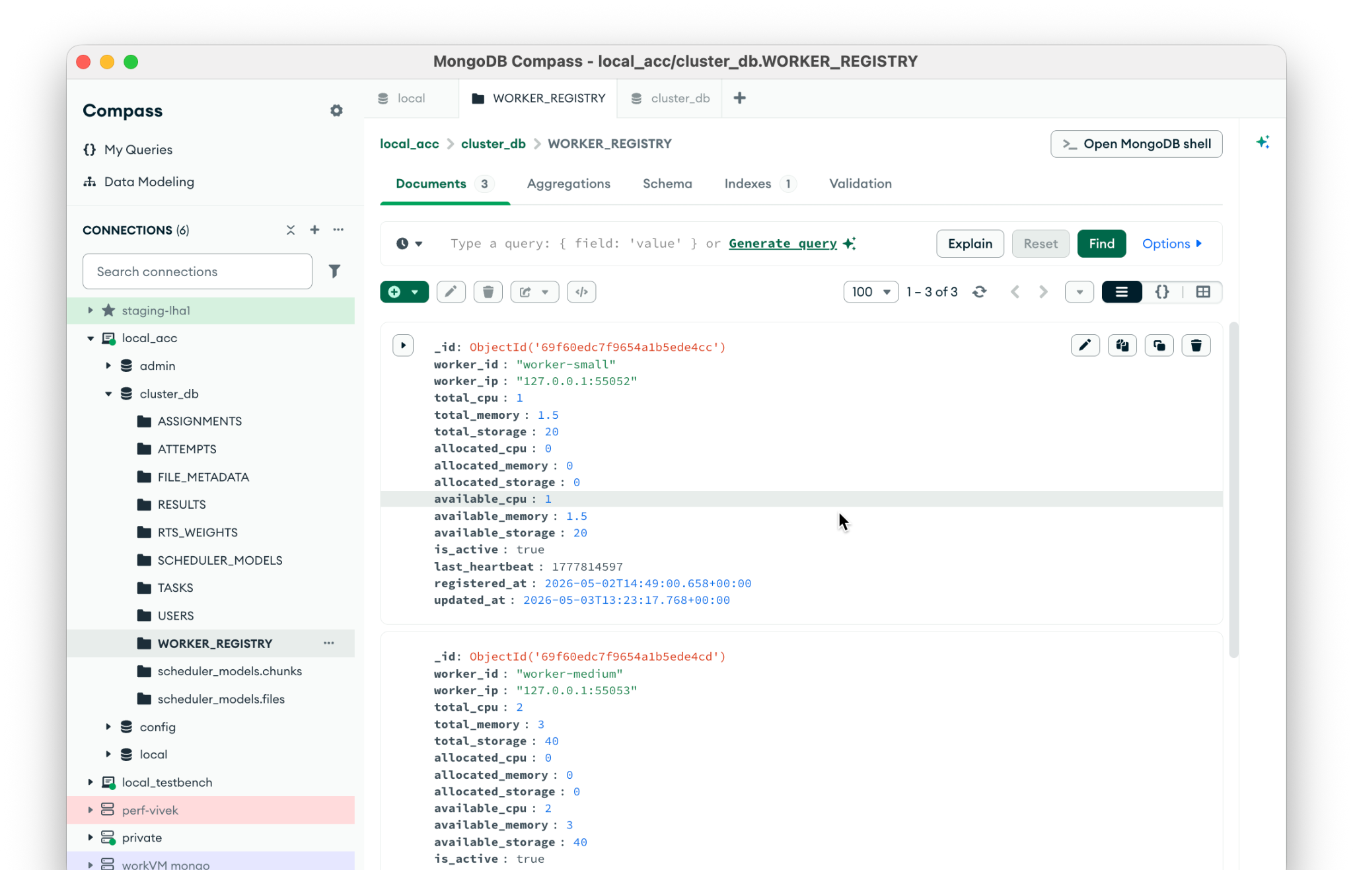
Project Outcomes - Database & Worker Registry
26-02-23
Notes:
Web UI

Slide 32
Novelty & Project Contributions
architecture
Framework Development
Designed and built the Go master-worker framework from scratch.
settings_ethernet
System Integration
Engineered the clean scheduler integration boundary and gRPC communications.
model_training
ML Pipeline & Env
Developed the PPO training pipeline and trace replay environment.
gpp_good
Fault Tolerance
Implemented attempt-level recovery logic for fault tolerance.
26-02-23

Slide 33
Learning outcomes
hub
Distributed Systems
Learned the criticality of strict state handling, retries, and clean API boundaries.
psychology
Reinforcement Learning
Realized the impact of reward shaping and safe deployment strategies.
26-02-23
Notes:
This project bridged two highly complex domains.
I learned that distributed systems rely heavily on robust state management and failure recovery.
On the AI side, I learned that a model is only as good as its reward function, and AI in systems engineering must be deployed with strict safety guardrails.
The project was successfully executed over a 17-week timeline, moving from Go development to final PPO benchmarking.

Slide 34

Future Work: CRIU Integration
CRIU (Checkpoint/Restore In Userspace) provides kernel-level support for freezing, dumping, and restoring process states on demand.
Key Benefits:
inventory_2
Container Migration
hourglass_empty
Task Preemption
healing
Failed Worker Recovery
Source: github.com/checkpoint-restore/criu
26-02-23
Notes:
This project bridged two highly complex domains.
I learned that distributed systems rely heavily on robust state management and failure recovery.
On the AI side, I learned that a model is only as good as its reward function, and AI in systems engineering must be deployed with strict safety guardrails.
The project was successfully executed over a 17-week timeline, moving from Go development to final PPO benchmarking.

Slide 35
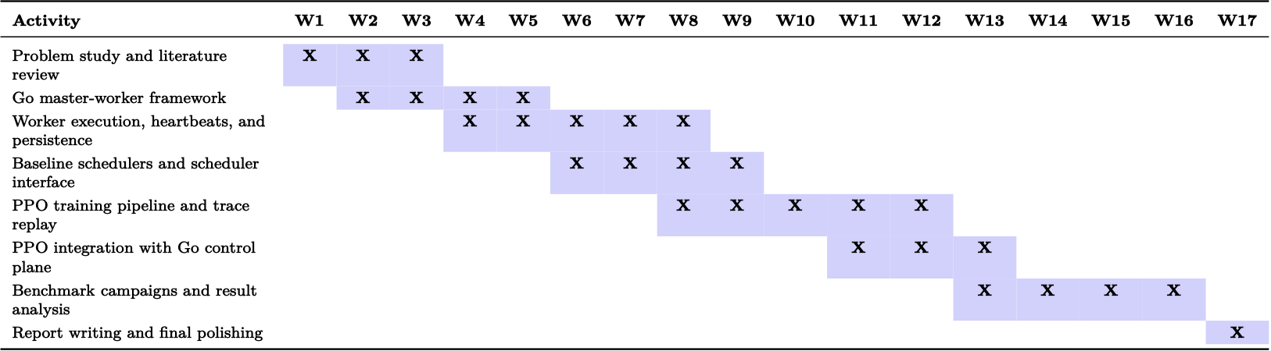
Gantt Chart
26-02-23

Slide 36
Beneficiaries of my work
business
Companies
Better handling of burstier traffic
code
Developers
Automate scheduling, fewer manual deployments
groups
Users
Faster, more reliable services
26-02-23

Slide 37
Bibliography
Gu, Y., Liu, Z., Dai, S., Liu, C., Wang, Y., Wang, S., Theodoropoulos, G., & Cheng, L. (2025, January 2). Deep Reinforcement Learning for job scheduling and Resource Management in Cloud Computing: An Algorithm-Level Review. arXiv.org. https://arxiv.org/abs/2501.01007
Schulman, J., Wolski, F., Dhariwal, P., Radford, A., & Klimov, O. (2017, July 20). Proximal Policy optimization Algorithms. arXiv.org. https://arxiv.org/abs/1707.06347
Alibaba. (2018). Alibaba cluster data. Cluster traces released for cluster management research. https://github.com/alibaba/clusterdata
Apache Software Foundation. (n.d.). Welcome to Apache YuniKorn. https://yunikorn.apache.org/
Kubernetes. (n.d.). Kubernetes documentation. https://kubernetes.io/docs/home/
CRIU. (n.d.). Checkpoint/Restore In Userspace. https://criu.org/Main_Page
26-02-23

Slide 38
Thank You!
26-02-23

