Slide 1
Minimum Spanning Trees (MST)
Connected weighted undirected graph
Disconnected graph
Tree : connected acyclic graph
n vertices, (n-1) edges, connected
Unique path between 2 vertices
Rooted tree, spanning tree
G = ( V, E)
v₁
1
v₂
1
1
3
3
6
3
6
3
v₃
4
v₄
4
2
5
5
2
v₅
A conn. Weighted undirected G
A S.T.
An MST
Spanning forest

Slide 2
Prim’s Algorithm
F={(v₁,v₂)} Y={v₁,v₂}
Input Graph
F=Ø, Y={v₁}
1
1
1
v₁
v₂
v₁
v₂
v₁
1
v₁
v₂
v₂
3
3
3
3
6
3
3
3
6
3
6
4
6
4
4
v₃
v₄
v₃
v₄
v₃
4
v₃
v₄
v₄
2
5
2
2
5
2
5
v₅
v₅
v₅
5
v₅
{(v₁,v₂),(v₁,v₃)} {v₁,v₂,v₃}
(v₃,v₅)→F v₅→Y
(v₃,v₄)→F v₄→Y
v₁
1
v₂
v₁
1
v₂
v₁
1
v₂
3
3
6
3
3
6
3
3
6
v₃
4
v₄
v₃
4
v₄
v₃
4
v₄
2
5
2
5
2
5
v₅
v₅
v₅
F=Ø; Y={v₁}; //Initialization//
While not solved do {
Select v∈V-Y nearest to Y; //selection feasibility
Add v to Y; add the edge to F;
if Y=V then exit;
}

Slide 3
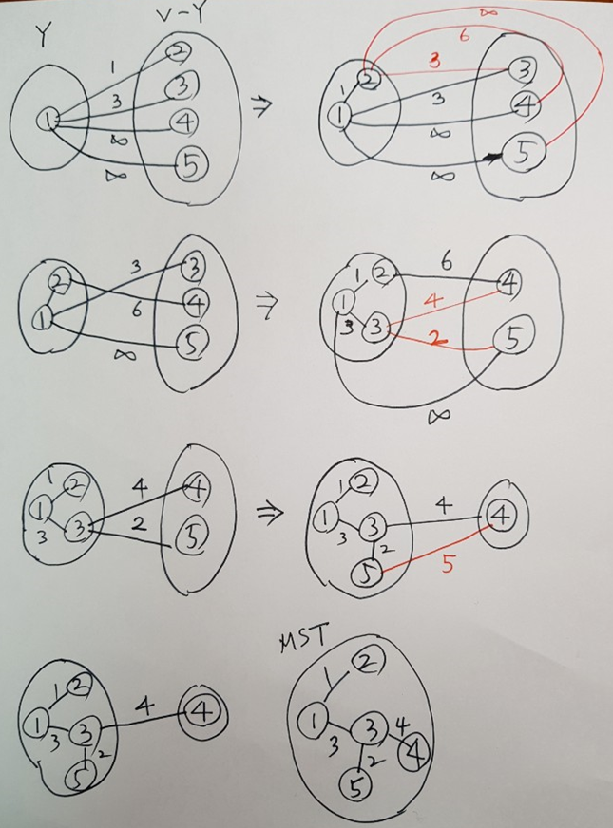
v₁
1
v₂
3
3
6
v₃
4
v₄
2
5
v₅
Data
Structure?
nearest[2..n]
distance[2..n]

Slide 4
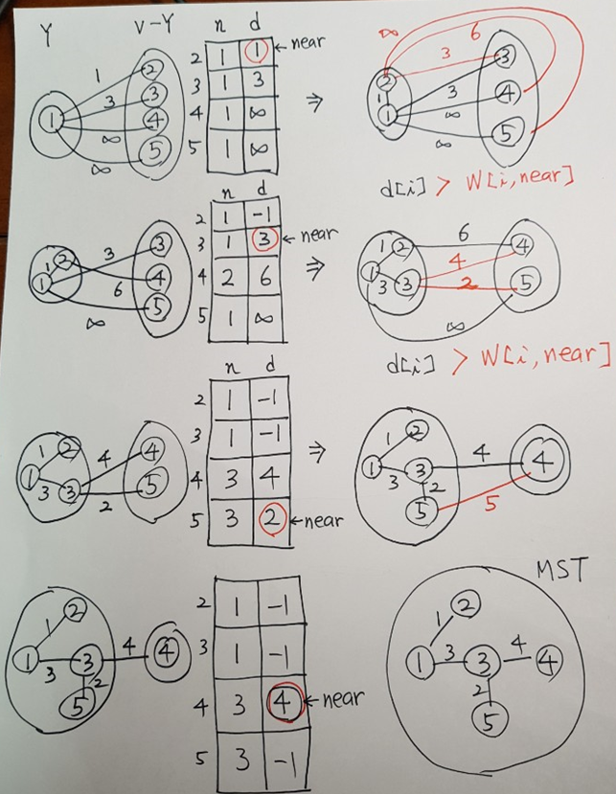
v₁
1
v₂
3
3
6
v₃
4
v₄
2
5
v₅
7
1 2 1
1 3 3
2 3 3
2 4 6
3 4 4
3 5 2
4 5 5
MST is in
nearest[2..n]

Slide 5
Data Structures :
nⅹn adjacency Matrix W.
nearest[i]=index of vertex in Y nearest to v_{i}
distance[i]= weight of edge (v_{i}, nearest[i])
procedure Prim(n, W, var F : set_of_edges)
var i, near, min, e (edge),
nearest : array [2..n] of index;
distance : array [2..n] of number;
{ F=Ø;
for i=2 to n do
{ nearest[i]=1; distance[i]=W[1,i];}
repeat n-1 times
min=∞;
for i=2 to n do
if 0≤distance[i]<min then {
min=distance[i]; near=i; }
e=(near, nearest[near]);
add e to F
distance[near]=-1;
for i=2 to n do
if W[i,near]<distance[i] then {
distance[i]=W[i,near]; nearest[i]=near;}
}

Slide 6
MST_PRIM (G, w, r)
for each u in V(G)
do { d[u] = infinity; flag[u] = 0; }
d[r] = 0;
p[r] = nil;
INSERT (PQ, <r, d[r]>) ;
while PQ != Empty Set {
do u = EXTRACT_MIN(PQ);
if flag[u] == 0 then
for each v in Adj[u]
do if flag[v] == 0 && w(u,v) < d[v]
then p[v] = u;
d[v] = w(u,v);
INSERT (PQ , <v, d[v]>);
flag[u] = 1; }

Slide 7
Dijkstra’s Algorithm for S.S.S.P.
All-pairs shortest prob. :θ(n³) Floyd Alg.(D.P.)
(no negative-weight cycle)
Single-Source Shortest Path Prob.
Dijkstra’s Alg. Θ(n²), Greedy Approach
Similar to Prim’s Alg.
Start with {v₁}; //source//
Choose nearest vertex from v₁,…
Y={v₁};
F=Ø; //Shortest paths tree //
While not solved do {
Select v from V-Y nearest from v₁
using only Y as intermediates;
add v to Y
add the edge touching v to F;
if Y=V then Exit;
}
Weighted directed graph (no negative-weight edge)
Adjacency Matrix : Input

Slide 8
V₅ is selected
v₄
1
v₁
7
1
v₁
7
1
v₁
7
1
v₅
6
4
v₂
7
v₅
6
4
v₂
7
v₅
v₂
5
3
3
1
3
1
2
1
2
v₄
v₃
v₄
v₃
4
v₄
v₃
5
4
2
5
6
v₁
v₁
4
v₂
v₃
v₅
v₂
5
v₅
v₂
v₄
v₃
v₄
v₃
touch[i]=index of v ∈Y s.t. <v,v_{i}> is the last edge from v₁ to v_{i} using only Y as intermediates
length[i]=length of such shortest path

Slide 9

1
v₁
7
v₅
6
4
v₂
3
2
1
v₄
v₃
5
Data Structure?
touch[2..n]
length[2..n]
l[near]+W[near,i] < l[i]
SPST is in
touch[2..n]

Slide 10
1
v₁
7
Procedural dijkstra ( n : integer; W, F);
Var i, near, e, touch[2...n], length[2…n]
{ F=Ø;
for i=2 to n do { touch[i]=1; length[i]=W[1,i];}
repeat n-1 times {
min=∞;
for i=2 to n do
if 0≤length[i]<min then {
min=length[i];
near=i; }
e=(touch[near], near);
add e to F;
for i=2 to n do
if length[near]+W[near,i]< length[i] then {
length[i]=length[near]+W[near, i];
touch[i]=near;}
length[near]=-1; }
}
Note : touch[2...n] constructs the shortest Path Tree.
v₅
6
4
v₂
3
2
1
v₄
v₃
5
8
1 2 7
1 3 4
1 4 6
1 5 1
3 2 2
3 4 5
4 2 3
5 4 1

Slide 11
DIJKSTRA (G, w, s)
for each u in V(G)
do { d[u] = infinity; flag[u] = 0; }
d[s] = 0;
p[s] = nil;
INSERT (PQ, <s, d[s]>) ;
while PQ != Empty Set {
do u = EXTRACT_MIN(PQ);
if flag[u] == 0 then
for each v in Adj[u]
do if flag[v] == 0 && d[v] > d[u] + w[u,v]
then { p[v] = u;
d[v] = d[u] + w[u,v];
INSERT (PQ , <v, d[v]); }
flag[u] = 1; }

