Slide 1
Optimal Binary Search Trees
  Binary Search Tree (BST)
Each node : one key
p → key >= keys in Left_Subtree(p)
p → key <= keys in Right_Subtree(p)
D
R
C
R
D
U
I
U
C
I
T
W
T
W
  balanced
  Depth of a node = level of a node
  Depth of a tree
Digital Media Lab.
1

Slide 2
struct nodetype
{
keytype key;
  nodetype* left;
  nodetype* right;
};
typedef nodetype* node_pointer;
Digital Media Lab.

Slide 3
Algorithm : Search Binary Search Trees
void search (node_pointer tree, keytype keyin,
node_pointer& p)
{
bool found;
p = tree;
found = false;
while (!found && p)
if (p→key == keyin)
found = true;
else if (keyin < p→key);
p = p→left; //Advance to left child.
else
p = p→right; //Advance to right child.
}
Digital Media Lab.

Slide 4
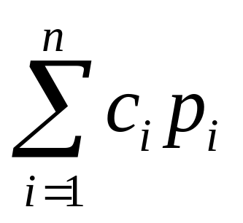
Search time for a given key:
depth (key) + 1
Optimal Binary Search Tree :
n keys,
key1 ≤ key2 ≤…. ≤ key n
p_{i} : probability (key i)
c_{i} : #comparisons (key i)
Minimize the average search time
key_{K}
Key₁ ,…, key_{k-1}
Key_{k+1} ,…, key_{n}
Digital Media Lab.

Slide 5
Eg3.7) p₁= 0.7, p₂=0.2, p₃=0.1
3(0.7)+2(0.2)+1(0.1)=2.6
2(0.7)+3(0.2)+1(0.1)=2.1
2(0.7)+1(0.2)+2(0.1)=1.8
1(0.7)+3(0.2)+2(0.1)=1.5
1(0.7)+2(0.2)+3(0.1)=1.4
1
2
3
4
5
key₃
key₃
key₂
key₁
key₁
key₂
key₁
key₁
key₃
key₃
key₂
key₁
key₂
key₂
key₃
Digital Media Lab.

Slide 6
Naive Algorithm :
  Construct all BST’s and find an optimal BST.
N(n) = #(n-node BST’s) ??? (key1 ≤ key2 ≤…. ≤key n)
N(n) >= 2 N(n-1) if n > 1,
N(1) = 1 otherwise.
( N(n) >= 2N(n-1) >= 2² N (n-2) …. >= 2^{n-1} (N(1)) = 2^{n-1} )
Too many BST’s
key1
key2
Key n
. . .
key1
All BST’s
With
Key 2, …,
key n
All BST’s
With
Key 3, …,
key n
All BST’s
With
Key 1, …,
key n-1
N(n-1)
N(n-1)
Digital Media Lab.

Slide 7
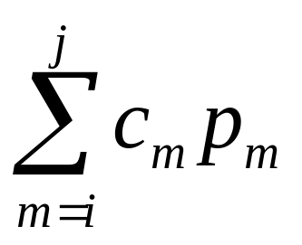
Better way? Yes! D.P.
  A[i][j] : min. avg. search time of an optimal BST with
  Key_{i} …. Key_{j.}
  Minimize
Digital Media Lab.

Slide 8
Eg3.8 ) p₁= 0.7, p₂=0.2, and p₃=0.1
1(p₂)+2(p₃)=1(0.2)+2(0.1)=0.4
2(p₂)+1(p₃)=2(0.2)+1(0.1)=0.5
  A[2][3]=0.4
1
2
key₂
key₃
key₃
key₂
Digital Media Lab.

Slide 9
For each key, there is one additional comparison at the root
key_{K}
Average search time in this subtree is A[1][k-1]
Average search time in this subtree is A[k+1][n]
Key₁ ,…, key_{k-1}
Key_{k+1} ,…, key_{n}
  Optimal binary search tree given that Key_{k} is at the root
Digital Media Lab.

Slide 10
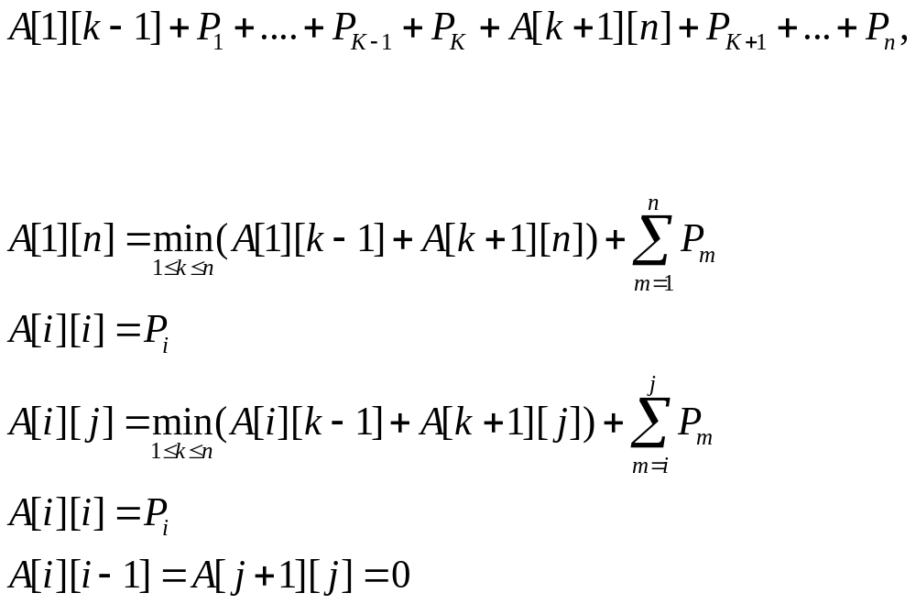
  Average time in left subtree
  Additional time comparing at root
  Average time searching for root
  Average time in right subtree
  Additional time comparing at root
i
j
Digital Media Lab.

Slide 11
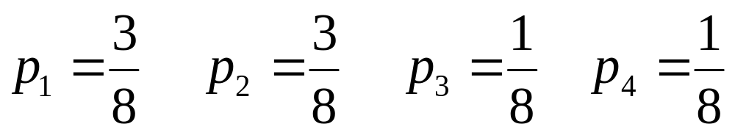






Eg3.9) Array Key :
Don
Isabelle
Ralph
Wally
Key[1]
Key[2]
Key[3]
Key[4]
0
1
2
3
4
0
1
2
3
4
I
1
0
1
0
1
1
2
2
D
R
2
0
1
2
0
2
2
2
0
3
0
3
3
W
3
4
0
4
0
4
5
0
5
0
Digital Media Lab.
A
R

Slide 12
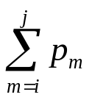

Algorithm 3.9 : Optimal Binary Search Tree
void optsearchtree (int n, const float p[ ], float& minavg, index R[ ][ ])
{
index i, j, k, diagonal;
float A[1..n+1] [0..n];
for ( i = 1; i <= n; i++ ) {
A[i][i-1] = 0;
A[i][i] = p[i];
R[i][i] = i;
R[i][i-1] = 0;
}
A[n+1][n] = 0;
R[n+1][n] = 0;
for ( diagonal =1 ; diagonal <= n-1 ; diagonal ++ )
for ( i=1 ; i <= n - diagonal ; i++ ) {
j = i + diagonal;
A[i][j] = (A[i][k-1]+A[k+1][j]) +
R[i][j] = a value of k that gave the minimum;
}
minavg = A[1][n];
}
Digital Media Lab.

Slide 13
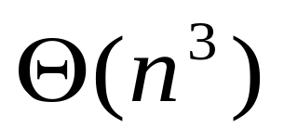
Algorithm 3.9 : Time Complexity
Build Optimal Binary Search Tree
node_pointer tree ( index i, j)
{
  index k;
  node_pointer p;
  k = R[i][j];
  if( k == 0) return NULL;
  else{
    p= new nodetype;
    p -> key = Key[k];
    p -> left = tree (i, k-1);
    p -> right = tree (k+1, j);
    return p;
    }
}
root = tree (1, n);
Digital Media Lab.

