Slide 1
Parallel Sorting
1. 1-D array processors.
8
7
6
5
4
3
2
1
(1)
(2)
(3)
(4)
(5)
(6)
(7)
(8)

Slide 2
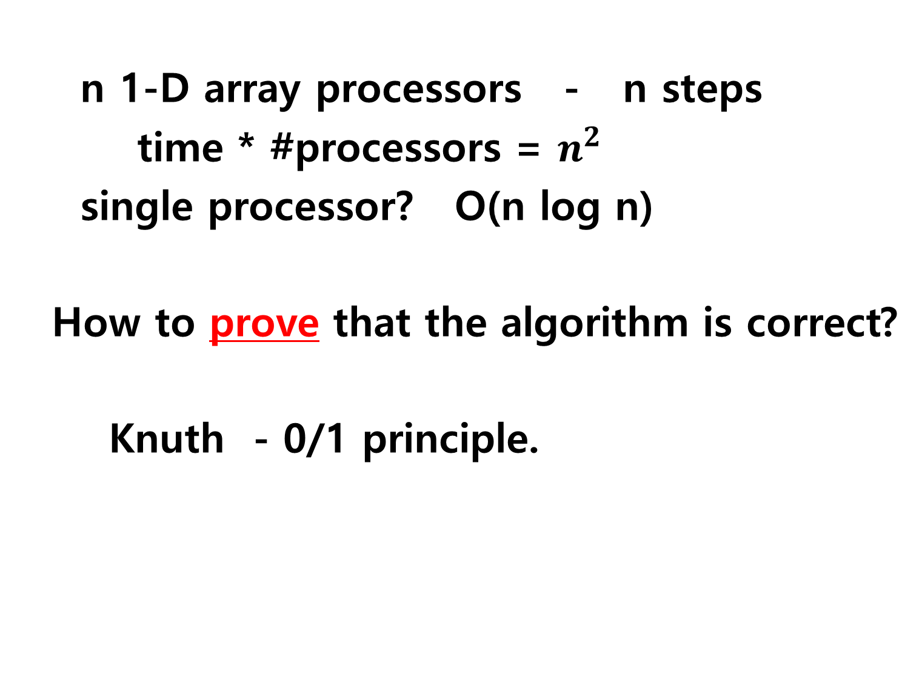
n 1-D array processors - n steps
time * #processors = $n^{2}$
single processor? O(n log n)
How to prove that the algorithm is correct?
Knuth - 0/1 principle.

Slide 3
Parallel Sorting
2. (n X n) 2-D array processors.
How to sort?
. . .
. . .
.
.
.
.
.
.
.
.
.
. . .

Slide 4
for i = 1 to (log n)
마지막 한 번

Slide 5
for i = 1 to (log n)
마지막 한 번
How to prove?
0/1 principle!!!
Half dirty rows!
Only one dirty row!

Slide 6
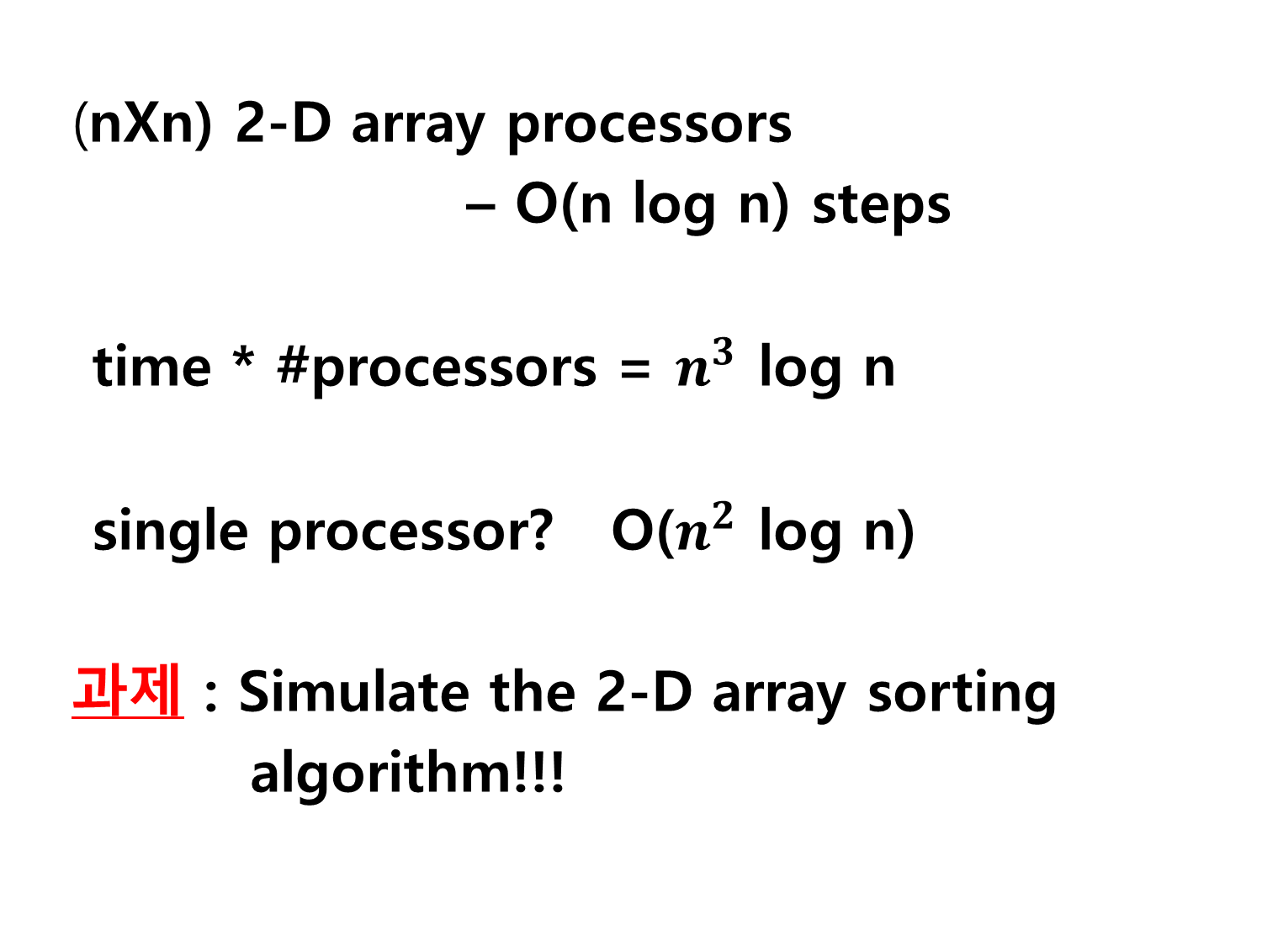
(nXn) 2-D array processors
– O(n log n) steps
time * #processors = $n^{3}$ log n
single processor? O($n^{2}$ log n)
과제 : Simulate the 2-D array sorting
algorithm!!!

