Slide 1
Bin packing Problem
N items with sizes
S₁, S₂, … , S_{n} , where 0 < S_{i} ≤ 1.
Determine min # of bins (unit-cap. bins).
NP-hard problem (optimization problem).
First-fit strategy (c.f. best-fit).
Nonincreasing first-fit (NFF) (off-line),
① sort in nonincreasing order, and
② pack into as close bin as possible.

Slide 2
(Eg) size : 0.85, 0.5, 0.4, 0.4, 0.3, 0.2, 0.2, 0.1
“Greedy algorithm within a greedy alg.”
Θ(n²) time. Why?
(n items, size of each item = 0.51.)
Non-optimal solution.
(Eg.) B2 : 0.5, 0.3, 0.2.
B3 : 0.4, 0.4, 0.2. 3 bins!!!!!!
0.1
0.2
0.4
0.3
0.85
0.5
0.4
0.2
B₁
B₂
B₃
B₄

Slide 3
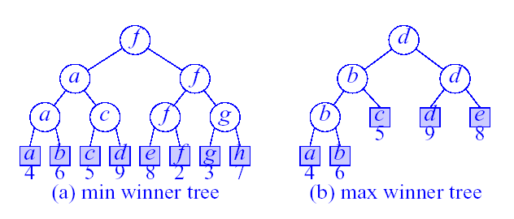
Winner Trees
The height is ⎡log₂(n+1)⎤ (excludes the player level)
What kind of games would use (a) min winner tree?
What kind of games would use (b) max winner tree?

Slide 4
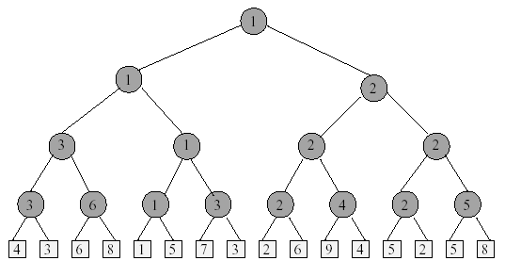
Sort 16 Numbers
1. Initialize the min winner tree

Slide 5
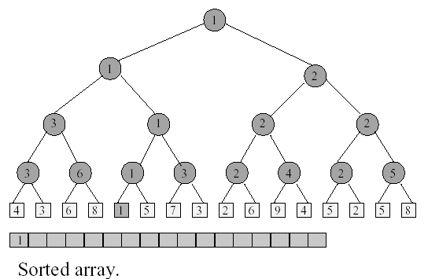
Sort 16 Numbers
2. Remove the winner and replace its value

Slide 6
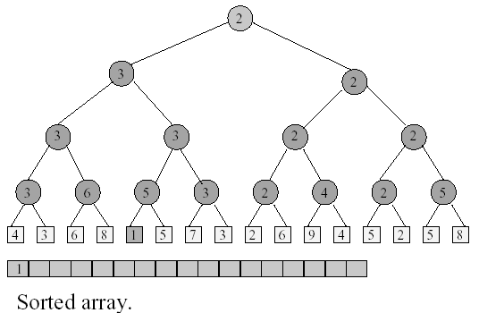
Sort 16 Numbers
3. Replay the matches

Slide 7
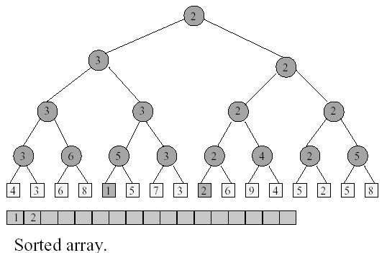
Sort 16 Numbers
Remove the winner and replace its value

Slide 8
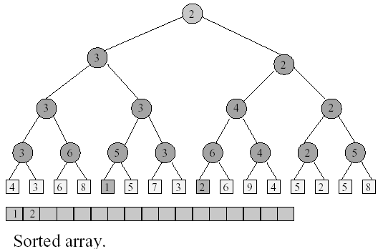
Sort 16 Numbers
Replay the matches

Slide 9
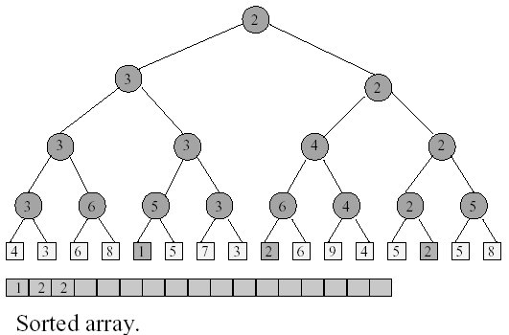
Sort 16 Numbers
Remove the winner and replace its value

Slide 10
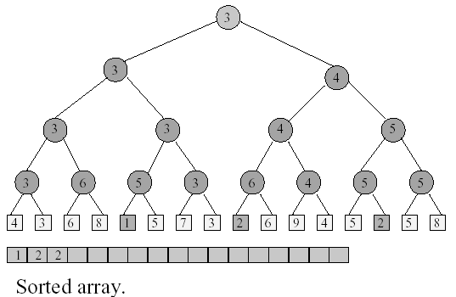
Sort 16 Numbers
Replay the matches

Slide 11
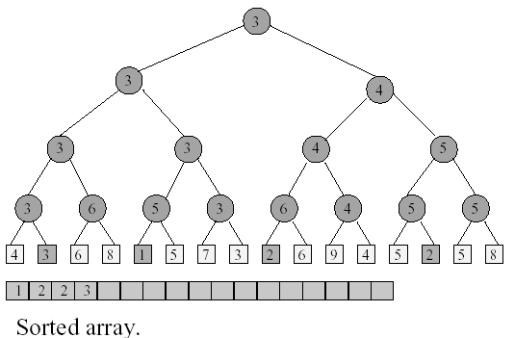
Sort 16 Numbers
Remove the winner and replace its value
Continue in this manner….

Slide 12
Time To Sort
Initialize winner tree: O(n) time
Remove winner and replay:
O(logn) time
Remove winner and replay n times :
O(nlogn) time
Thus, the total sort time is O(nlogn)

Slide 13
The Winner Tree Representation
Using the array representation of a complete binary tree
A winner tree of n players requires n-1 internal nodes tree[1:n-1]
The players (external nodes) are represented as an array player[1:n]
tree[i] is an index into the array player and gives the winner of the match played at node i

Slide 14
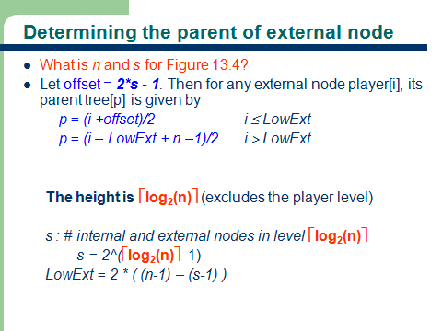

Slide 15
Bin Packing Problem
We have bins that have a capacity binCapacity and n objects that need to be packed into these bins
Object i requires objSize[i], where 0 < objSize[i] ≤ binCapacity, units of capacity
Feasible packing - an assignment of objects to bins so that no bin’s capacity is exceeded
Optimal packing - a feasible packing that uses the fewest number of bins
Goal: pack objects with the minimum number of bins
The bin packing problem is an NP-hard problem
→ We use approximation algorithms to solve the problem

Slide 16
Bin Packing Approximation Algorithms
First Fit (FF)
First Fit Decreasing (FFD)
Best Fit (BF)
Best Fit Decreasing (BFD)

Slide 17
First Fit (FF) Bin Packing
Bins are arranged in left to right order.
Objects are packed one at a time in a given order.
Current object is packed into the leftmost bin into which it fits.
If there is no bin into which current object fits, start a new bin.

Slide 18
First Fit Bin Packing with Max Winner Tree
Use a max winner tree in which the players are n bins and the value of a player is the available capacity binCapacity in the bin.

Slide 19
First Fit Bin Packing with Max Winner Tree
Example: n=8, binCapacity=10, objSize[] = {8,6,5,3,6,4,2,7}
1
1
5
1
3
5
7
10
10
10
10
10
10
10
10
1
2
3
4
5
6
7
8
Initial
bin[tree[1]].unusedCapacity >= objSize[1]?

Slide 20
First Fit Bin Packing with Max Winner Tree
Example: n=8, binCapacity=10, objSize[] = {8,6,5,3,6,4,2,7}
2
2
5
2
3
5
7
2
10
10
10
10
10
10
10
1
2
3
4
5
6
7
8
After objSize[1]=8 packed
Where will objSize[2]=6 be packed into?

Slide 21
First Fit Bin Packing with Max Winner Tree
Example: n=8, binCapacity=10, objSize[] = {8,6,5,3,6,4,2,7}
3
3
5
2
3
5
7
2
4
10
10
10
10
10
10
1
2
3
4
5
6
7
8
After objSize[2]=6 packed
Where will objSize[3]=5 be packed into?

Slide 22
First Fit Bin Packing with Max Winner Tree
Example: n=8, binCapacity=10, objSize[] = {8,6,5,3,6,4,2,7}
4
4
5
2
4
5
7
2
4
5
10
10
10
10
10
1
2
3
4
5
6
7
8
After objSize[3]=5 packed
Where will objSize[4]=3 be packed into?

Slide 23
First Fit Bin Packing with Max Winner Tree
Example: n=8, binCapacity=10, objSize[] = {8,6,5,3,6,4,2,7}
4
4
5
1
4
5
7
2
1
5
10
10
10
10
10
1
2
3
4
5
6
7
8
After objSize[4]=3 packed
Where will objSize[5]=6 be packed into?

Slide 24
First Fit Bin Packing with Max Winner Tree
Example: n=8, binCapacity=10, objSize[] = {8,6,5,3,6,4,2,7}
5
3
5
1
3
5
7
2
1
5
4
10
10
10
10
1
2
3
4
5
6
7
8
After objSize[5]=6 packed
Where will objSize[6]=4, objSize[7]=2 and objSize[8]=7 be packed into?

