Slide 1
알고리즘 설계 및 분석
Foundations of Algorithm
유관우

Slide 2
Chap27. Maximum Flow (p579)
Modeling
road map digraph
Digraph → flow network
      “liquid flowing thru pipes, parts thru assembly lines
    current thru elec. networks, Information thru comm. networks”...
(Eg)
12
4 10
0 1 16
0 2 13
1 2 10
1 3 12
2 1 4
2 4 14
3 2 9
3 5 20
4 3 7
4 5 4
V₁
V₃
20
16
S
10
4
7
t
source
-produces
9
sink-consumes
13
V₂
V₄
4
14
Capacity : max. flow rate.
“flow conservation”
Max-flow problem
Digital Media Lab.

Slide 3



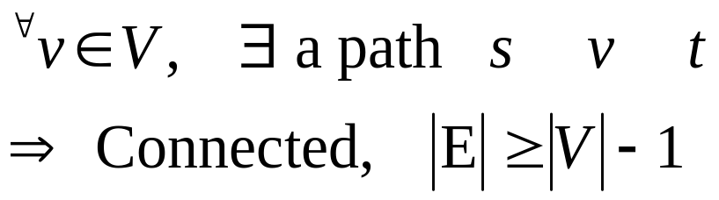
27.1 Flow Networks
A flow network G=(V,E) is a diagraph
  s.t. each edge has a nonnegative capacity
  If source s, sink t.
  Assume
V₁
12
V₂
12/12
16
20
11/16
15/20
S
10
4
7
t
S
9
10
1/4
4/9
7/7
13
V₃
V₄
4
V₃
V₄
8/13
4/4
14
11/14
Capacity : max. flow rate.

Slide 4


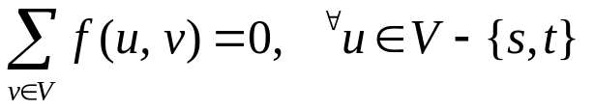

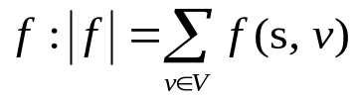
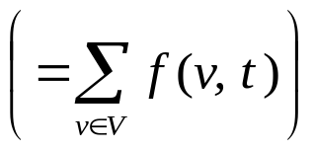
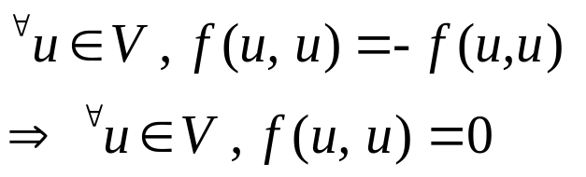

A flow in G is a function
    f : V x V → R s.t.
  Capacity constraint :
  Skew symmetry :
  Flow conservation:
  “total net flow out of a vertex is 0”
  The value of a flow
    Total flow out of the source
Maximum-flow problem : find a flow of maximum value.
By skew sym.,
Flow conservation :
By skew sym. :
“total net flow into a vertex is 0”

Slide 5
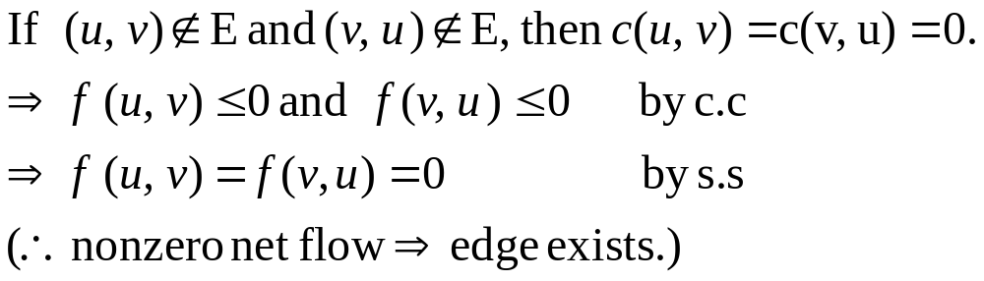
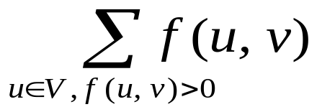
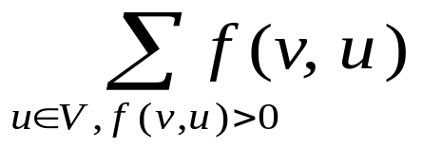

Positive net flow entering v :
Positive net flow leaving v :
IF ,they are the same(f.c).
(Eg) “represents only positive net flows”
v
…
v
…
V₁
V₁
V₁
V₁
V₁
10
4
8/10
4
8/10
3/4
5/10
4
8/10
2/4
V₂
V₂
V₂
V₂
V₂
Digital Media Lab.

Slide 6
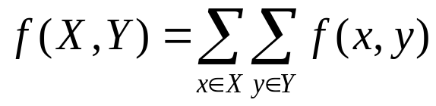
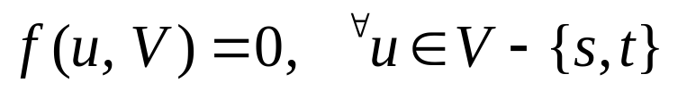
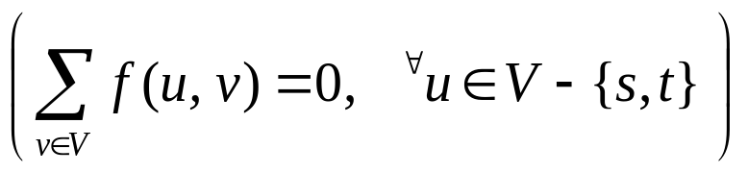
Multiple sources & sinks
Lemma : The two problems are equivalent
X,Y : set of vertices
→ Flow-cons. :
s₁
1
1
t₁
∞
2
3
2
3
s₂
∞
∞
3
4
3
4
4
1
S’
∞
4
1
t’
s₃
∞
∞
1
2
1
2
2
t₂
Super source
2
Super sink
s₄
Digital Media Lab.

Slide 7

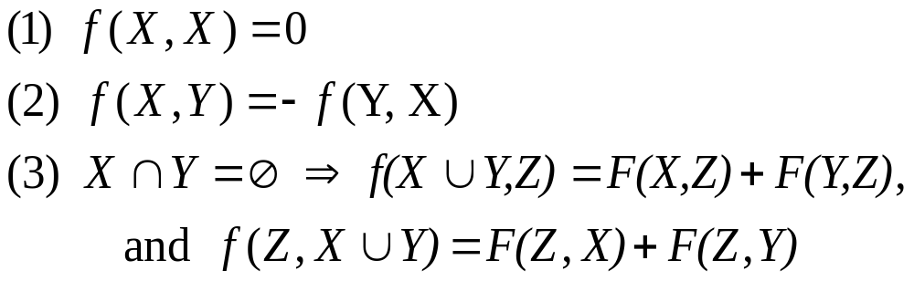
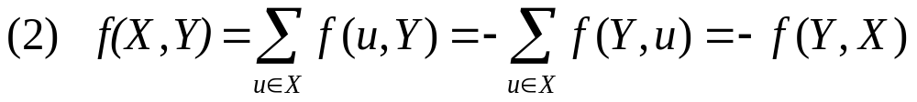
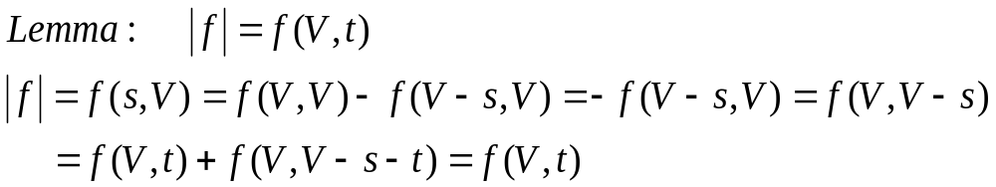
Lemma 27.1
{s}
Digital Media Lab.

Slide 8
27.2 The Ford-Fulkerson method
Different implementation → different run time.
Ford-Fulkerson-Method(G, s , t)
  Initialize flow f to 0.
  While there exists an augmenting path do augment flow f along P.
  Return f.
<Residual Network>
V₁
12/12
V₃
V₁
12
V₃
11/16
15/20
5
5
11
4
15
S
10
1/4
7/7
t
S
11
3
7
t
4/9
5
5
8/13
V₂
V₄
8
V₂
3
V₄
4
4/4
11/14
11
12/12
V₁
12
V₃
V₁
V₃
11/16
19/20
5
1
11
19
S
t
S
11
3
7
t
10
1/4
9
7/7
1
9
12/13
V₂
V₄
12
V₂
3
V₄
4
4/4
11
11/14

Slide 9
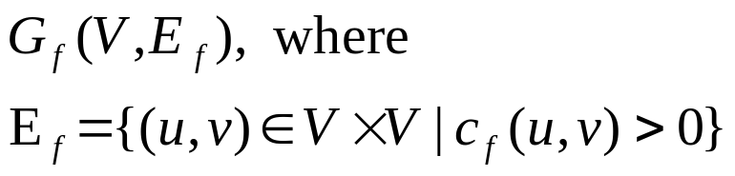
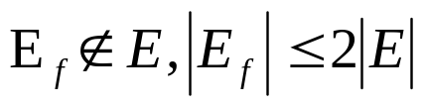

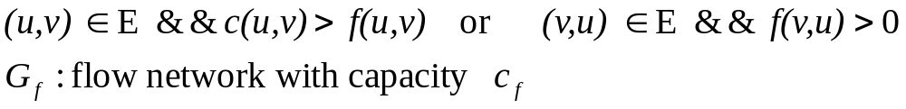
Residual Networks :
  residual capacity of (u, v): c_{f} (u, v) = c(u, v) - f(u, v)
(Eg)
c_{f} (3, 2) = c(3, 2) – f(3, 2) = 9 – 4 = 5
c_{f} (2, 3) = c(2, 3) – f(2, 3) = 0-(-4) = 4
Residual network of G induced by f :
Residual edge (u, v) : c_{f}(u,v) >0
Note that
4/9
4
v₂
v₃
v₂
v₃
5
Digital Media Lab.

Slide 10

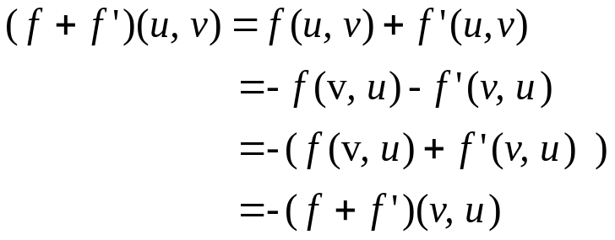
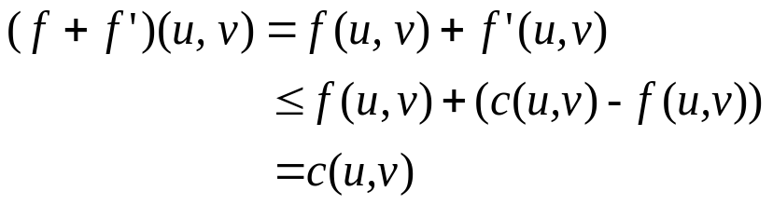
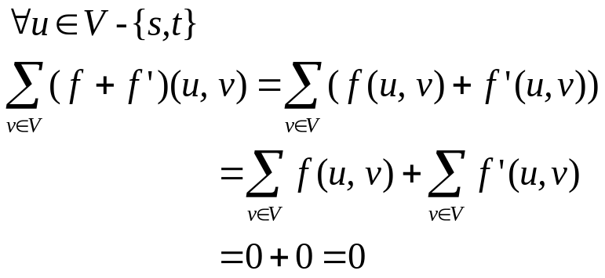
Lemma 27.2
    f‘ : a flow of G_{f}. Then the flow sum
    f+f’ is a flow with value |f+f’|=|f|+|f’|
(proof)
skew symmetry :
Capacity constraint :
Flow conservation :
Digital Media Lab.

Slide 11
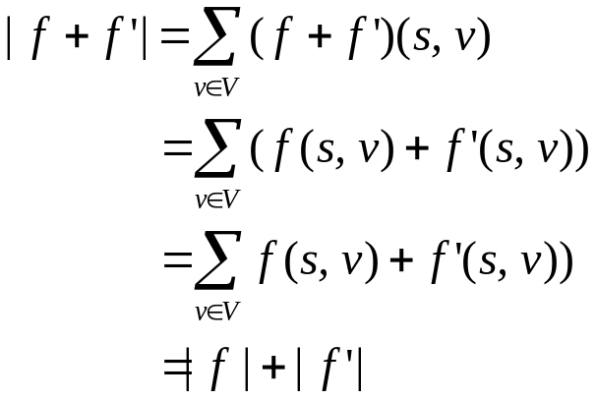


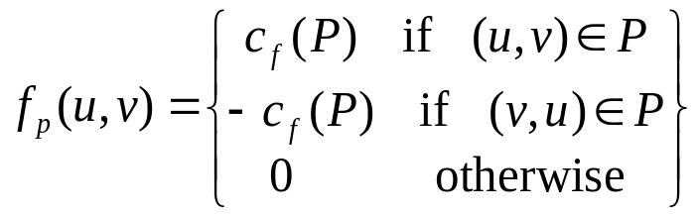
Finally,
Augmenting Paths : G=(V, E), f
  a simple path P from s to t in G_{f}
  All edges in P have positive capacities
  additional net flow possible!!!
  Residual capacity of P : max. such amount.
Lemma 27.3
Digital Media Lab.

Slide 12


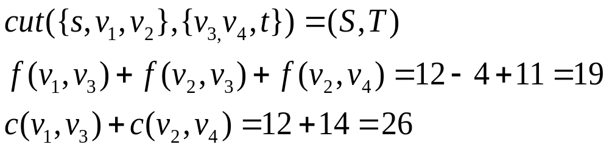
Corollary 27.4
f‘ is a flow in G with
Cuts of flow networks :
  cut(S, T) : partition of V into S and
  f(S,T) : net flow across the cut(S, T).
  c(S,T) : capacity of the cut(S,T).
(Eg)
V₁
12/12
V₃
11/16
15/20
S
10
1/4
7/7
t
4/9
8/13
V₂
V₄
4/4
11/14
Digital Media Lab.
S
T

Slide 13
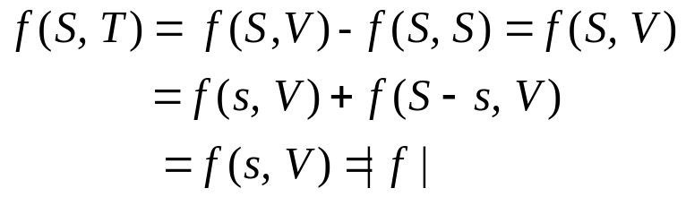

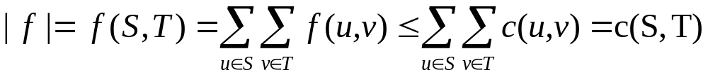
Lemma 27.3
(S, T) : a cut then f(S, T) =|f|
(proof)
Corollary 27.6
(proof)
Theorem 27.7
Max-flow min-cut theorem
The following conditions are equivalent
f is a maximum flow in G
G_{f} contains no augmenting paths
| f | = c(S, T) for some cut (S,T)
(proof) (1) →(2) : Suppose b.w.o.c that
f is a max. flow but that G_{f} has an aug. path.
Then by coro. 27.4, | f + f_{p} | > | f | → 모순
Digital Media Lab.

Slide 14
The Ford-Fulkerson method(1/2)
4 10
0 1 16
0 2 13
1 2 10
1 3 12
2 1 4
2 4 14
3 2 9
3 5 20
4 3 7
4 5 4
V₁
12
V₃
V₁
4/12
V₃
16
20
4/16
20
S
10
4
7
t
S
10
4
7
t
9
4/9
13
V₂
V₄
4
13
V₂
V₄
4/4
14
4/14
V₁
8
V₃
V₁
4/12
V₃
12
4
20
11/16
7/20
S
4
4
t
S
t
10
4
5
7
7/10
4
4/9
7/7
13
V₂
10
V₄
4
13
V₂
V₄
4/4
4
11/14
V₁
8
V₃
V₁
12/12
V₃
13
11/16
15/20
5
4
S
11
4
7
t
S
t
3
11
7
10
1/4
4/9
7/7
5
V₂
3
V₄
4
8/13
V₂
V₄
4/4
13
11
11/14

Slide 15
The Ford-Fulkerson method(2/2)
V₁
12
V₃
V₁
12/12
V₃
5
5
11/16
19/20
S
11
4
15
t
S
t
11
3
7
10
1/4
7/7
5
5
9
8
V₂
3
V₄
4
12/13
V₂
V₄
4/4
11
11/14
V₁
12
V₃
5
1
S
11
19
t
11
3
9
7
1
12
V₂
3
V₄
4
11
Digital Media Lab.

Slide 16

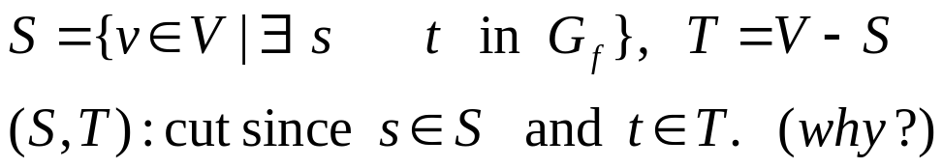
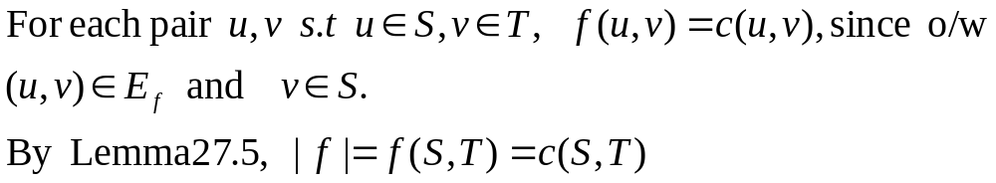
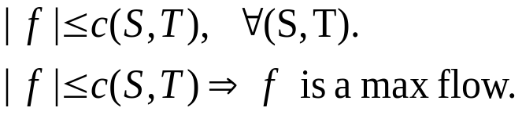
(2)→(3) : Suppose that G_{f} has no aug. path, that is,
(3)→(1) : By coro.27.6,
Digital Media Lab.

Slide 17
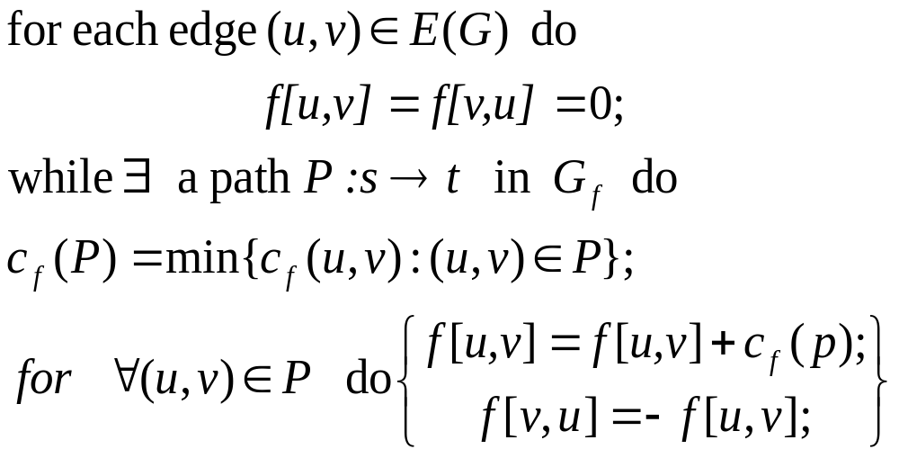
The Basic Ford-Fulkersom Algorithm :
Digital Media Lab.

Slide 18
4 10
0 1 16
0 2 13
1 2 10
1 3 12
2 1 4
2 4 14
3 2 9
3 5 20
4 3 7
4 5 4
V₁
12
V₃
20
16
S
10
4
7
t
source
-produces
9
sink-consumes
13
V₂
V₄
4
14
Digital Media Lab.

Slide 19

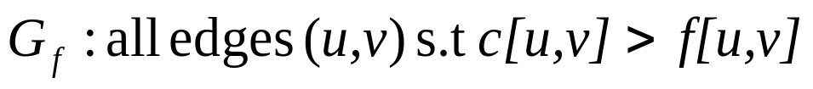
Analysis of Ford-Fulkerson Alg.
  Major op. : Aug. path finding routine. Use BFS to construct an aug. path.
  → Edmonds-Karp Alg. : O(VE²) time.
  Data Structure
    Adj. list for G’=(V,E’) , where
1
…
v
u | c(v,u) | f (v,u)
…
…
n
Adj[v]
Construction of G_{f} from G’ : O(E) time.
BFS to construct an A.P. : O(E) time.
Digital Media Lab.

Slide 20
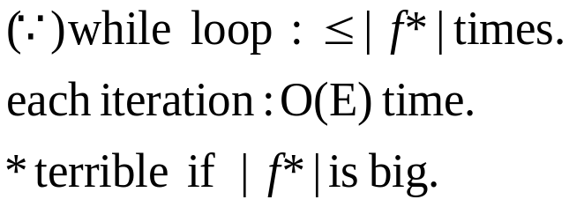
(Digression ) IF do not use BFS,?
Assume that capacities are integers.
O(E|f*|) time (f* : max flow value)
(Eg)
u
u
u
999,999
100만
100만
100만
100만
100만
1
S
1
t
S
1
t
S
1
t
999,999
100만
100만
1
100만
100만
v
100만
v
v
999,999
u
999,998
u
999,999
999,999
200만번 수행!! → terrible
BFS→ 2번 수행 O.K
1
1
2
1
S
1
t
S
1
t
999,999
999,998
999,999
999,999
1
v
1
1
v
2
Digital Media Lab.

Slide 21
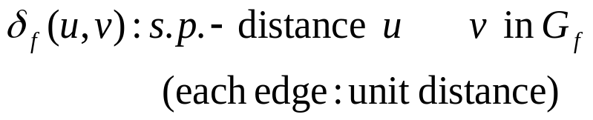
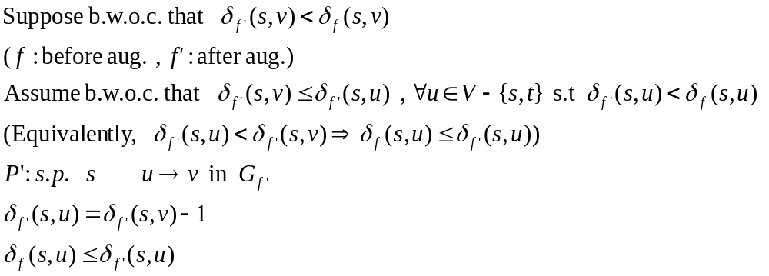
Ford-Fulkerson method + BFS A.P. finding
→ Edmonds-Karp Alg. : O(VE²) time.
(Note : each iteration O(E) time.)
Lemma 27.3
(Edmonds-Karp Alg.)
(proof)
Digital Media Lab.

Slide 22
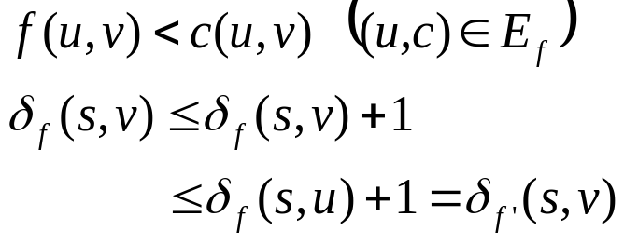
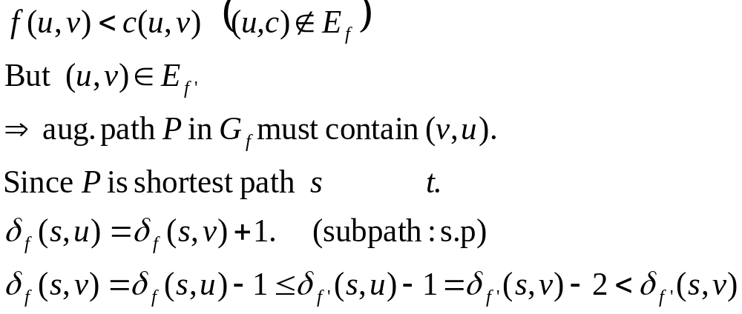
(Case 1)
(Case 2)
모순
Digital Media Lab.

Slide 23
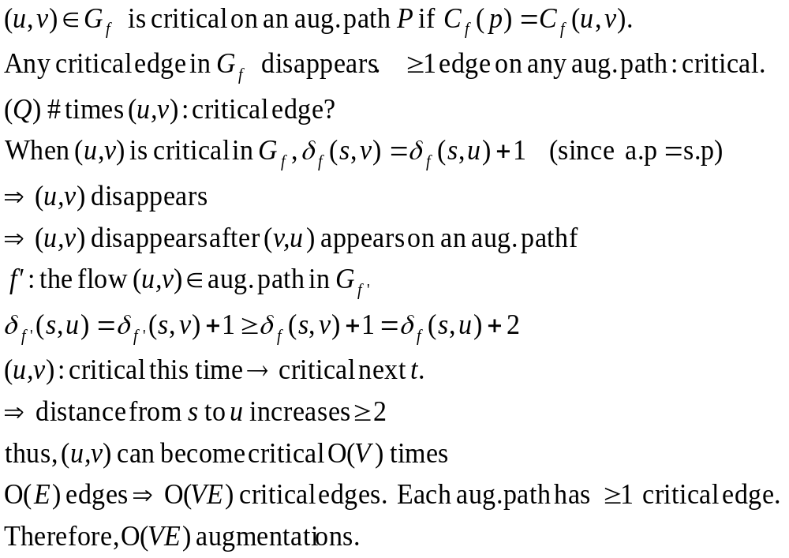
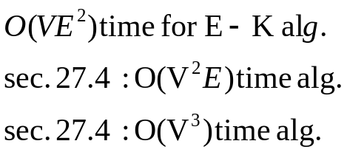
Theorem 27.9
# Augmentation : O(VE)
(proof)
Corollary 27.6

Slide 24

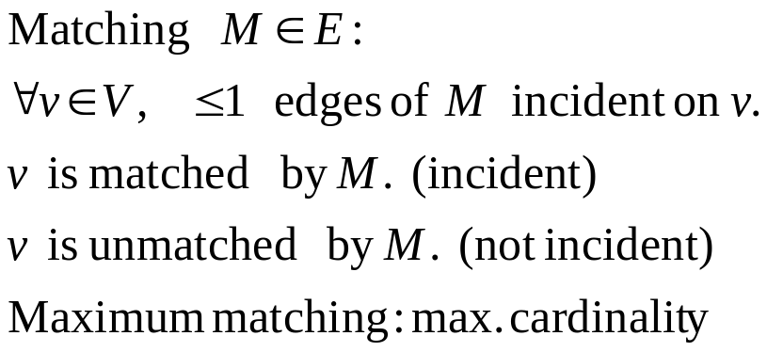
27.3 Maximum Bipartite Matching
G=(V,E) undirected graph.
Bipartite graph :
edges :
L
R
L
R
L
R
matching
Maximum matching
Digital Media Lab.

Slide 25
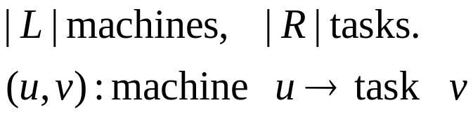
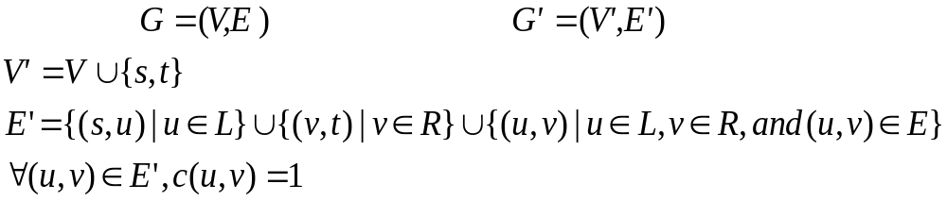
Finding max. bipartite matching
(application)
  Max. matching : as many machines a.p.
Ford-Fulkerson method
S
t
L
R
L
R
Digital Media Lab.

Slide 26

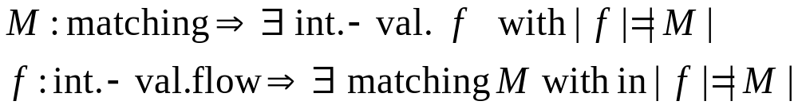
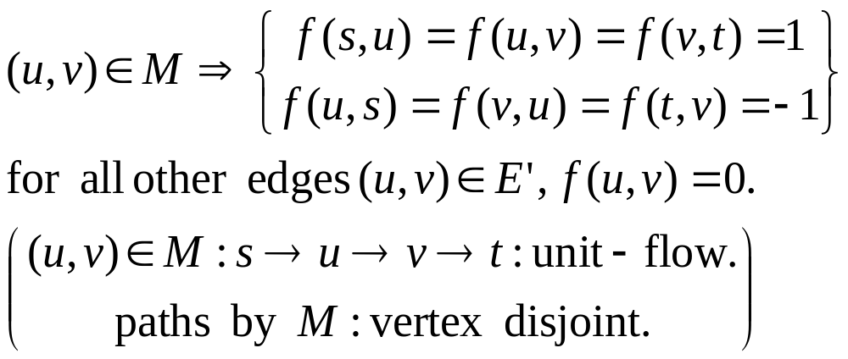
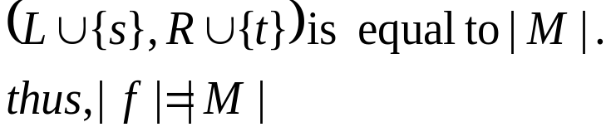
Flow f is integer-valued.
If f(u,v) is an integer
(proof) ( M→ f ) Let M be a matching in G.
Define f as follows :
    (Verify skew sym. , cap. const., flow cons.)
    The net flow across cut
Lemma 27.10
Digital Media Lab.

Slide 27
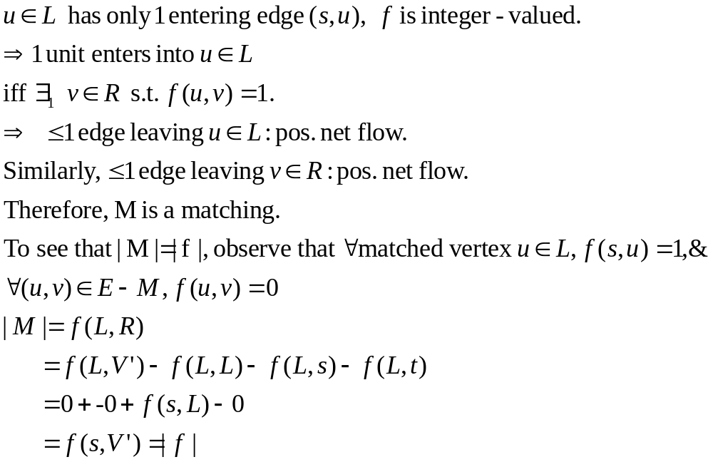
( f→ M )
Let f be an integer-valued flow in G’ and let
Digital Media Lab.

Slide 28
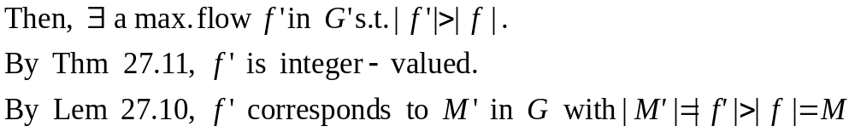
Lemma 27.11
(Integrality theorem)
c: integer values.
  Max flow f by F.-F. method :
(proof) By induction on # iterations.
(proof) suppose b.w.o.c that M is max.
mat. in G but corr. Flow f is not max. in G’
Similarly, f is a max flow in G’
corresponding matching is a max.
matching on G
Corollary 27.12
| max. matching | = | max. flow |
모순
Digital Media Lab.

Slide 29
Finding Bipartite max. matching
  Construct G’ from G(Bipar. G.)
  Run F.-F. method.
  Construct M from the max. matching.
  At most O(V) iterations.
  O(E) time in each iteration.
  O(VE) time.
Digital Media Lab.

