Slide 1
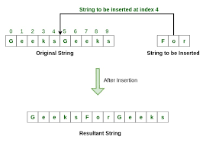
Strings
Outline
String Definition
Immutability and Concatenation
Comparing Strings
String Comparison Methods
String Manipulation Methods
Review
Further Reading
Exercises

Slide 2
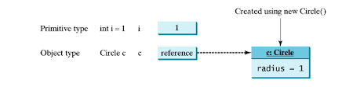
Strings
String Definition
Letters, numbers, and special characters strung together.
Strings are objects, not primitives.
String variables are a reference type, that is the reason why the “==” operator does not behave as expected when comparing strings.
Using the == operator with two objects checks
if both sides are the same reference, that is,
if they refer to the same object.
This is not the same as checking to see if the two objects have the same value.

Slide 3
Strings
Immutability and Concatenation
Strings are immutable. This means that once a string is created, it cannot be changed.
Let's explore this and take a look at an example of string concatenation:
This makes it look like we are changing the string in message, but we are not.
We are creating a new string, and then setting message to reference the new string.
DEMO IT!
String message = "Hello";
System.out.println(message); // prints "Hello"
message = message + " World!";
System.out.println(message); // prints "Hello, World!"

Slide 4
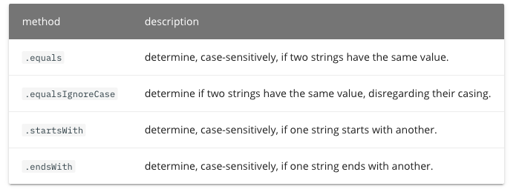
Strings
Comparing Strings
Because strings are not primitive data types but objects, we must use methods to compare them rather than the relational operators.
Let's take a look at some of the common methods we can use to compare strings. All of the methods we will look at here return either true or false.
Demo it

Slide 5
Strings
String Manipulation Methods
DEMO
char charAt(int index) | Returns the character at the specified index of the string.
int indexOf(String subString) | Returns the index of the first occurrence of a certain substring. Returns -1 if the substring is not found.
int lastIndexOf(String subString) | Like indexOf, but starts the search from the end of the string.
int length() | Returns the length of a string.
String replace(String pattern, String replacement) | Returns a copy of the string that has pattern replaced with replacement.
String substring(int beginIndex[, int endIndex]) | Returns a new substring that starts at a specified index and (optionally) ends at the specified index
String toLowerCase() | Returns a string that has all lower case letters.
String toUpperCase() | Returns a string that has all upper case letters.
String trim() | Returns a copy of the string without leading and trailing whitespaces.

Slide 6
Strings
Review
What is a string?
A String is letters, numbers, and special characters strung together.
Are strings primitives are objects?
Objects.
How do you compare strings?
With methods like “equals”, and “equalsIgnoreCase”.
What does Immutable mean?
Once something is created, it cannot change.
Does a String variable contain a reference to data, or the actual data?
A String variable contains a reference to data.
How do you get the length of a string?
Use the “length()” method.

