Slide 1
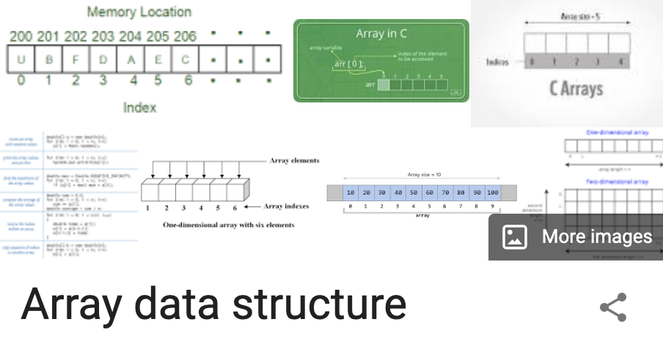
Arrays
Outline
Overview
Working with Array Elements
Iterating
The Arrays Class
Two-Dimensional Arrays
Review

Slide 2
Arrays
Overview
In this lesson, we will talk about arrays in Java, both defining them and how to work with them.
In Java, arrays are a special kind of object that contain zero or more items called elements.
Array elements can be any valid type (including a custom class we've defined ourselves).
All elements must be of the same type.
An array type is defined by using an existing type followed by square brackets.
Here, we'll define a variable named prices whose type is an array where each element is a double:
double[] prices;

Slide 3
Arrays
Overview
Unlike JavaScript, Java arrays have a fixed length.
The length must be defined when they are created.
Expanding on our last example, we'll assign a value to prices that is an array with 4 elements:
The size of the array can be either a literal (like in the example above), a constant, or a variable.
double[] prices;
prices = new double[4];
final int NUMBER_OF_BEATLES = 4;
BandMember[] theBeatles = new BandMember[NUMBER_OF_BEATLES];

Slide 4
Arrays
Overview
When we assign to the variable, we create a new array where the size is determined by the value of a variable.
int numberOfBugs = (int) Math.floor(Math.random() * 100);
Bug[] myCode = new Bug[numberOfBugs];

Slide 5
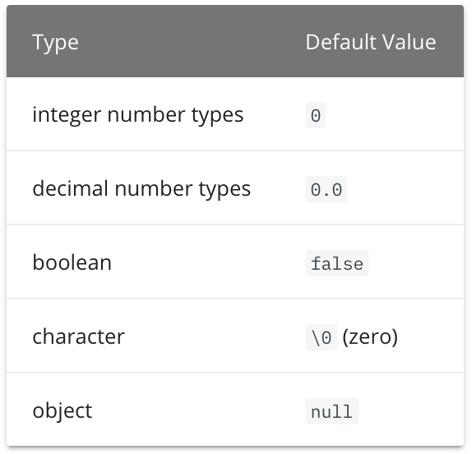
Arrays
Working with Array Elements
Elements of an array are defined by their index, their position
in the array, starting at 0.
Example, the fifth element array x is: x[4].
Any elements that have not been initialized will have that
type's default value.
Referring to an index that outside the range of the array will
cause an ArrayIndexOutOfBoundsException.
DEMO IT!

Slide 6
Arrays
Working with Array Elements
An array's size and elements can both be defined when it is created with array initializer syntax.
DEMO IT!
// using the array initializer syntax
String[] beatles = {"John", "Paul", "Ringo"};
System.out.println(beatles.length); // 3
System.out.println(beatles[0]); // "John"
System.out.println(beatles[1]); // "Paul"
System.out.println(beatles[2]); // "Ringo"
// ArrayIndexOutOfBoundsException !
beatles[3] = "George";

Slide 7
Arrays
Iterating
Like we've seen in JavaScript, we can use the length property of any array in combination with a looping construct object to iterate over it.
Both for loops print the same thing.
DEMO IT!
String[] languages = {"html", "css", "javascript", "java"};
// Conventional for loop
for (int i = 0; i < languages.length; i += 1) {
System.out.println(languages[i]);
}
// Enhanced for loop
for (String language : languages) {
System.out.println(language);
}

Slide 8
Arrays
The Arrays Class
The java.util.Arrays class contains static methods for common array manipulation tasks.
All methods can accept arrays of primitive data types or of objects.
All index arguments must be of the type int .
We'll take a look at some of the most common methods:
Demo IT!
Method | Description
void Arrays.fill(arrayName, value) | Fills all elements of the specified array with the specified value.
boolean Arrays.equals(array1, array2) | Returns true if both arrays are of the same type and all of the elements within the arrays are equal to each other.
array Arrays.copyOf(array, length) | Returns a copy of the given array with the specified length.
String Arrays.toString(array) | Returns a string representation of the array.
void Arrays.sort(array) | Sorts the elements of an array into ascending order.

Slide 9
Arrays
Two-Dimensional Arrays
We've said that array elements can be any type, and this includes arrays; meaning we can define an array whose elements are themselves arrays.
This is called a two-dimensional array, or a matrix.
You can think of a two-dimensional array like a grid, with rows and columns.
int[][] matrix = {
{1, 2, 3},
{4, 5, 6},
{7, 8, 9}
};
// access the first element in the second row
System.out.println(matrix[1][0]); // 4
// the last element in the first row
System.out.println(matrix[0][2]); // 3
// the first element in the last row
System.out.println(matrix[2][0]); // 7

Slide 10
Arrays
Two-Dimensional Arrays
We can also iterate over the rows in a matrix, and, within the loop iterating over the rows, iterate over each element in each row with a nested loop:
int[][] matrix = {
{1, 2, 3},
{4, 5, 6},
{7, 8, 9}
};
for (int[] row : matrix) {
System.out.println("+---+---+---+");
System.out.print("| ");
for (int n : row) {
System.out.print(n + " | ");
}
System.out.println();
}
System.out.println("+---+---+---+");
DEMO IT!

Slide 11
Arrays
Review
What types can be stored in an array?
Any valid type, including a custom class we've defined ourselves, can be stored in an array. However, all elements must be of the same type.
How do you declare an array?
An array type is defined by using an existing type followed by square brackets.
Example: double[] prices;
When is the length of the array set?
Java arrays have a fixed length (accessed with the .length property) that must be defined when they are created.
Is “.length” a method?
No. It is a property. Example: Int length = IntArray.length;

Slide 12
Arrays
Review
Given an int array named iArr, how do you access the 3rd element of iArr?
iArr[2];
What happens if you access an element outside of the range of an array?
You get an ArrayIndexOutOfBoundsException error.
Do non-initialized arrays have default values?
Yes
What JavaScript concept is similar to the Java Enhanced For-loop?
Java provides an enhanced for that is similar to a forEach in JavaScript.
How do you set initial values into an array?
Using curved brackets. Ex: int[] numbers = {1, 2, 3, 4, 5};

Slide 13
Arrays
Review
What does the Arrays.fill() Method do?
It fills all elements of the specified array with the specified value.
void Arrays.fill(arrayName, value)
What does the Arrays.toString() Method do?
Returns a string representation of the array. String Arrays.toString(array)
Is it possible to have an array of arrays?
We've said that array elements can be any type, and this includes arrays.

