Slide 1

Bridge Pattern
Abstraction? Implementation? Sound scary?

Slide 2


About me
Software Engineer at WiX
Co-org Codeus
[тут має бути фото]

Slide 3
Bridge is a structural design pattern that lets you split a large class or a set of closely related classes into two separate hierarchies—abstraction and implementation—which can be developed independently of each other.

Slide 4
Problem

Slide 5





Payment Types
Payment Gateways

Slide 6
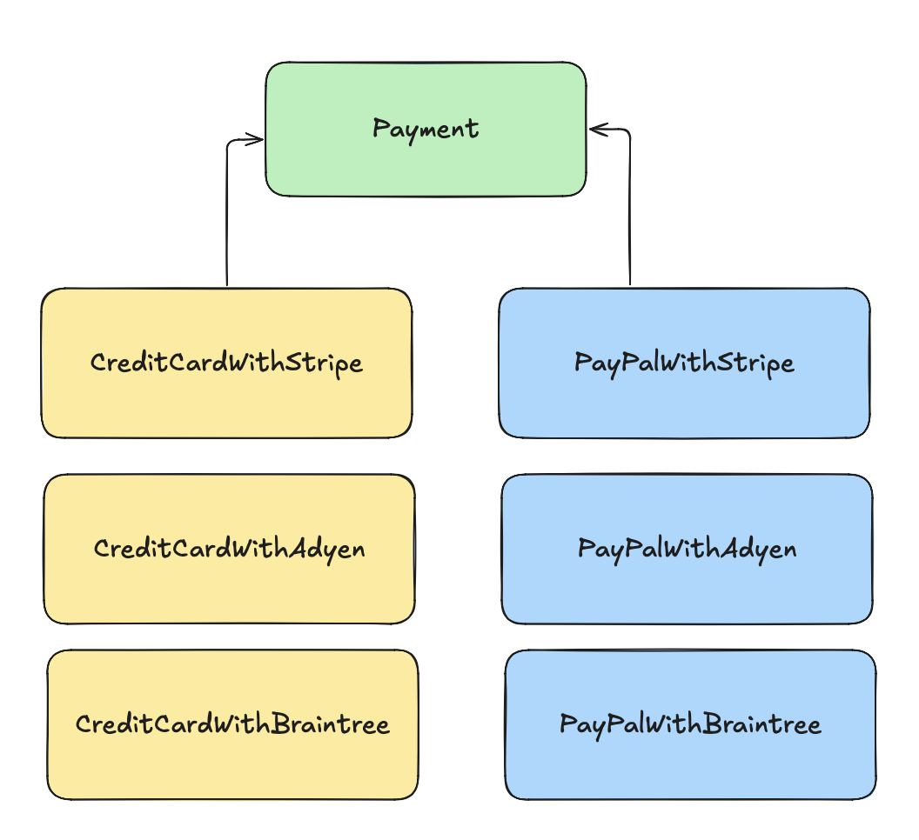
2 (payment types) * 3 (payment gateway) = 6 classes

Slide 7
Solution

Slide 8
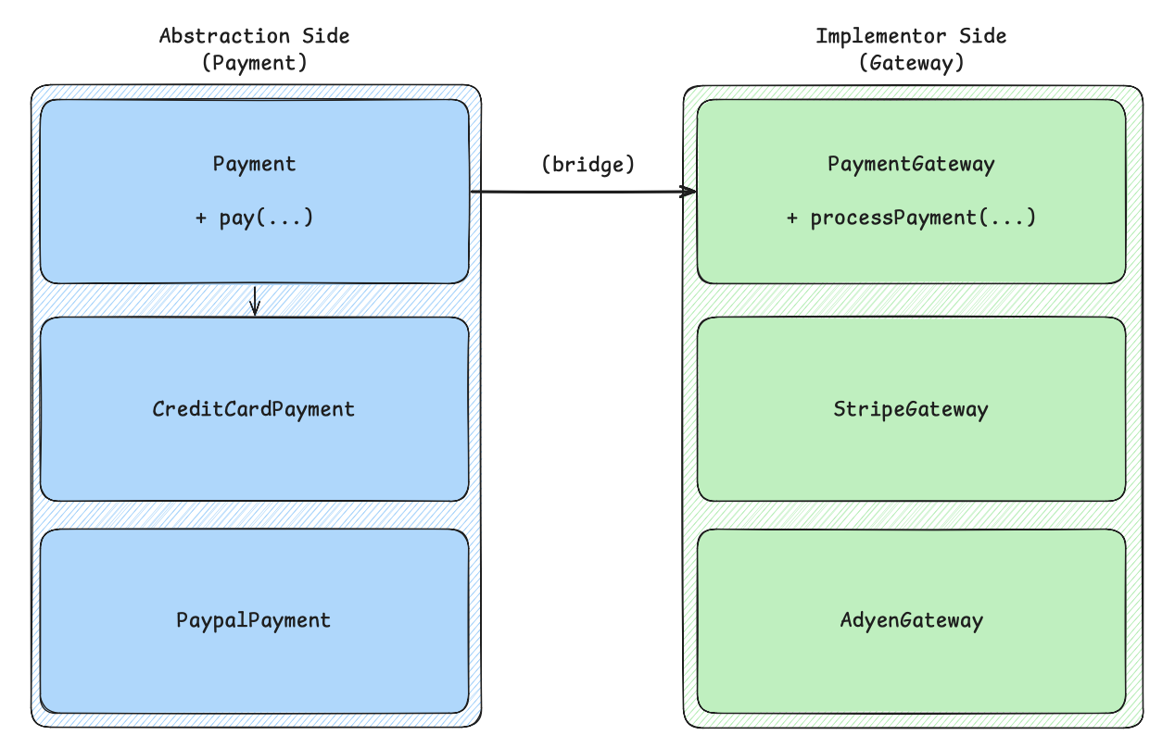

Slide 9
Implementor
Concrete Implementors
class StripeGateway implements PaymentGateway { @Override public void processPayment(double amount) { System.out.println("Processing $" + amount + " via Stripe."); } } class AdyenGateway implements PaymentGateway { @Override public void processPayment(double amount) { System.out.println("Processing $" + amount + " via Adyen."); } }
interface PaymentGateway { void processPayment(double amount); }

Slide 10
Abstraction
Implementations
class CreditCardPayment extends Payment { public CreditCardPayment(PaymentGateway gateway) { super(gateway); } @Override public void pay(double amount) { System.out.println("Paying with Credit Card..."); gateway.processPayment(amount); } } class PayPalPayment extends Payment { public PayPalPayment(PaymentGateway gateway) { super(gateway); } @Override public void pay(double amount) { System.out.println("Paying with PayPal..."); gateway.processPayment(amount); } }
abstract class Payment { protected PaymentGateway gateway; public Payment(PaymentGateway gateway) { this.gateway = gateway; } public abstract void pay(double amount); }

Slide 11


Pros and Cons
You can create platform-independent classes and apps.
You might make the code more complicated by applying the pattern to a highly cohesive class.
The client code works with high-level abstractions. It isn’t exposed to the platform details.
Open/Closed Principle.
Single Responsibility Principle.

Slide 12

Thank you
Author: Dmytro Halchenko

