Slide 1
CRM System – Initial Design & Development Review
Presented by:
Team Name:

Slide 2

Agenda
Project Overview Progress Update Key Design Elements Database Structure User Interface (UI) | Back-End Logic System Integrations Testing and QA Plan Next Steps QA session

Slide 3

Project Overview
Project Name: CRM System Development
Objective: Streamline customer interactions, sales tracking, and reporting.
Current Phase: System Design & Development
Timeline: Jan 1 – Apr 9, 2025
Key Stakeholders: Internal teams, vendors, clients

Slide 4

Progress Update
Completed Phases: Project Initiation (Jan 13, 2025) Planning (Jan 29, 2025) Current Phase: System Development (Jan 30 – Mar 1, 2025) Database structure & UI wireframes done Back-end logic & API integrations ongoing | Upcoming Phases: Testing (Mar 2 – Mar 21, 2025) Deployment (Mar 22 – Apr 1, 2025)

Slide 5

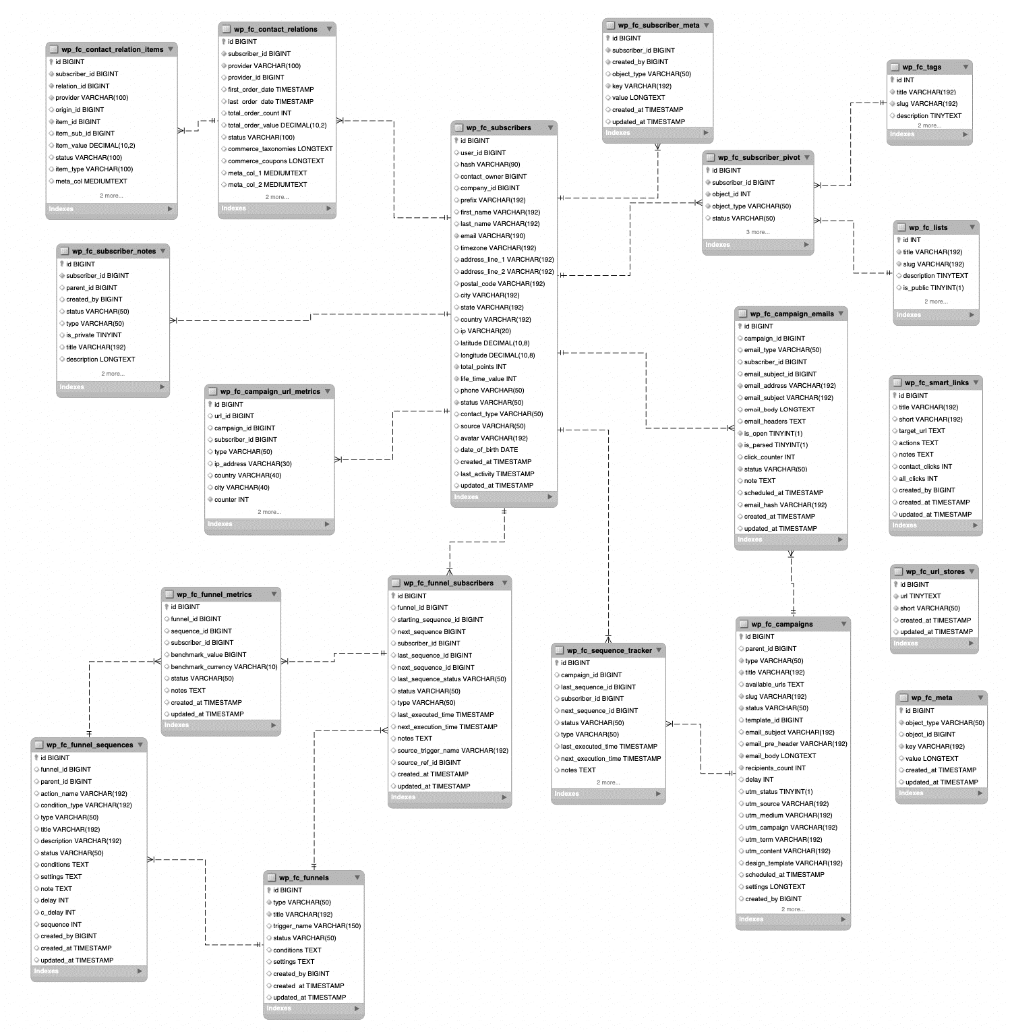
Database Structure
Entity Relationship Diagram (ERD):
Customers, sales, interactions
Defined relationships & constraints
Schema:

Slide 6
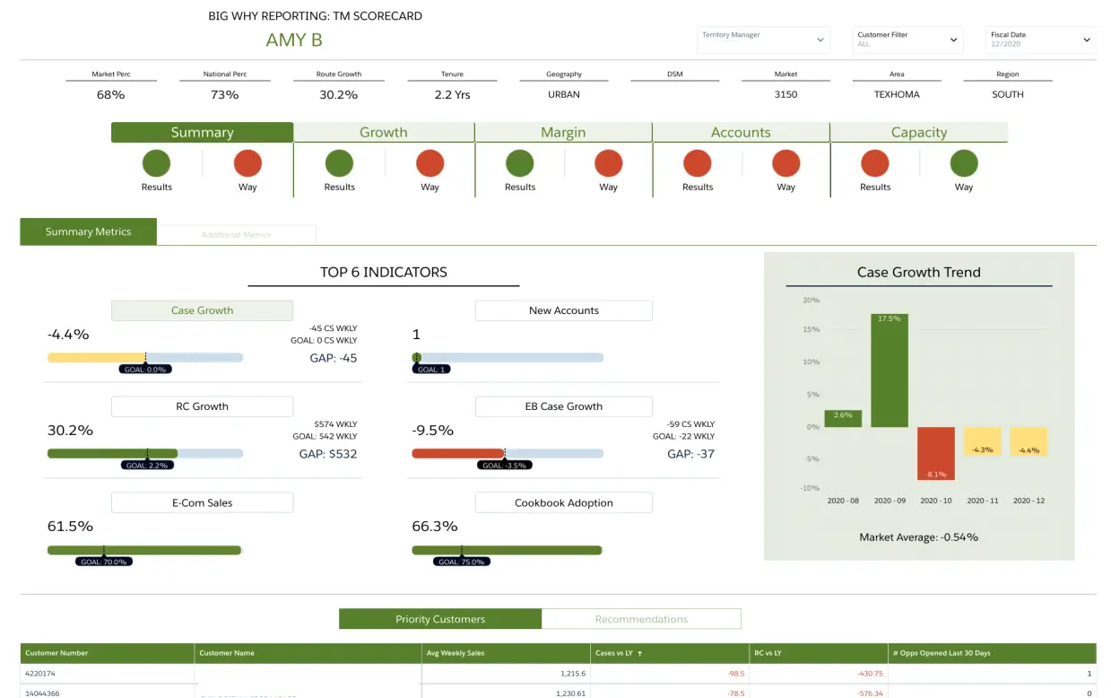
User Interface (UI)
Wireframes:
Incorporation of Layouts for dashboards, customer profiles and reports
UI Design:
Built using HTML, CSS, JavaScript
Example: Dashboard with sales & customer insights as shown

Slide 7
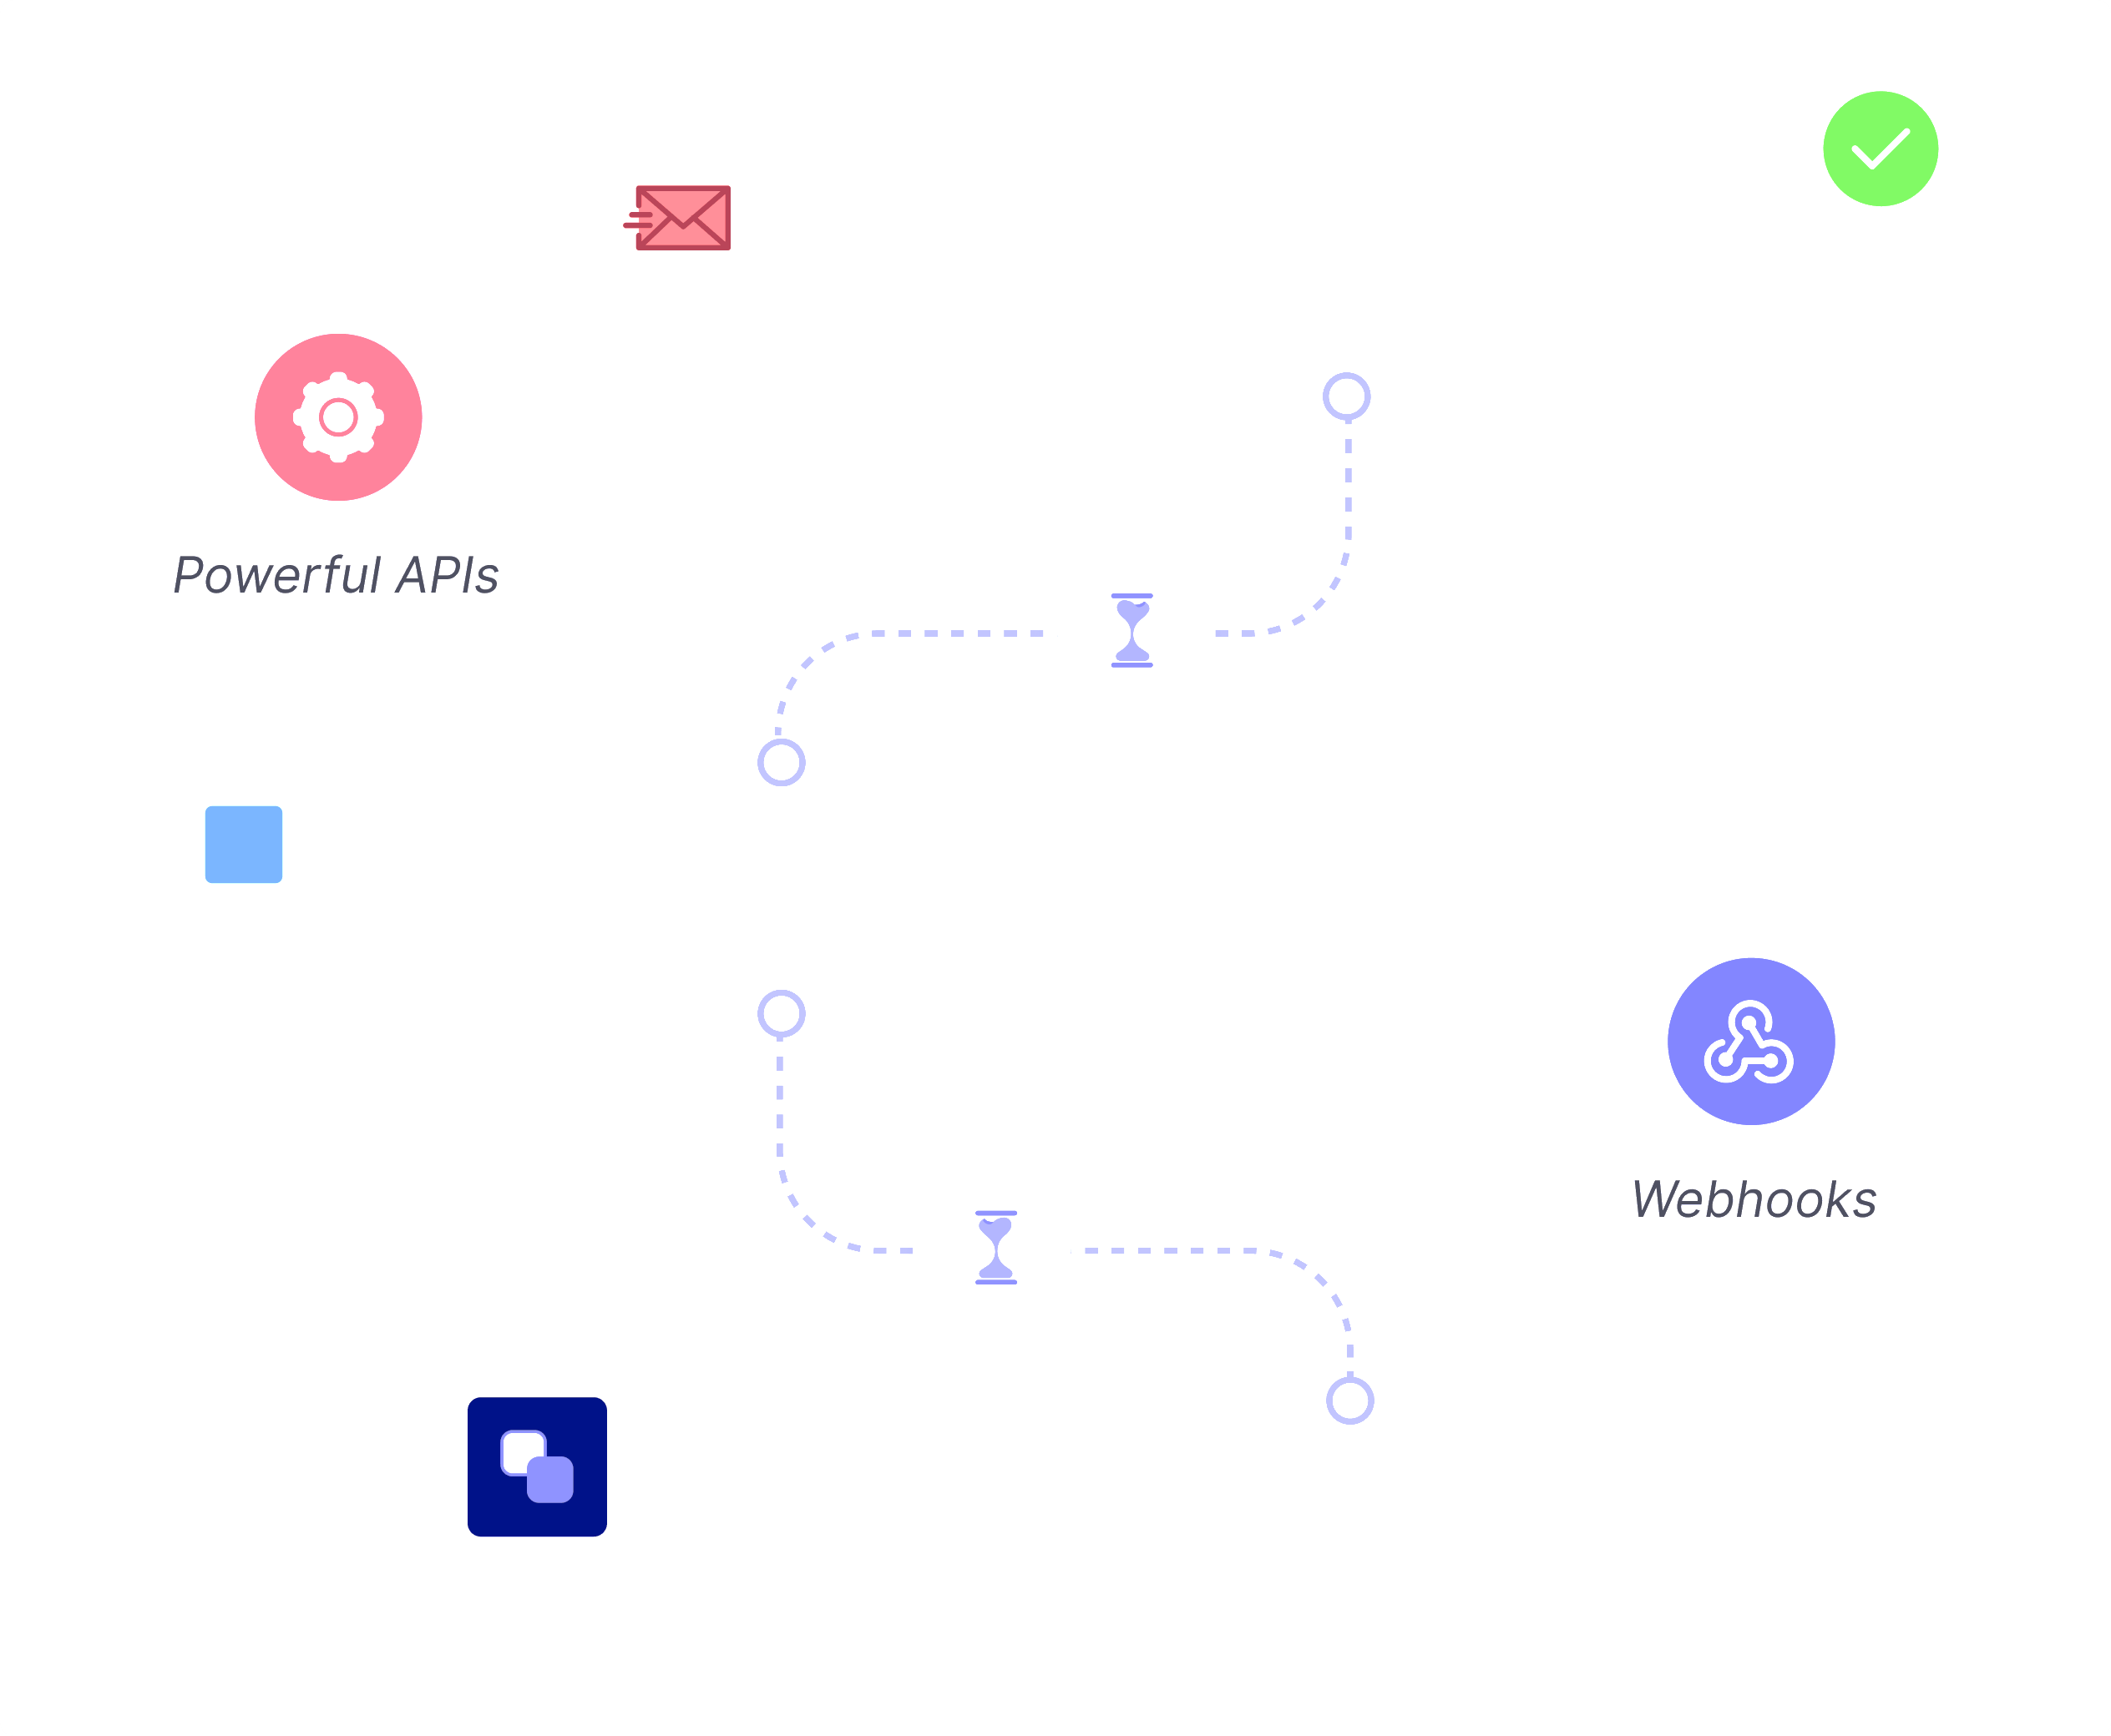
Back-End Logic
Business Logic:
Sales tracking, automated follow-ups, lead management
API Integrations:
Connects CRM to email, accounting, and support tools
Above is Example of Automated email follow-ups to be integrated

Slide 8
System Integrations
Integration Points:
Email, accounting, marketing tools
Custom Modules:
Syncs CRM with external systems
Example: we are going to implement accounting software synchronization

Slide 9
Testing & QA Plan
Unit Testing:
Test cases for modules (Mar 2 – Mar 9, 2025)
System Testing:
Integration & end-to-end tests (Mar 10 – Mar 16, 2025)
UAT:
User testing & feedback (Mar 17 – Mar 21, 2025)

Slide 10
Next Steps
Finalize API integrations (by Feb 21, 2025)
Complete UI development (by Feb 14, 2025)
Start testing phase (Mar 2, 2025)
Prepare for deployment (by Mar 22, 2025)

Slide 11

I welcome all stakeholders to ask any question(s)
or clarifications!

