Slide 1


SMART INDIA HACKATHON 2026
TITLE PAGE
Problem Statement ID –26075
Problem Statement Title- CAPACITY CONNECT a digital capacity building and learning management portal to support organizational training, competency development and knowledge sharing through a centralized web-based platform.
Theme- Smart Education
PS Category- Software
Team ID-
Team Name- CodeCrafterz

Slide 2
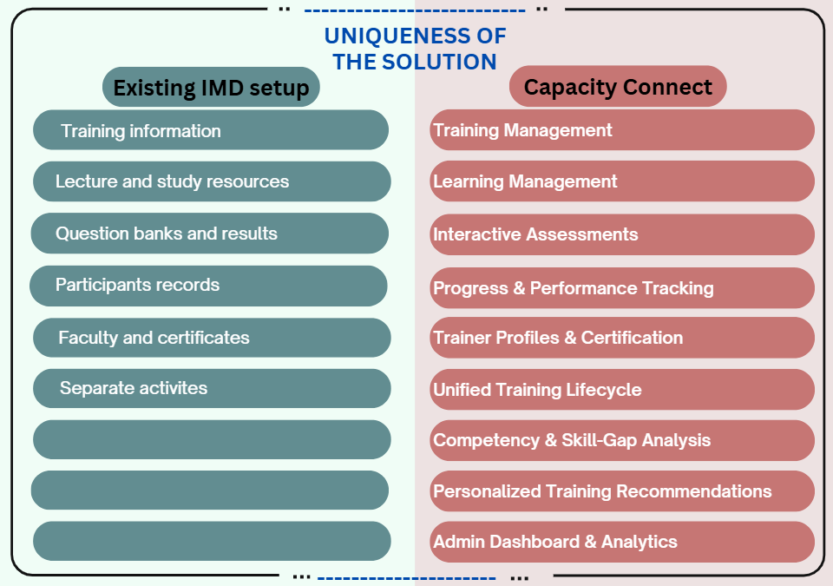
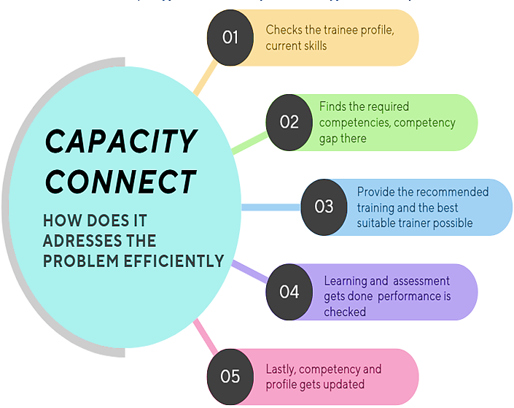
IDEA TITLE
Code
Craftez
Proposed Solution
Our solution is unified, organization-specific digital ecosystem that connects trainee profiles, trainers, course, learning resources, assessments, certifications, performance analytics and competency mapping so that training becomes measureable, discoverable and competency

Slide 3
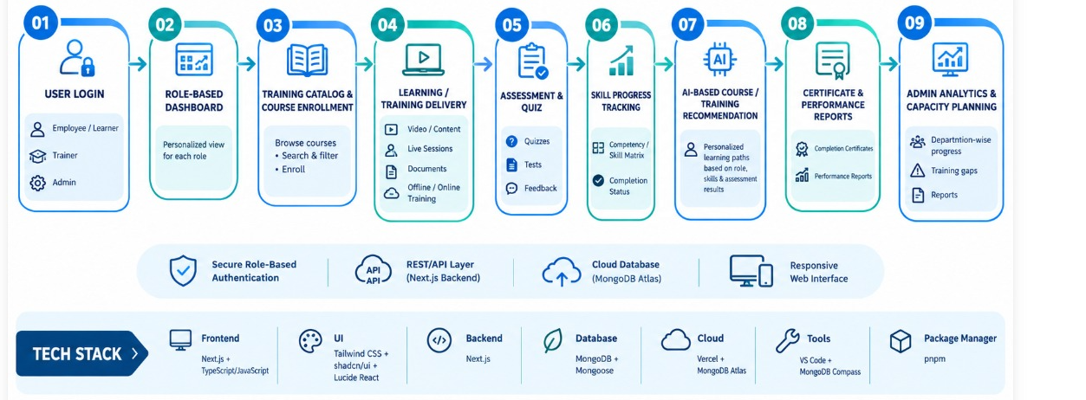
TECHNICAL APPROACH
Code
Crafterz

Slide 4
FEASIBILITY AND VIABILITY
Code Crafterz
Technical feasibility
VALIDITY
Domain relevance – supporting competency development , structured learning pathways that centralized to institutional training ecosystem.
CHALLENGES
Designing a scalable learning- where management workflow is capable of handling course enrollment, assessments, and feedback within a clean modular structure.
Building data-driven analytical modules - it transform raw training activity into meaningful intelligence, enabling measurable tracking of competency gaps and progression trends.
2. Functional appropriateness – a component to sustain the real-world utility of platform such as trainer led course delivery, trainee profiling.
3. Systematic coherence – maintaining internal consistency by connecting user authentication, role-specific workflow into one integrated learning framework.
4. Practical acceptability – it addresses a genuine organizational need and demonstrate a functional prototype with measurable outcomes.
Competency mapping- Framework to foster purposeful growth and bridging skill lacunae.
Continuous capacity building loop - standard web-based learning with course enrollment , assessments and content dissemination.
2. Operational feasibility
Competency gap calculation to evaluate current proficiency against expected role standards.
IMD capacity intelligence platform to identify learning needs and progression patterns with clarity.
3. Legal feasibility
A secure role authentication for trainee, trainer, and admin
FEASIBILITY
Competency mapping – it’s used as an intelligent discovery layer that matches subject requirements or performance dashboard with the most suitable trainer, from the trainer profile.

Slide 5
IMPACT AND BENEFITS
Code Crafterz
Benefits:
Cohesive hybrid architecture: a platform where training resources, assessments, and administrative oversight converges into a single ecosystem.
Enabling more granular understanding of skill distribution through competency mapping.
By digitizing training delivery and knowledge dissemination, it offers a scalable and adaptable framework to support professional development.
A structured workflow to promote clarity , consistency, and accountability across individual roles.
Impacts:
It improves decision-making fidelity for trainers and administrators by converting raw learner data into more strategic planning of course.
Cultivating sustainable learning culture, that moves beyond one- time training events towards continuous skill enrichment.
It can create a transformative shift in workforce with measurable competency outcomes.
The platform can evolve in a capacity intelligence infrastructure in which analytics and learning histories collectively inform institutional growth.

Slide 6
RESEARCH AND REFERENCES
Code Crafterz
•IMD Meteorological Training Institute — Academics: https://imdpune.gov.in/training/academics.php
•IMD Training Disciplines: https://www.imdpune.gov.in/training/academics/disciplines.html
•IMD Lecture Notes: https://imdpune.gov.in/training/notes.html
•IMD Forecasters Training Course Lecture Resources: https://www.imdpune.gov.in/training/lectureftc.php
•IMD Question Bank: https://imdpune.gov.in/training/Question.html
•IMD Training Results: https://www.imdpune.gov.in/training/results.html
•IMD training history/about: https://imdpune.gov.in/training/about/introduction.html
•IMD published training/capacity-building vision document:
https://internal.imd.gov.in/press_release/20250114_pr_3552.pdf
•Mission Mausam — Ministry of Earth Sciences: https://www.moes.gov.in/index.php/mission-mausam
•Moodle LMS: https://moodle.com/solutions/lms/features/
•SAP SuccessFactors Learning: https://help.sap.com/docs/successfactors-learning
•Karmayogi Competency Model:

