Slide 1
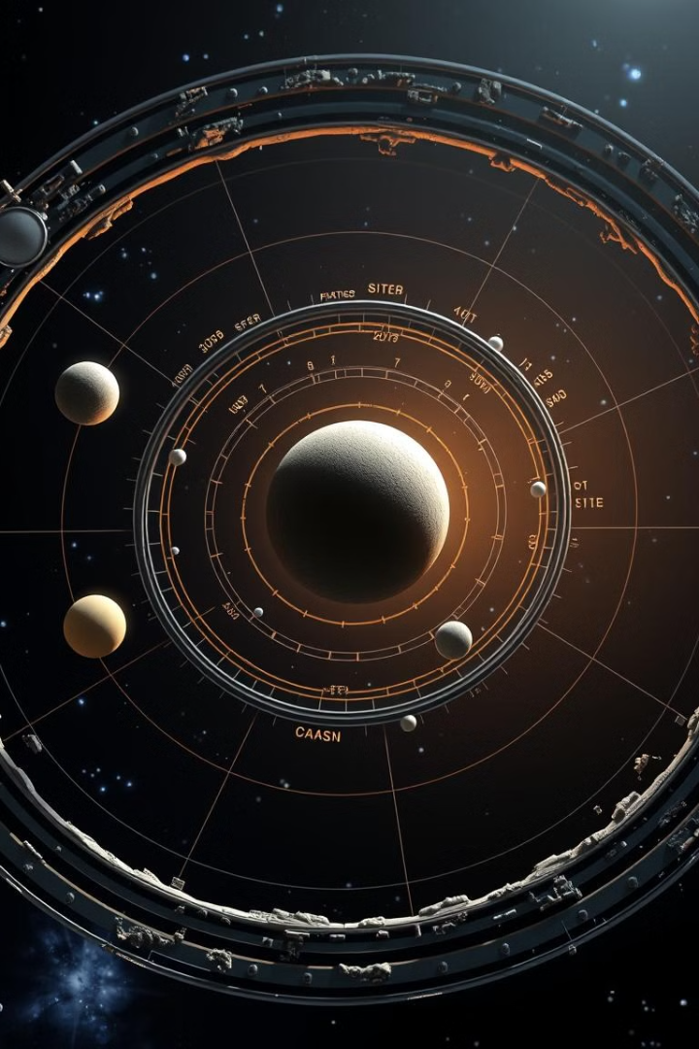

Orrery Model for Visualizing Near-Earth Objects
This project is a web-based orrery model that visualizes near-Earth objects. It uses data from NASA APIs to represent potentially hazardous asteroids.
by Äbdullah Arain

Slide 2
Fetching Data from NASA APIs and Visualizing in 3D
NASA APIs
3D Visualization
The orrery retrieves data from NASA's publicly available APIs for near-Earth objects, like asteroids.
The fetched data is transformed into a 3D representation of the objects, including their orbits and positions in space.

Slide 3
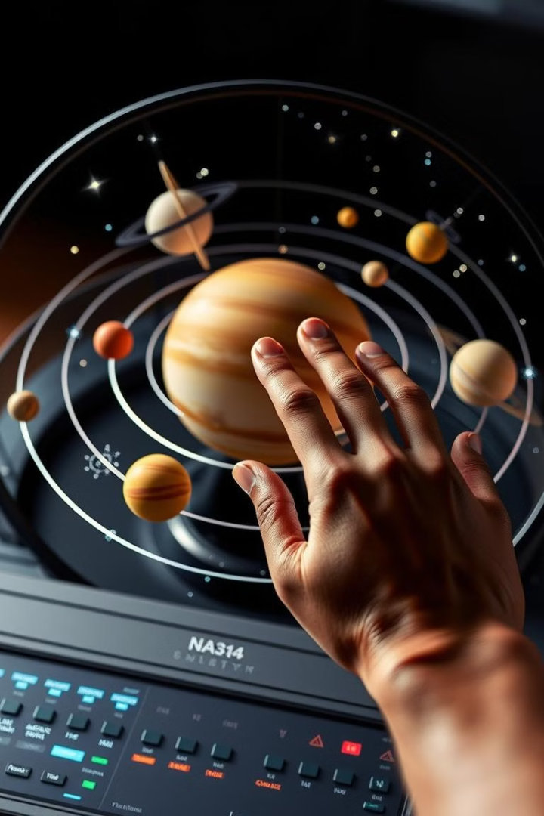



Interacting with the Dynamic Simulation of Orbits
Rotation
The user can rotate the orrery model to view it from different angles.
Simulation
The simulation allows the user to observe the dynamic movement of Earth and asteroids around the sun.
Information
The user can select individual objects to view their properties, such as size, composition, and orbital data.

