Slide 1
Chapter
3
Information Security Challenge in e-Enterprise

Slide 2
Management Information Systems
OBJECTIVES
Explain why information systems need special protection from destruction, error, and abuse
Assess the business value of security and control
Evaluate elements of an organizational and managerial framework for security and control

Slide 3
Management Information Systems
OBJECTIVES (Continued)
Evaluate the most important tools and technologies for safeguarding information resources
Identify the challenges posed by information systems security and control and management solutions

Slide 4
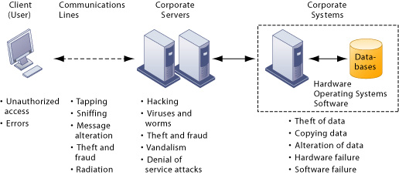
Management Information Systems
Why Systems Are Vulnerable
Security threats and Vulnerabilities
Figure 10-1

Slide 5
Management Information Systems
Why Systems Are Vulnerable (Continued)
Internet Vulnerabilities:
Use of fixed Internet addresses through use of cable modems or DSL
Lack of encryption with most Voice over IP (VoIP)
Widespread use of e-mail and instant messaging (IM)

Slide 6
Management Information Systems
SYSTEM VULNERABILITY AND ABUSE
Wireless Security Challenges:
Radio frequency bands are easy to scan
The service set identifiers (SSID) identifying the access points broadcast multiple times

Slide 7
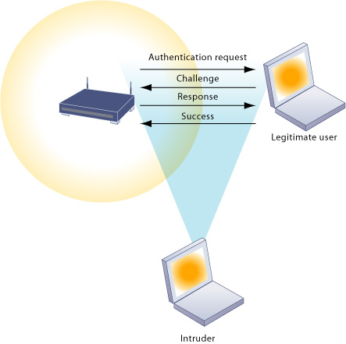
Management Information Systems
SYSTEM VULNERABILITY AND ABUSE
Wi-Fi Security Challenges
Figure 10-2

Slide 8
Management Information Systems
SYSTEM VULNERABILITY AND ABUSE
Malicious Software: Viruses, Worms, Trojan Horses, and Spyware
Hackers and Cybervandalism
Computer viruses, worms, trojan horses
Spyware
Spoofing and Sniffers
Denial of Service (DoS) Attacks
Identity theft
Cyberterrorism and Cyberwarfare
Vulnerabilities from internal threats (employees); software flaws

Slide 9
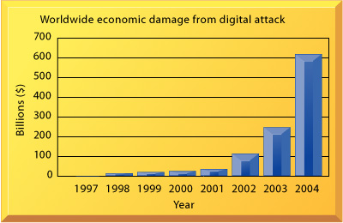
Management Information Systems
SYSTEM VULNERABILITY AND ABUSE
Worldwide Damage from Digital Attacks
Figure 10-3

Slide 10
Management Information Systems
BUSINESS VALUE OF SECURITY AND CONTROL
Inadequate security and control may create serious legal liability.
Businesses must protect not only their own information assets but also those of customers, employees, and business partners. Failure to do so can lead to costly litigation for data exposure or theft.
A sound security and control framework that protects business information assets can thus produce a high return on investment.

Slide 11
Management Information Systems
CONTROLLING SECURITY THREATS AND VULNERABILITY
Types of Information Systems Controls
General controls:
Software and hardware
Computer operations
Data security
Systems implementation process

Slide 12
Management Information Systems
CONTROLLING SECURITY THREATS AND VULNERABILITY
Ensuring Business Continuity
Downtime: Period of time in which a system is not operational
Fault-tolerant computer systems: Redundant hardware, software, and power supply components to provide continuous, uninterrupted service
High-availability computing: Designing to maximize application and system availability

Slide 13
Management Information Systems
CONTROLLING SECURITY THREATS AND VULNERABILITY
Ensuring Business Continuity (Continued)
Load balancing: Distributes access requests across multiple servers
Mirroring: Backup server that duplicates processes on primary server
Recovery-oriented computing: Designing computing systems to recover more rapidly from mishaps

Slide 14
Management Information Systems
CONTROLLING SECURITY THREATS AND VULNERABILITY
Ensuring Business Continuity (Continued)
Disaster recovery planning: Plans for restoration of computing and communications disrupted by an event such as an earthquake, flood, or terrorist attack
Business continuity planning: Plans for handling mission-critical functions if systems go down

Slide 15
Management Information Systems
CONTROLLING SECURITY THREATS AND VULNERABILITY
Auditing:
MIS audit: Identifies all of the controls that govern individual information systems and assesses their effectiveness
Security audits: Review technologies, procedures, documentation, training, and personnel

Slide 16
Management Information Systems
CONTROLLING SECURITY THREATS AND VULNERABILITY
Access Control
Access control: Consists of all the policies and procedures a company uses to prevent improper access to systems by unauthorized insiders and outsiders
Authentication:
Passwords
Tokens, smart cards
Biometric authentication

Slide 17
Management Information Systems
CONTROLLING SECURITY THREATS AND VULNERABILITY
Firewalls, Intrusion Detection Systems, and Antivirus Software
Firewalls: Hardware and software controlling flow of incoming and outgoing network traffic
Intrusion detection systems: Full-time monitoring tools placed at the most vulnerable points of corporate networks to detect and deter intruders

Slide 18
Management Information Systems
CONTROLLING SECURITY THREATS AND VULNERABILITY
Firewalls, Intrusion Detection Systems, and Antivirus Software (Continued)
Antivirus software: Software that checks computer systems and drives for the presence of computer viruses and can eliminate the virus from the infected area
Wi-Fi Protected Access specification

Slide 19
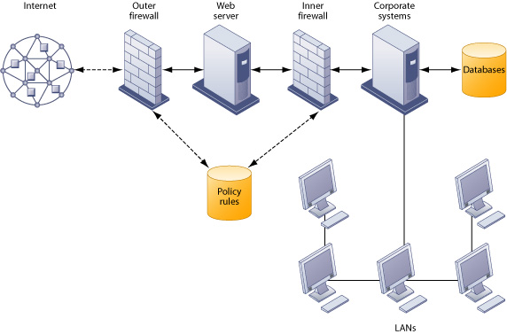
Management Information Systems
CONTROLLING SECURITY THREATS AND VULNERABILITY
A Corporate Firewall
Figure 10-7

Slide 20
Management Information Systems
CONTROLLING SECURITY THREATS AND VULNERABILITY
Encryption and Public Key Infrastructure
Public key encryption: Uses two different keys, one private and one public. The keys are mathematically related so that data encrypted with one key can be decrypted using only the other key
Message integrity: The ability to be certain that the message being sent arrives at the proper destination without being copied or changed

Slide 21
Management Information Systems
CONTROLLING SECURITY THREATS AND VULNERABILITY
Encryption and Public Key Infrastructure (Continued)
Digital signature: A digital code attached to an electronically transmitted message that is used to verify the origin and contents of a message
Digital certificates: Data files used to establish the identity of users and electronic assets for protection of online transactions
Public Key Infrastructure (PKI): Use of public key cryptography working with a certificate authority

Slide 22
Management Information Systems
CONTROLLING SECURITY THREATS AND VULNERABILITY
Encryption and Public Key Infrastructure (Continued)
Secure Sockets Layer (SSL) and its successor Transport Layer Security (TLS): protocols for secure information transfer over the Internet; enable client and server computer encryption and decryption activities as they communicate during a secure Web session.
Secure Hypertext Transfer Protocol (S-HTTP): used for encrypting data flowing over the Internet; limited to Web documents, whereas SSL and TLS encrypt all data being passed between client and server.

Slide 23
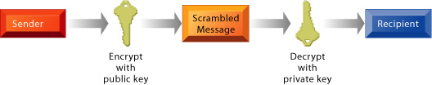
Management Information Systems
CONTROLLING SECURITY THREATS AND VULNERABILITY
Public Key Encryption
Figure 10-8

Slide 24
Management Information Systems
MANAGEMENT OPPORTUNITIES, CHALLENGES AND SOLUTIONS
Management Opportunities:
Creation of secure, reliable Web sites and systems that can support e-commerce and e-business strategies

Slide 25
Management Information Systems
MANAGEMENT OPPORTUNITIES, CHALLENGES AND SOLUTIONS
Management Challenges:
Designing systems that are neither overcontrolled nor undercontrolled
Implementing an effective security policy

Slide 26
Management Information Systems
MANAGEMENT OPPORTUNITIES, CHALLENGES AND SOLUTIONS
Solution Guidelines:
Security and control must become a more visible and explicit priority and area of information systems investment.
Support and commitment from top management is required to show that security is indeed a corporate priority and vital to all aspects of the business.
Security and control should be the responsibility of everyone in the organization.

