Slide 1
IMS
Oforitsesan Towesho

Slide 2
Who am I?
A graduate of Computer Science from the University of Essex
Have used Java MySQL GIT

Slide 3
IMS – Inventory Management System
Allows the user to CREATE READ UPDATE and DELETE
Customer, Order and Product entitites from a MySQL database using a Java program

Slide 4
What was my approach?
Use the working code and mirror it in the new classes
Focus on the program working and reflecting the required functionality

Slide 5
GIT
How did I set up GIT?
How did it work out?
What would I have done better?

Slide 6
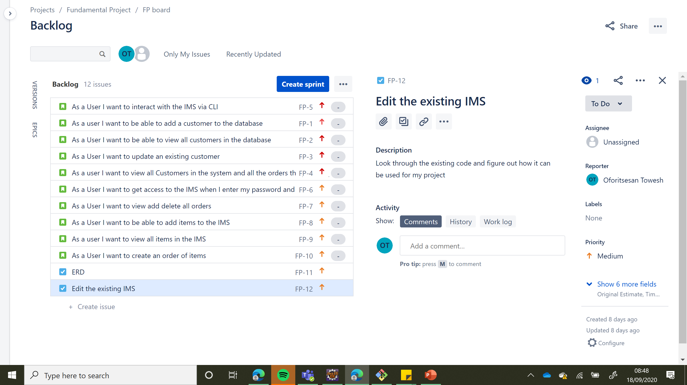

Slide 7
Testing: Coverage, Static Analysis, red-green-refactoring
Coverage: 67%, aim was for 80% needed more time for testing
Red-green-refactoring: helped improve the coverage, worked on the code to ensure most tests ran well
Struggled a bit with Mockito

Slide 8
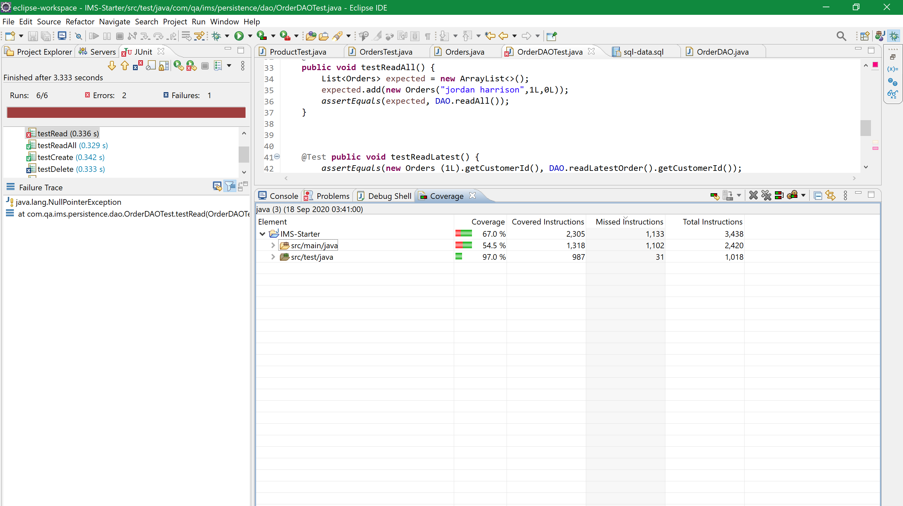

Slide 9
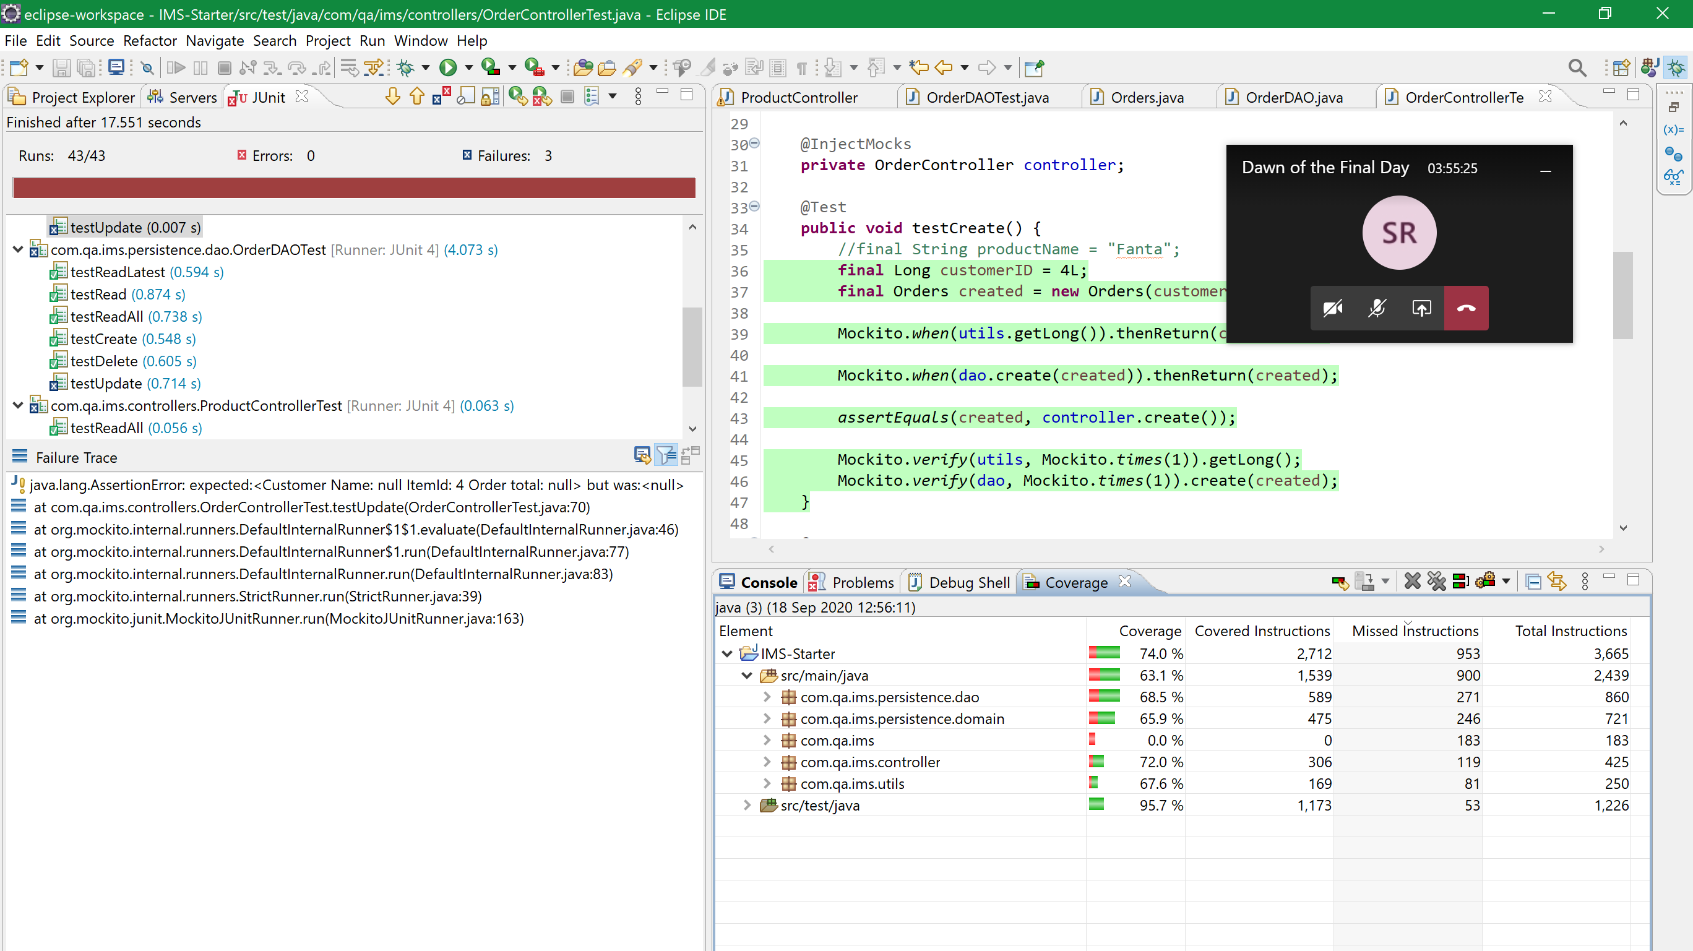

Slide 10
Demonstration
Creating a New Customer
Creating an Order for Customer
Adding items to the Order of the Customer
Viewing the Customers order

Slide 11
Sprint Review
What did I not finish? Extra tasks etc
What was finished?

Slide 12
Sprint Retrospective
What went well?
What could be improved?

Slide 13
Future Prospects?
With more time I would hope to figure out the dev/ feature branch model properly
Add more features to the IMS such as different Users and implement it on the GCP

Slide 14
Questions?
Anything questions that you may have?

