Slide 1
Web Application – To do List
Oforitsesan Towesho

Slide 2
Who am I?
A graduate of Computer Science from the University of Essex
Have used Java MySQL GIT

Slide 3
Web Application
Allows the user to CREATE READ UPDATE and DELETE
Recipe and Ingredient Entities using a Front End made of HTML, JS, CSS
That integrates with an API developed using Springboot

Slide 4
Concept
Recipes and Ingredients
Simple and effective
With more time Order and Own entities would have been added

Slide 5
Sprint Plan
Focus – what the User is seeing and what they are able to do
Application – What does that mean for the Backend? What does it mean for the Frontend?

Slide 6
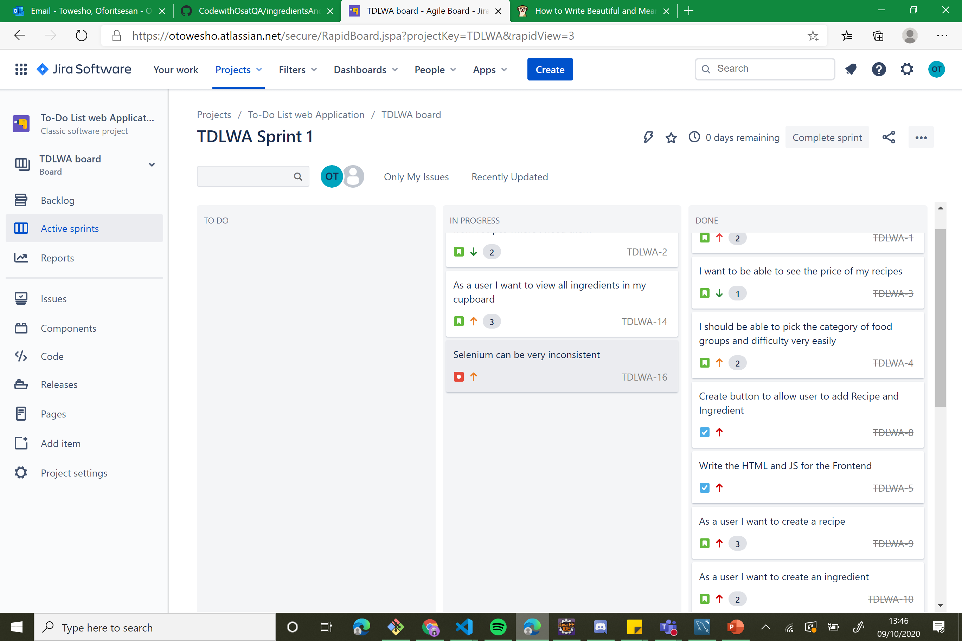

Slide 7
What was my approach?
Focus on the program working and reflecting the required functionality
Backend > Frontend – Developing
Backend > Frontend – Testing
Work in a way that would allow most implementations

Slide 8
Testing: Coverage, Static Analysis, red-green-refactoring
Coverage: 87%, aim was for 80% needed more time for testing
Red-green-refactoring: helped improve the coverage, worked on the code to ensure most tests ran well
Overall Coverage better than previous project

Slide 9
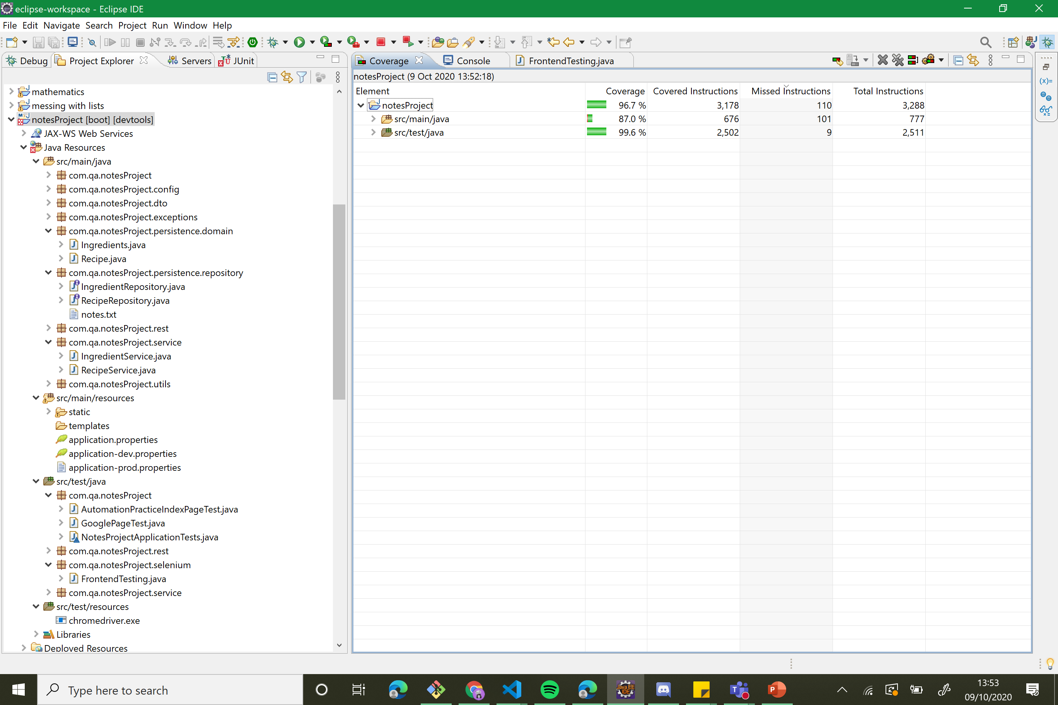

Slide 10
Consultant Journey
Spring Boot
Boot Strap
Selenium
Mockito

Slide 11
Demonstration
Creating a New Recipe
Creating an Ingredient for a Recipe
Update Recipe and Ingredient
Delete

Slide 12
Sprint Review
What did I not finish? Extra tasks etc
What was finished?

Slide 13
GIT
How did I set up GIT?
How did it work out?
What would I have done better?

Slide 14
Sprint Retrospective
What went well?
What could be improved?

Slide 15
Future Prospects?
Integrate with shopping websites and Online Recipes
Host it on a GCP

Slide 16
Questions?
Anything questions that you may have?

