Slide 1
AJAX

Slide 2
AJAX, is a web development technique for creating interactive web applications.
AJAX stands for Asynchronous JavaScript and XML. AJAX is a new technique for creating better, faster, and more interactive web applications with the help of XML, HTML, CSS, and Java Script.
Ajax uses XHTML for content, CSS for presentation, along with Document Object Model and JavaScript for dynamic content display.
Conventional web applications transmit information to and from the server using synchronous requests. It means you fill out a form, hit submit, and get directed to a new page with new information from the server.
With AJAX, when you hit submit, JavaScript will make a request to the server, interpret the results, and update the current screen. In the purest sense, the user would never know that anything was even transmitted to the server.

Slide 3
XML is commonly used as the format for receiving server data, although any format, including plain text, can be used.
AJAX is a web browser technology independent of web server software.
A user can continue to use the application while the client program requests information from the server in the background.
Intuitive and natural user interaction. Clicking is not required, mouse movement is a sufficient event trigger.
Data-driven as opposed to page-driven.

Slide 4
list of some famous web applications that make use of AJAX.
Google Maps
A user can drag an entire map by using the mouse, rather than clicking on a button.
http://maps.google.com/
Google Suggest
As you type, Google will offer suggestions. Use the arrow keys to navigate the results.
http://www.google.com/webhp?complete=1&hl=en
Gmail
Gmail is a webmail, built on the idea that email can be more intuitive, efficient and useful.
http://gmail.com/
Yahoo Maps (new)
Now it's even easier and more fun to get where you're going!
http://maps.yahoo.com/

Slide 5
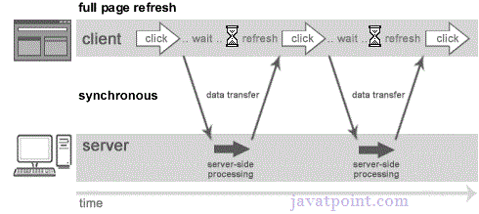
Synchronous (Classic Web-Application Model)
A synchronous request blocks the client until operation completes i.e. browser is not unresponsive. In such case, javascript engine of the browser is blocked.

Slide 6
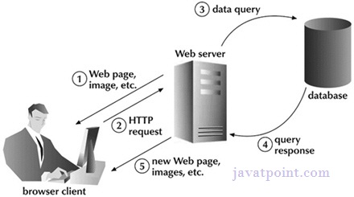
As you can see in the image, full page is refreshed at request time and user is blocked until request completes.
Let's understand it another way.

Slide 7
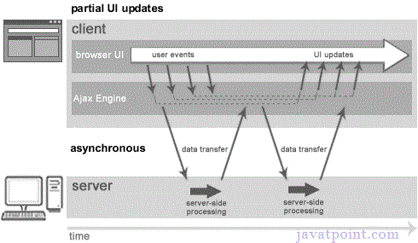
Understanding Synchronous vs Asynchronous
Asynchronous (AJAX Web-Application Model)
An asynchronous request doesn’t block the client i.e. browser is responsive. At that time, user can perform another operations also. In such case, javascript engine of the browser is not blocked.

Slide 8
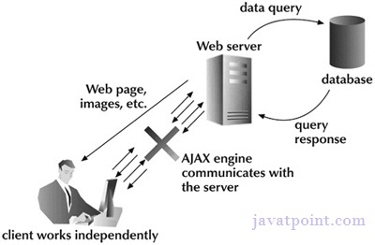
Understanding Synchronous vs Asynchronous
As you can see in the above image, full page is not refreshed at request time and user gets response from the ajax engine.
Let's try to understand asynchronous communication by the image given below.

Slide 9
AJAX Technologies
As describe earlier, ajax is not a technology but group of inter-related technologies. AJAX technologies includes:
HTML/XHTML and CSS
These technologies are used for displaying content and style. It is mainly used for presentation.
DOM
It is used for dynamic display and interaction with data.
XML or JSON
For carrying data to and from server. JSON (Javascript Object Notation) is like XML but short and faster than XML.
XMLHttpRequest
For asynchronous communication between client and server.
JavaScript
It is used to bring above technologies together.
Independently, it is used mainly for client-side validation.

Slide 10
Understanding XMLHttpRequest
An object of XMLHttpRequest is used for asynchronous communication between client and server.
It performs following operations:
Sends data from the client in the background
Receives the data from the server
Updates the webpage without reloading it.

Slide 11
Properties of XMLHttpRequest object
The common properties of XMLHttpRequest object are as follows:
Property | Description
onReadyStateChange | It is called whenever readystate attribute changes. It must not be used with synchronous requests.
readyState | represents the state of the request. It ranges from 0 to 4.0 1 OPENED : open is called but send() is not called. 2 HEADERS_RECEIVED: send() is called, and headers and status are available. 3 LOADING: Downloading data; responseText holds the data. 4 DONE: The operation is completed fully.
reponseText | returns response as text.
responseXML | returns response as XML

Slide 12
Methods of XMLHttpRequest object
The important methods of XMLHttpRequest object
are as follows:
Method | Description
void open(method, URL) | opens the request specifying get or post method and url.
void open(method, URL, async) | same as above but specifies asynchronous or not.
void open(method, URL, async, username, password) | same as above but specifies username and password.
void send() | sends get request.
void send(string) | send post request.
setRequestHeader(header,value) | it adds request headers.

Slide 13
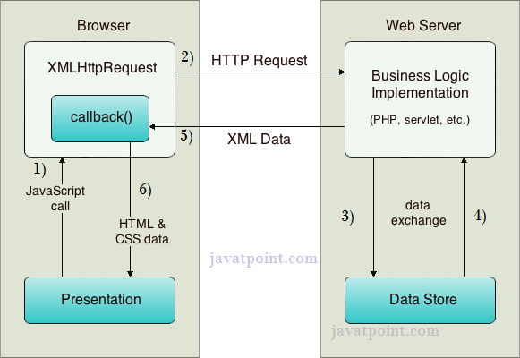
How AJAX works?
AJAX communicates with the server using XMLHttpRequest object. Let's try to understand the flow of ajax or how ajax works by the image displayed below.

Slide 14
How AJAX works?
As you can see in the above example, XMLHttpRequest object plays an important role.
User sends a request from the UI and a javascript call goes to XMLHttpRequest object.
HTTP Request is sent to the server by XMLHttpRequest object.
Server interacts with the database using JSP, PHP, Servlet, ASP.net etc.
Data is retrieved.
Server sends XML data or JSON data to the XMLHttpRequest callback function.
HTML and CSS data is displayed on the browser.

Slide 15
Ajax Java Example
To create ajax example, you need to use any server-side language e.g. servlet, jsp, php, asp.net etc. Here we are using JSP for generating the server-side code.
Steps to create ajax example with jsp
You need to follow following steps:
load the org.json.jar file
create input page to receive any text or number
create server side page to process the request
provide entry in web.xml file

Slide 16
table1.html
<html> <head> <script>
var request;
function sendInfo()
{ var v=document.vinform.t1.value;
var url="index.jsp?val="+v;
if(window.XMLHttpRequest){ {// code for IE7+, Firefox, Chrome, Opera, Safari
request=new XMLHttpRequest();
}
else if(window.ActiveXObject){ // code for IE6, IE5
request=new ActiveXObject("Microsoft.XMLHTTP");
}
try {
request.onreadystatechange=getInfo;
request.open("GET",url,true);
request.send();
} catch(e)
{ alert("Unable to connect to server"); }
}

Slide 17
function getInfo(){
if(request.readyState==4){
var val=request.responseText;
document.getElementById(‘ccvt').innerHTML=val;
} }
</script>
</head>
<body>
<marquee><h1>This is an example of ajax</h1></marquee>
<form name="vinform">
<input type="text" name="t1">
<input type="button" value="ShowTable" onClick="sendInfo()">
</form>
<span id=“ccvt"> </span>
</body>
</html>

Slide 18
create server side page to process the request
In this jsp page, we printing the table of given number.
index.jsp
<%
int n=Integer.parseInt(request.getParameter("val"));
for(int i=1;i<=10;i++)
out.print(i*n+"<br>");
%>

Slide 19
web.xml
<?xml version="1.0" encoding="UTF-8"?>
<web-app version="2.5" xmlns="http://java.sun.com/xml/ns/javaee"
xmlns:xsi="http://www.w3.org/2001/XMLSchema-instance"
xsi:schemaLocation="http://java.sun.com/xml/ns/javaee
http://java.sun.com/xml/ns/javaee/web-app_2_5.xsd">
<session-config>
<session-timeout>
30
</session-timeout>
</session-config>
<welcome-file-list>
<welcome-file>table1.html</welcome-file>
</welcome-file-list>
</web-app>

